Slide 1
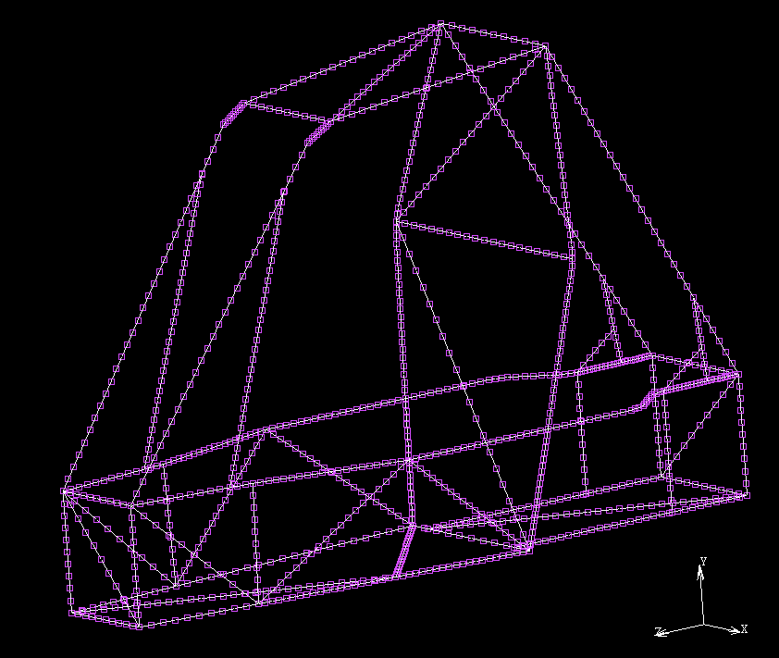
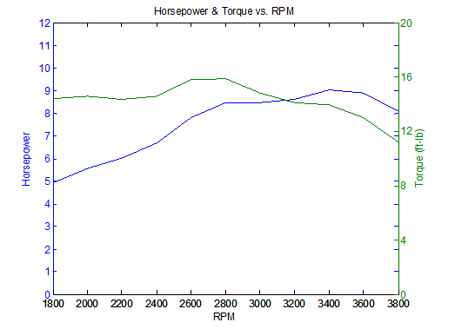
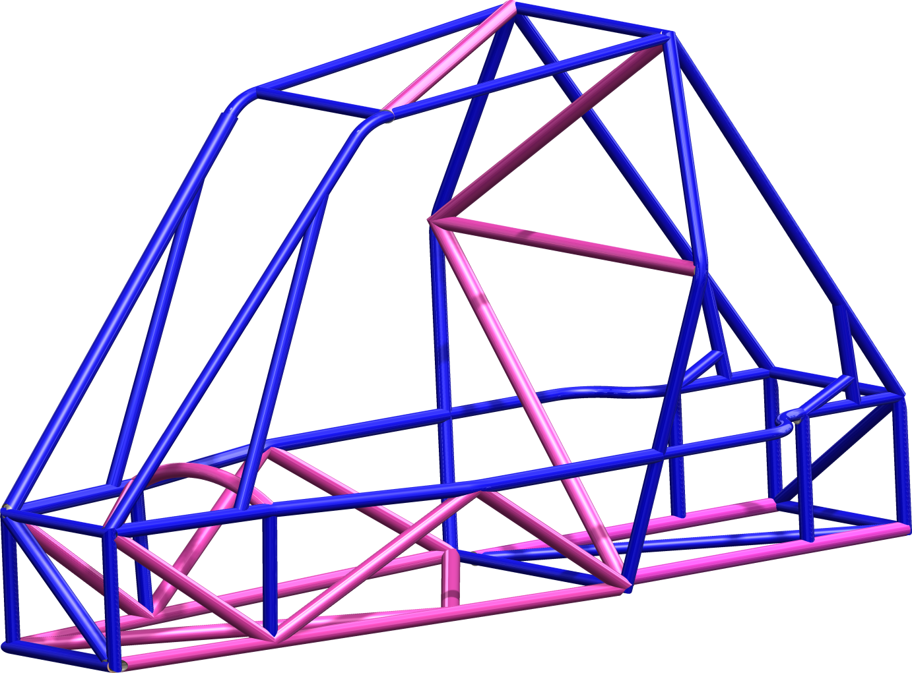
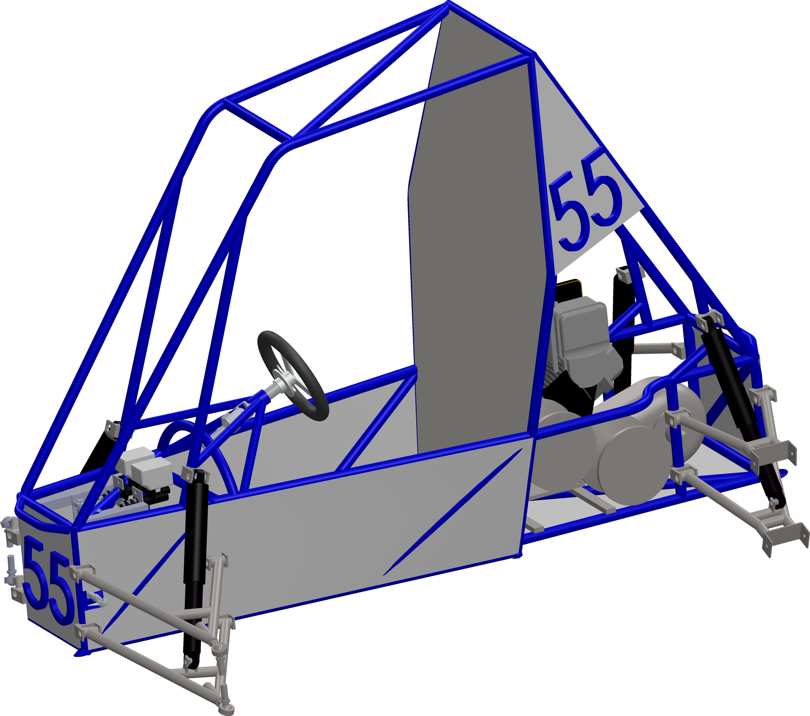
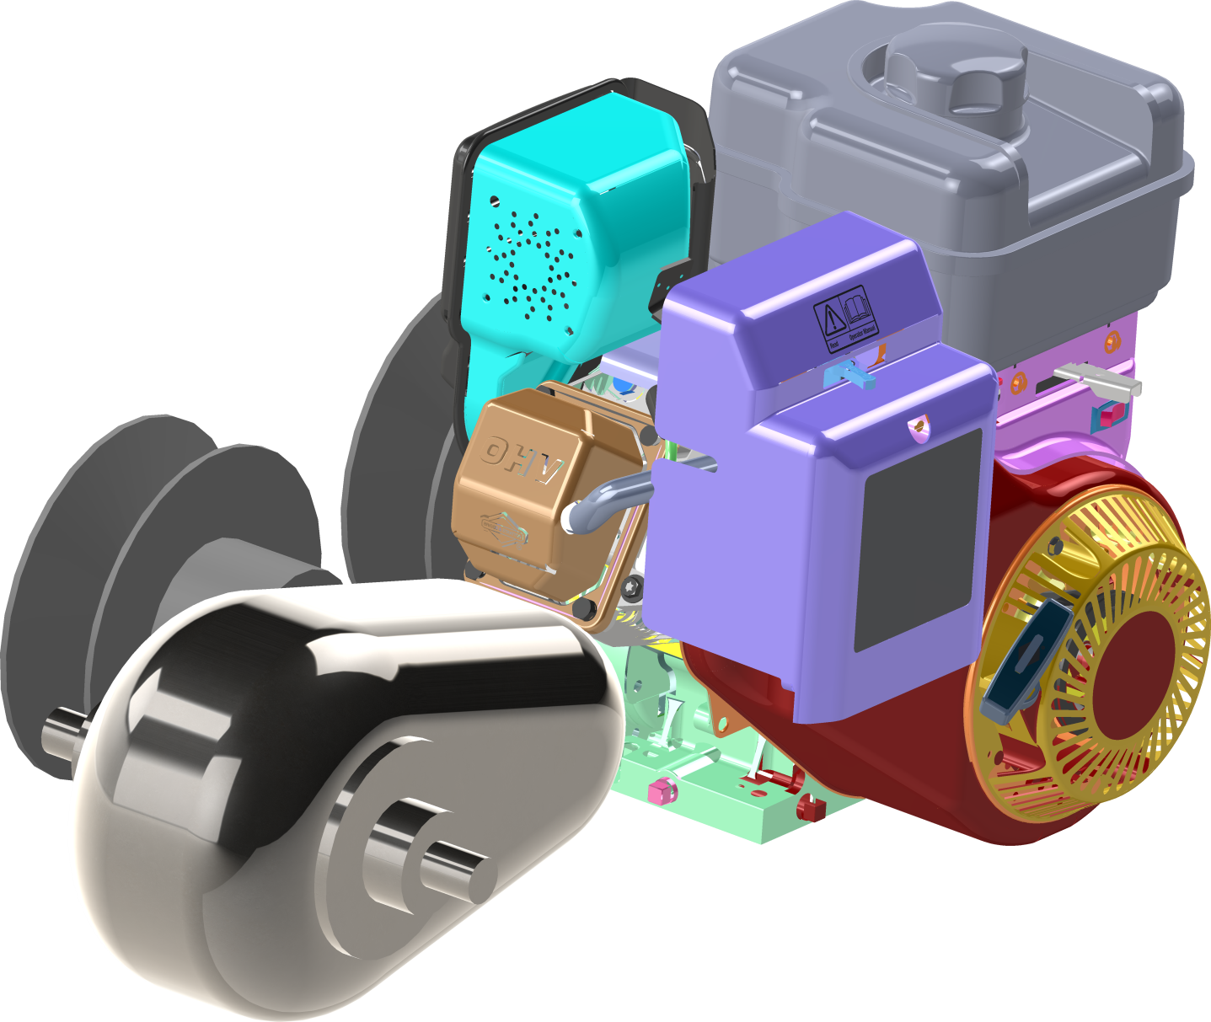
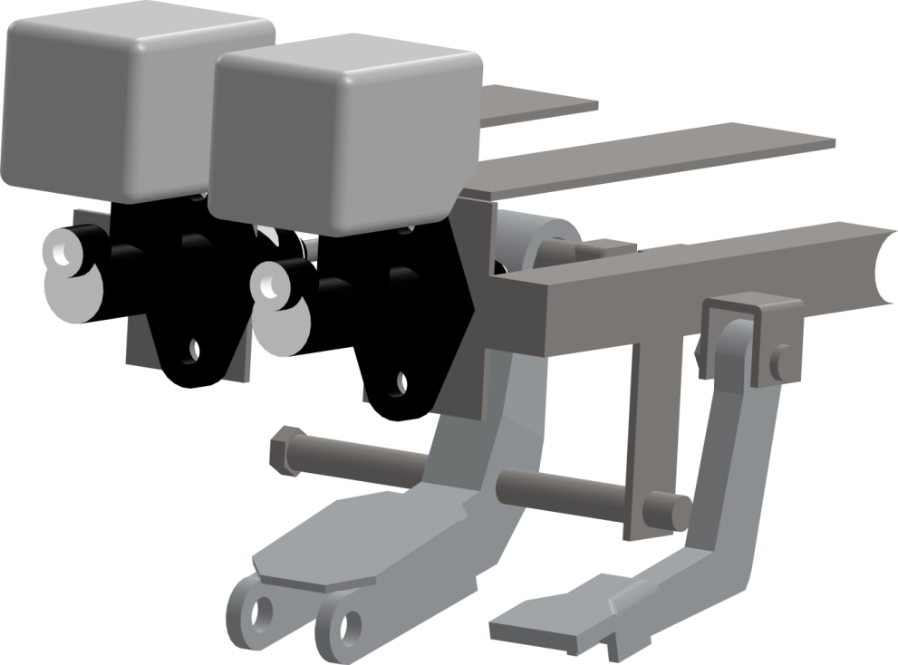
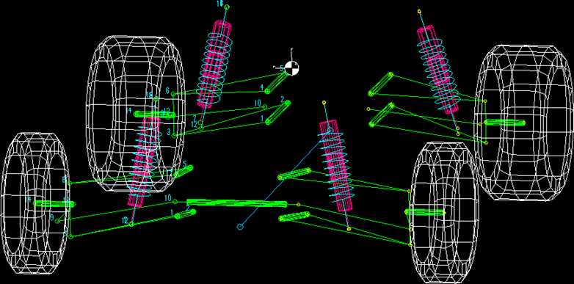
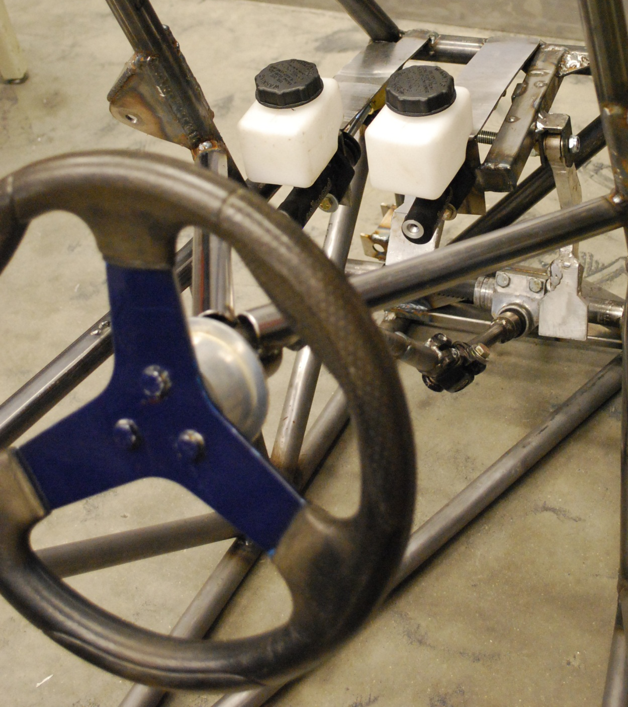
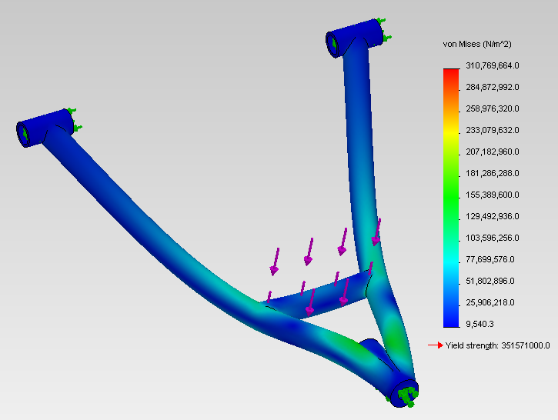
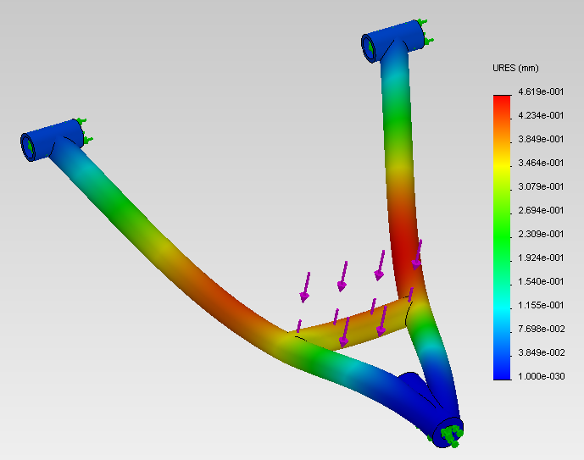
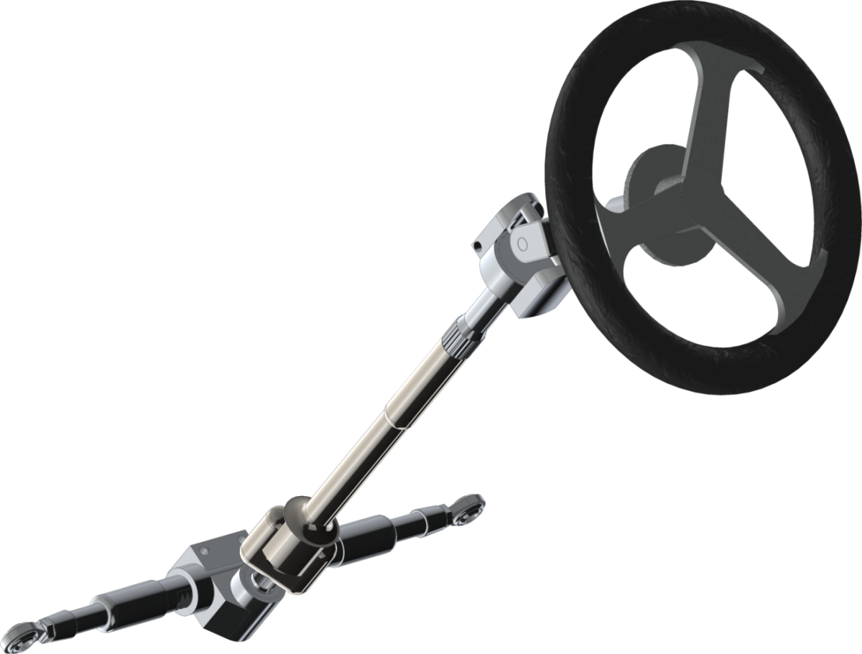
UNH Baja SAE
Off-Road Racing Vehicle
Frame Design
Background/Objectives
Drivetrain Design
Goals
Maintain driver safety
Minimize weight
Maximize structural integrity
The purpose of UNH Baja is to design, fabricate, and race a single seat, all-terrain, sporting vehicle within the regulations set by SAE.
During competition the vehicle is tested for endurance, acceleration, maneuverability, and hill-climb capabilities.
Transmission
Gearbox is a Spicer H-12 FNR transaxle with a set 13.25:1 gear ratio
All components are internal (no external sprockets or chain drive) to reduce debris interference during competition
Custom axles fabricated from ATV and UTV axles
Includes: Forward, Neutral, and Reverse
Figure 1: Marc-Mentat Finite Element Analysis to test frame under torsion, loading, and impact
Figure 6: Plot of horsepower and torque vs. revolutions per minute. Max allowed RPM is 3800 producing 8HP and 11.8ft-lb of torque
Marc-Mentat FEA Results
Engine
Engine: 10 Horsepower Briggs & Stratton
CVT driven, allowing engine to develop peak power at nearly all ground speeds
Load-case | Max Deflection | Max Stress
Collision (30 mph) | 0.452 inches | 798 psi
Figure 2: SolidWorks frame model showing A500 steel in blue and A513 steel in magenta
Personal Goals (Minimize Weight, Cost, etc.)
Steel Selection: Our steel was chosen to meet competition requirements
while maintaining a high strength to weight ratio, low cost, and
to simplify welding requirements.
Steel | Cost $/ft | Weight lb/ft | Outer Diameter (inches) | Thickness (inches) | Tensile Strength (psi) | Yield Strength (psi) | Weldability
A500 | 5.05 | 1.14 | 1.05 | 0.113 | 72,300 | 65,700 | Easy MIG/TIG
A513 | 8.80 | 0.50 | 1.00 | 0.049 | 98,740 | 86,530 | Easy MIG/TIG
Suspension Design
Controls Design
Front and rear double a-arm to allow a fully independent suspension
Fox Float Airshox chosen for vehicle shocks
Braking
Two hydraulic brake cylinders (front and rear) provide redundancy in case of failure
One pedal control to ease drivability
Bias bar for a front-rear braking ratio of 70:30
Pedals mounted from above to reduce interference on the floor
Polaris Outlaw 525 front calipers
Arctic Cat Mudpro 1000 Rear Calipers
¾” Bore Wildwood Cylinders
Figure 3: Lotus Suspension Analysis view of complete suspension
Thanks to Our Sponsors
Suspension Geometry Parameters | Front | Rear
Camber Toe Angle | 0° at Rebound -5° at Bump | 0° at Rebound -10° at Bump
Caster Angle | 3° at Static Ride Height | 0°
Toe Angle | -1° at Static Ride Height | 0°
Wheel Travel | 3” up 7” down | 3” up 8” down
Track Width | 52” | 50”
Static Ride Height | 11.5” | 11.5”
Steering
Rack & pinion steering
Turning radius of 12’
Detachable quick-release steering wheel
Todd Gross
Shea Family
 | Static Rest | 5ft Drop
Maximum Stress | 14.6 MPa | 311 MPa
Maximum Displacement | .017 mm | .462 mm
Safety Factor (at max SCF) | 30.82 | 1.45
UNH Baja Group Members
Alex Kachuck
Damon Tarry
Kevin Quinn
Cole Gustafson
Jon Ulrich
Ted Withers
Tim O’Neil
Anthony Tonelli
Devan Shea
Shifting
Jetski Steering Cable to shift the transmission
Figures 4 and 5: SolidWorks finite element analysis load simulation given a 5ft drop

