Slide 1
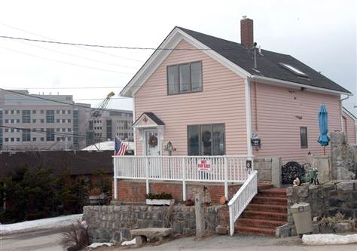
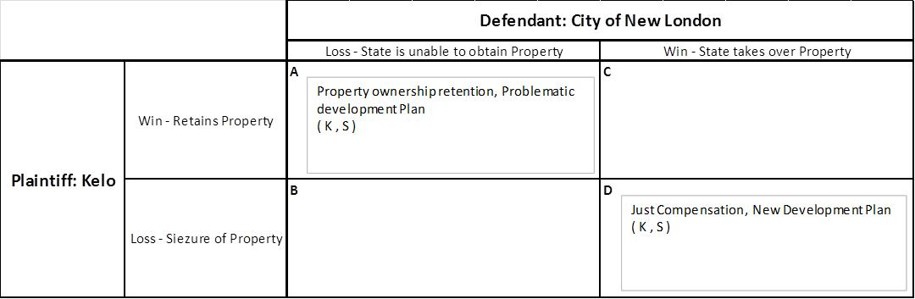
An Economic Analysis of Kelo v. City of New London
Law and Economics
Harry Shea
Case Summary
On June 23, 2005, the Supreme Court of the United States granted the writ of certiorari for the case, Kelo v. City of New London. This was a property law case involving the plaintiff, a disgruntled property owner named Susette Kelo, and the city of New London, Connecticut, as the defendant. In an attempt to revitalize an economically distressed area, the city of New London approved a development plan that required the use of privately owned property. In conjunction with this decision, the pharmaceutical company Pfizer announced the development of a large research facility close by, which would presumably serve as a catalyst for further economic development. In order to attain this private property, the state planned to make purchases from willing sellers and use the power of eminent domain to acquire land from unwilling sellers for just compensation. A group of petitioners who wished to retain their property and resist eminent domain, led by Susette Kelo, took action to the New London Superior Court. It is important to note that these properties were selected by the state solely because of their location in relation to the development plan, not because there were blighted.
The New London Superior Court came to a mixed decision, granting the state to take over some of the properties, while also allowing a select number of petitioners to keep their property. This case was then appealed to the Supreme Court of Connecticut, who decided that the power of eminent domain to take over all property was valid. The Supreme Court of the United States decided to review the lower court’s finding and granted a writ of certiorari. Ultimately, the decisions of the Supreme Court of Connecticut were affirmed on the basis that the New London economic development plan was in accordance with the “public use” restriction of the Fifth Amendment. The city of New London was able to use eminent domain to take over private property for just compensation for the state’s own public use. (Stevens, 2005.)
Economic Issues
The outcome of this case brings up the widely contested debate about what sort of role governments should have in relation to the economy. The ruling of this case supports government intervention as a positive force for improved economic momentum. This sort of ruling varies greatly from the laissez faire system, another popular economic theory which opposes any sort government intervention. The city of New London felt it necessary to provide assistance to restore a deteriorating economy. The unemployment level was higher than other parts of the state of Connecticut and a diminishing population was at its lowest level since 1920. The development plan included a hotel, shopping stores, restaurants, office buildings, and a new residential area. The ultimate goal was to create over 1000 jobs and increase tax revenue. (Stevens, 2005.)
A significant catalyst to the revitalization of this area was the Pfizer announcement to build a large research and development facility that would complement the economic development plan. In 2009, Pfizer shut down its New London site for consolidation after a merger with Wyeth, another pharmaceutical company. (Gershon, 2009.) The company that was supposed to develop a large portion of the land was unable to secure sufficient financing. Around a third of land which was supposed to be developed for hotels, restaurants, and shops remain vacant. When asked about the current status of New London, Susette Kelo stated “I don’t think this is what the United States Supreme Court justices had in mind when they made this decision.” (Nelson, 2009.)
Clearly, the economic development plan provided little if any economic relief to the city of New London. This is not, however, a clear sign that all government intervention in the economy is negative. It is important to note that the timing and execution of this plan occurred during the great recession, providing a severe economic decline and difficult environment for business expansion. The merger, consolidation, and movement of the Pfizer facility was an unexpected event, that could have potentially boosted this area with economic activity had it stayed.
Major Legal Issues
The outcome of Kelo v. City of New London created a significant amount of controversy because the interpretation of the Supreme Court gave state governments increasingly more flexibility and power in relation to private ownership. The judges of the Supreme Court used their interpretation of the Takings clause of the Fifth Amendment to formulate their final opinion. This clause states, “nor shall private property be taken for public use without just compensation.” (Stevens, 2005.) The main focus of this case was to determine whether or not the city of New London’s economic development plan constituted as “public use.” Historically, the Supreme Court has widely accepted projects like major highways or roadways as public use. Led by Justice Stevens, it was the majority opinion of the court to take a broad view on what constitutes as public use. They determined that economic development is a traditionally accepted role of government, and there is no way to distinguish this type of public purpose from something like the creation of a state roadway. Therefore, by determining this economic plan served as a public purpose to revitalize a distressed area, the Supreme Court deemed this state action a sufficient qualification of public use and was thus considered constitutional. (Stevens, 2005.)
Cases that deal with private property rights like this one evoke controversy and strong criticism. The Supreme Court narrowly affirmed the ruling of the state to use eminent domain in a five to four decision. Powerful dissent from Justice O’Connor vehemently opposed the loose interpretation of what constitutes as public use. There is a concern that this outcome makes private property significantly more vulnerable setting the precedent for governments to transfer property from one private owner to another for the purpose of a higher public benefit.(O’Connor, 2005.) Many believe that the Fifth Amendment was misinterpreted by the Supreme Court which led to an outcome that blurs the line between public and private ownership rights.
Since the case ruling, there have been a number of states have passed laws to prohibit the use of eminent domain. New Hampshire added an amendment to the State Constitution mandating that “no part of a person's property shall be taken by eminent domain and transferred, directly or indirectly, to another person if the taking is for the purpose of private development or other private use of the property.” (New Hampshire State Constitution, 2006.) Many states, concerned with the looser interpretation of public use and increased eminent domain power, made legislative changes to preserve private property rights
Economic Analysis
The payoff matrix (Figure 1) provides a helpful resource to analyze the various outcomes of this case. The potential outcome for the plaintiff is to either retain the property, or to lose this property to the state. As for the defendant, a favorable outcome would be one that allows them to seize the privately held property, while a loss would result in the state being unable to obtain the private property. There are only two potential outcomes to this case, depicted in box A and D. Box A depicts a scenario where Supreme Court ruled this particular use of eminent domain as unconstitutional, resulting in the Plaintiff, Susette Kelo, being able to keep her property. This would prove problematic to the city of New London, who would have to either significantly alter the development plan or find new land for the project. Scenario D represents the situation where the Supreme Court ruled in favor of the state, allowing them to take possession of the privately held property. Susette Kelo would lose her house but would be paid just compensation. The state would then be able to execute the economic development plan.
Conclusion
Kelo v. City of New London is one of the most controversial cases in the history of the United States. The ruling of this case, while very unpopular, was extremely important because its wide publicity evoked strong questions and conversation about the role of government. From an economic point of view, this case brings up the subject of government intervention and what kind of role should be taken to facilitate financial well-being. While the Supreme Court interpreted a loose interpretation on the justification for eminent domain, many states subsequently adopted new legislation to preserve private property rights. This action indicates that the unpopular precedence set by the Supreme Court is relatively ineffective.
References
Cooter, Robert and Thomas Ulen, Law and Economics Sixth Edition, chapter 1. Prentice Hall, 2011.
Gershon, Eric. “Pfizer to Close New London Headquarters.” Hartford Courant (Nov. 9, 2009).
Nelson, Katie. “Conn. Land taken from homeowners still undeveloped.” The Seattle Times (Sept. 25, 2009).
New Hampshire State Constitution. Art. 12-a. (November 7, 2006).
O’Connor, J. Kelo v. City of New London, 545 U.S. (2005).
Stevens, J. Kelo v. City of New London, 545 U.S. (2005).

