Slide 1
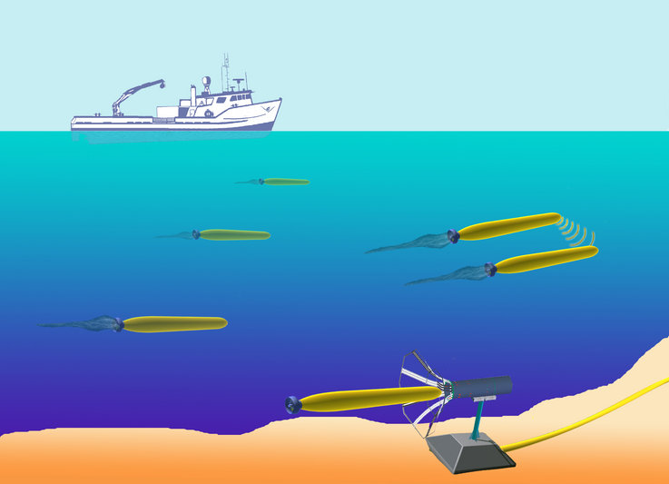
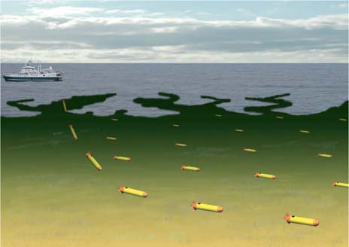
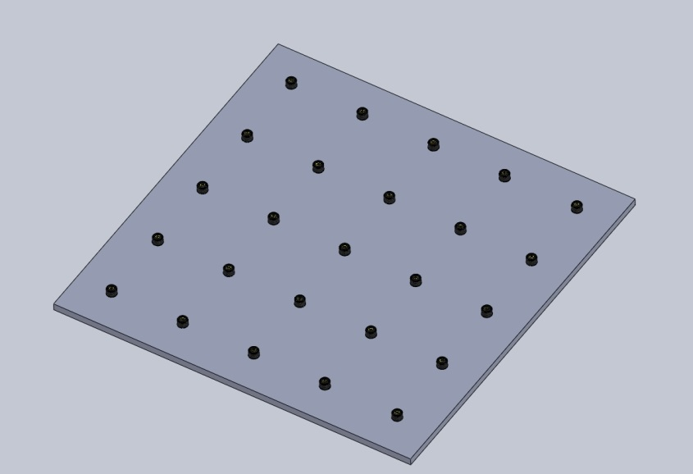
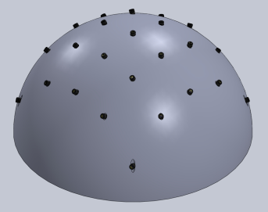
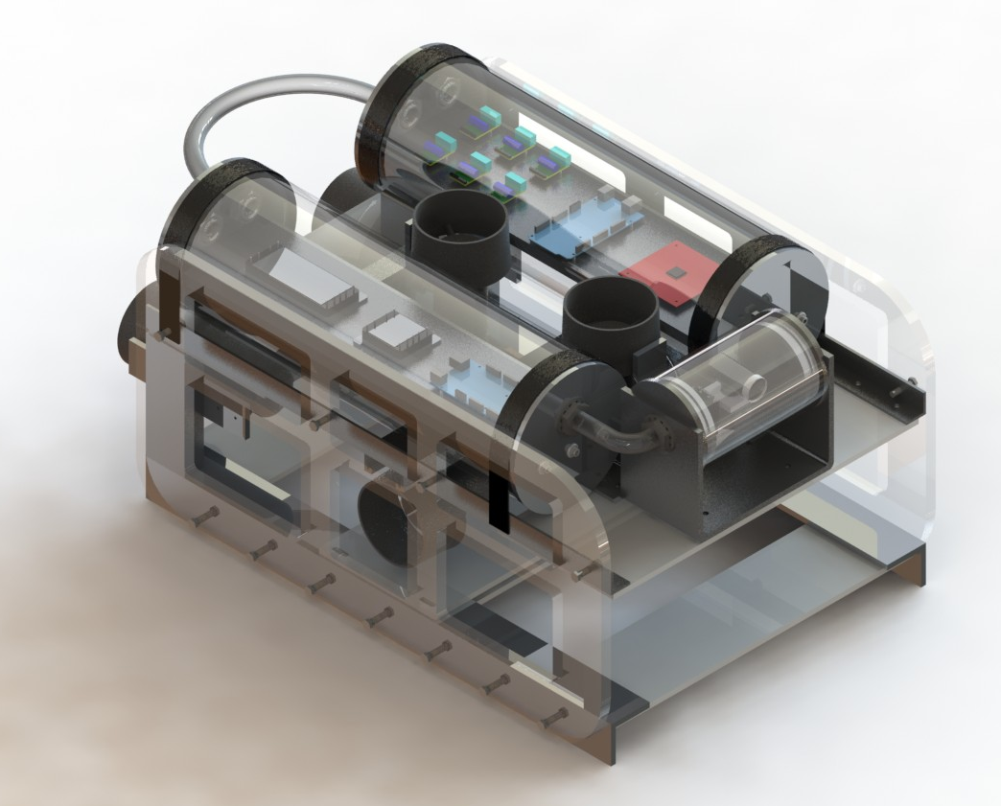
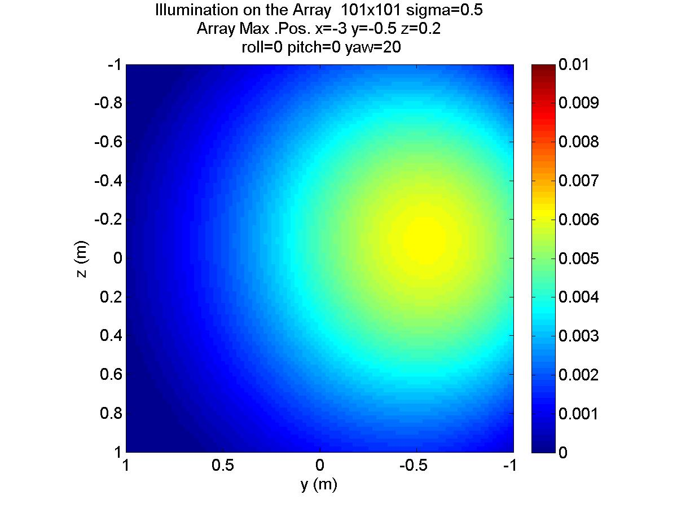
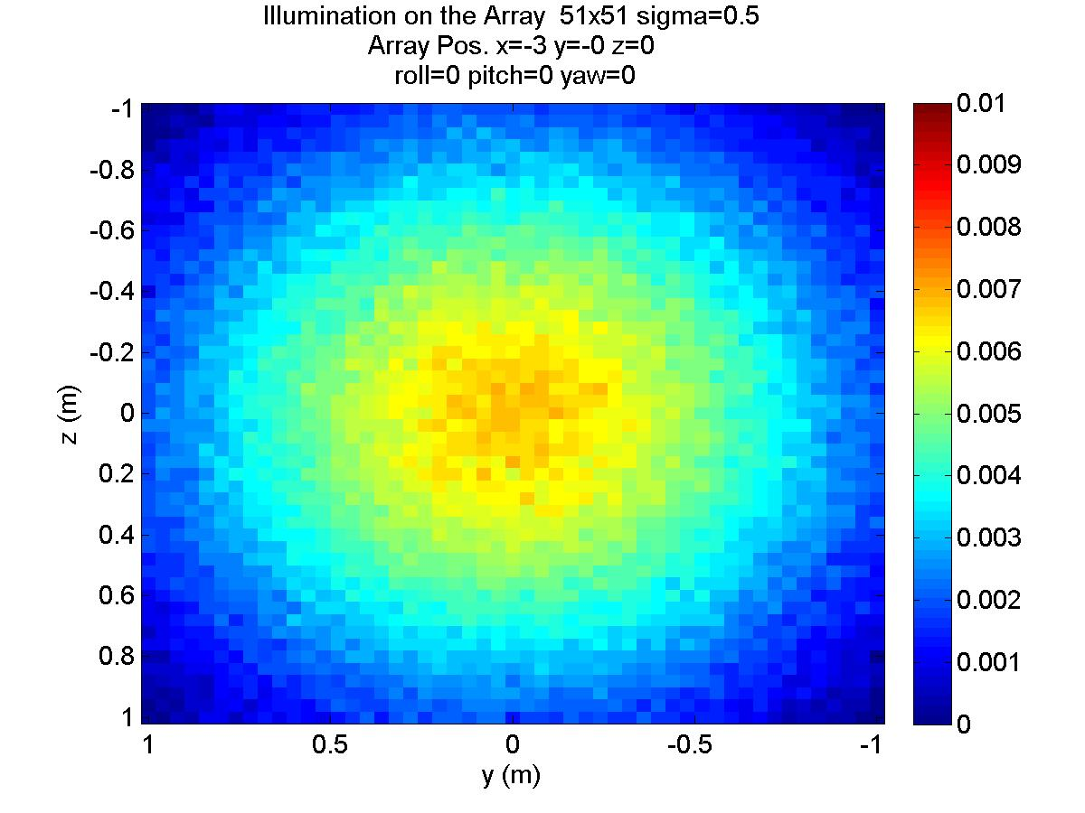
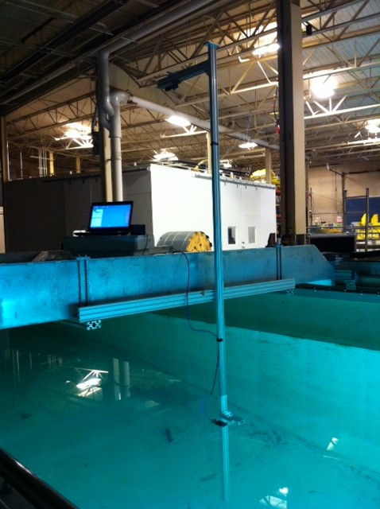
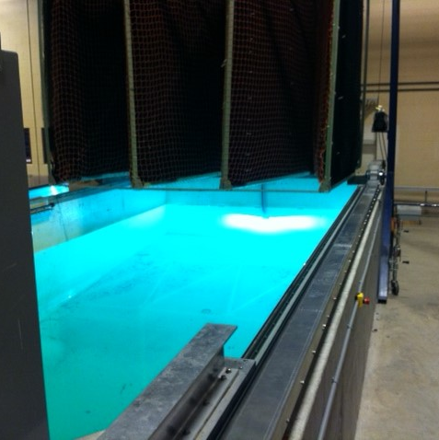
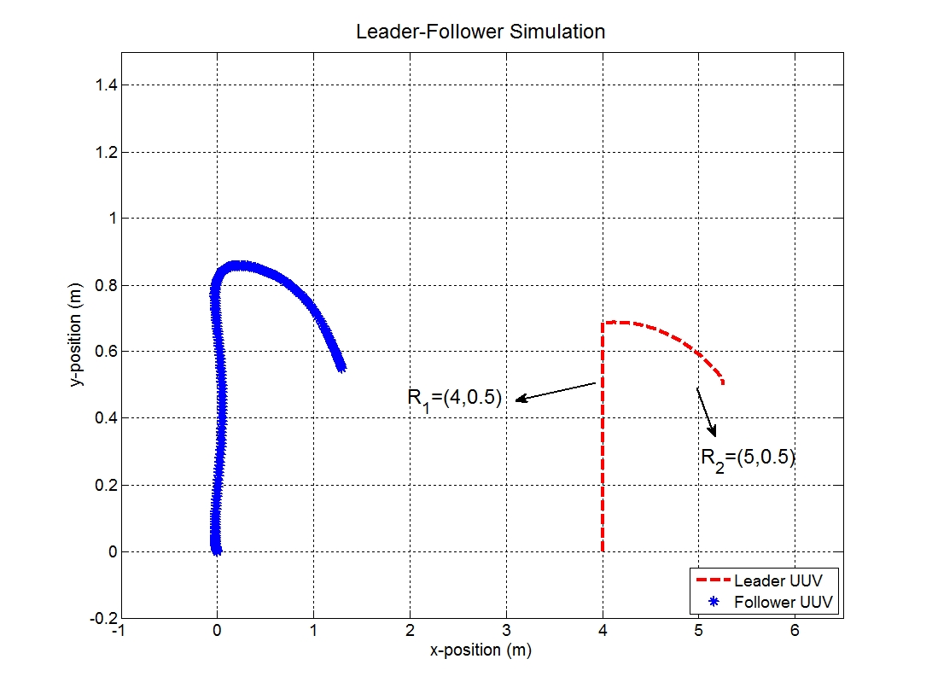
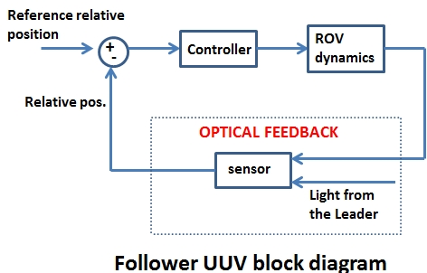
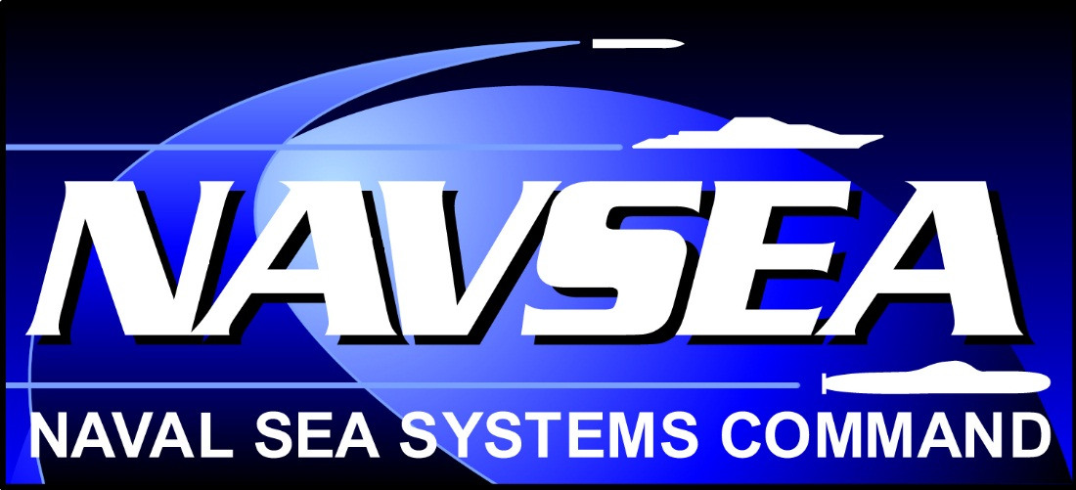
Dynamic Positioning of Unmanned Underwater Vehicles (UUVs) Utilizing Optical Sensory Feedback
Faculty Advisor: Professor May-Win Thein
NAVSEA POC: Dr. Martin Renken, Keyport NUWC
Team Members: Firat Eren, Chris Barr, Eric Boudreau, Ryan Cahill, Tyler Fausnacht, Nick Geist, Sean Gribbin, Alex Leboeuf, Sean Leighton, Matt Sweeney
Research Goal
The goal of this research is to develop an optical communication instrument for formation control of a group of UUVs, leader-follower formation.
Array Design and Simulator
Test Platform: UNH ROV
Planar and Curved Array Designs
Simulator for underwater light intensity
Optimal Number of elements for a unique image footprint
Variety of relative geometries between the leader and the follower
Environmental and electronic noise
Abstract
UNH Underwater Remotely Operated Vehicle (ROV) is an interdisciplinary team devoted to designing, building, testing, and competing with an underwater ROV. UNH ROV currently consists of students studying mechanical engineering, computer engineering, and computer science. The team will participate in an international and intercollegiate competition in the spring of 2014. The competition will be held by the Marine Advanced Technology Education (MATE) Center.
http://www.geoexpro.com/article/Seismic_Imaging_Technology_Part_IV/82c1b416.aspx
http://www.mbari.org/auv/slideshow.htm
Experimental Setup
UNH Tow/Wave Tank
4.5m-8m in x-axis, 0.1m in z-axis
400W and 50W light sources
Spectrometer
Planar Array
Curved Array
Light source
Spectrometer and laptop
y-axis
x-axis
Light detector with collimator
z-axis
Curved Array Image 101x101
Curved Array Image 51x51 with noise
Configuration and Controls
Follower UUV receives optical input
Converted into relative pose information
Control action is taken, PD, Sliding Mode, Fuzzy Controller
Pose Detection Algorithms and Results
Pose Detection based on key image parameters such as Spectral Angle Mapper (SAM), skewness of the gradients among row and column intensity profile, row and column number of the optical element with maximum intensity
Detection Algorithm based on look-up table approach
PD control implemented
Design Goals
Maintain slight positive buoyancy
Space and modularity to accommodate UUV research
Symmetry to eliminate roll
Waterproof housing of electronics and camera
Safe mounting of tether on rear of ROV
Pitch and Yaw control
6 thrusters for 3 translational degrees of freedom
Reversible thrusters to add power and ease of control
Position around center of mass
 | Initial Position (m) (x,y) | Desired Final Position (x,y) | Final Position (m) (x,y) | Desired Offset (m) (x, y) | Final Offset (m) | Controller Parameters
Leader UUV | (4,0) | (5,0.5) | (5.26,0.5) | Δx_{d}=4 | Δx_{f}=3.97 | P=50 D=8
Follower UUV | (0,0) | (1,0.5) | (1.29,0.55) | Δy_{d}=0 | Δy_{f}=0.05 | P=50 D=8
Special thanks to Dr. Martin Renken, NAVSEA, NEEC, and the Link Foundation Ocean Engineering and Instrumentation Ph.D. Fellowship.

