Slide 1

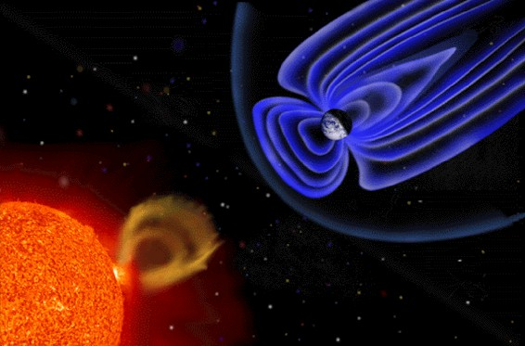
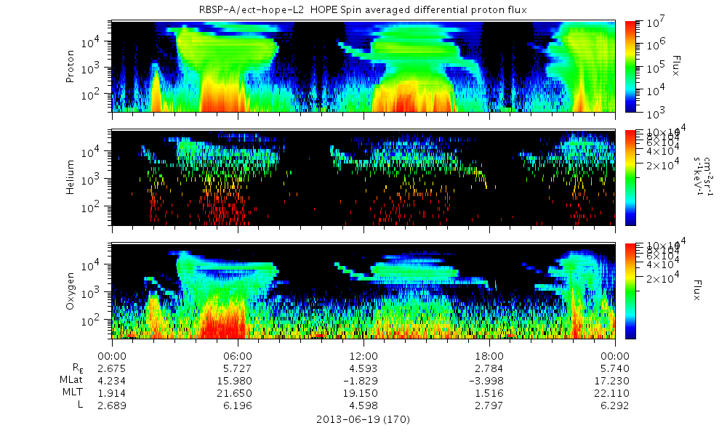
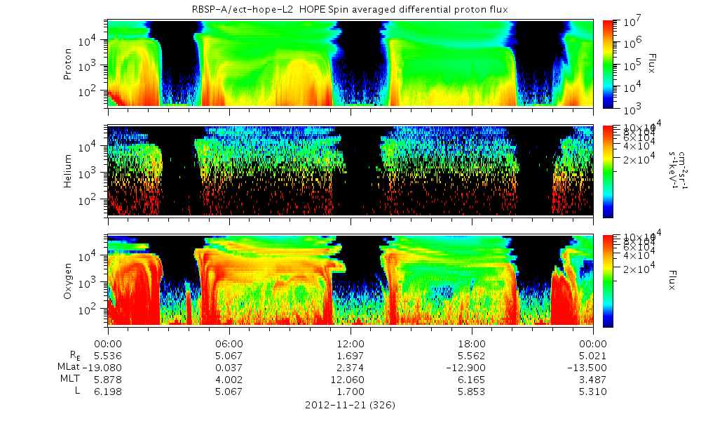
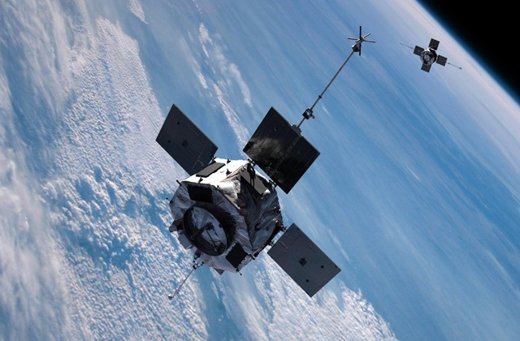
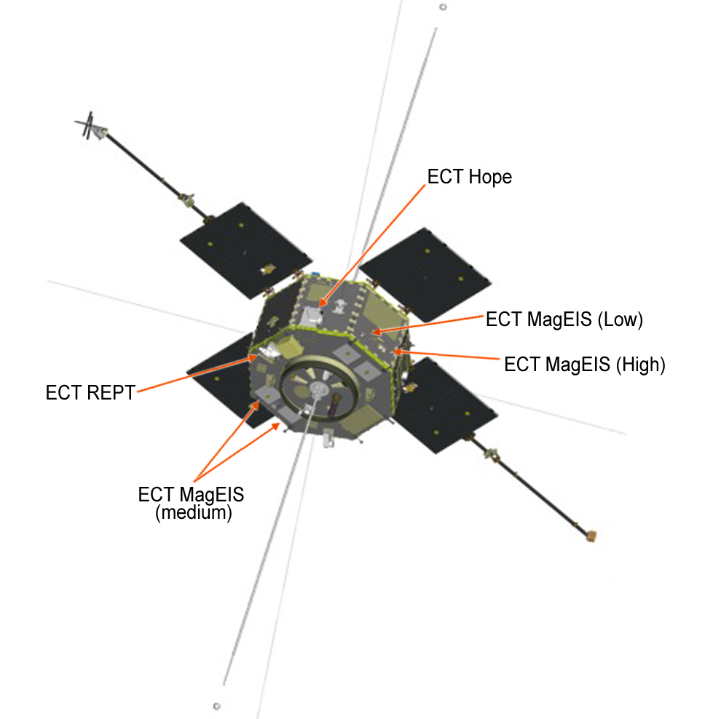
Looking For Patterns With Magnetospheric Ions
John Gadbois, Brandor Matos
What is Space Science?
Space Science is the study of the interaction between the Earth and the Sun. In my research, I studied data from a Satellite called Hope.
Objective:
Hope was a satellite that recorded data on various atoms including Oxygen, Helium, and Protons. Our objective was to look for certain shapes that reflected an increase of flux of high energy particles. These ions are the ones injected into our magnetosphere. The shapes we looked for resembled noses, tusks and trunks.
Results:
These points have a somewhat unknown reason of what causes them. Having a long excel list of events that we helped compile, allows scientists to preform a statistical study. Here they can focus on other aspects that these events have in common. Hopefully, this would help pin down the source of these events.
Advised by Dr. Zhang and Cristian Ferrera
Data: We studied plots from 2012, looking for these shapes.
Proton
Helium
Oxygen
Tusks
This is an example of some well shaped tusks and trunks.
Trunks
Proton
Helium
Oxygen
Here are some examples of noses
Acknowledgements:
Louis Broad, Scott Goelzer, Dr. Zhang and Cristian Ferrera
Hope Instrument

