Slide 1
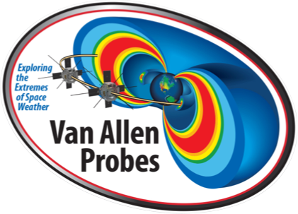
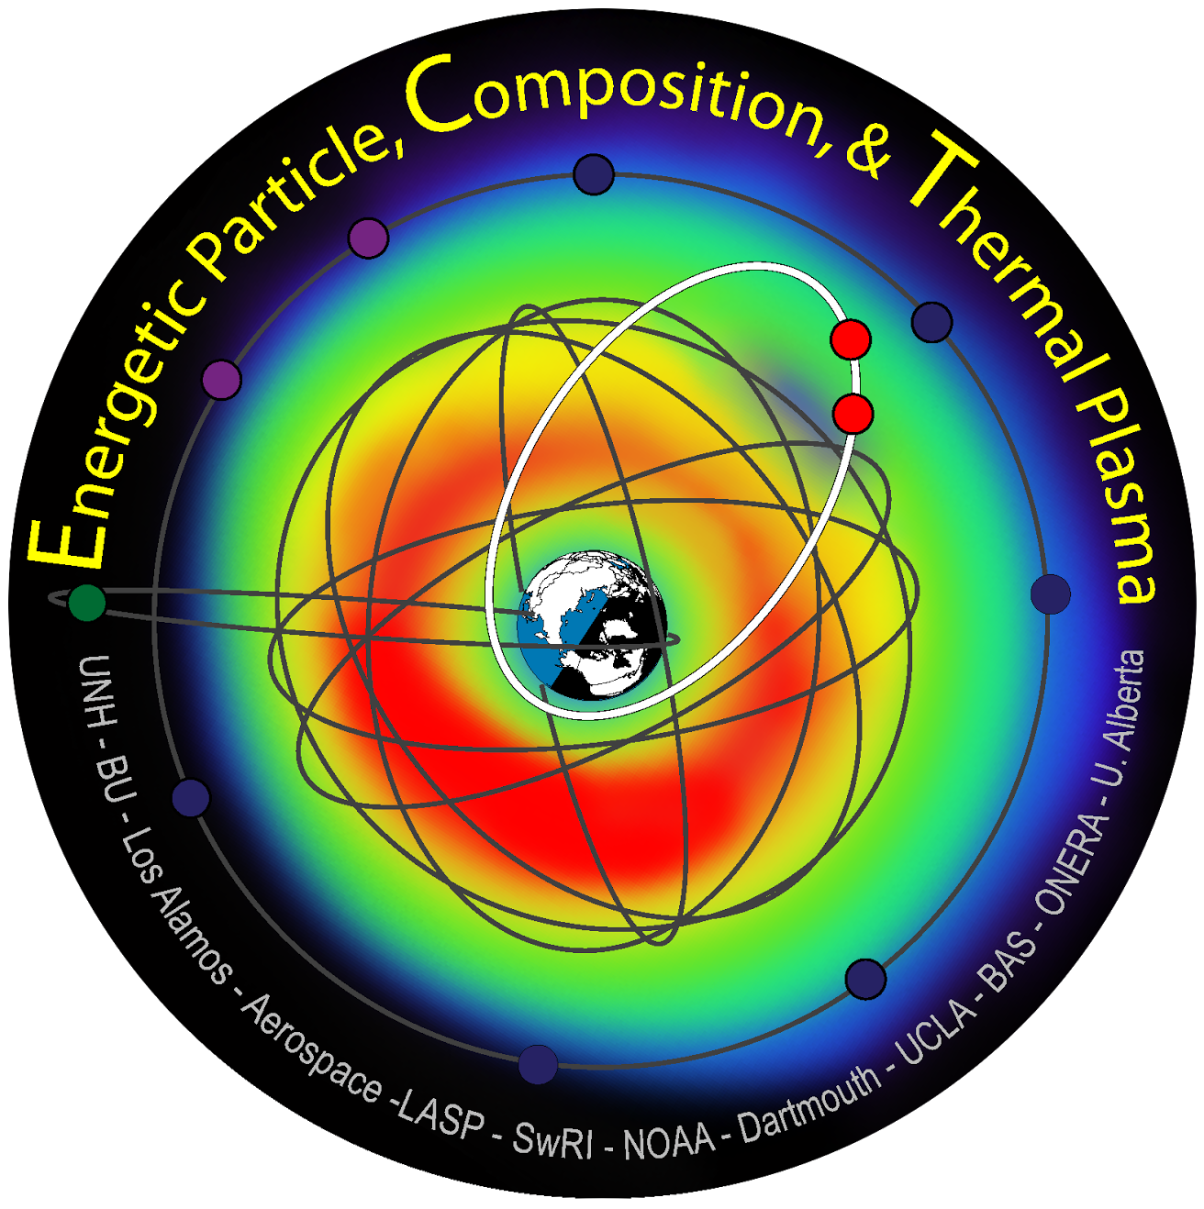
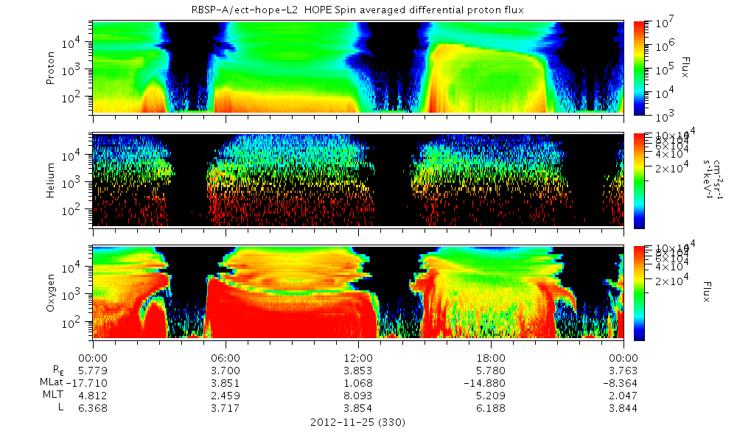
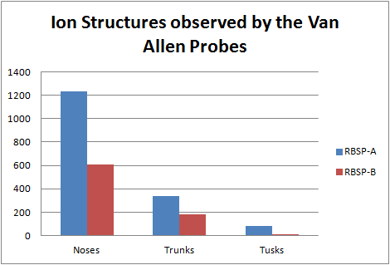
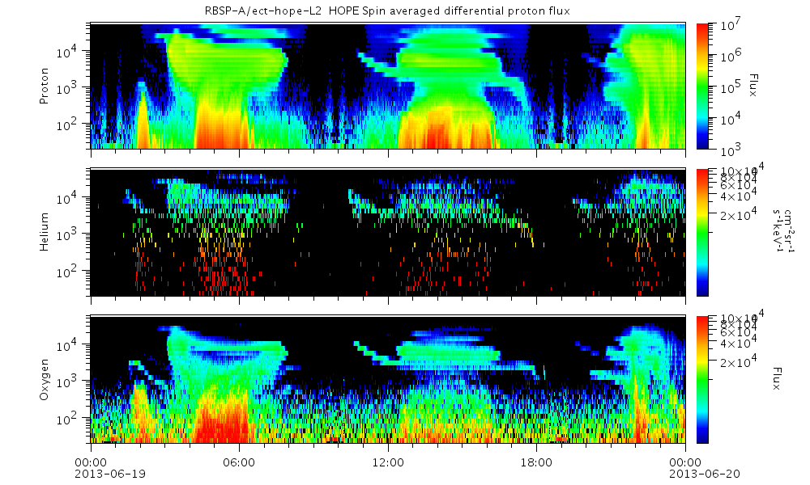
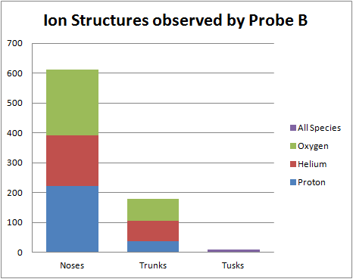
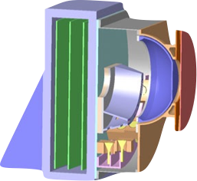
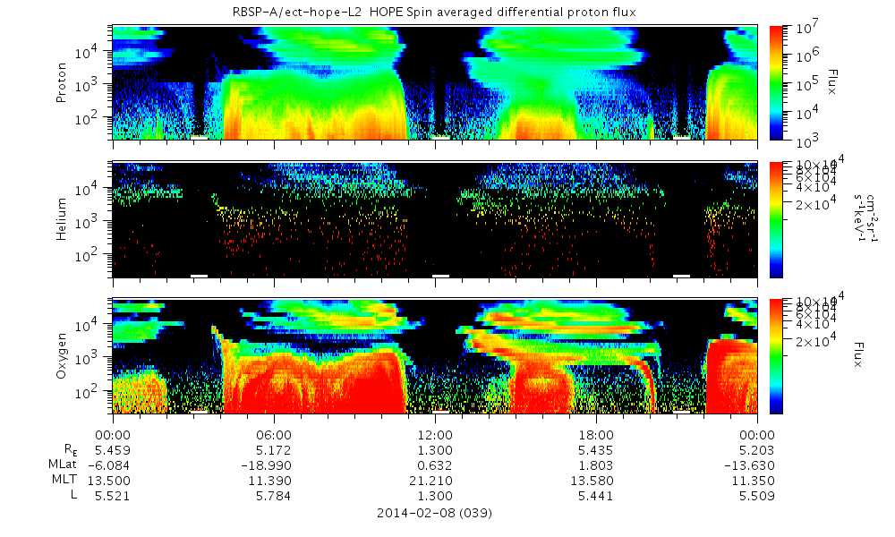
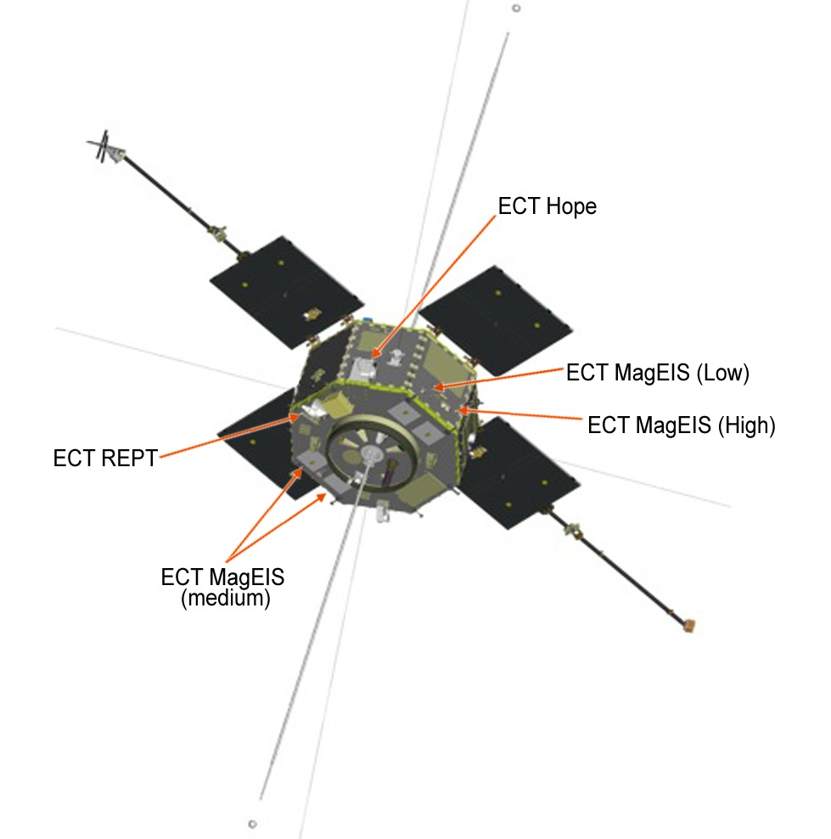
Ion Structures Observed by Van Allen Probes
Brandor Matos (Concord Academy), John Gadbois (Amesbury High School),
Cristian Ferradas (UNH), and Jichun Zhang (UNH)
Two Van Allen Probes, previously known as RBSP (Radiation Belt Storm Probes), are equipped with HOPE (Helium Oxygen Proton Electron). HOPE is an instrument that measures particles in the inner magnetosphere. Using data from HOPE, we classified ion injections into three different types of structures: noses, tusks, and trunks.
“Noses” are the most common ion structure. They are typically formed by freshly injected ions from the tail of the magnetosphere.
Data
This study shows the structures of Proton, Helium and Oxygen ions injected into our Earth’s inner magnetosphere. Our results indicate how deep the ions are able to penetrate inside the magnetosphere, and how often different types of ion structures occur.
“Tusks” are most common in heavier ions They shoot upwards, in a thin band.
Data was mainly analyzed from the six points of perigee each day. Perigee is when the satellite is closest to the Earth. HOPE measures how much Helium, Oxygen and Protons are entering through the instrument. Each day contained an inward and outbound record of data. The number of these formations was then recorded in two excel spreadsheet, for both probes. The data analyzed was from October 2012-December 2012, the first three months of the mission.
FIG. 1
FIG. 3
FIG. 3
HOPE, instrument used to measure the ions.
Fig. 1
Picture of the RBSP satellite in orbit
“Trunks” are structures that often slant downwards. This type is also more common in heavy ions.
The exact cause for this phenomenon isn't fully understood. But through the data that has been collected, scientists may be able to do statistical studies allowing them to achieve a better understanding of the different ion structures. Through this study they we are able to find how common these events are.
References: http://www.rbsp-ect.lanl.gov/
FIG. 2
Acknowledgements
Thanks to Jichun and Cristian for helping with data analysis and creating the graphs. Special thanks to Scott Goelzer, and Louis Broad for helping write the poster and design it.
Fig.2 Labeled diagram of the Van Allen robe

