Slide 1
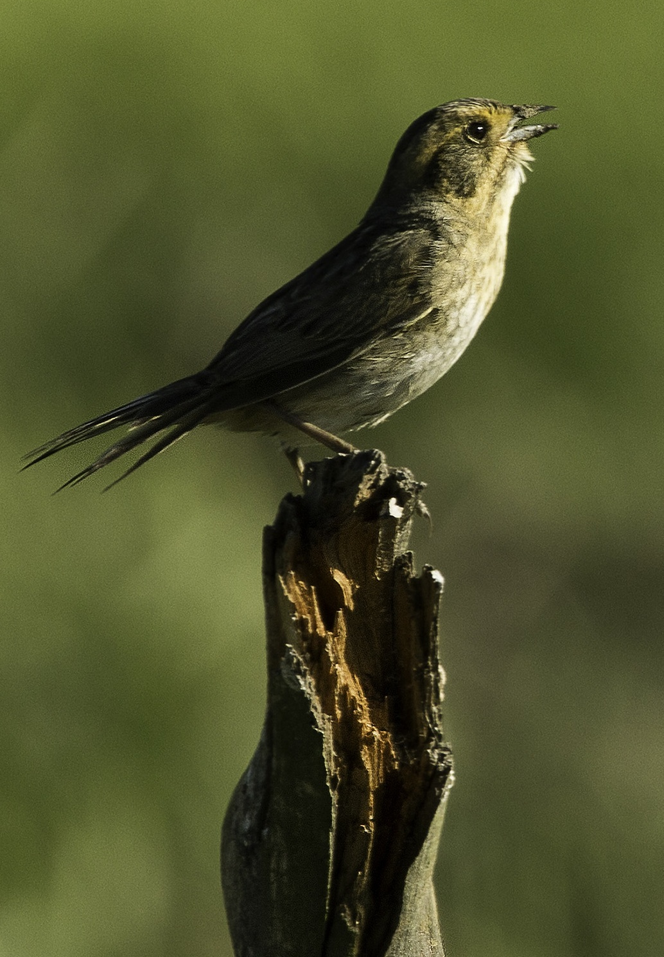
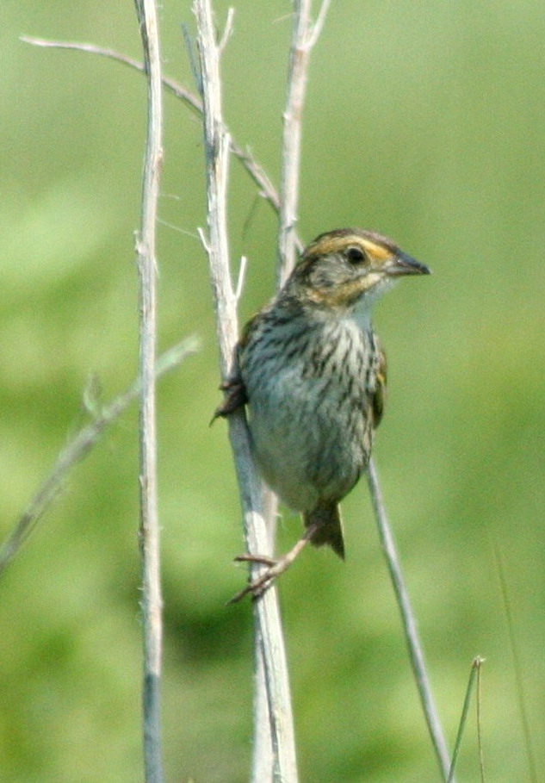

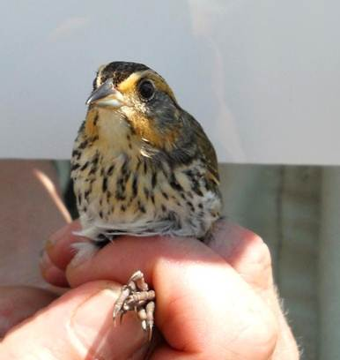
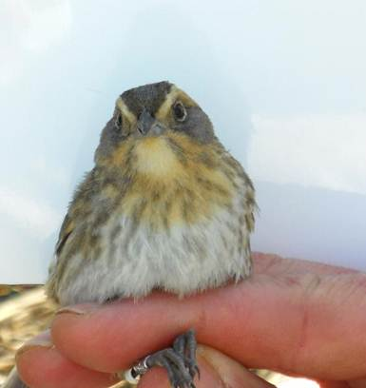
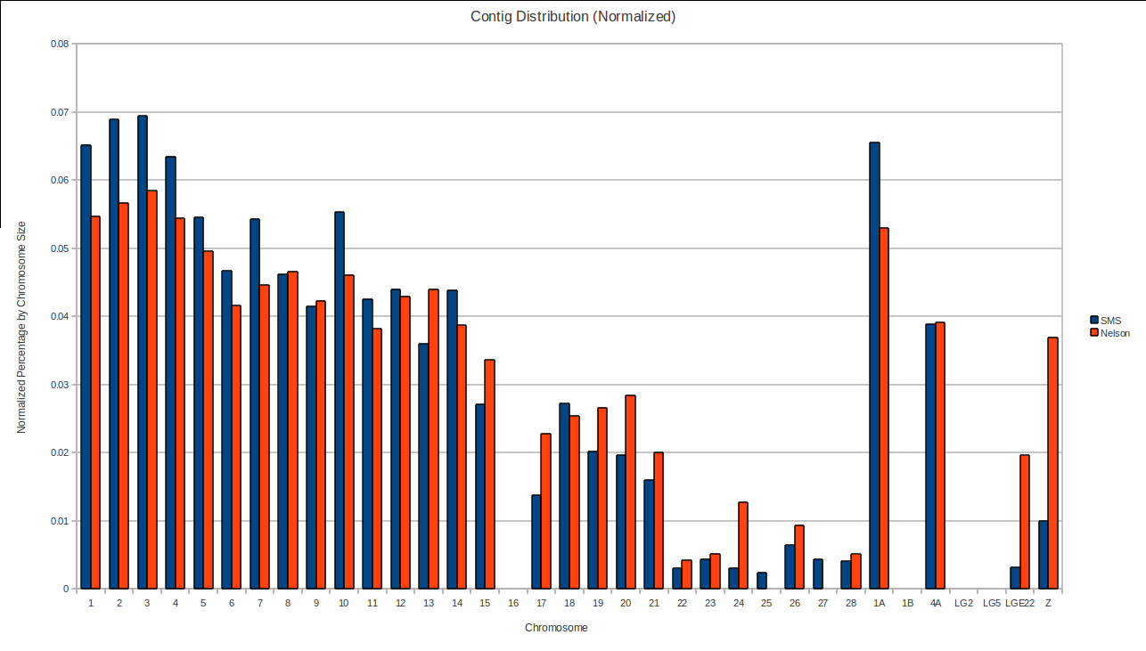
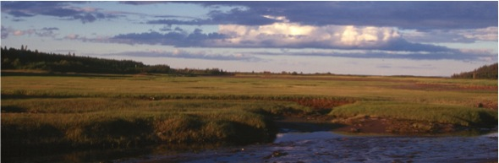
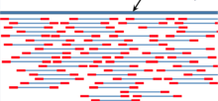
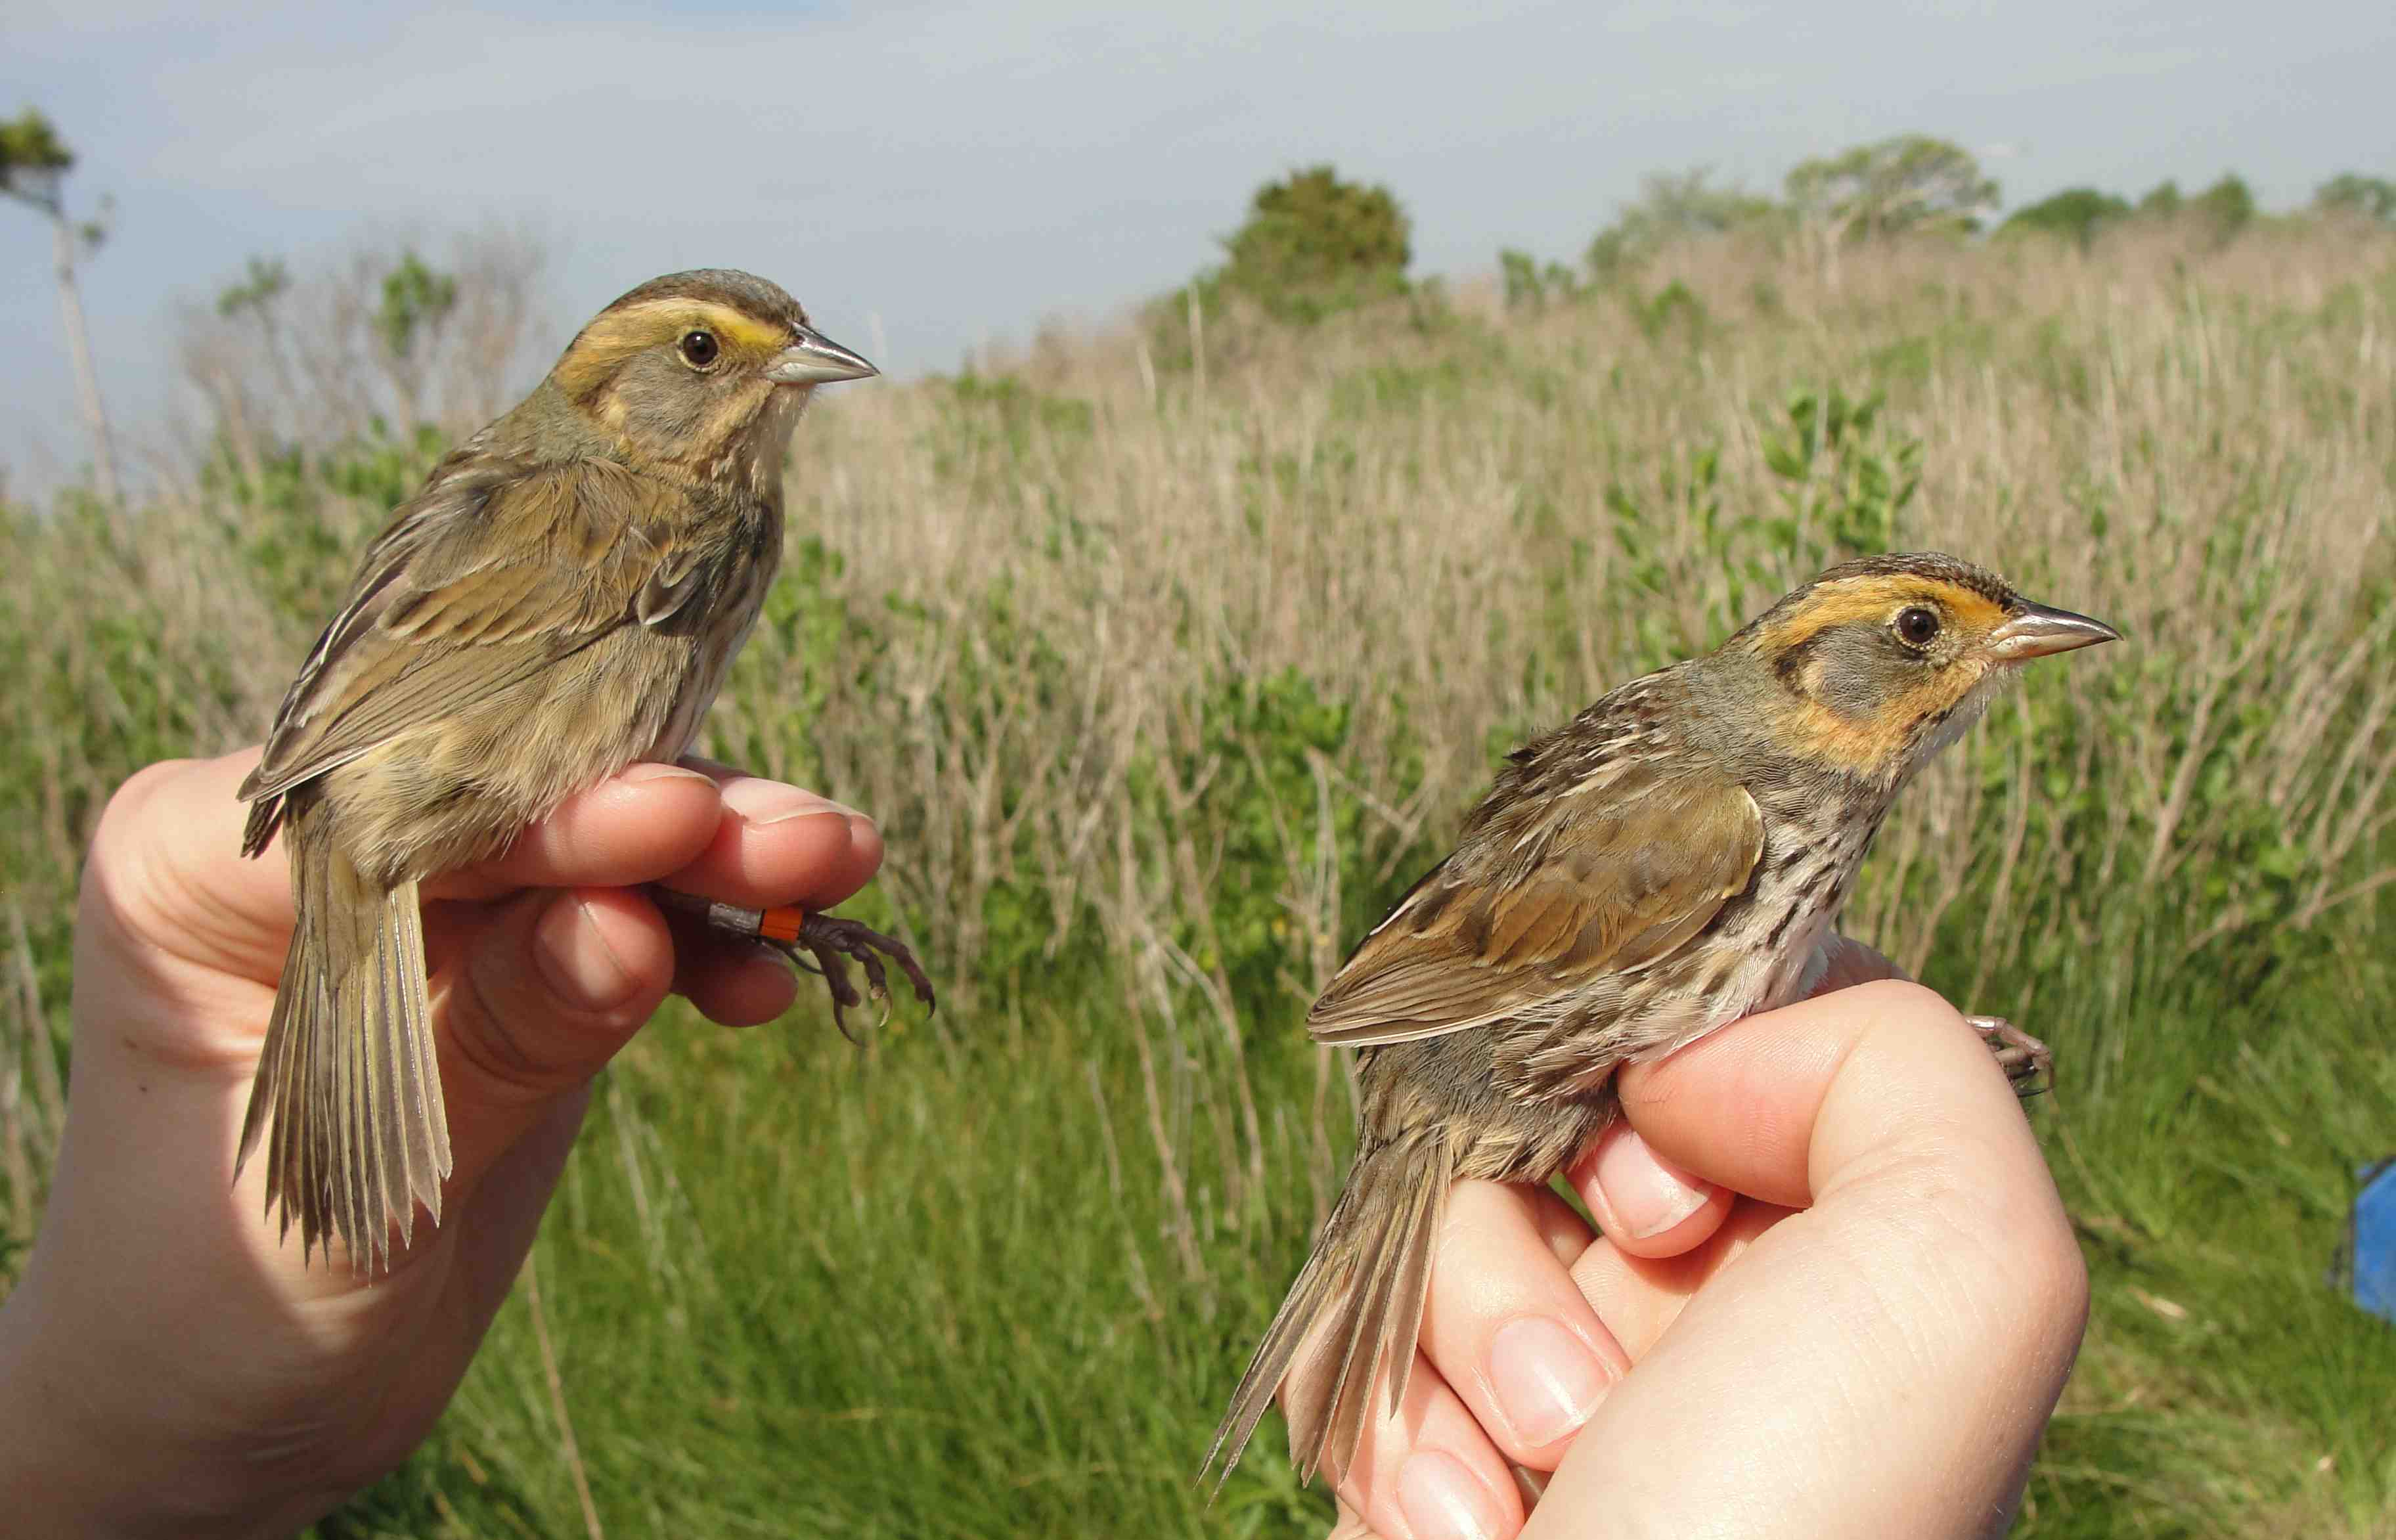
Comparative Analysis of Two Tidal Marsh Bird Genomes
Adrienne Kovach*, Philip Hatcher, Lauren Kordonowy, Kazufusa Okamoto, Jordan Ramsdell, Eleanne Solorzano, Jennifer Walsh, and W. Kelley Thomas
*akovach@unh.edu
Introduction
Obj. 1: Draft Genomes of Saltmarsh and Nelson’s Sparrow
Tidal marsh birds are ideal subjects for studying adaptation and speciation, because they have evolved specialized adaptations to harsh environmental pressures of the tidal marsh ecosystem, including in bill morphology, kidney structure and function, social behavior, and reproductive strategies.
Saltmarsh and Nelson’s Sparrows (Ammodramus caudacutus and A. nelsoni subvirgatus) inhabit tidal marshes of the northeastern Atlantic coast. These young sister species diverged ~600,000 years ago and are now in secondary contact along the New England coast, where they co-occur and hybridize. Their different adaptive histories (Saltmarsh Sparrows are tidal marsh obligates, while Nelson’s Sparrows exhibit a wider ecological niche and are found in tidal marshes, brackish waters and hay fields) and incomplete speciation make them model focal species for studying questions about ecological speciation, introgression, and adaptive evolution.
Individuals in Assembly | Coverage Depth | Assembly Size (Gb) | No. of Matched Reads | Total Nucleo-tides (bp) | GC Content | No. of Contigs | N50 Contigs (bp) | Largest Contig (bp) | Average Contig (bp) | Predicted Gene Models | Conserved Eukaryotic Orthologs | Core Eukaryotic Proteins
6 | 59 X | 1.0 Gb | 533,306,292 | 58.9 billion | 41.6% | 149,927 | 16,195 | 169.862 | 6,654 | 28,150 | * | *
1 | 26 X | 1.0 Gb | 376,102,986 | 38.8 billion | 41.6% | 142,556 | 30,931 | 442,557 | 7,262 | 25,486 | 95% | 80%
Saltmarsh Sparrow
(SALS)
Assembly: 100-bp paired end reads were assembled in CLC Genomics Workbench from: 1) the consensus of 6 Saltmarsh Sparrows and 2) one Nelson’s Sparrow.
Quality Control of Assembly: Comparisons with CEGMA to 458 core eukaryotic proteins.
* >90% overlap between the species
Synteny with Zebra Finch Genome
Normalized % by Chromosome Size
Gene Predictions (ab initio) were made in MAKER2 using the Augustus algorithm, the Zebra Finch protein data, and RNA Seq data from a Saltmarsh Sparrow.
Synteny Analysis: Alignment with Zebra Finch Chromosomes using MAUVE (see figure to the right).
Nelson’s Sparrow
(NESP)
Zebra Finch Chromosome
Obj. 2: Comparative Genomics
Gene Family Analysis
Genes with Accelerated Rates of Evolution
Gene Family Contractions in Saltmarsh & Nelson’s
Sparrows Relative to Medium Ground Finch (MGF)
Gene Family Expansions in Saltmarsh & Nelson’s
Branch site test in CODEML of PAML 4.7 was used to identify genes with accelerated rates of evolution (positive selection).
8 genes were found to be evolving faster in MGF relative to SALS and NESP, with cellular functions:
zinc finger proteins, enhancing hormone receptor activation,
mitochondrial morphology and lipid metabolism
1 gene – nodal receptor – was evolving faster in NESP relative to the other 2 lineages and no genes were accelerated in SALS.
Future analyses with additional avian lineages, including more tidal marsh bird species may yield insight into important genes in the evolution of tidal marsh birds.
Gene Family | SALS | NESP | MGF | Annotation
17166 | 7 | 12 | 78 | Beta-Keratin Protein
327 A | 2 | 3 | 14 | histone 2-A protein
17153 | 0 | 0 | 214 | Putative uncharacterized transposon-derived protein ZK1236.4, partial
Gene Family | SALS | NESP | MGF | Annotation
8791 | 18 | 27 | 1 | erythroblast NAD(P)(+)--arginine ADP-ribosyltransferase-like
16453 | 10 | 17 | 3 | mas-related G-protein coupled receptor member H-like
4889 | 2 | 12 | 0 | protocadherin alpha-13-like
8349 | 6 | 12 | 1 | myosin heavy chain
10554 | 19 | 25 | 12 | myosin
450 | 14 | 9 | 3 | collagen-alpha chain
6786 | 6 | 2 | 0 | Actin-binding LIM protein
6786 A | 6 | 11 | 0 | myosin heavy chain
Tidal marshes present unique environmental pressures that pose adaptive challenges to terrestrial vertebrates, including the few species of passerines that inhabit them.
Orthology identified by reciprocal blasts across the 3 species.
Gene Counts by Species – Lerat threshold 0.4
To provide a framework for addressing questions about adaptive evolution, our goal was to develop genomic resources and use them to begin to characterize these two tidal marsh bird genomes and lay a foundation for future research.
Species | Unique Genes | Family Genes
SALS | 9022 | 18.688
NESP | 6592 | 18.072
MGF | 3502 | 11,782
Expansion/Contraction Tables show number of genes per family by species.
Our specific objectives were to
Develop high quality draft genomes of the Saltmarsh and Nelson’s Sparrow.
Identify gene family expansions/contractions and regions of the genome undergoing accelerated rates of evolution.
Characterize polymorphism within Saltmarsh Sparrows and divergence between the species.
Obj. 3: Polymorphism & Divergence
Future Directions
Variant Detection Pipeline
Individual Heterozygosity:
The NESP individual was heterozygous at 1.37 million positions, corresponding to 1 in 769 segregating sites.
Population genomic analyses with RAD sequencing will be used to investigate the processes driving ecological divergence across the hybrid zone of these tidal marsh birds.
Sampling sparrows across the hybrid zone from coastal and upriver marshes, we will evaluate the effects of introgression on genomic patterns of divergence due to drift and selection.
Read Mapping with BWA
Nelson’s Sparrow
Saltmarsh Sparrow Reference Sequence
Hybrid Zone
Individual Reads of
6 SALS and 1 NESP
Saltmarsh
Sparrow
Pre-Processing BAM files
Acknowledgements
To this end, we collected Illumina sequencing data from 3 runs of 6 Saltmarsh Sparrows (1 individual in one lane and and 5 together in a separate lane) and 1 Nelson’s Sparrow (in a separate lane). We conducted comparative genomic analyses using Medium Ground Finch (Geospiza fortis) as an outgroup.
Duplicate Marking (Picard Tools)
Indel Realignment (GATK)
We appreciate the contributions of UNH Bioinformatics classes of 2012 and 2013. We are also grateful to Dan Bergeron, Feseha Abebe-Akele, and Matthew MacManes for bioinformatics guidance.
Erin King (USFWS) and Brian Olsen (UMaine) shared blood samples from a Rhode Island Saltmarsh Sparrow and the Nelson’s Sparrow, respectively.
Funding was generously provided by a UNH NSF ADVANCE grant to AK, ES and WKT.
Photo Credits: Singing Nelson’s Sparrow – O. Ehrlich; Perching Saltmarsh Sparrow – K. Papanastassiou;
Tidal Marsh – SHARP; Individual Saltmarsh & Nelson’s in hand – J. Walsh; Paired Sparrows – C. Elphick.
Variant Detection with GATK
Haplotype Caller & SNP Recalibration
VCF Tools to process SNP Data
Intraspecific Polymorphism (SALS)
Interspecific Divergence (SALS-NESP)
Nelson’s Sparrow (left); Saltmarsh Sparrow (right)

