Slide 1
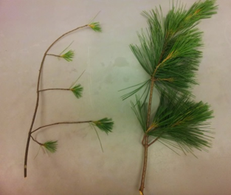
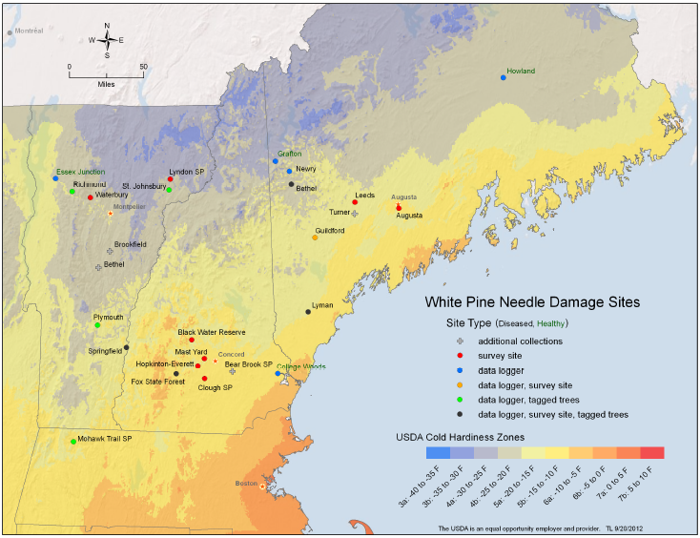
Interactive effects of White Pine Needle Damage and climate change on forest health across the Northeastern United States
Cameron McIntire¹, Heidi Asbjornsen¹, Isabel Munck², Kirk Broders¹ and Bill Livingston³
University of New Hampshire, Durham, NH. ²United States Forest Service, Durham, NH. ³University of Maine, Orono, ME.
Introduction
Regional Defoliations
Growth Declines
White Pine Needle Damage (WPND) is a complex of rain dispersed fungal pathogens that infect and defoliate the needles of eastern white pine (Pinus strobus L.). Since the spring of 2009 the northeastern United States has been experiencing an outbreak of WPND that continues to persist and spread throughout the region.
Methods: In 2014 litterfall was measured using 0.18m² traps (n=5) in 3 plots at 4 of the study sites. Litter was collected at the end of each month starting in May then dried and sorted for P. strobus needles. Stem counts at each plot were used to normalize litterfall based on basal area of white pine and to estimate total foliar dry weight using an allometric relationship to DBH (Levia 2008).
Methods: Dendrochronological analysis at the Fox State Forest (Hillsborough, NH) was conducted on increment cores (n=60) from a total of 20 tree classified as either low or high severity of WPND infection (Fig. 4).
WPND defoliates second and third year needles prior to the current year needle elongation. This effectively thins the crowns and often results in the premature death of the lower branches. WPND represents a significant threat to tree health and has been known to result in tree mortality in extreme cases.
Disease
Outbreak
Results
Photo: Stephen Wyka 2014
Needles become chlorotic and are cast during a large pulse in June, then intermittently drop throughout the rest of the growing season. Thee degree of defoliation severity differs between sites (Fig. 2).
Study Area
The US Forest Service has established eight permanent study plots for monitoring WPND throughout the NE region spanning four cold hardiness zones. The 2014 field season focused on sites within the 4a , 4b, 5a, and 5b climate zones.
 | Bethel | Hillsborough | Lyman | Durham
Cumulative Defoliation | 20% | 10% | 29% | 8%
Figure 4. Standardized chronology converted to units of basal area
increment (BAI) from the Fox Forest, NH.
Results
Trees identified as having >30% WPND affected crowns in the spring (crown class 2, 3) show a mean decline of 50% compared to pre-outbreak growth patterns. Healthy tees or of low severity defoliation (crown class 0) show minimal declines and often positive growth over the same time interval (Fig. 5).
Map: Tom Luther, USFS
A Changing Climate
The climate in the Northeastern U.S. has already experienced increased annual temperature and total precipitation (Fig. 1); a trend that is expected to continue. Variability in climate may exacerbate WPND if wetter and warmer-than-average springs and summer droughts persist in the future. Higher amounts of SPRING rainfall are thought to facilitate the spread of WPND associated fungi.
Bethel, ME
Hillsborough, NH
Lyman, ME
Durham, NH
Figure 2. Monthly (May-August, 2014) pine litterfall proportional to the total
estimated foliar dry weight at four of the permanent study plots.
Current year needles are not yet fully elongated at the time of needle drop. This represents a loss of photosynthetic potential during a large portion of the growing season (Fig. 3).
Figure 5. WPND induced growth decline at Fox Forest, NH.
Future Work
Analysis of leaf level photosynthesis, stomatal conductance, water use efficiency, and whole tree water use.
Dendrochronological analysis to quantify growth declines at each of the permanent study sites.
Silvicultural thinning treatments for developing management recommendations.
Acknowledgements
I am extremely greateful to Isabel Munck, Bill Livingston, Kirik Broders, and Heidi Asbjornsen for their assistance in designing the sampling and analysis. Field work would not have been possible without the help of Stephen Wyka, Sydney Snelling, Jake Mavrogeorge, Conor Brenton, Connor Madison, Kate Jennings, Katie Accashian, Lauren Buzinski, Stacie Powers, Andy Ouimette, Lucie Lepine, Rand Snyder, Inge Seaboyer, and Jen Weimer.
References
Figure 1. Annual trends in temperature and precipitation; Concord, NH.
Figure 3. Mean (n=3) needle elongation measured on three trees in Durham, NH.
Levia, D.F. 2008. A generalized allometric equation to predict foliar dry weight
on the basis of trunk diameter for eastern white pine (Pinus strobus L.) Forest
Ecology and Management. 255, 1789-1792

