Slide 1



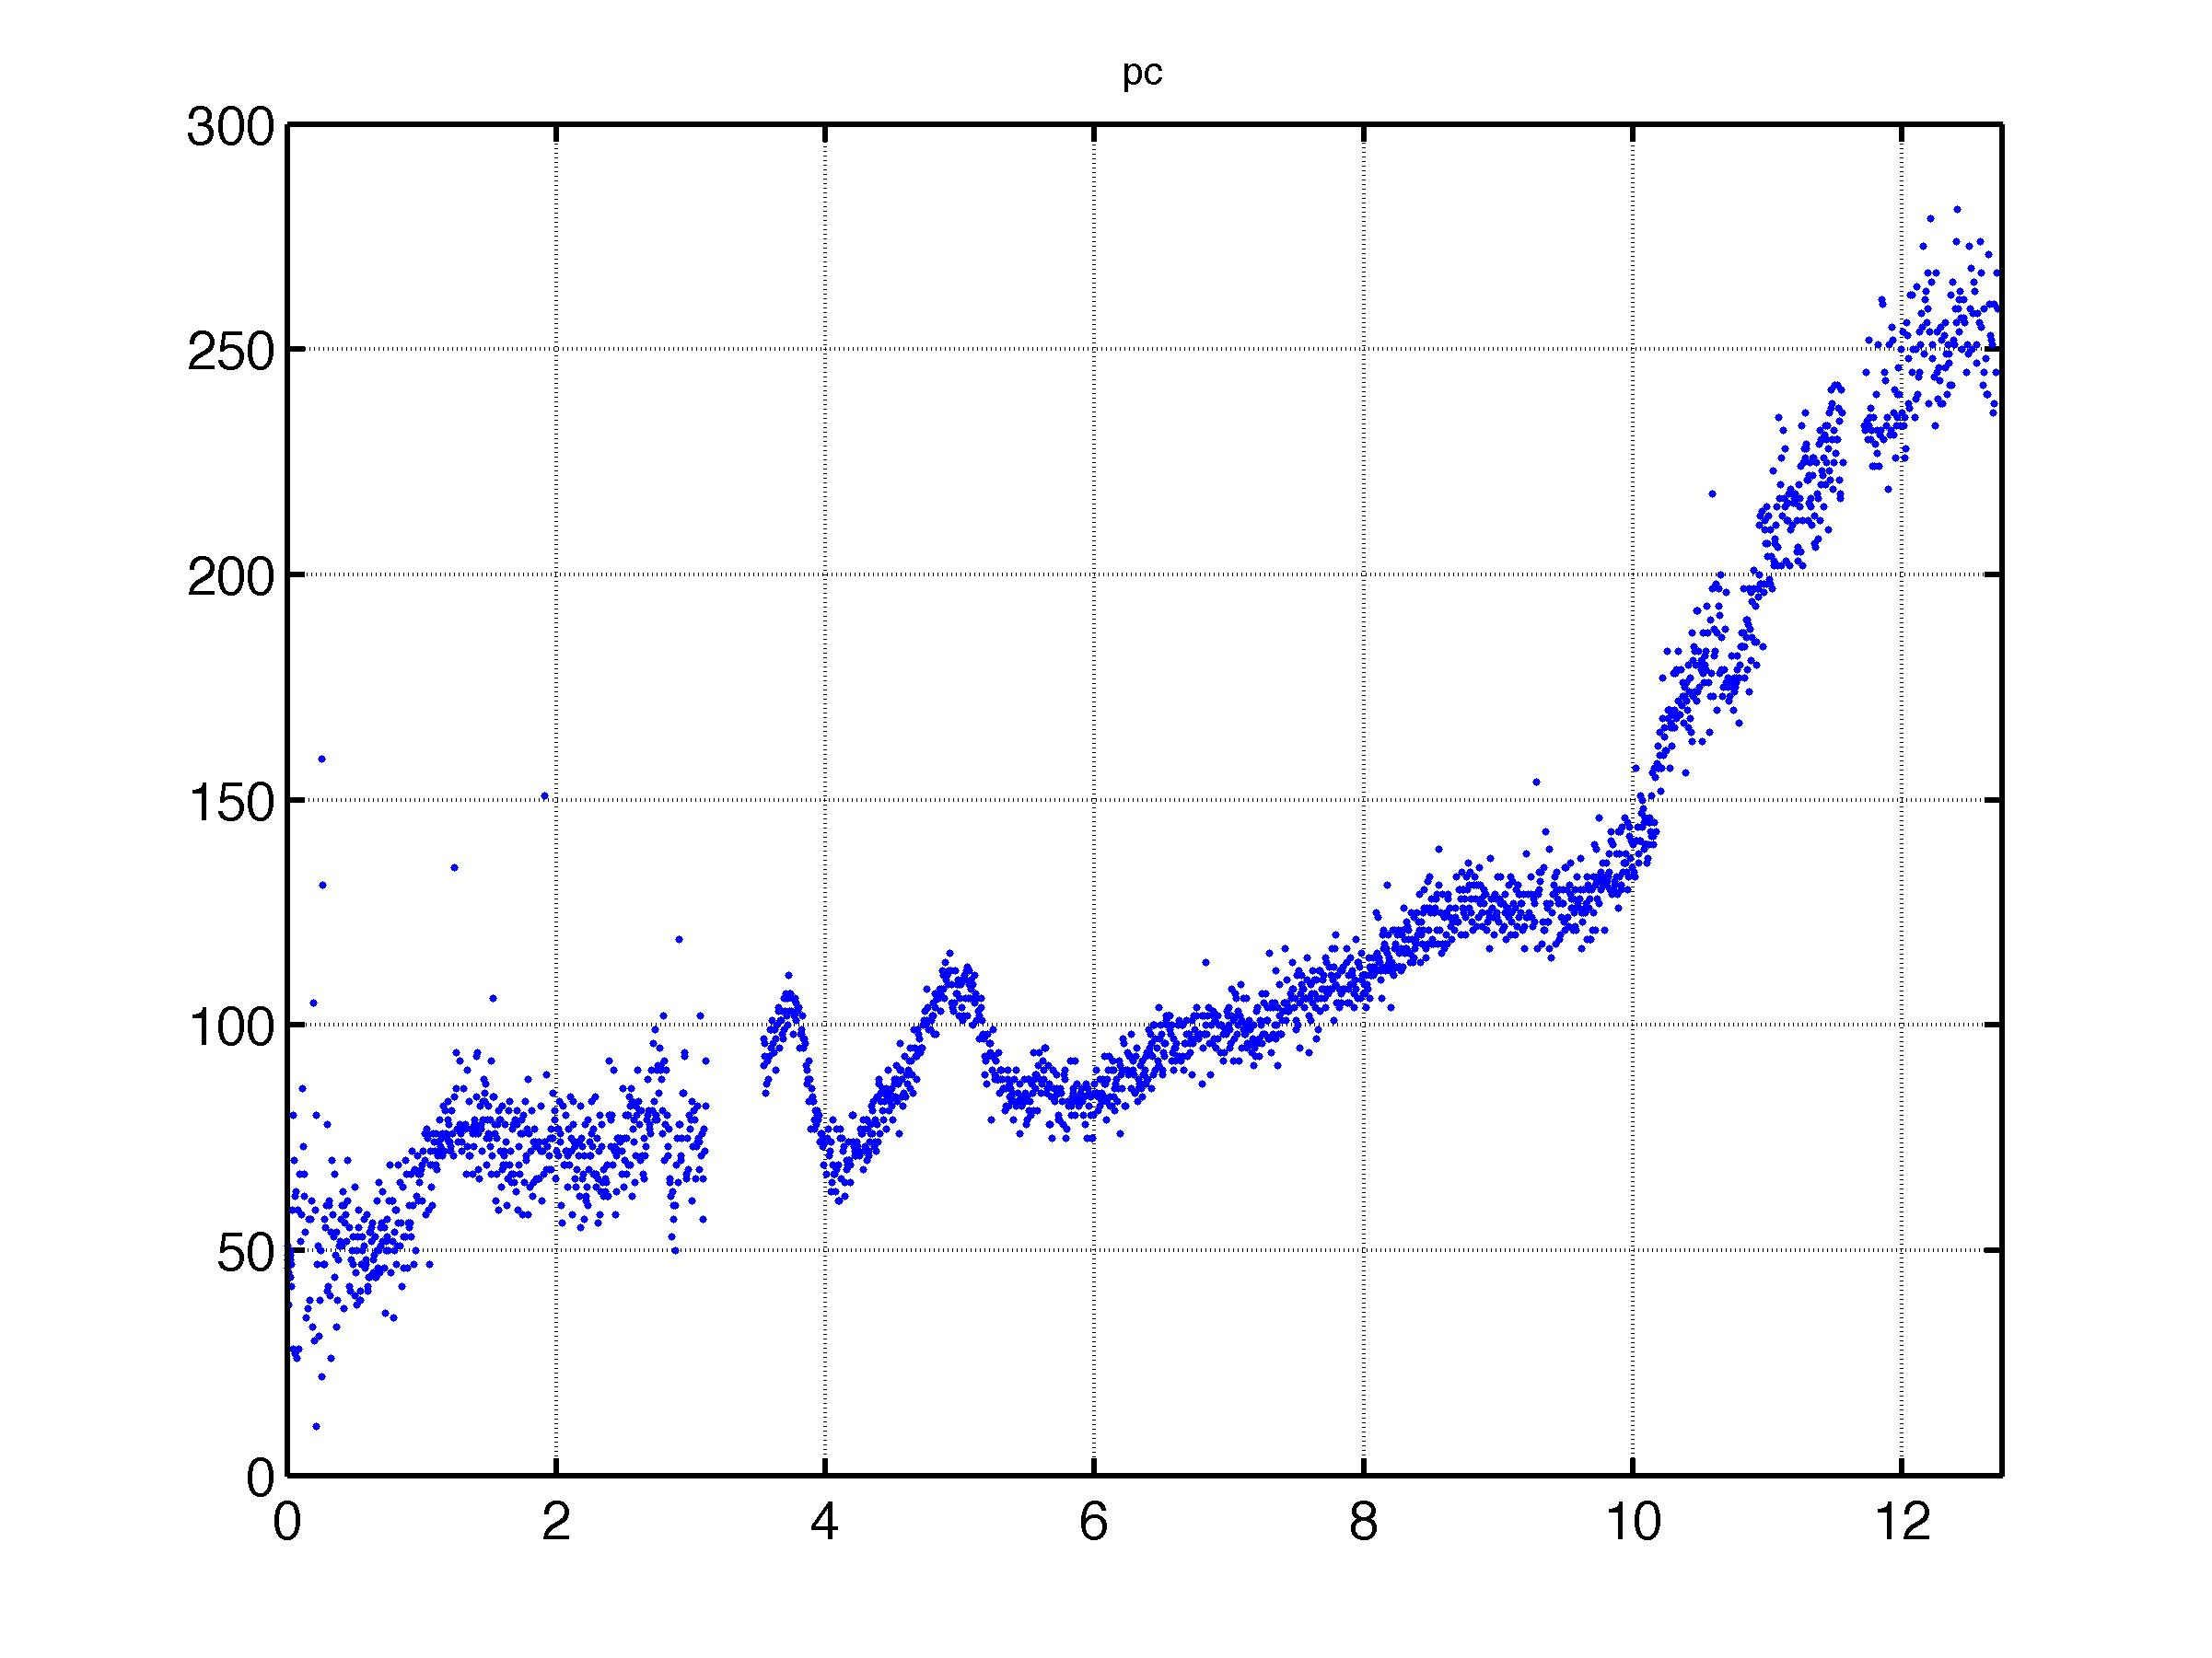
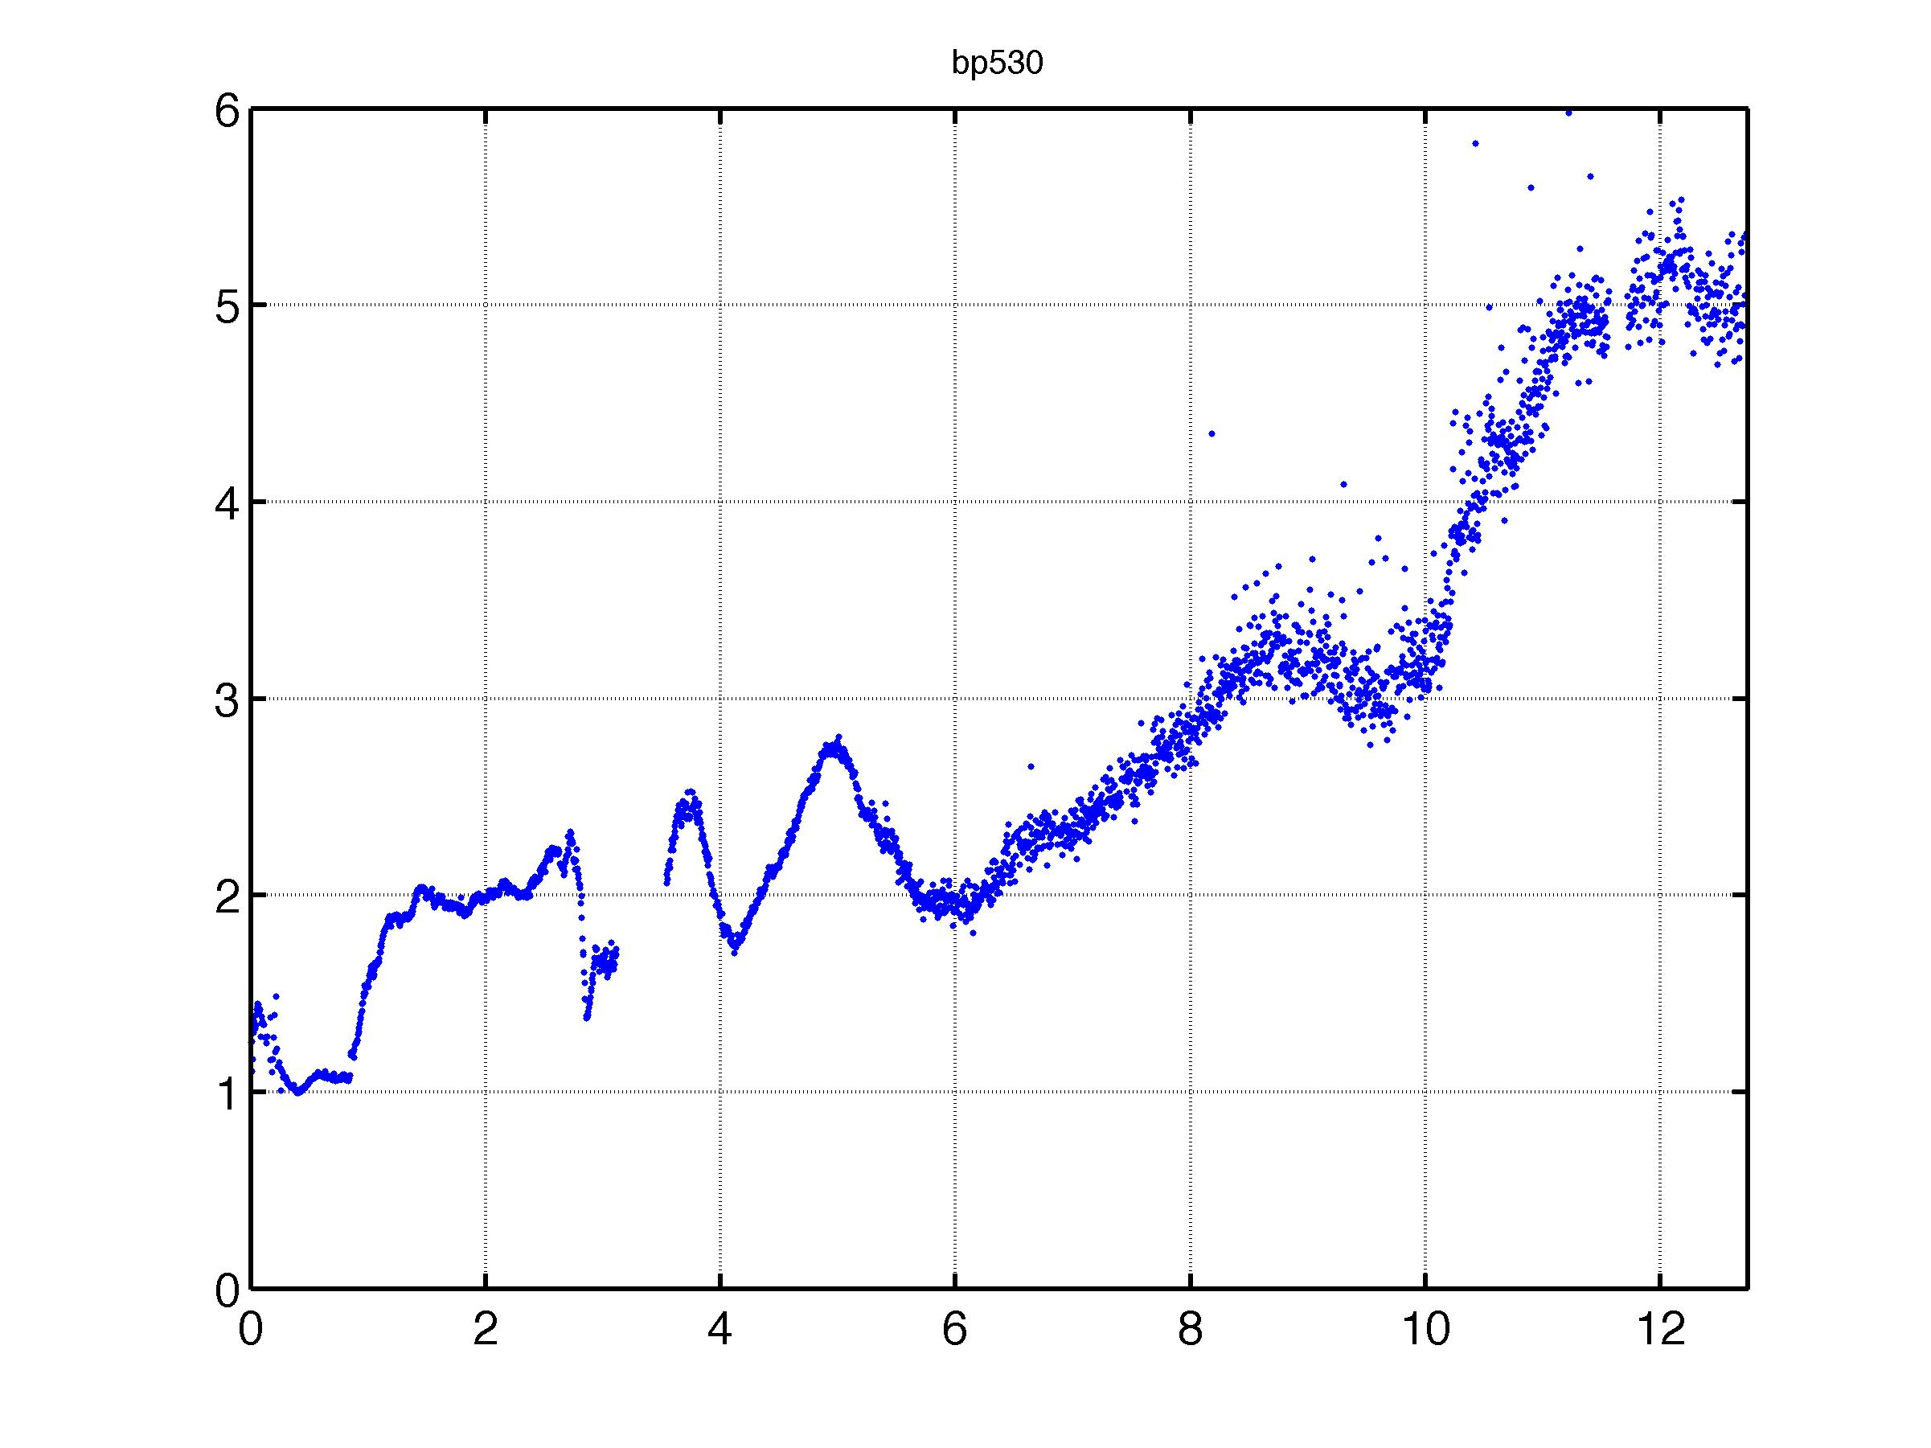
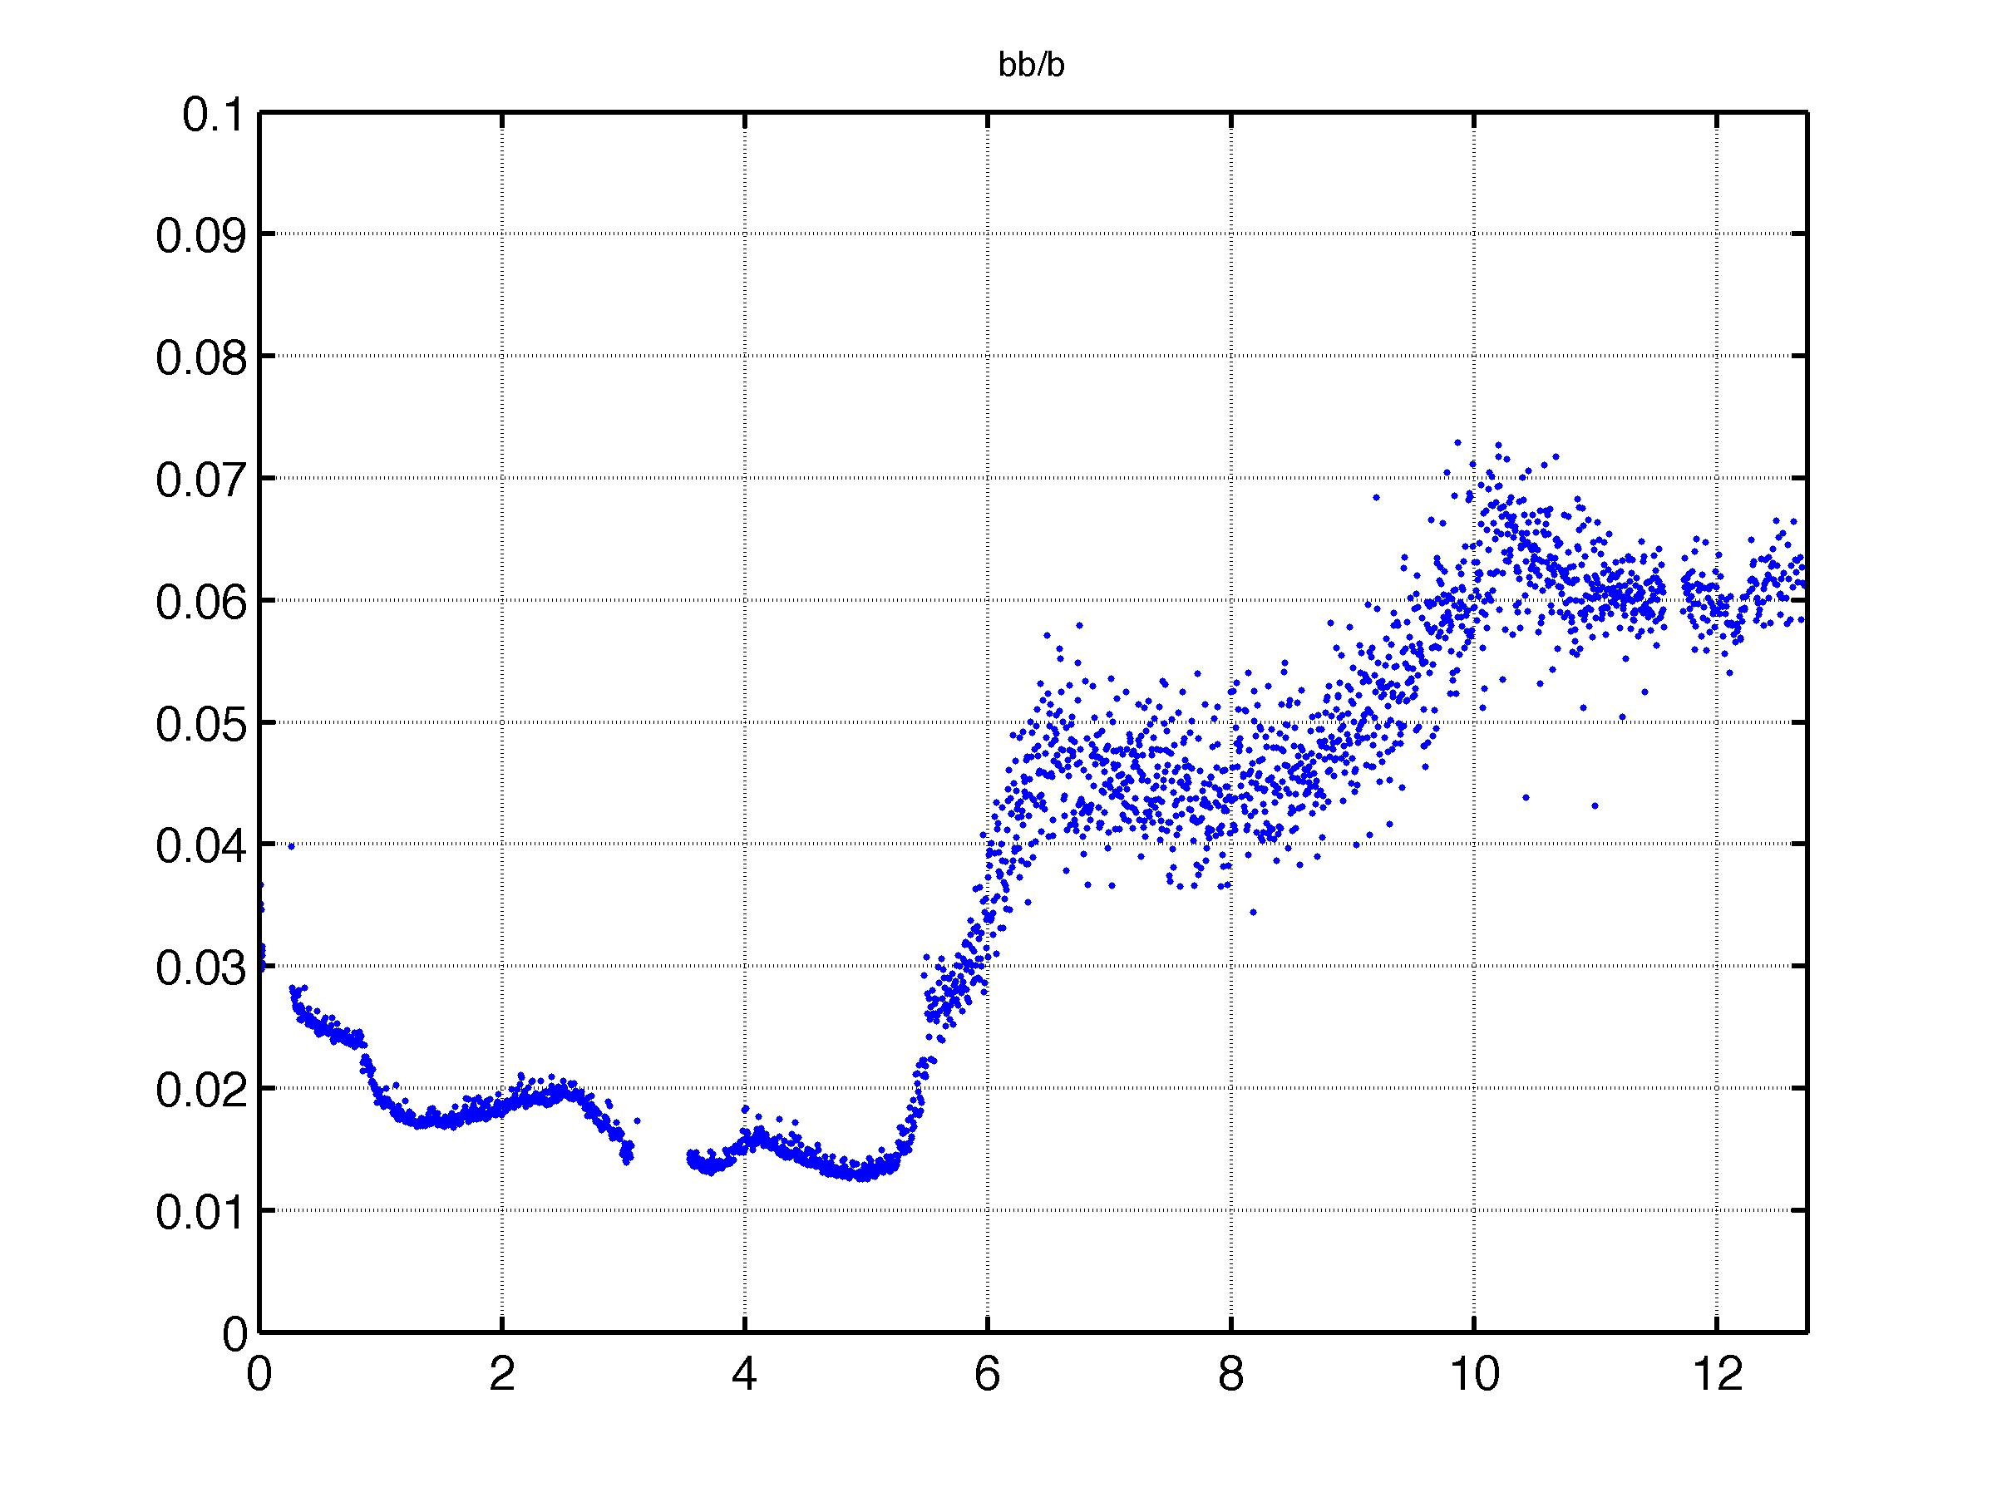
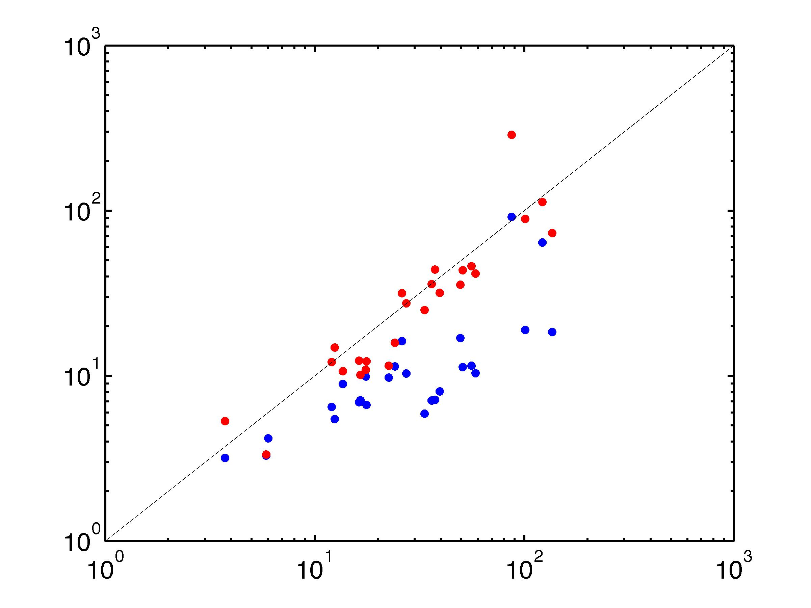
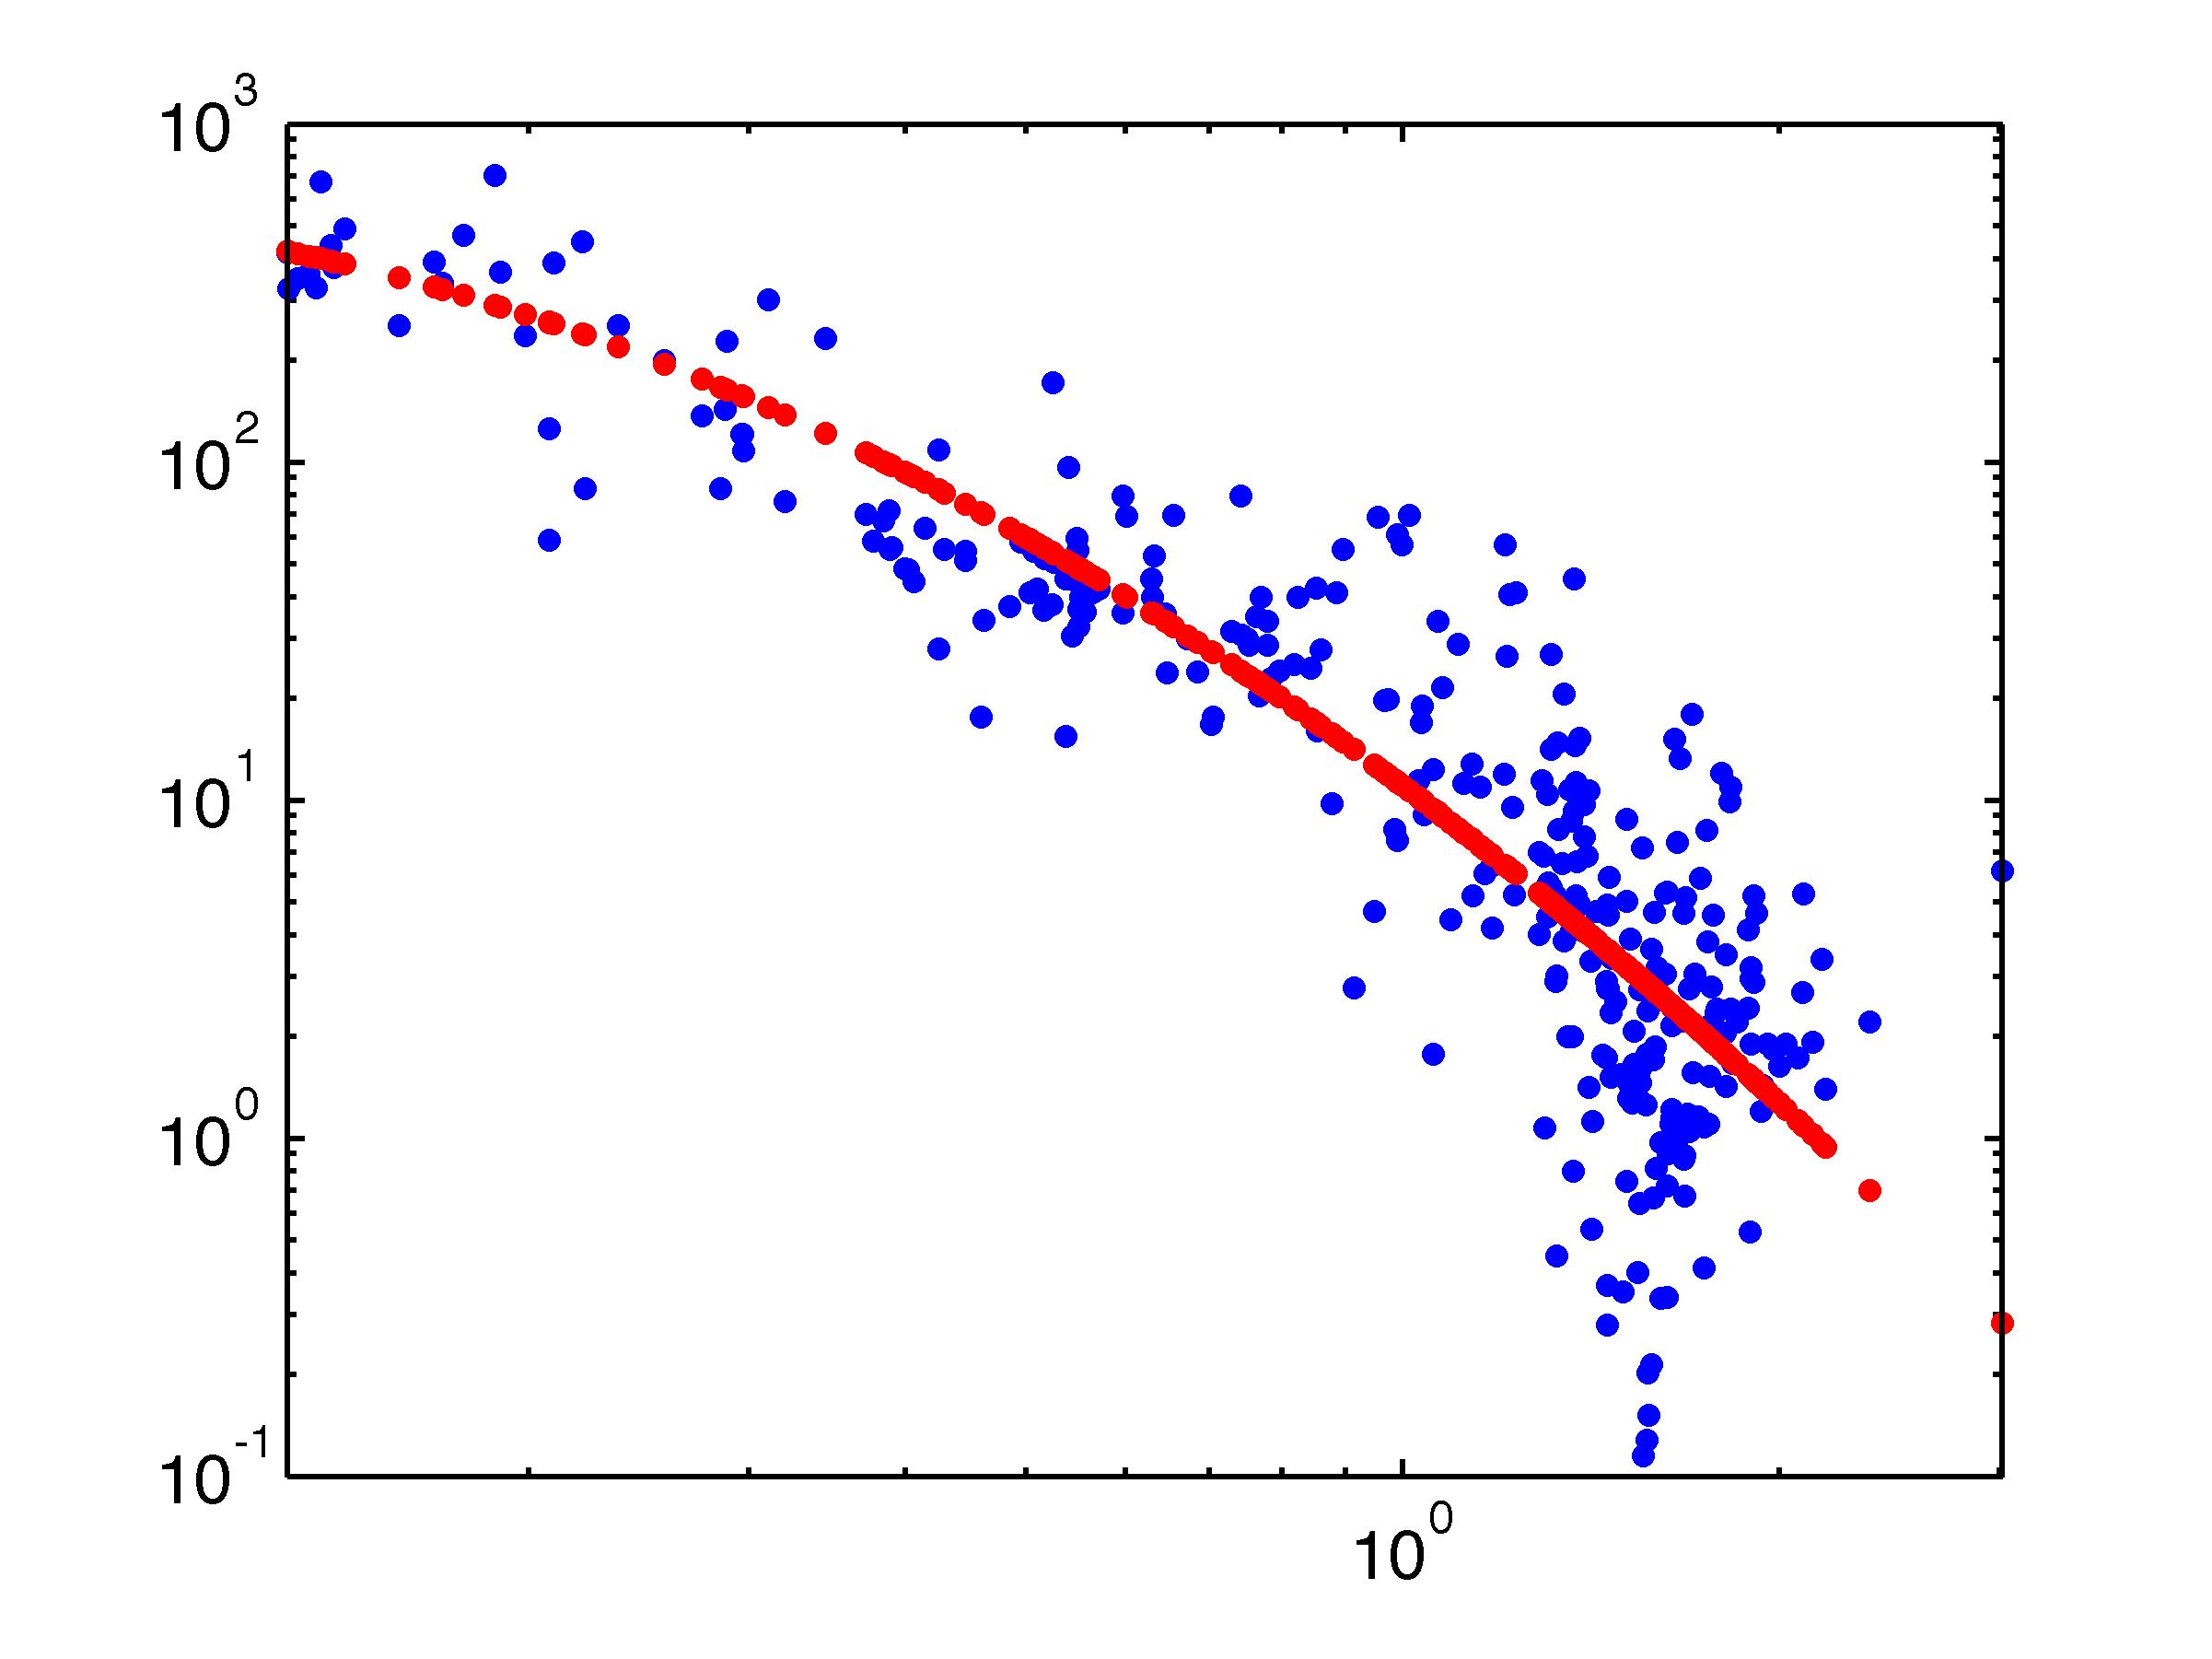
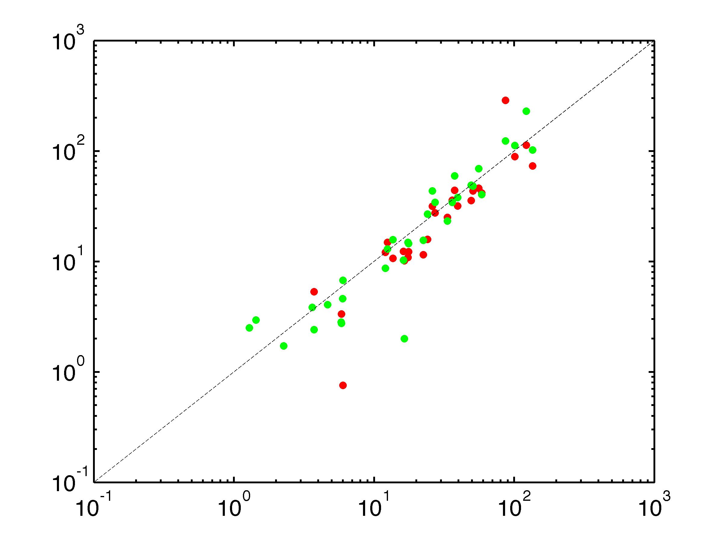
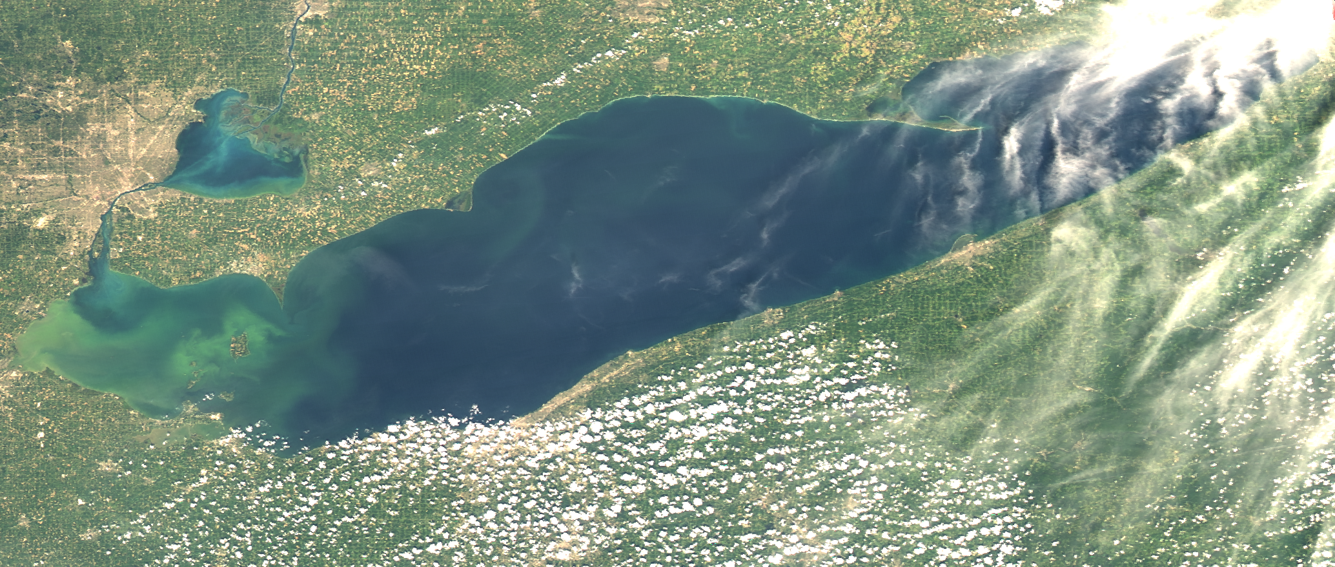
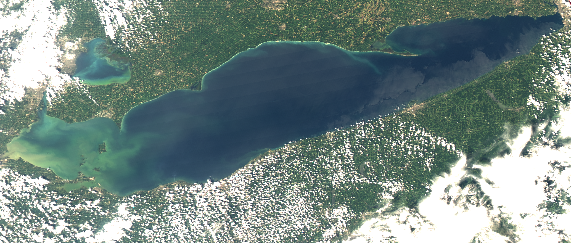
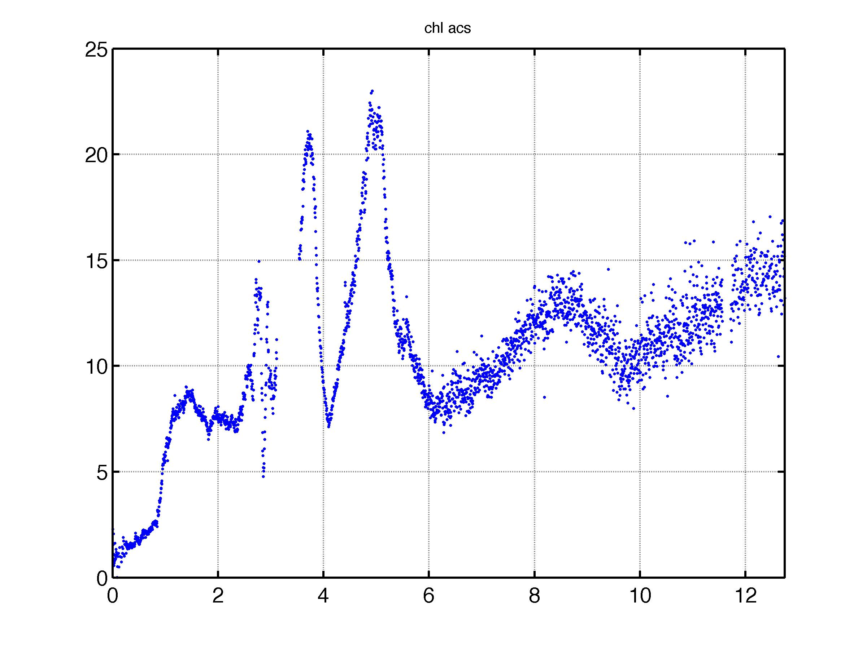
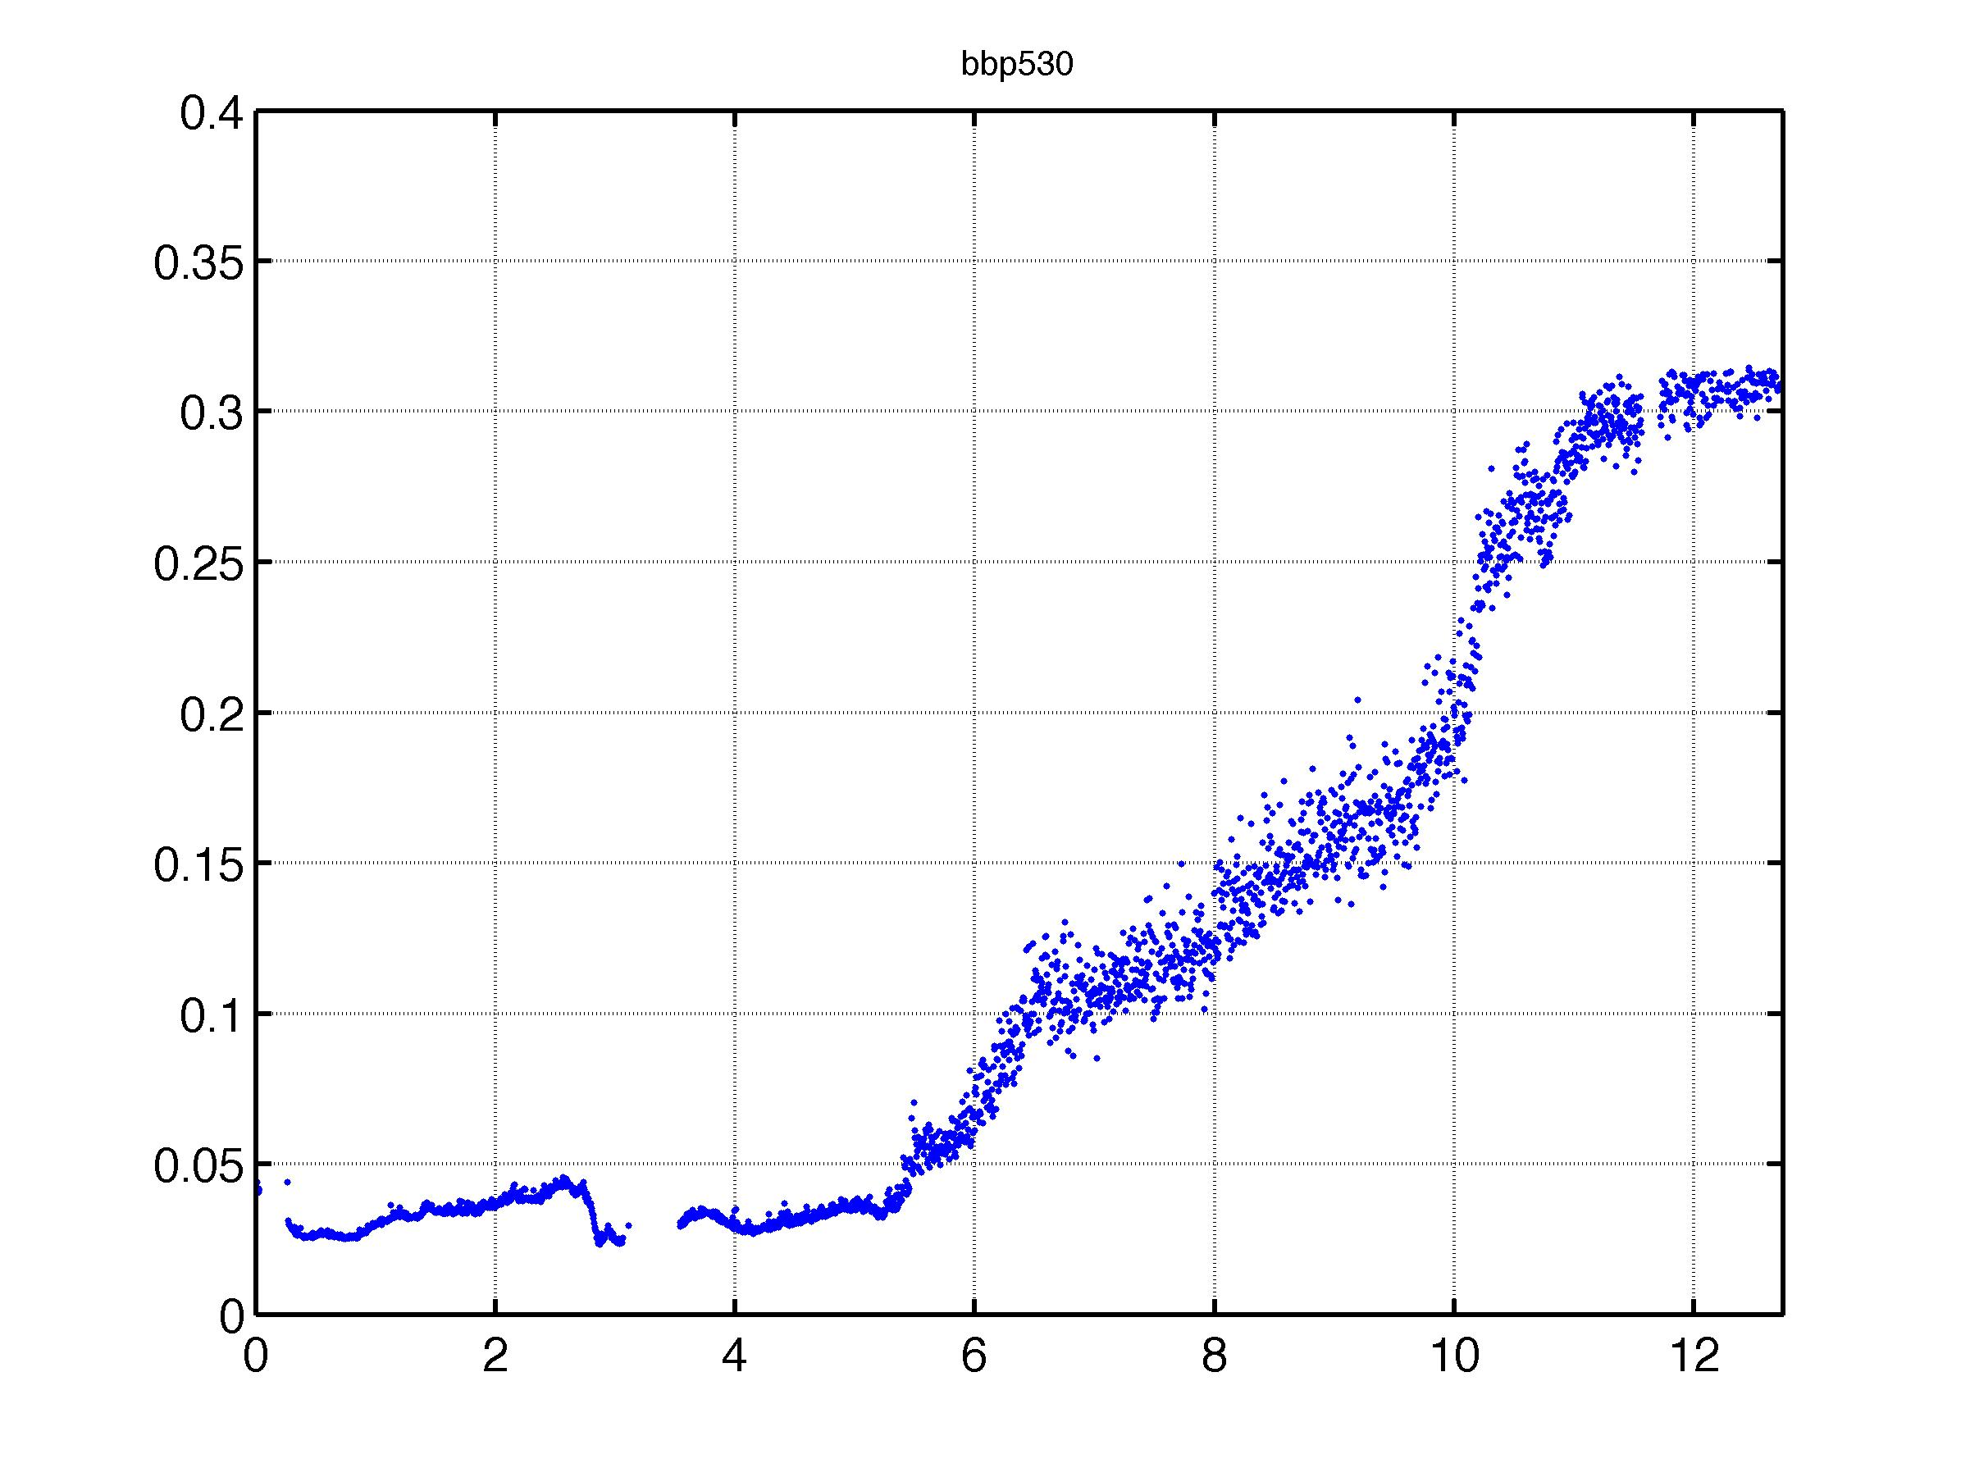
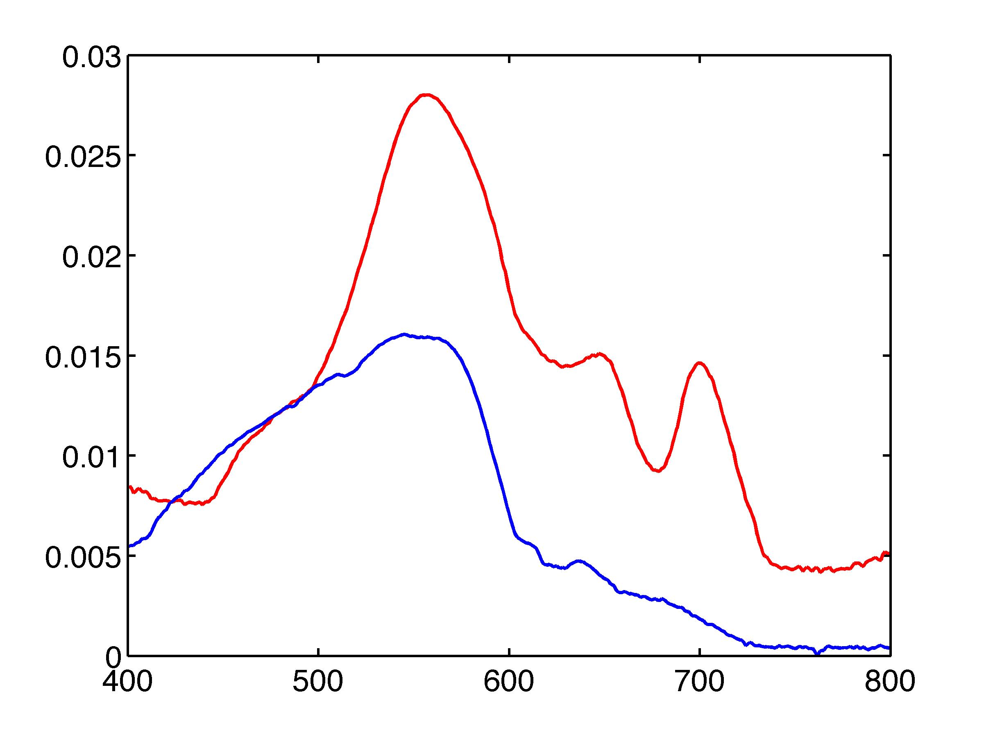
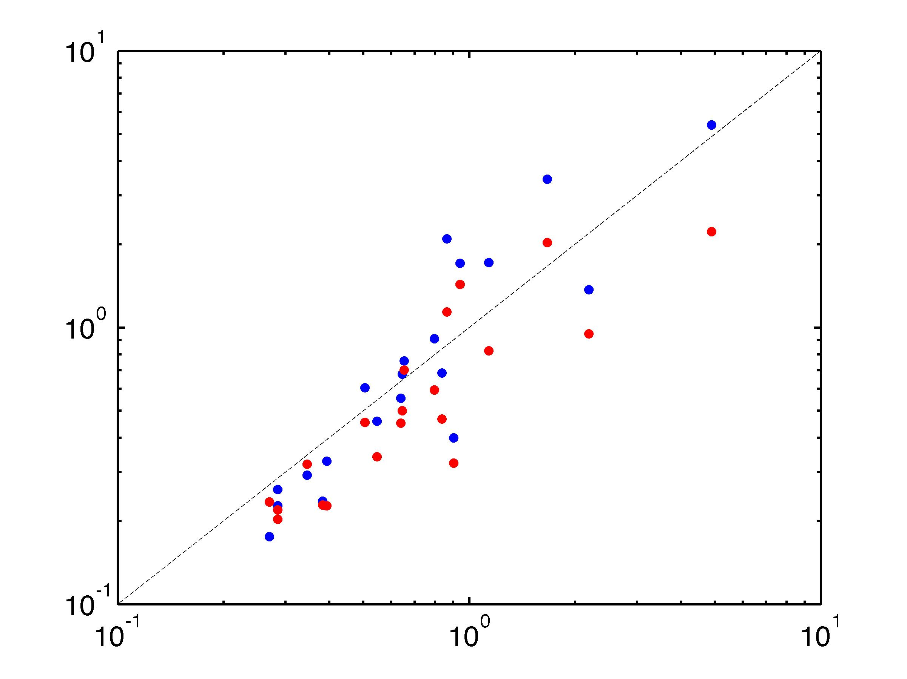
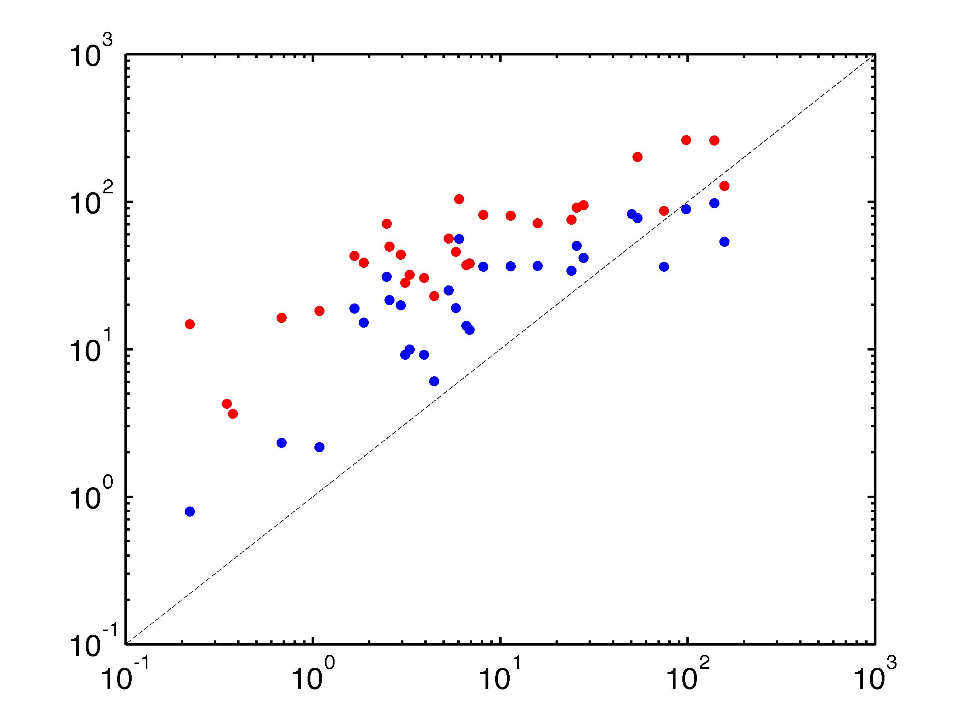
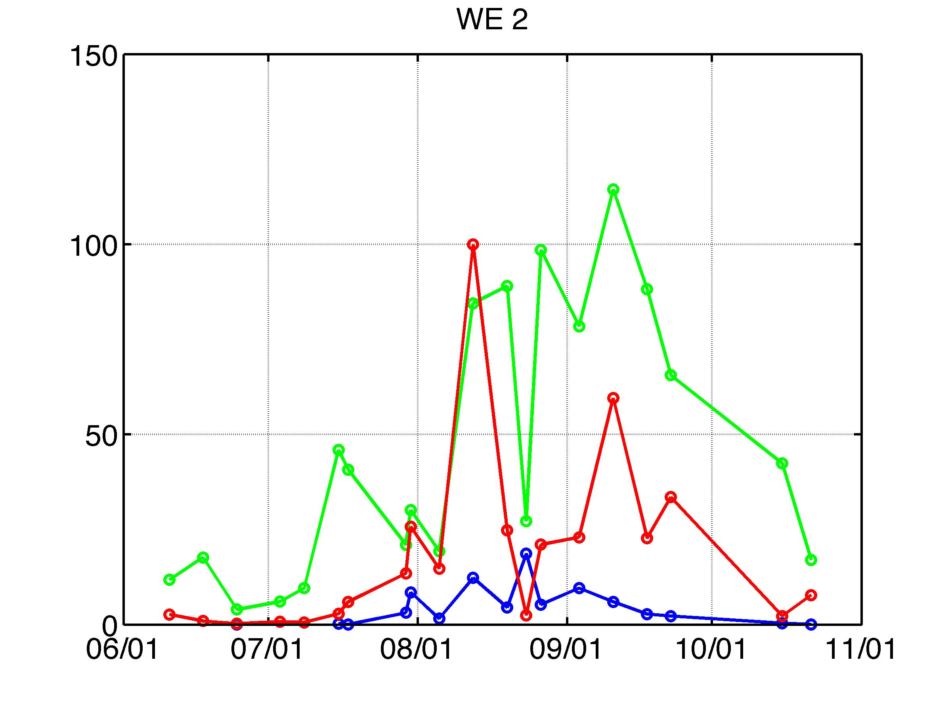
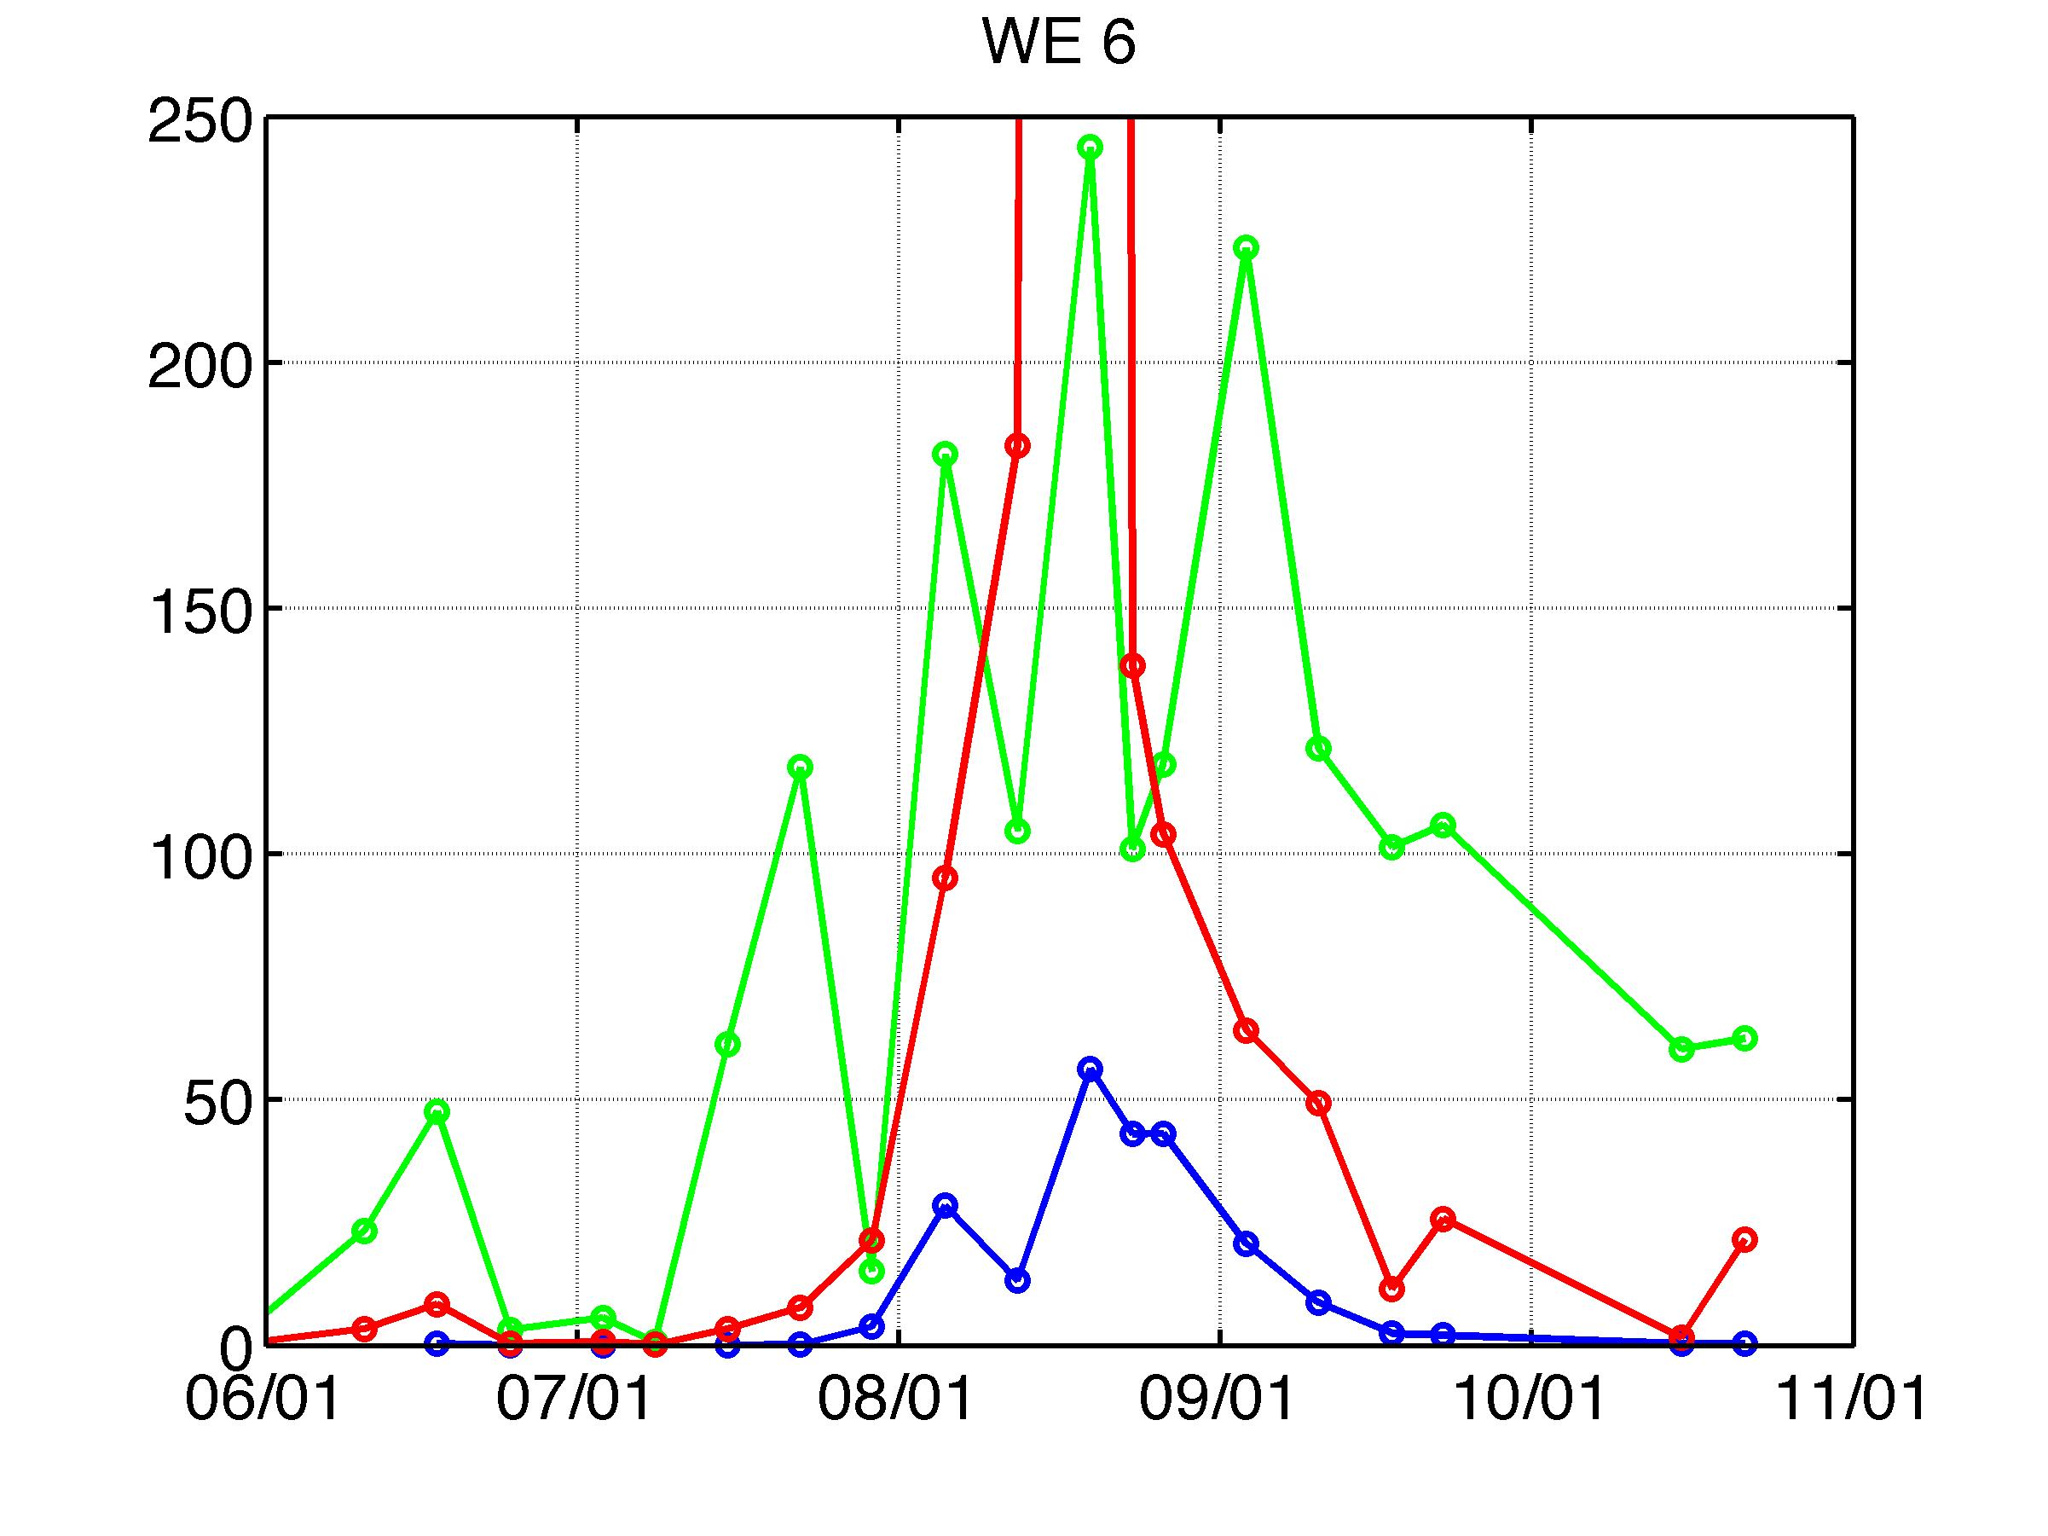
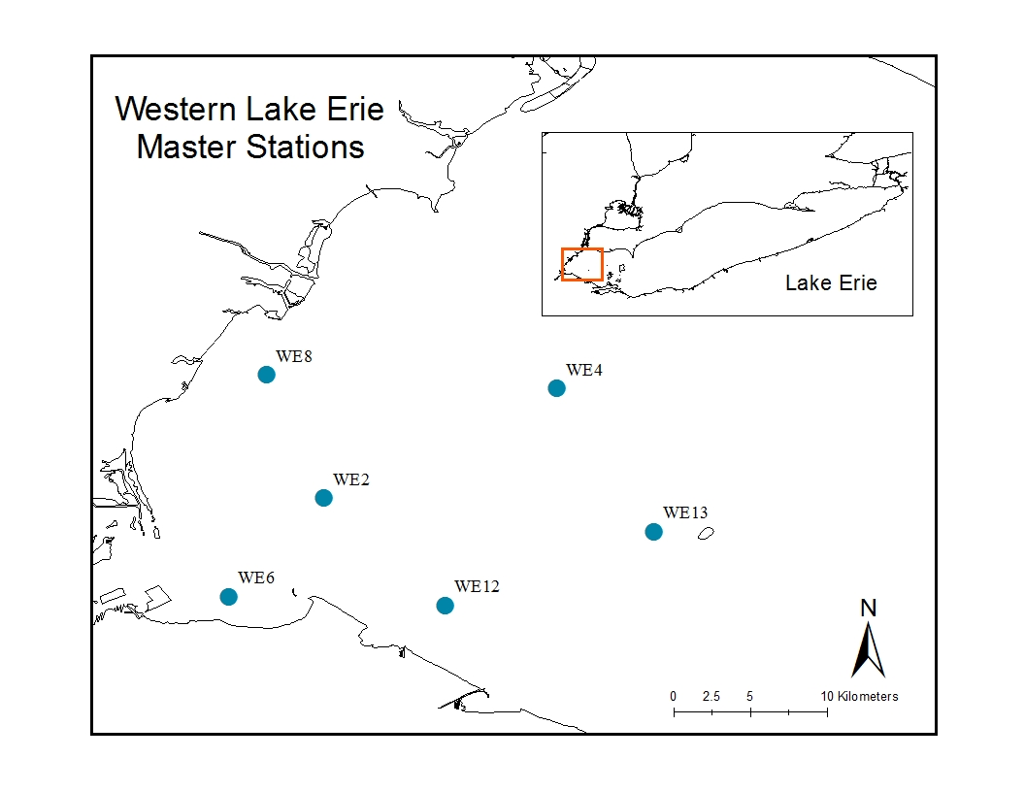
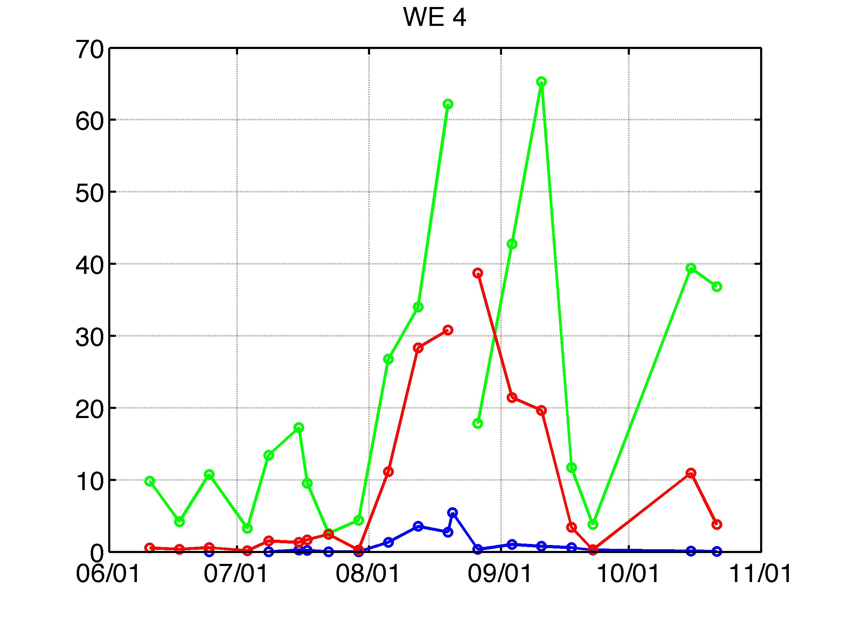
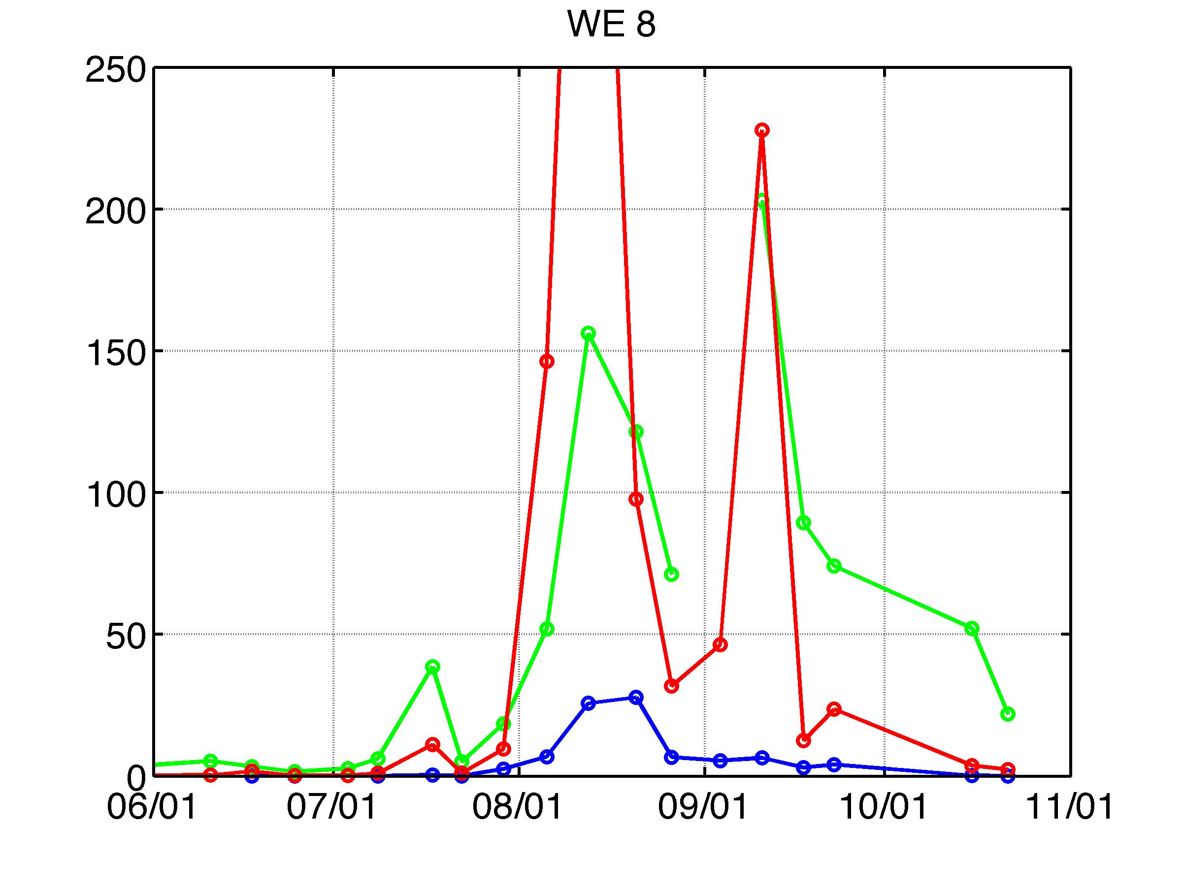
Optical characteristics of harmful algal blooms in western Lake Erie:
impacts on bio-optical algorithms and ocean color remote sensing
Timothy Moore¹, Colleen Mouw², James Sullivan³, Mike Twardowski³, Steve Ruberg⁴ and Tom Johengen⁵
1 - Ocean Process Analysis Laboratory, University of New Hampshire, Durham, NH
2 - Dept. of Geological & Mining Engineering & Sciences, Michigan Technological University, MI
3 – Western Environmental Technologies Labs, Narragansett, RI; 4 – NOAA, Great Lakes Environment Research Laboratory, Ann Arbor, MI
5 - Cooperative Institute for Limnology and Ecosystems Research, Univ. of Michigan, Ann Arbor, MI
contact: timothy.moore@unh.edu
Background
Harmful algal blooms (HABs) have been increasing in intensity and duration in western Lake Erie in the last 10 years, adversely impacting water quality for the region. These blooms typically initiate in July near Maumee Bay, and can last through September/October. HABs are dominated by the colony-forming cyanobacteria Microcystis but other are often accompanied by other toxic species (Planktothrix, Anabaena).
The use of ocean color remote sensing for the detection and quantification of these HABs is subject to a number of special considerations. Microcystis can form long, clustered colony chains. They also contain gas vacuoles which help regulate vertical position with a tendency to form dense surface mats in low winds. The vacuoles and the vertical distributions of the colonies exert a strong influence on backscattering properties. In the summer of 2013 and 2014, we collected in situ data in western Lake Erie to assess and understand HAB distributions and their optical properties in the context of remote sensing algorithms.
Spatial Backscattering Characteristics
Impacts on Bio-optical algorithms
Surface Dolphin tow (with WET Labs ACS, bb9, phycocyanin (PC) and Chl fluorometers) was made from clear Detroit River water across front and into Microcystis HAB patch (Figure 1, from position A to B).
Microcystis dominated waters show much higher levels of backscattering and backscattering ratio compared to non-bloom waters (Figure 2).
Backscattering ratio was 3-5 times higher in Microcystis patch compared to Detroit River water.
Total scattering increased significantly at frontal boundary where a Chl maximum was encountered, but without a major increase in backscattering and PC indicating another algal type accumulating at front.
Impacts on Rrs are most pronounced from ~530 to 800 nm, with very little change from 400 to ~530nm.
Microcystis waters show high peaks at 550 and 709 nm, and troughs at 620 and 680nm. These features are important to bio-optical algorithms.
Traditional OCX algorithms underestimate Chl in eutrhophic waters when Chl > 10 mg/m3 (Figure 4).
The MERIS 3-band Chl algorithm (Gitelson et al., 2011) works well above 10 mg/m3.
Below 10 mg/m3, the MERIS 3-band algorithm can produce negative Chl values.
A modification of the MERIS 3-band algorithm, using curvature or derivative principles, shows improved performance overall and does not produce negative Chl (Figure 4).
Phycocyanin – an indicator pigment of cyanobacteria – can be retrieved from Rrs.
A new PC algorithm of Mishra et al. (2013) was applied, which uses output from a modified version of QAA adapted to eutrophic waters incorporating Rrs data from 620 and 709nm (Figure 5).
Eutrophic QAA has slight improved retrievals compared to oceanic QAA for total absorption (in situ absorption components not yet ready from our field data).
The Simis et al (2005) PC algorithm shows the better performance (Figure 5), although both the Simis and Mishra algorithms should improve with regional tuning.
B
A
Chla
Chla curvature
Chla
PC
bp530
bbp/bp (530nm)
Meris 3-band RMS=0.25
Meris 3-band RMS=0.25
OC4 RMS=0.50
Curvature RMS=0.22
ppb
m⁻¹
modeled Chla ug/L
in situ Chla ug/L
modeled Chla ug/L
Aug. 19-22, 2013
Aug. 20-23, 2013
Field survey
Aug. 18-21, 2014
X = Rrs681²/(Rrs664 * Rrs709)
Chl
bbp530
A
Distance (km)
B
Chl = 10-1.1280 *log10(X)^2 -2.7796 *log10(X) +1.0422
Detroit
River
Rrs
in situ Chla ug/L
X
in situ Chla ug/L
Detroit
River
A (Detroit R.)
Figure 4. Chlorophyll algorithm performance based on the 2013/2014 data set. Left: Modeled OC4 Chl (blue) shows systematic low retrievals, while MERIS 3-band (red) Chl algorithm performs better at higher ranges (but returned negative Chl at levels < 10 ug/L). Middle: Development of an alternative 3-band Chl algorithm based on curvature (manuscript in prep) using a separate lake data set (Moore et al, 2014). Right: Curvature algorithm outperforms MERIS 3-band, and captures lower Chl range.
Maumee
Bay
Maumee
Bay
ug/L
m⁻¹
sr⁻¹
B (Bloom)
Islands
Islands
total absorption at 443nm
Phycocyanin
A
Distance (km)
B
A
Distance (km)
B
Wavelength (nm)
QAA v5 RMS=0.20
Aug. 23, 2013 Modis-Aqua
Aug. 17, 2014 Modis-Aqua
Figure 2. Dolphin transect data from 2013 across a gradient from clear, non-HAB water (position A) into a HAB patch in western Lake Erie (position B) (See Figure 1). Phycocyanin, scattering, backscattering and backscattering radio increase dramatically across the front. Lower Right: Rrs spectra from Detroit River (blue) at beginning of Dolphin tow and in bloom patch near end of Dolphin tow (red) show the impacts of the IOPs on Rrs spectra.
QAA Mishra RMS=0.16
Figure 1. Map of western Lake Erie data collection sites. Top Left: Station locations in 2013 (Dolphin tows solid lines, LOBO black square); Bottom Left: MODIS-Aqua True color from Aug. 23, 2013; Top Right: station locations for 2014; Bottom Right: MODIS-Aqua True color from Aug. 17, 2014. Modis images from Chuanmin Hu’s website (http://optics.marine.usf.edu/).
Modeled (QAA) m⁻¹
modeled PC ug/L
Mishra RMS=0.96
Data Collection
Field data were collected during 2 cruises from Aug. 19-22, 2013 and Aug. 18-21, 2014 in western Lake Erie at 16 and 20 stations respectively during the peak HAB period (Figure 1). Station locations were chosen to maximize environmental gradient in and out of bloom patches, and included Detroit River water, Maumee Bay, and island region (summarized in Table 1).
Data measurements encompassed:
Discrete water sample analysis included chlorophyll, phycocyanin, microcystin and nutrient concentrations, CDOM, and particulate absorption measurements.
Above-water Reflectance (Rrs) were measured with a hand-held ASD (courtesy of H. Dierssen).
A WET Labs MASCOT vertical profiling system measured absorption, scattering, backscattering, fluorescence, volume scattering and particle size.
A WET Labs towed Dolphin package at surface, measuring Chl, PC and CDOM fluorescence, absorption, scattering and backscattering (2013 only).
A profiling WET Labs Holocam, measuring particle size, shape and orientation as well as digital imagery (2014 only).
A Satlantic/WET Labs Land/Ocean Biogeochemical Observatory (LOBO) buoy deployed in western Lake Erie from June through October, 2013 & 2014 (http://algae.loboviz.com/.
Temporal Biological Characteristics
Simis RMS=0.60
Development of high biomass blooms typically begin in July (Figure 3).
Pre-bloom chlorophyll levels can range from 1 to 30 ug/L, while phycocyanin levels rarely rise above 1ug/L.
Basin-wide bloom events are reflected in high biomass (typically higher than 10 and into the 100’s ug/L chlorophyll a) and phycocyanin levels (which can match or exceed Chl levels).
The concentration levels can vary as a function of vertical distribution, significantly impacted by wind conditions and bloom stage, with a direct impact on optical conditions.
The result is a wide range in chlorophyll and IOP levels across space (Figure 2) and time (Figure 3).
Appropriate bio-optical algorithms (and satellite applications) are needed to accommodate this large range in conditions.
Chlorophyll and PC algorithms are both needed to observe environmental change and to identify eutrophic HAB events from eutrophic non-HAB events.
in situ (AC9) m⁻¹
in situ PC ug/L
Figure 5. Left: Application of adapted QAA to eutrophic waters to retrieve absorption at 620/709 bands, needed for PC algorithms. Eutrophic QAA total absorption shows slight improvement over QAA v5 at 443nm (similar at other bands). Right: PC retrievals for Simis et al (2005), and Mishra et al (2013) using QAA phytoplankton absorption products at 620 and 709nm.
Summary
Western Lake Erie experiences a wide range of chlorophyll concentrations, including eutrophic summertime conditions dominated by Microcystis blooms.
High backscattering properties of Microcystis blooms impact Rrs in the green/red/NIR region (between 550 and 800 nm).
The wide range requires algorithms that can accurately retrieve in moderate and high chlorophyll concentration, for which the blending approach of Moore et al (2014) is suited.
The MERIS 3-band chlorophyll algorithm performs very well with Microcystis blooms across a large range of chlorophyll concentrations beginning around 10 mg/m3.
A new chlorophyll algorithm adapted from the MERIS 3-band algorithm, based on curvature principles, has advantages in 1) avoiding negative retrievals and 2) producing the lowest RMS compared to the other chlorophyll algorithms.
Phycocyanin retrievals can help distinguish HAB from non-HAB high chlorophyll events. The Simis et al (2005) and Mishra et al (2013) show good potential for PC retrieval from Rrs in western Lake Erie.
ug/L
ug/L
Table 1. Data set sources and station distribution for analysis. All station data contained hyperspectral above-water reflectance and chlorophyll measurements.
Region | Depth | Plankton | Optical description | Secchi Depth (m)
Maumee Bay | 3-5m | Microcystis | shallow, turbid HAB region | <0.5
Detroit River | 4-8m | Sparse | clear, no HAB | 3+
Islands West | 7-8m | Microcystis | HAB | 1-2
Islands East | 7-8m | Planktothrix | HAB | 2+
Maumee
Bay
References
Gitelson, A.A., Gurlin, D., Moses, W.J. and Yacobi, Y.Z. (2011). Remote estimation of chlorophyll-a concentration in inland, estuarine and coastal waters, in Advances in Envirnmental Remote Sensing, ed. Q. Weng, CRC Press.
Mishra, S., Mishra, D.R.,Lee, Z. and Tucker, C.S (2013). Quantifying cyanobacterial phycocyanin concentration in turbid productive waters: a quasi-analyitcal approach, Rem. Sens.Env., 133, 141-151.
Mishra, S., Mishra, D.R. and Lee, Z. (2014). Bio-optical inversion in highly turbid and cyanobacteria-dominated waters, IEEE Trans. Geoscie. Remote Sens., 52(1), 375-388.
Moore, T.S., M.D. Dowell, S. Bradt and A. Ruiz-Verdu. (2014). A framework for selecting and blending ocean color products in coastal zones and lakes.” Rem. Sens. Env., 143, 97-111.
Simis, S.G.H., Peters, S.W.M. and Gons, H.J. (2005). Remote sensing of the cyanobacterial pigment phycocyanin in turbid inland water. Limnol. Oceanogr., 50, 237-245.
ug/L
ug/L
Figure 3. Time series of Chl, PC and microcystin concentrations from NOAA weekly stations in 2013. Chlorophyll ranged from 1 to over 200 mg/m3 (typical summer/fall progression). Data courtesy of NOAA/GLERL.
Acknowledgment: This work is funded by NIH/NSF Grant R01 ES021929-02.

