Slide 1
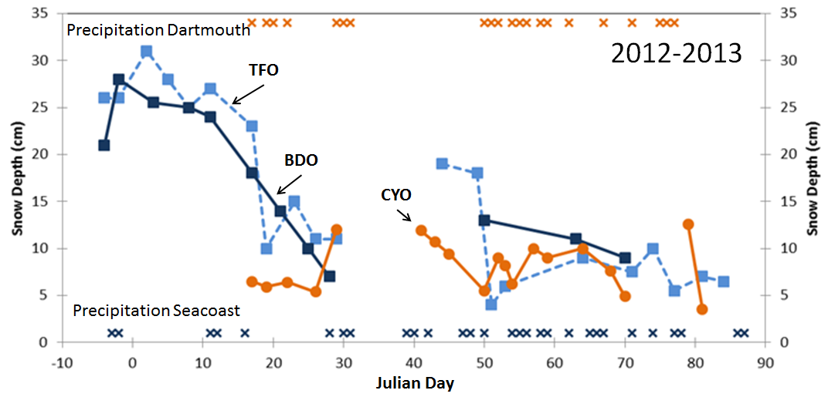
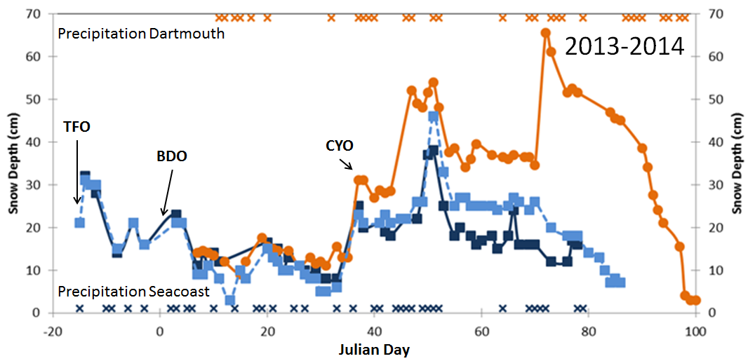
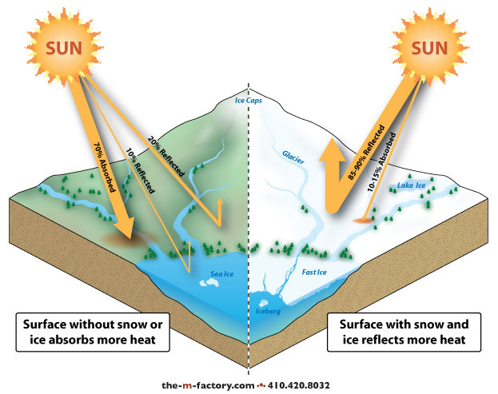
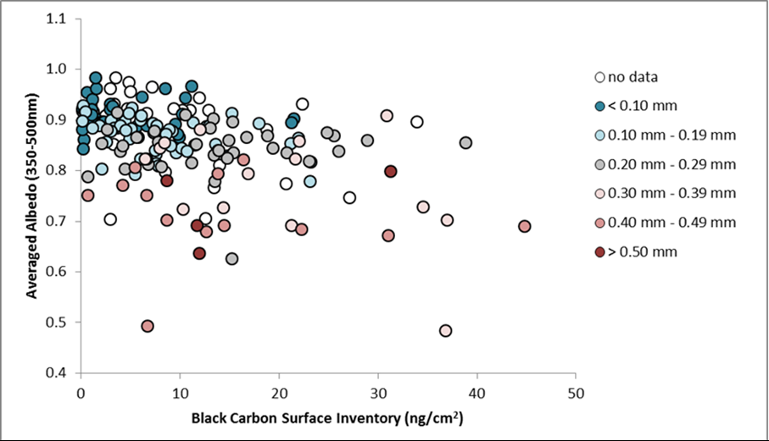
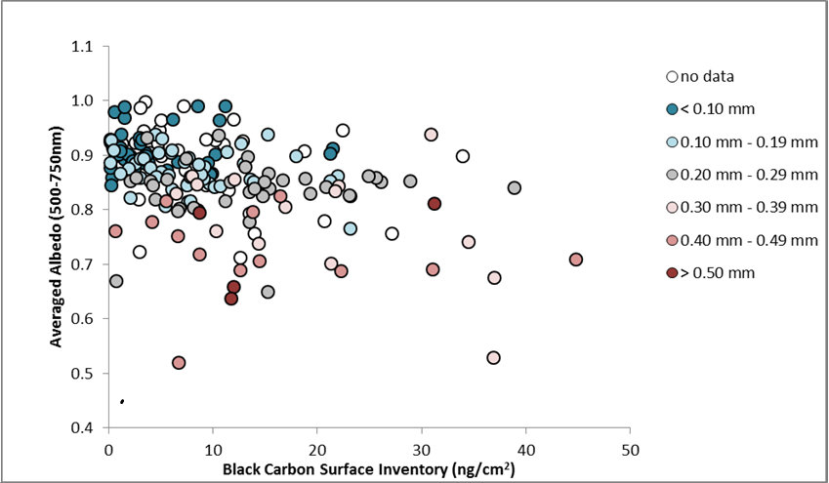
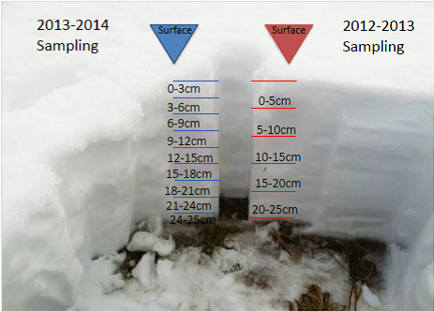
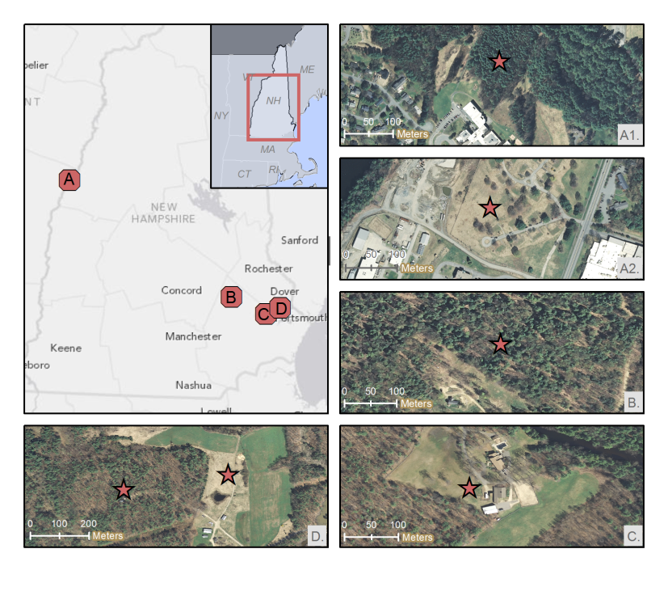
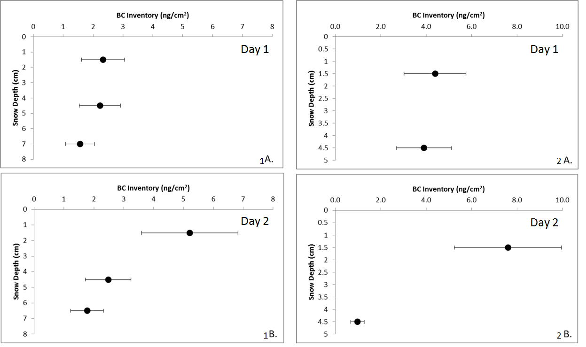
Snow Group: Recent findings and future direction
James Lazarcik ^{1, 2}, Jacqueline Amante ^{1, 2}, Alden Adolph³,
Mary Albert³, Jack Dibb ^{1, 2}, Cameron Wake ^{1, 2}
¹ Department of Earth Science , University of New Hampshire, Durham, NH, USA
²Institute for the Study of Earth, Oceans and Space, University of New Hampshire, Durham, NH, USA
³Thayer School of Engineering, Dartmouth College, Hanover, NH, USA
Rationale:
Snow albedo is an important climate control (Figure 1)
Snowpack acts as a dynamic reservoir for atmospheric pollutants
Results:
Ongoing work:
Continue observations to better understand processes controlling the albedo of NH’s snowpack and changes of albedo over time.
Quantify small-scale spatial variability of snow characteristics at all sites
Pair HYSPLIT back-trajectory modeling with physical and chemical properties of seasonal snow to determine source region(s) of each storm – see Alden Adolph’s poster
Figure 4: A detailed plot of snow depth vs. time for each of the three open sites. Large differences in snow cover were observed. In 2012-2013, there was a longer period of snow cover and more snow in the seacoast region, whereas in 2013-2014, the upper valley had deeper snow and a three week longer season.
From CoCoRaHS website
Additional Questions:
Can solute movement be characterized through other components of the system (soils, headwater streams, and rivers)?
What are thresholds for solute movement throughout the winter?
Figure 1: A cartoon illustrating the effect that snow albedo has on energy balance.
Methods:
Figure 5 : The black carbon inventory of the top sample of every snowpack sampled during both years at open sites is plotted against the averaged albedo values. BC concentrations are not high enough at any site either season to produce an unambiguous reduction of albedo.
Figure 6: Figures 1A and 1B depict an increase of double the BC inventory over a period where air temperatures did not allow for melting, possibly due to BC dry deposition. Figures 2A and 2B depict an increase in BC inventory at the top of the snowpack during a melt of 2% SWE loss. A SWE loss of >40% led to a rapid flushing of all solutes from the snowpack
References:
1. Amante, Jacqueline. THE DISTRIBUTION AND MOVEMENT OF BLACK CARBON AND OTHER CHEMICAL IMPURITIES AND THE EFFECTS ON SNOW ALBEDO IN NEW HAMPSHIRE.
M.S. in Earth Sciences Thesis, University of New Hampshire. Submitted: Sept 2014.
2. Amante, Jacqueline, et. al. THE DISTRIBUTION AND MOVEMENT OF BLACK CARBON AND OTHER CHEMICAL IMPURITIES AND THE EFFECTS ON SNOW ALBEDO IN NEW HAMPSHIRE, in prep.
Figure 2 (above left) and Figure 3 (above right): Figure 2 displays the difference in sampling resolution over the course of the first two winters. Figure 3 is a map of the site locations for the two seasons. Canopied sites (A1, D (left), and B) will not be sampled in winter 2014-2015 because the canopy makes albedo measurements unreliable. Site A2 has been relocated to an open field a short distance away. Credit for Figure 3 goes to ESRI/NAIP 2010 (large map) and DeLome/NAVTEQ (insets).
Support for the New Hampshire EPSCoR Program is provided by the National Science Foundation’s Research Infrastructure Improvement Award # EPS 1101-245

