Slide 1


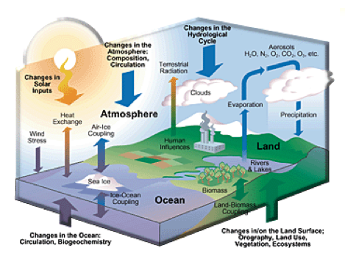

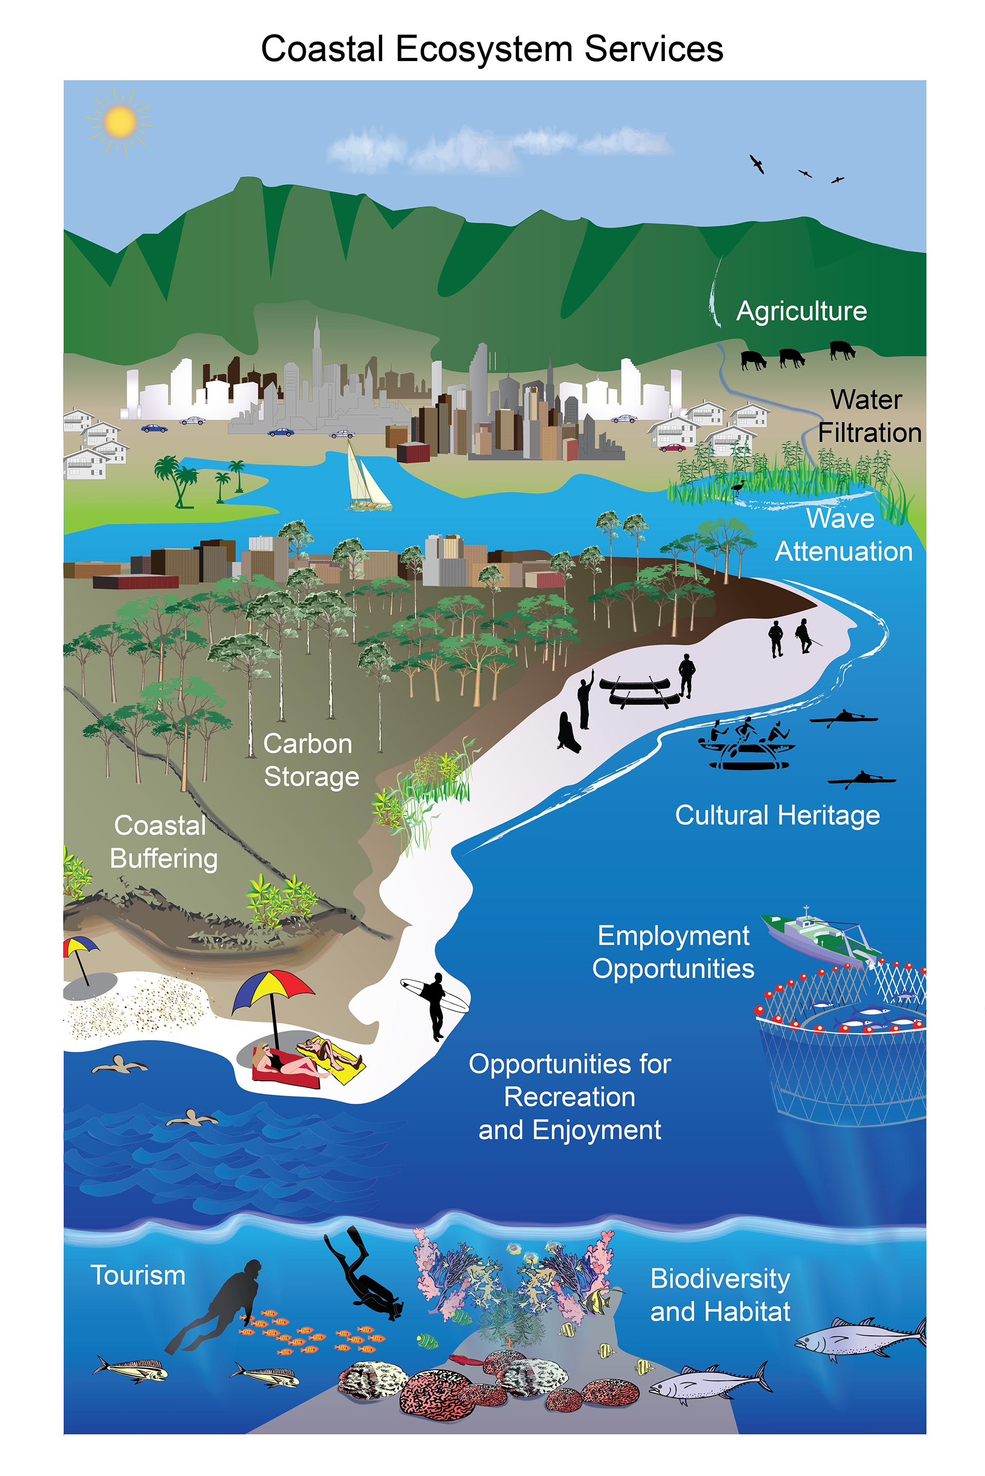
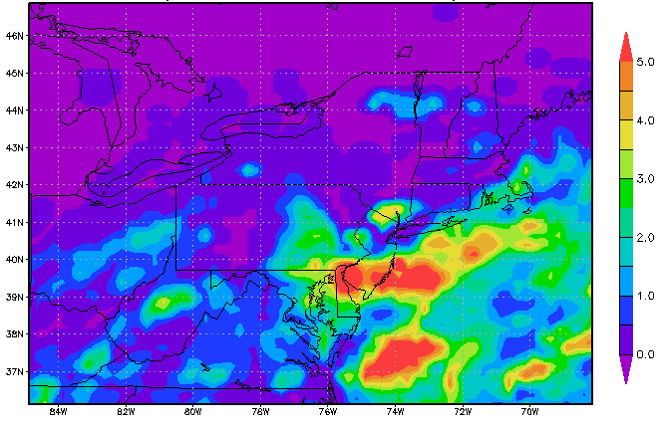
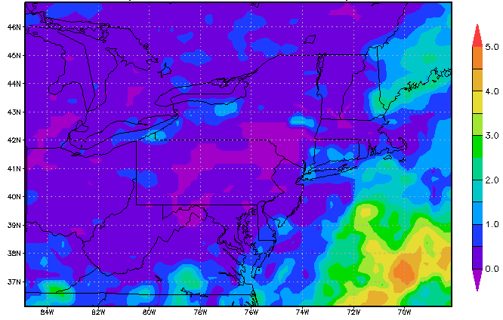
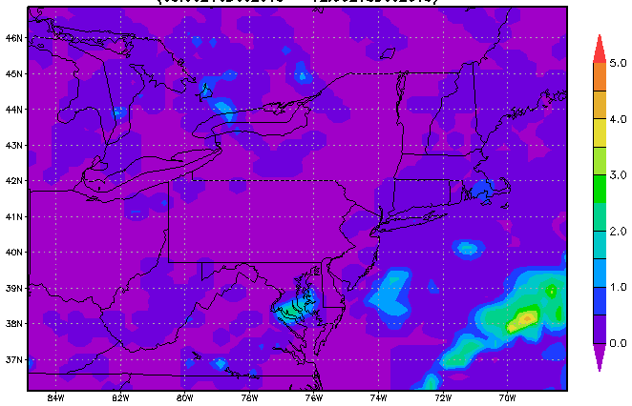
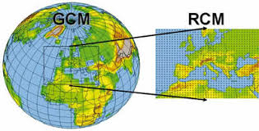
Dynamical Downscaling and Model Calibration for Simulating Regional Climate Change in New Hampshire
Replace w/ Logo
Muge Komurcu, R. Paul Acosta, Jonathan Buzan, Matthew Huber
University of New Hampshire
INTRODUCTION
RESULTS
CLIMATE SYSTEM
ECOSYSTEM SERVICES
Five Daily
Reinitialization
Monthly
Reinitialization
TRMM
Satellite Retrieavals
Accumulated
Total Precipitation
December 7-9 2013
In a changing climate, changes in the components of the climate system will have consequences on ecosystems, ecosystem services and economy.
This study aims to simulate future regional climate of New England o simulate future changes in ecosystems, ecosystem
services and economy.
Accumulated
Total Precipitation
December 13-17 2013
METHODS
To simulate future regional climatolody, we will use
Community Earth System Model future projections using a
High impact emission scenario (RCP8.5) and dynamically
downscale these results using Weather Research and
Forecasting Model (WRF)
Accumulated
Total Precipitation
December 16-18 2013
Global
Model
Regional
Model
CONCLUSIONS & OUTLOOK
First, we perform sensitivity studies for computational efficiency
and model calibration using GFS reanalysis as WRF driver.
Here we present results from model reinitialization test:
Reinitialization of the WRF from CESM every five days versus
Reinitialization of the WRF from CESM every month.
We use 3 nested domains with 297, 9, and 3 km resolution.
Results are shown on the third domain focusing on New England.
Preliminary results show that five-daily reinitialization of the WRF model with CESM produces similar results to
Monthly reinitialization.
The result is significant because more simulations can be run concurrently with a five-daily reinitialization which increases computational efficiency. (considering we will be preforming downscaling simulations for the next century.) This is contrary to similar studies focusing on the Western US, where topography is high.
Tests are being applied for longer time periods to confirm the results.
Tests focusing on model parameterizations (boundary layer, land surface and microphysics) are ongoing.
Contact: Dr. Muge Komurcu : ESRC 366 Morse Hall UNH Email: muge. komurcu@unh.edu

