Slide 1
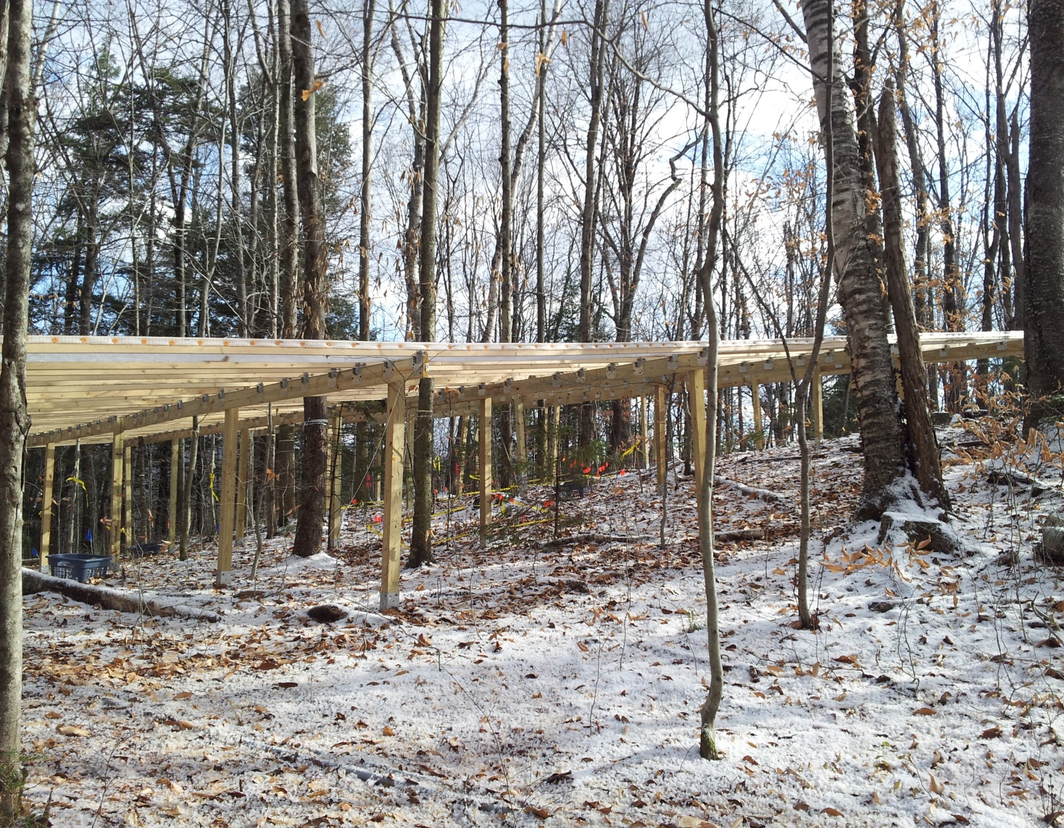
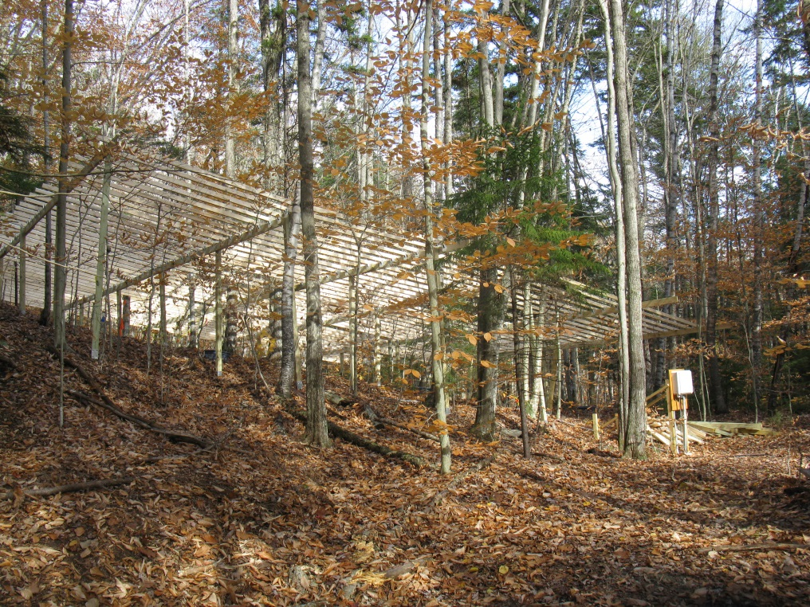
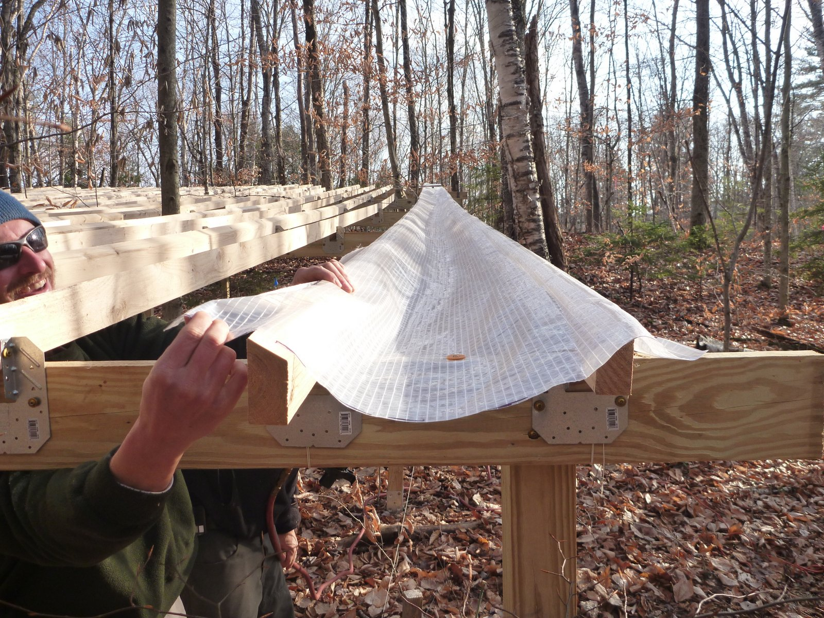
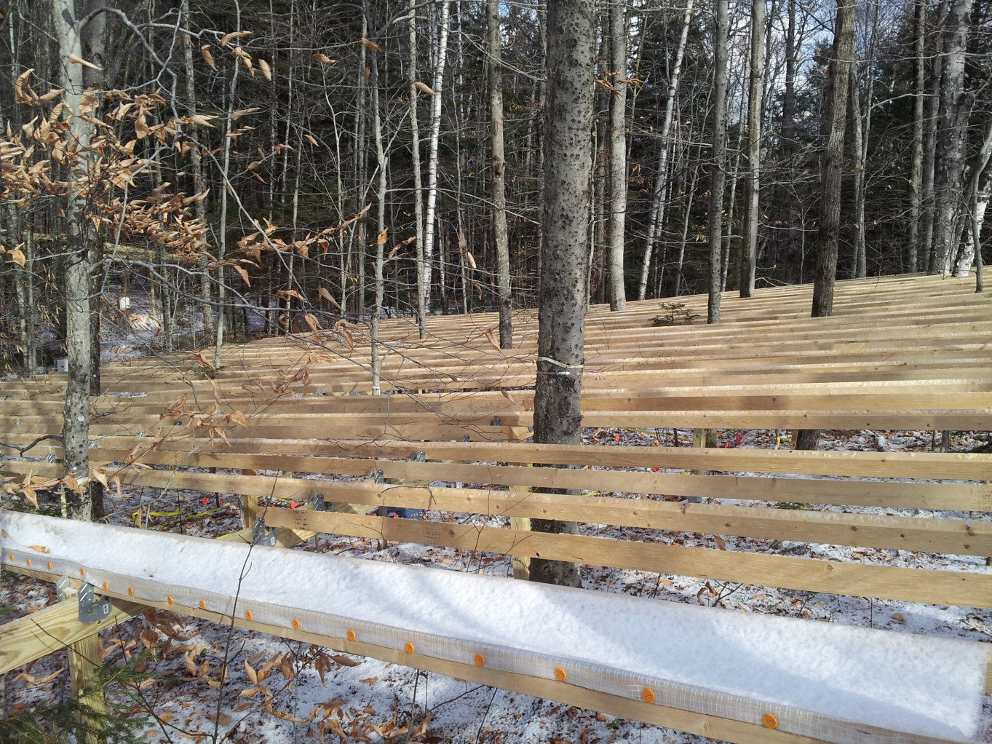
AGU Fall meeting
San Francisco, CA; December 15-19, 2014
Northern Forest DroughtNet: A New Framework to Understand Impacts of Precipitation Change on the Northern Forest Ecosystem
Heidi Asbjornsen¹; Lindsey Rustad²; Pamela H Templer³; Katie Jennings¹; Richard P Phillips⁴, Melinda Smith⁵
¹University of New Hampshire, Durham, NH, USA, ²USDA Forest Service, Northern Research Station, Durham, NH, USA, ³Boston University, Boston, MA, USA, ⁴Indiana University, Bloomington, IN, USA, ⁵Colorado State University, Fort Collins, CO, USA
Presentation #: GC23C-0641
Contact information: heidi.asbjornsen@unh.edu
Background
Barriers to TDEs in Forest Ecosystems
Proposed Forest TDE Protocol: Recommendations & Remaining Gaps
Motivation
Why study drought?
Globally, climate change will alter precipitation regimes and increase the frequency of extreme drought.
In the Northeastern U.S. models forecast more precipitation, but ironically, drier (in the late growing season).
Mesic adapted forest ecosystems may be more sensitive to drought.
Why experimentally induced drought?
Observational studies are limited in their ability to effectively capture climate extremes and tease apart different drivers
Projected drought events will likely be more severe than in the past (i.e., outside the range typically experienced by ecosystems), potentially surpassing physiological thresholds and leading to novel responses.
Resource intensive
Large, complex, and expensive infrastructure
Maintenance needs (labor, materials, funds) continue throughout the experiment
Problematic for under-resented sites (tropics)
Successfully creating “drought” conditions can be difficult
Possible access to water by deep roots and lateral roots
Many forest sites have large water storage capacity
High variability in ambient rainfall; consecutive wet years possible
Need to identify common criteria for stimulating drought
Amount of precipitation to remove – fixed or based on site-specific historical record?
Growing season or annual removal of precipitation
For temperate regions, snow is a major challenge
Lack of a common methodology hampers cross-site comparisons
Site selection recommendations:
Identify sites that are more “drought prone” due to soil texture, soil depth, bedrock, slope, etc.
Consider features that reduce lateral flow, e.g., ridges
Avoid sites with high soil water storage capacity or shallow groundwater
Plot size recommendations:
Large enough to impose drought conditions on a “core” set of trees (excluding the buffer area)
Gaps: Standard criteria for plot size (e.g., multiple of tree height) or site specific? Is there a minimum acceptable size or number of core trees?
Replication recommendations:
N = 2 or greater is ideal; avoid pseudo-replication
Oftentimes a tradeoff between larger plot size and replication (prioritize plot size)
Network of many sites with N = 1 (replication at the site scale)
Gap: increase replication for small-scale measurements (e.g., soil respiration)?
Trenching recommendations:
Avoid trenching if possible (disturbance, labor/equipment intensive, difficult to maintain over time) by making the plot size larger.
Gap: identify site-level criteria to justify not trenching
Infrastructure for TDE recommendations:
Site specific considerations most important (many possible ‘appropriate’ TDE designs)
Validate performance by measuring precipitation removal
Gap: Accounting for artifacts (microsite conditions; disturbance) – an “infrastructure control” is ideal, but usually not possible
Amount of precipitation removal recommendations:
99th percentile of the 100-year precipitation record (either based on local site data or global simulation) over a minimum of three years.
Gap: is this enough?
Timing of precipitation removal recommendations:
remove a fixed amount on an annual basis (including snow in the winter)
Gaps:
Determining an effective method for snow removal that minimizes artifacts (e.g., soil freezing, disturbance).
How to conduct cross-site comparisons when timing differs
Objectives
1) Establish Northern Forest DroughtNet – a network focused on understanding the impacts of changing precipitation regimes on forest ecosystems.
2) Develop a standard methodology for conducting forest throughfall displacement experiments (TDEs), in collaboration with International RCN-DroughtNet.
3) Implement a forest TDE prototype at the Hubbard Brook Experimental Forest (HBEF), NH.
4) Promote and disseminate results to facilitate a network of TDE experiments and cross-site comparison and integration, particularly in the Northeastern region.
Activities this year
Series of 3 webinars - spring 2014
Discussed obstacles for conducting forest throughfall displacement experiments (TDE) – logistically complex and resource intensive.
Informed the design of the prototype built at HBEF
2) Built the TDE prototype structure - fall 2014
Collected pre-treatment data – spring/summer 2014
Precipitation manipulation will begin spring 2015
3) Held Northern Forest DroughtNet Workshop -November, 2014
Fig 2. HBEF TDE prototype wooden frame before plastic sheeting is added to create troughs.
Prototype at HBEF
Goal: Create a resource-efficient forest TDE design that is adaptable to a variety of forest ecosystem and facilitates the future establishment of a regional to global network of forest TDEs.
HBEF-TDE design:
Two 15x15m plots
3m buffer; 12x12m core area
Simple design
Wooden frame secured with metal stakes
Plastic sheeting stapled to frame creates troughs
Removes 50% of growing season precipitation
Total cost (materials and tools) ~ $5,000/plot, or ~$22/m²
Acknowledgements – Funding is provided by Northeastern State Research Cooperative (NSRC), NSF CAREER (DEB 1149929), and NSF (RCN 1354732).
Fig 1. Trough design with plastic sheeting stapled to wooden frame.

