Slide 1
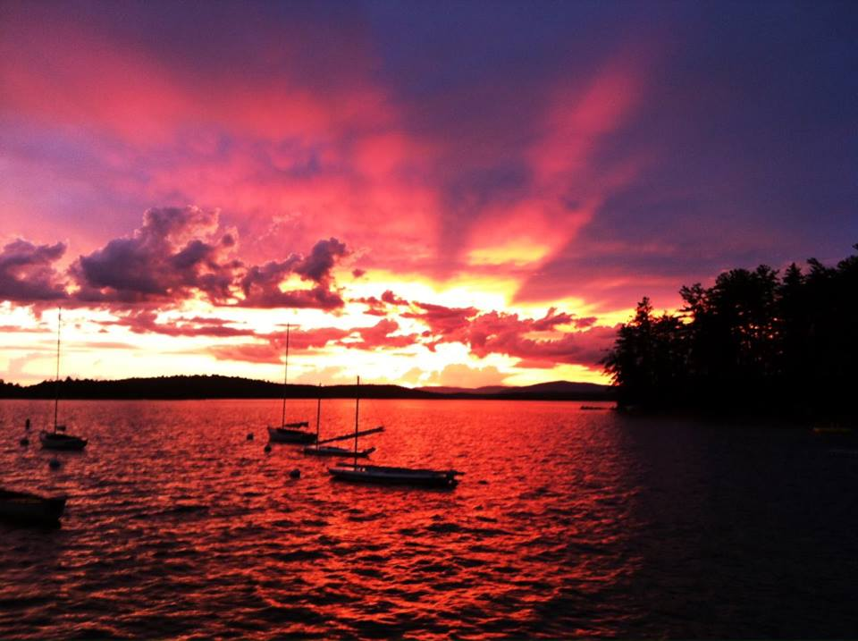
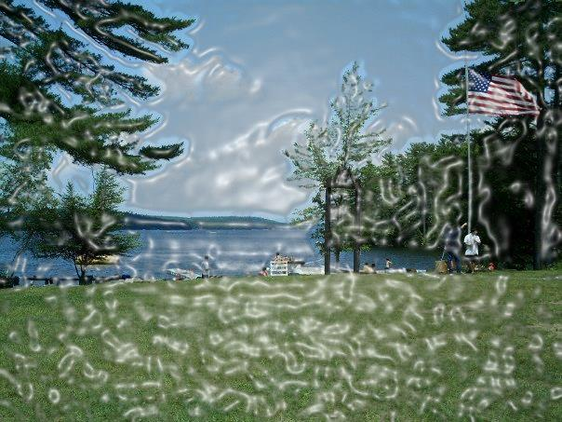
ASSESSING CREATIVITY VIA DIVERGENT THINKING IN RESIDENTIAL CAMP SETTINGS
Myles Lynch, University of New Hampshire
Boyd Hegarty, University of New Hampshire
Nate Trauntvein, University of New Hampshire
Jonathan Plucker, University of Connecticut
INTRODUCTION
The American Camp Association National Board of Directors created a work group to focus on skills learned at camp; one of which is creativity (Sheets, 2013). Camp has long been considered by many camp professionals as an environment that helps to promote creativity among youth (Sheets, 2013). However, there has been very little research completed to either support or refute this long held belief. We do know from prior creativity research that having more choice and opportunities to try different activities enhances creativity and imagination (Amabile & Gitomer, 1984). Camp is generally considered an environment where children have a lot of choice, exposure to varied activities, and time to play in informal settings. Meanwhile, creativity, pretend play, and imagination have been devalued in school, which hinders children’s abilities for self-expression and flexibility of thoughts (Russ, 2014). And research on children’s creativity reflects this. Creativity, specifically divergent thinking, has been on a decline among US children since 1990 (Kim, 2011). This research aims to test long held beliefs by exploring creativity, specifically divergent thinking, as an outcome of residential camp.
METHODS
This study assessed divergent thinking among children who attended residential summer camp over a 2 week time period. A sample of campers (n= 189) between the ages of 8-15 participated in this study (mean age = 11.9). A modified version of Guilford’s Alternate Uses Task was used for both pre-test and post-tests examples of questions asked were: “Name all the uses for a plate” and “Name all the uses for a brick”. Campers took the divergent thinking pre test the first day of camp and the post test was administered on the last full day of camp. Paired t-tests were used to determine differences in means. The responses were matched from the first assessment to the second, and then each assessment was scored based on responses. Scoring was done based on fluency, flexibility, and originality. Campers were also compared on gender and whether they selected artistic or non-artistic activities and if this choice impacted divergent thinking scores. Results indicated on average a significant increase in mean scores for fluency, flexibility, and originality with higher increases among campers who chose to participate in 1 or more artistic activities. On average boys significantly increased in flexibility but not in originality and fluency. Girls significantly increased across all scoring methods.
Results
Descriptive statistics for divergent thinking and activity type
* Participant indicated that they participated in one or more artistic activity or did not.
Variable | Overall: N= 189 Mean (SD) | Male N= 89 Mean (SD) | Female N= 100 Mean (SD)
Divergent Thinking
Fluency Pre Test | 11.640 (5.110) | 10.741 (5.527) | 12.440 (4.588)
Fluency Post Test | 13.547 (6.268) | 11.550 (6.363) | 15.325 (5.642)
Flexibility Pre Test | 4.978 (1.680) | 4.494 (1.626) | 5.410 (1.846)
Flexibility Post Test | 6.425 (1.991) | 5.651 (1.869) | 7.115 (1.846)
Originality Pre Test | 0.815 (0.830) | 0.8034 (0.858) | 0.825(0.808)
Originality Post test | 1.174 (1.361) | 0.989 (1.346) | 1.340 (1.359)
Artistic Activity
Average number of Artistic Activities | 0.979 (0.928) | 0.528 (0.724) | 1.380 (0.908)
Artistic Activity* % (N) | 62.9% (119/189) | 40% (36/89) | 83% (83/100)
IMPLICATIONS
*Camper scores on average significantly increased overall after two weeks.
*There was a large difference in scores when considering gender – Girls increased across all scoring methods
*Activity choice may play an important role in creativity at camp – Campers who self selected artistic activities increased more than those who did not.
*No Artistic activities ‘stood out’ as yielding higher divergent thinking scores.
*Camp could be an environment in which divergent thinking increases – more studies need to be done
2015 Graduate Research Conference, University of New Hampshire

