Slide 1
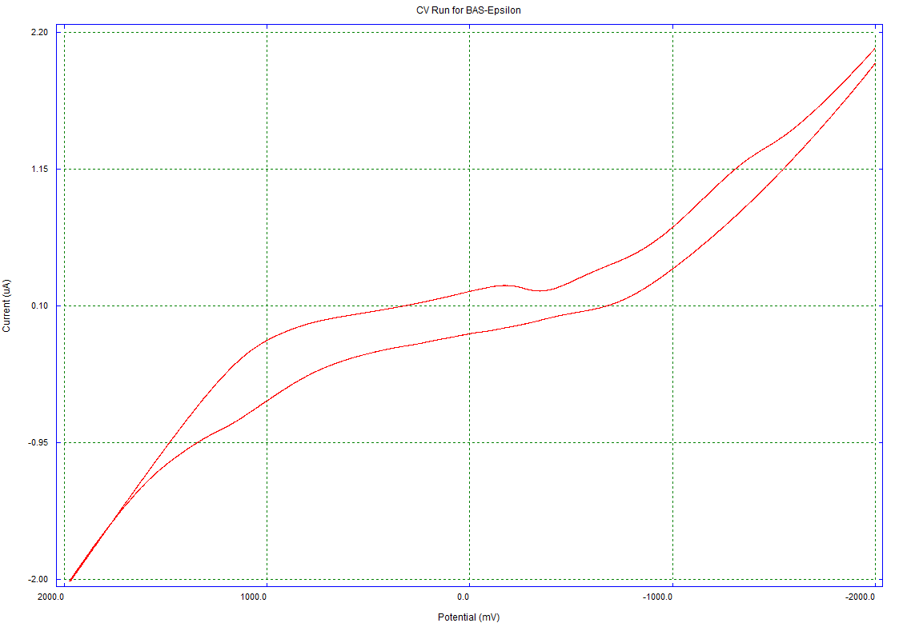
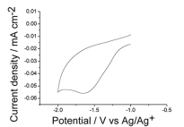
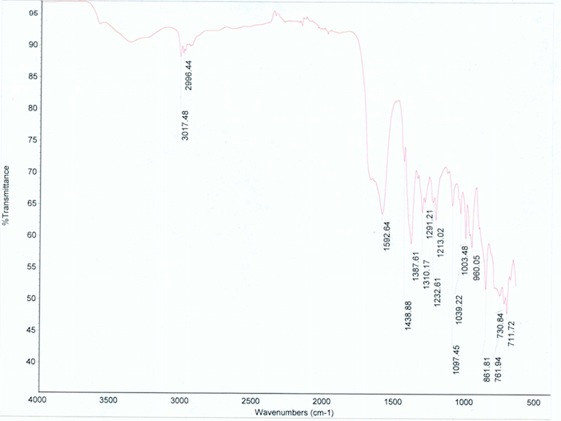
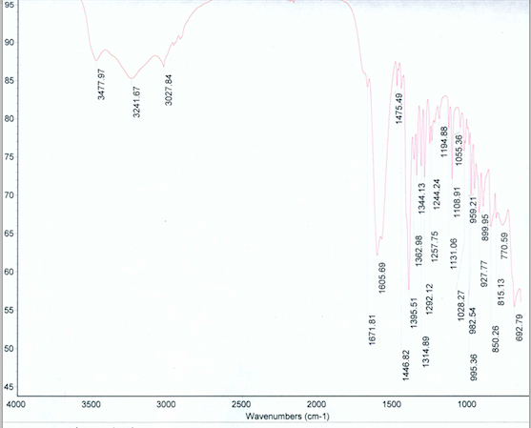
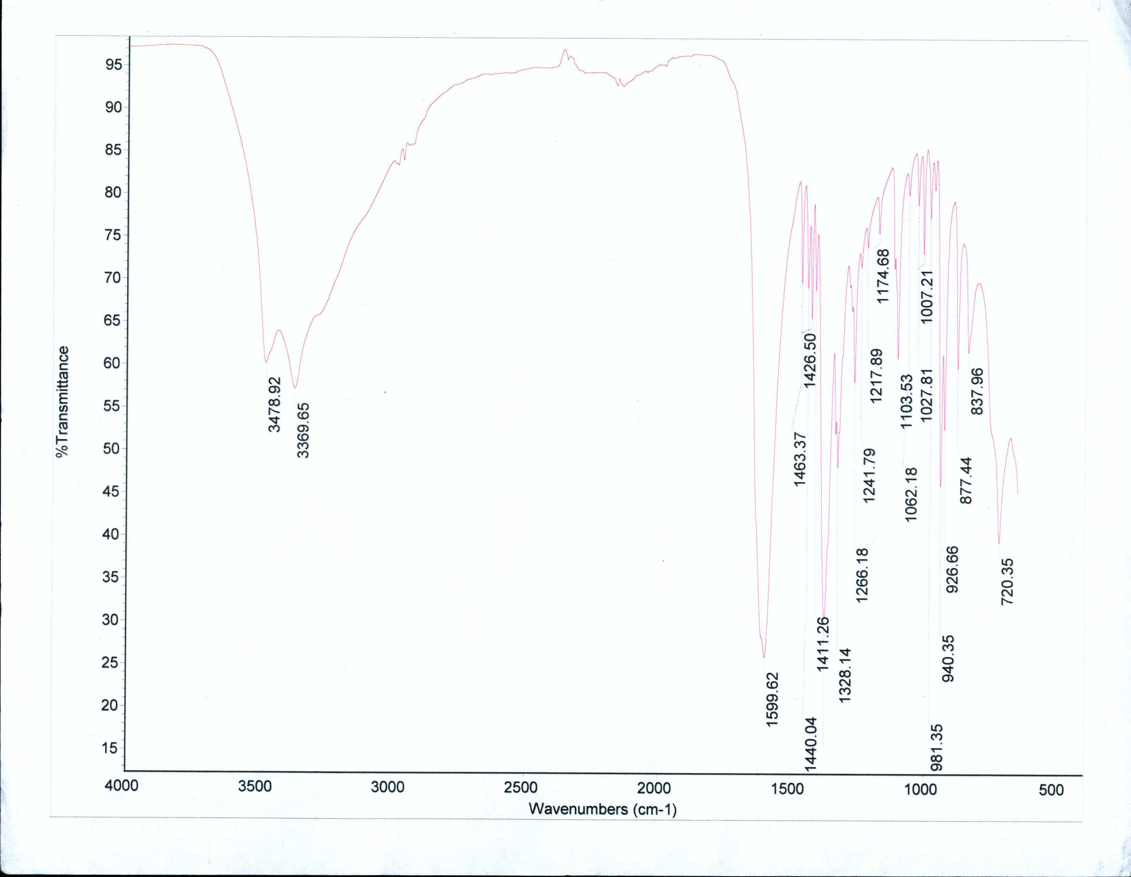
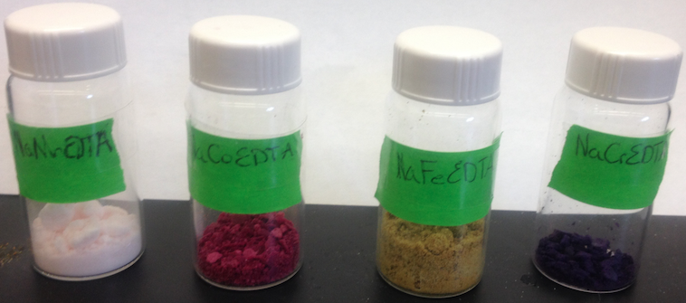
Chromogenic Liquids: Synthesis of [P_{6,6,6,14}]M(EDTA) Complexes using Various 3d-transition Metals
James Chase, Luke Fulton, Dr. Roy Planalp
jwq342@wildcats.unh.edu; Parsons Hall, 23 Academic Way, Durham NH 03824
Introduction
Electrochromic devices alter their color, level of absorbance and level of refraction in a continuous and cyclical manner when a potential is applied.¹ These electrochromic materials are used in smart windows, anti-glare windows, electrochromic mirrors, etc. Electrochromic devices are constructed from three components, of which one is a layer of a chromogenic complex. This experiment attempted to bind the RTIL trihexyltetracecylphosponium chloride [P_{6,6,6,14}]Cl to various EDTA bound 3d transition metal salts. Cyclic Voltammetry was then used to demonstrate the redox gap.²
Experimental and Results
Due to time and resource constraints the RTIL [P_{6,6,6,14}]Cl was only bound to the Co-EDTA Salt and the Mn-EDTA Salt. The RTIL was dissolved in ethanol and the Metal-EDTA Salt was dissolved separately in deionized water. The solutions were combined and allowed to stir under nitrogen. The manganese complex was never extracted from solution, there appeared to be a faint pink immiscible liquid. The cobalt reaction mixture was dried on a Schlenk line. This resulted in a purple sludge. Work-up yielded a viscous light purple oil. Cyclic voltammetry was attended to using a standard three electrode set-up.²
The cyclic voltammetry analysis shows the redox activity of [P_{6,6,6,14}]Co(EDTA) to be intrinsically different than that of the the RTIL. This in conjunction with the expected color change² characterizes the product of the cobalt reaction scheme as the expected product [P_{6,6,6,14}]Co(EDTA).
Figure 4. Cyclic Voltammetry analysis of [P_{6,6,6,14}]Co(EDTA), 50mV/s (versus Ag/AgCl). Inset shows cyclic voltammetry of [P_{6,6,6,14}]Cl in H₂O.³
Future Work
Both the the reaction involving the binding of the RTIL to the Cr-EDTA Salt and the Iron-EDTA Salt would be attempted. The product from the manganese reaction would be isolated. All products including that of the cobalt scheme would be characterized by CV, ¹H NMR, ¹³C NMR, and a time lapse UV/Vis Spectroscopy during electrolysis.
Figure 1. Reaction schemes for the synthesis of [P_{6,6,6,14}]M(EDTA)
Experimental and Results
In equal equivalence disodium ethylenediaminetetraacetato dihyride, 1M NaOH, and the various 3d metal chlorides were refluxed under nitrogen for 1 hour. The resulting Metal-EDTA salts were refrigerated for various periods of time spanning between 1 day to 1 week until precipitate formed. NaFe(EDTA) and NaMn(EDTA) precipitated readily out of solution. Addition of ethanol was used to encourage precipitation of NaCo(EDTA) and NaCr(EDTA). All products were dried. ATR-FTiR spectroscopy was used to characterize all but NaCr(EDTA).²
Figure 5. Depiction of future experiments
Conclusions
The Metal-EDTA Salts of Chromium, Cobalt, Iron, and Manganese were synthesized in 15.7%, 60.5%, 94.7%, and 84.2% yield respectively. [P_{6,6,6,14}]Co(EDTA) was synthesized in 63.7% yield. Completion of future work would allow for meaningful comparison of electrochemical features of the chromogenic complexes.
IR: 3017.48, 2996.44 (OH-enol), 1592.64 (C=O, C=C-enol), 711.12-1438.88 (CH, CN, C-O)
IR: 3027.84-3477.97 (OH-enol), 1671.81 (C=O, C=C-enol), 692.79-1444.64 (CH, CN, C-O)
IR: 3478.92, 3369.65 (OH-enol), 15.99.62 (C=O, C=C-enol), 720.35-1440.04 (CH, CN, C-O)
Acknowledgments
I would like to thank the Advanced Inorganic Lab Staff as well as the entire UNH Chemistry Department for funding.
Figure 2. ATR-FTiR for Metal EDTA Salts of Cobalt, Manganese, and Iron.
References
¹Nicholson, R. S.; Irving. Shain (1964-04-01). Analytical Chemistry 36 (4): 706–723
²Chem. Commun., 2011,47, 2300-2302 Communication
³J. Phys. Chem. Lett., 2013, 4 (11), pp 1834–1837, 2013 American Chemical Society
Figure 3: Synthesized Metal EDTA Salts

