Slide 1
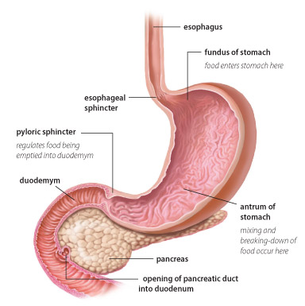
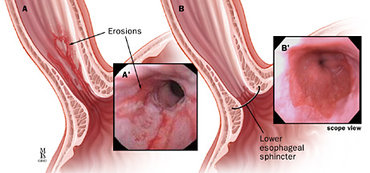
Gastrointestinal Complications of Diabetes
Loreal Brown, Nurs 807 Spring 2015
Present Illness
24 hour episode of emesis with blood
Upper abdominal pain since emesis
Past Medical History
60 yo Female
Height 65in, Weight 114.4kg, BMI 40.1
History of:
40 Year Smoking History
Recreational Drug Use: 19 years clean
Obesity
Diabetes
GERD, Gastroparesis, Gastritis
Pyloric sphincter Botox injections 2012
Hyperlipidemia
Fatty Liver Disease
Hypokalemia
Family History:
Father died 71yo; diabetes related illness
Mother died 52yo; asbestosis
Sister died 53yo; diabetic renal failure
Pharmacology
Drug | Dose/Route | Frequency | Classification/Action | Rationale
Insulin Lispro | sliding scale SC INJ | Before meals & HIS | Fast Acting Insulin | Glucose Control
Insulin NPH/REG 70/30 | 28units SC INJ | Once Daily | Combination Insulin | Diabetes Management
Pantoprazole Sodium | 40mg PO | Once Daily | Protein-Pump Inhibitor | GERD/Erosive esophagitis
Sucralfate | 1G=10mL PO | Before meals & HIS | Aluminum Salt Complex | Erosive esophagitis
Acetaminophen | 500mg PO | Once Daily | Para-aminophenol Derivative Analgesic | Mild knee pain
Enalapril Maleate | 5mg PO | Once Daily | Antihypertensive: ACE Inhibitor | HTN
Escitalopram Oxalate | 10mg PO | Once Daily | SSRI Antidepressant | Depression
Magnesium Gluconate | 250mg PO | Once Daily | Dietary Supplement | Hypomagnesemia
Potassium Chloride | 400mL IV (100mL/hr over 4hrs) | Once | Dietary Supplement | Hypokalemia
Assessment Findings
Vitals: Temp- 98.4, HR- 86, RR- 18, BP- 114/64, O₂ Sat- 96% room air, Pain- 0/10.
Recommendations
Continue PPI with sucralfate for erosive esophagitis.
Diabetic nutritional consult/support.
Repeat pyloric Botox injections.
Assess home support system.
http://www.familyhealthonline.ca/fho/diabetes/DI_gastroparesis_MDb09.asp
EGD w/ biopsy: severe erosive esophagitis throughout mid-esophagus.
Abdomen: soft, non-tender, bowl sounds present in all quadrants.
No nausea or vomiting, tolerating diet.
 | 4/19/15 | 4/20/15
Glucose | 165 H | 272 H
Sodium | 141 | 142
Potassium | 2.3 CL | 2.6 CL
Chloride | 91 L | 96 L
CO₂ | 39 H | 41 CH
Anion Gap | 11 | 5
Creatinine Enz | 0.6 | 0.61
BUN | 6 L | 10
Calcium | 7.9 L | 8.0 L
BUN/Creatinine | 10 | 16.4
Cap Glucolse | 188 H | 340 H
WBC | 8.5 | 7.1
RBC | 4.7 | 4.45
HGB | 14.5 | 13.5
HCT | 41.5 | 39.6
MCV | 88.4 | 88.9
MCH | 30.9 | 30.4
MCHC | 35 | 34.2
RDW | 13.2 | 13.2
PLT | 172 | 166
Auto Neut | 67.7 | 58.4
Auto Lymp | 24.2 | 31.8
Auto Mono | 7.3 | 8
Abs Neut | 5.7 | 4.1
Pathophysiology
Long-term high blood glucose levels may cause damage of the vagus nerve which controls gastric emptying.
Delayed nutrient absorption by food remaining in stomach potentiates this cycle causing further GI damage/issues.
References
Aschenbrenner, D. S., & Venable, S. J. (2012). Drug therapy in nursing (4th ed.). Philadelphia: Wolters Kluwer Health/Lippincott Williams & Wilkins.
American Diabetes Association. (2014, June 27). Gastroparesis. Retrieved April 25, 2015, from http:// www.diabetes.org/living-with-diabetes/ complications/gastroparesis.html
http://www.lgmpharma.com/blog/wp-content/uploads/2012/06/erosive-esophagitis.jpg

