Slide 1
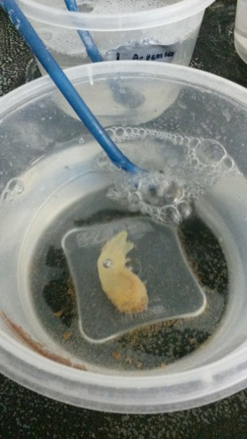
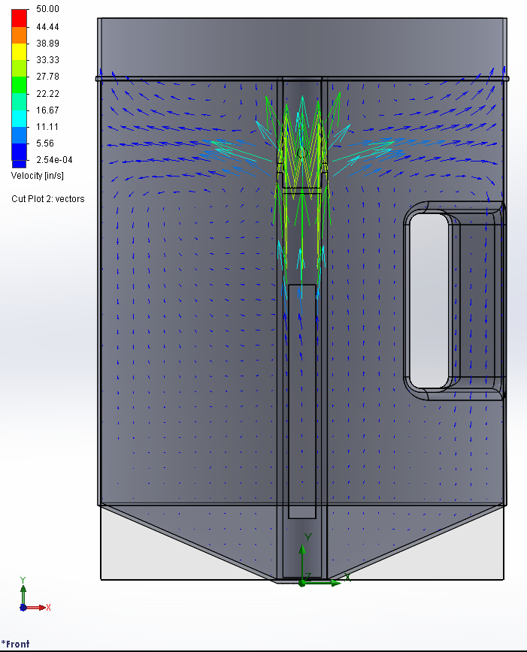
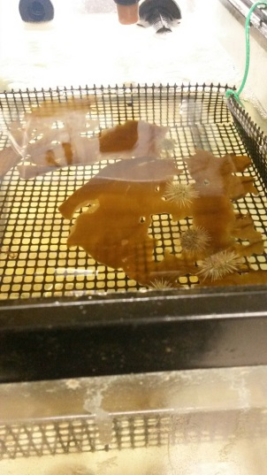
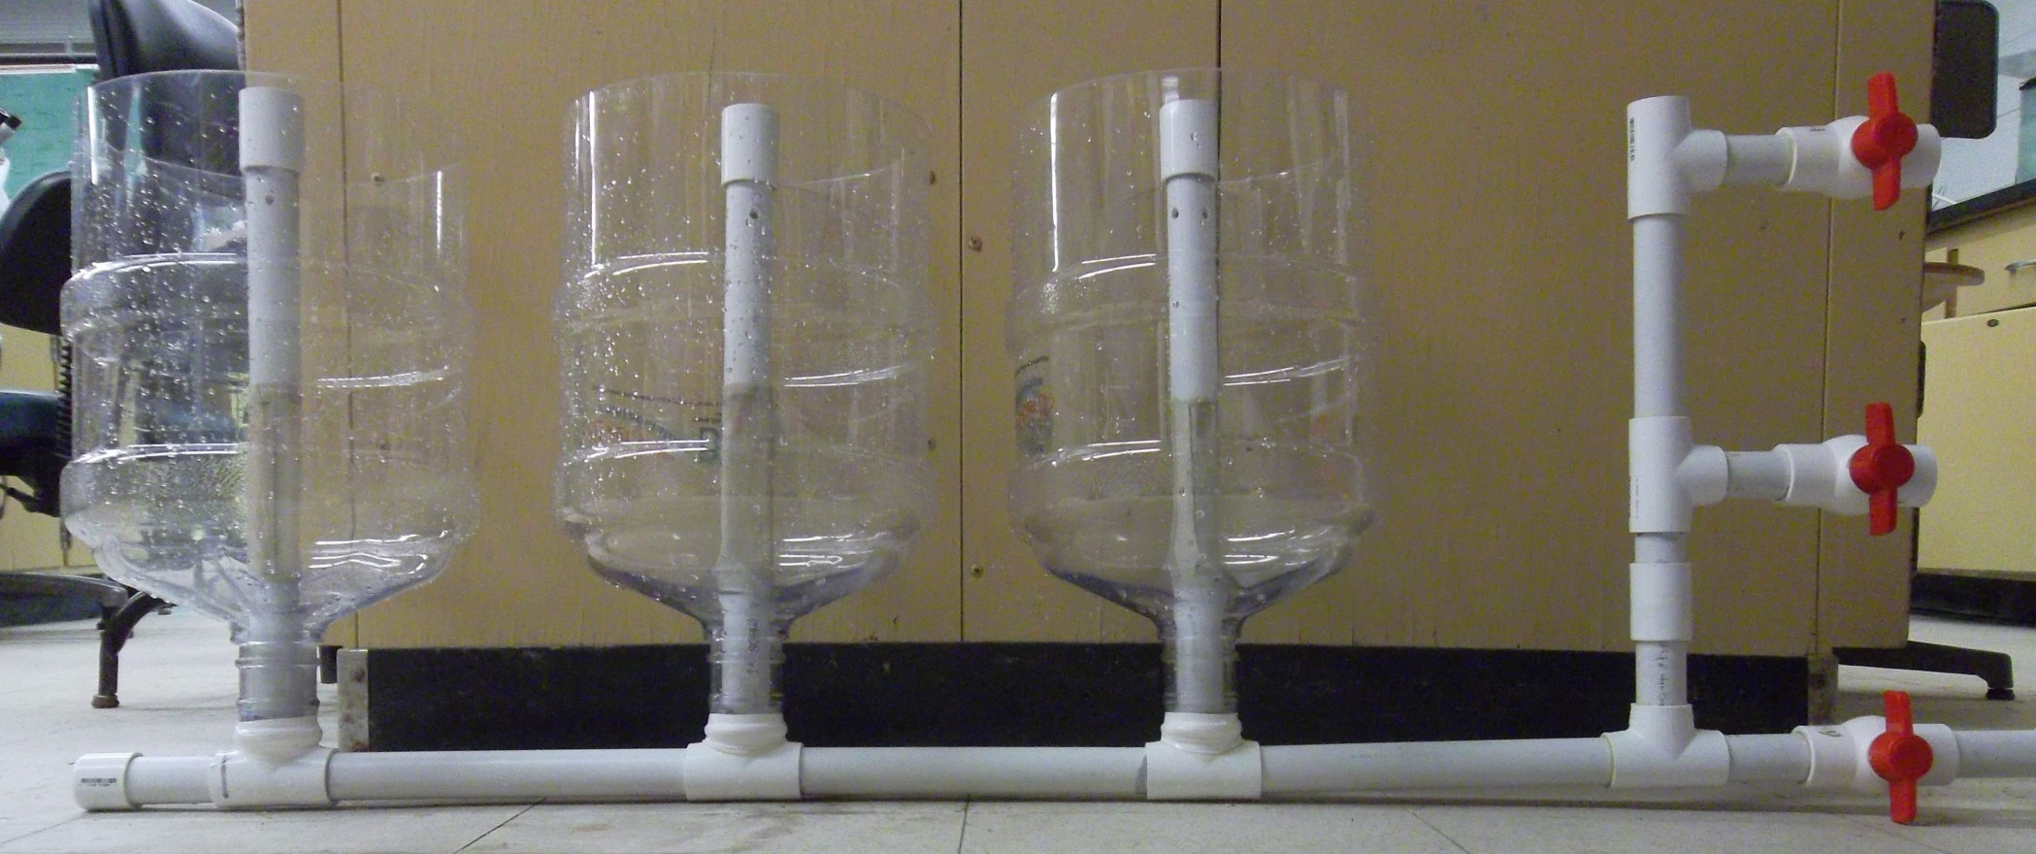
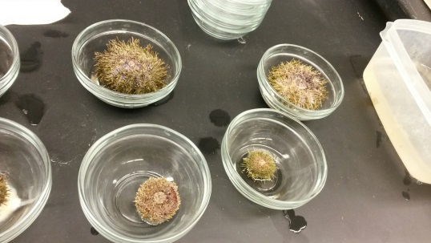
Integrated Aquaculture Hatchery System
Eryn Murphy, Nathan Battey, Eric Samuel, John Heavisides; Dr. Larry Harris, faculty adviser
Department of Biology, University of New Hampshire, Durham NH
Commercial fishing has been practiced for thousands of years. Recently, overfishing has increased the demand for the development of more efficient aquaculture systems. Several species of interest in the Gulf of Maine region include the European oyster and the green sea urchin. Both of these species can be easily spawned and held in a recirculating system during larval development as well as can be held during the grow out stage to legal size. Typically, they are kept in distinct aquaculture systems. Our project sought to create an aquaculture system that could spawn both the urchins and oysters without necessitating different systems, while also being simple, affordable, and easily maintained, Additionally, we investigated the use of the vase tunicate as a biological component of this system.
Preliminary Results
The system should be simple and affordable
Ideally, the system that we design should be easily purchased and fabricated, so that new aquaculture enterprises can begin without requiring a large investment of capital. All parts should preferably be available in a local hardware store, keeping construction and maintenance uncomplicated and straightforward.
The system should accommodate multiple species
Current hatchery systems are generally designed only for the spawning of a single species, which only occurs during part of the year. By creating a hatchery that can support multiple organisms that spawn at different times of the year, the system may be used by an aquaculture effort to diversify their cultured species, without extra infrastructure investment.
The system must maintain a constant, uniform flow
This allows the cultured larvae to filter greater volumes of water, leading to faster growth.
In addition, uniform flow prevents eddies and areas of low flow. This avoids having the developing organisms settle on the bottom, which would lead to their death.
The hatchery must also take measures to avoid any areas of strong current within the tank, particularly near any meshes. Strong flow risks trapping the larvae against the mesh.
Introduction
Design Principles
Ciona intestinalis had an overall filtration rate of
98.19% per 24 hours of phytoplankton in the combined container at 1000 μm
98.39% per 24 hours of phytoplankton at 1000 μm
94.66% per 24 hours of phytoplankton at 500 μm
92.22% per 24 hours of phytoplankton in the combined container at 500 μm
85.45% per 24 hours of phytoplankton in the combined container at 250 μm
77.25% per 24 hours of Artemia at 1000 μm
80.74% per 24 hours of Artemia at 500 μm
89.53% per 24 hours of Artemia in the combined container at 500 μm
90.53% per 24 hours of Artemia at 250 μm
93.34% per 24 hours of Artemia in the combined container at 250 μm
Figure1: Feeding trial with Ciona intestinalis to determine whether zooplankton or phytoplankton was a preferred food source
Feeding trials done over a 2 month period on the European oyster show that overall, the oysters grew at a slightly faster rate when given both the phytoplankton as well as the particulate matter from the urchins. Trials are currently still running as oysters grow at a slow rate.
Green Sea Urchin (Strongylocentrotus droebachiensis)
Prized for their roe, green sea urchins are the focus of many Japanese aquaculture efforts. Additionally, there is an existing market in the Gulf of Maine region.
European Oyster (Ostrea edulis)
Already a valuable aquaculture product in Canada, oysters used to be commonplace in the Great Bay area, although they were American (rather than European) oysters. European oysters are considered more commercially viable.
Vase Tunicate (Ciona intestinalis)
An invasive species, vase tunicates are filter-feeders that have to potential to remove pollutants from the water of the hatchery system. In addition, they may serve as a local source of protein to be fed to the developing urchins and oysters.
Species Included
Figure 2: Three control tanks where oysters were given only phytoplankton as a food source. Length and width taken from each oyster in tanks 1-3.
Figure 3: Three trial tanks where oysters were given phytoplankton as well as food particulates from urchins as a food source. Length and width taken from each oyster in tanks 4-6.
Figure 4: Weight taken from each oyster in tanks 1-3.
Figure 5: Weight taken from each oyster in tanks 4-6.
Methods
Prototype Hatchery
Fluid Flow Analysis
Many thanks to the UNH Tech 797 for providing funds for this project.
Additionally, this project would have never been possible without the support of our advisor, Professor Larry Harris.
P Russell, M.P. 2000. A tank-system design for the hatchery production of sea-urchin larvae. In Proceedings of the Workshop on the Co-ordination of Green Sea Urchin Research in Atlantic Canada. June 1 - 2, 2000, Université de Moncton. [http://oursin/pdf/bert.pdf].
C. Intestinalis were placed into 15 separate containers with 5 having phytoplankton as the sole source of food, 5 had zooplankton (Artemia) as the sole source of soon, and the remaining 5 had both phytoplankton and zooplankton. Daily measurements were taken to test the percent removal of each food source.
24 oysters were placed into 6 different tanks,, 4 per tank, with 3 of the tanks containing a basket of 6 urchins above with a layer of kelp. Phytoplankton concentrations were given to all 6 tanks daily and the 3 tanks with urchins also had the particulate that fell from the urchins as another source of food.
Urchins were spawned in an attempt to create larvae for the prototype hatchery.
Acknowledgements
The prototype hatchery was modeled after a system by Michael P. Russell of Villanova University. One tank can be constructed from a 5 gallon water bottle, mesh, and PVC pipe. Flow is created by an air stone and pumped air. Two sets of three tanks were built for a total of $300, though costs can be lessened with more efficient purchasing and construction.
Fluid flow within tanks with and without handles was analyzed using SOLIDWORKS Fluid Flow Simulation and in physical tests. Flow increased through the tube of the handle but decreased beneath where it protruded. The effects of handle were negligible, but fully cylindrical bottles were chosen for the hatcheries. Simulations were also run to test inlet sizes for the central pipe in the tank. It was found that a larger inlet circulated water the best and should be used in the hatchery.
References

