Slide 1
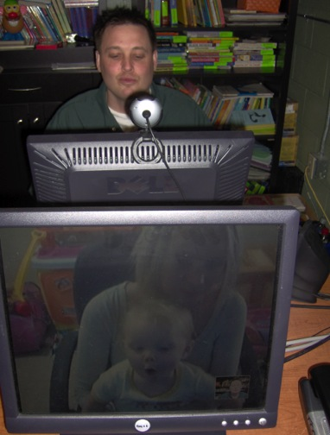
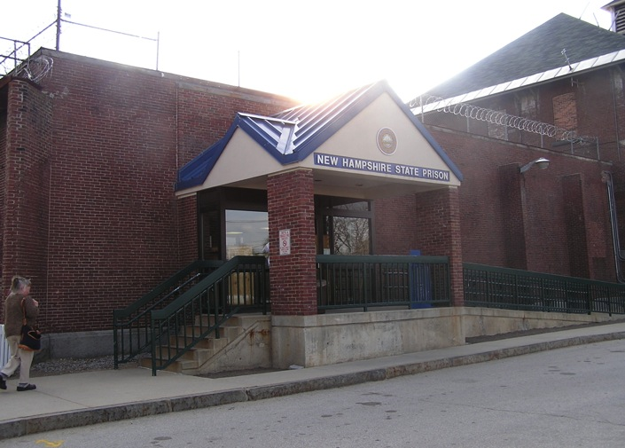
Incarcerated Fathers Skype with Their Children from Prison: Outcome Indicators of Children’s Well-Being
Kerry Kazura, Ph.D.
Human Development and Family Studies
University of New Hampshire
Introduction
• Parental incarceration is a dynamic experience that impacts children’s lives to varying degrees across their lifespan.
• There is little research on the impact of prison visitations has on children’s development.
•Programs that aid children with incarcerated parents have adopted a wide range of formats which have been delivered by a variety of agencies: family support providers, state agencies, and community and faith based organizations.
• The Family Connections Center (FCC) was founded in 1998 from a partnership created among the New Hampshire’s Department of Corrections, University of New Hampshire’s (UNH) Department of Human Development & Family Studies.
•Programming objectives are to strengthen at-risk families and improve the healthy development of children with incarcerated parents through a family-centered approach.
• The goal of this study was to evaluate the effectiveness of Skype visitation from prison across Visit 1 to Visit 3.
Participants
The following analyses were conducted using data from 32 incarcerated fathers (21 inmates from the Berlin facility and 11 from the Concord facility) and their children.
Fathers’ ages ranged from 25 to 45 (M=34.37, SD=7.43), with the majority reporting they were Caucasian n=25.
Twenty inmates reported that they were single, 8 were married, two were divorced, one person chose not to answer.
The number of children inmates had ranged from one to five (M= 2.19, SD=1.11).
The ages of the target children that came for visits ranged from four months old to 23 years old (M=7.75, SD=5.21).
Hierarchical Regressions Visit 1 and Visit 3
In order to examine if there was a carry-over effect between visits a series of exploratory hierarchical regressions were conducted to examine if fathers behaviors at visit 1 were predictive of their child’s behavior at visit 3.
The first regression examined how well fathers’ sadness, when controlling for children’s happiness at visit 1, predicted children’s happiness at visit 3. When children’s happiness at visit 1 was entered alone is did not significantly predict children’s happiness at visit 3; however, when fathers’ sadness level at visit 1 was added, it significantly improved the prediction R² change=.25, F(1,24)=8.06, p<.05. Fathers sadness at visit 1 significantly and negatively predicted children’s happiness at visit 3, F(2,23)=4.56, p<.05. Therefore, the happier fathers were during visit 1 predicted increase levels of happiness in children during visit 3.
The second hierarchical regression examined how well fathers’ level of confidence, when controlling for children’s behavior at visit 1, predicted children’s compliance at visit 3. When children’s compliance at visit 1 was entered alone it significantly predict children’s compliance at visit 3, F(1,23)=21.80, p>.001, adjusted R²=.48. However, when fathers’ confidence was added, it significantly improved the prediction, R² change=.13, F(2,22)=17.94, p<.001.
The third hierarchical regression examined how fathers’ behaviors at visit 1 predicted children’s anger at visit 3, when controlling for children’s anger at visit 1. When children’s anger at visit 1 was entered alone it significantly predict children’s anger at visit 3, F(1,24)=8.03, p>.001, adjusted R²=.25. However, when the father variables were added, it significant improved the prediction, R² change=.35, F(5,19)=3.30, p<.001. Beta scores indicated that fathers’ level of sadness (i.e. positive association) and maturity demands (i.e., negative association) contributed most to predicting children’s anger at visit 3. Therefore, a decrease in fathers’ sadness and increase in fathers’ maturity demands resulted in lower levels of children’s anger during visit 3.
10 Parent Behaviors
Confidence Anger
Limit Setting Responsiveness
Expressiveness Interactive
Maturity Demands Happy/Sad
Warmth/Coldness Anxiety
Measure
Parenting Behaviors. The Parenting Style rating scale (Cowan & Cowen, 1988) was used to collect information on parents' interaction with their children. This information allowed staff to employ a parenting skill training method. Using the information gathered during the Skype interaction, staff met with the parent immediately after the visit to discuss the skills they demonstrated and techniques for overcoming challenges.
6 Child Behaviors
Happy/Sad
Anger
Expressiveness
Interactive
Anxiety
Compliance

