Slide 1
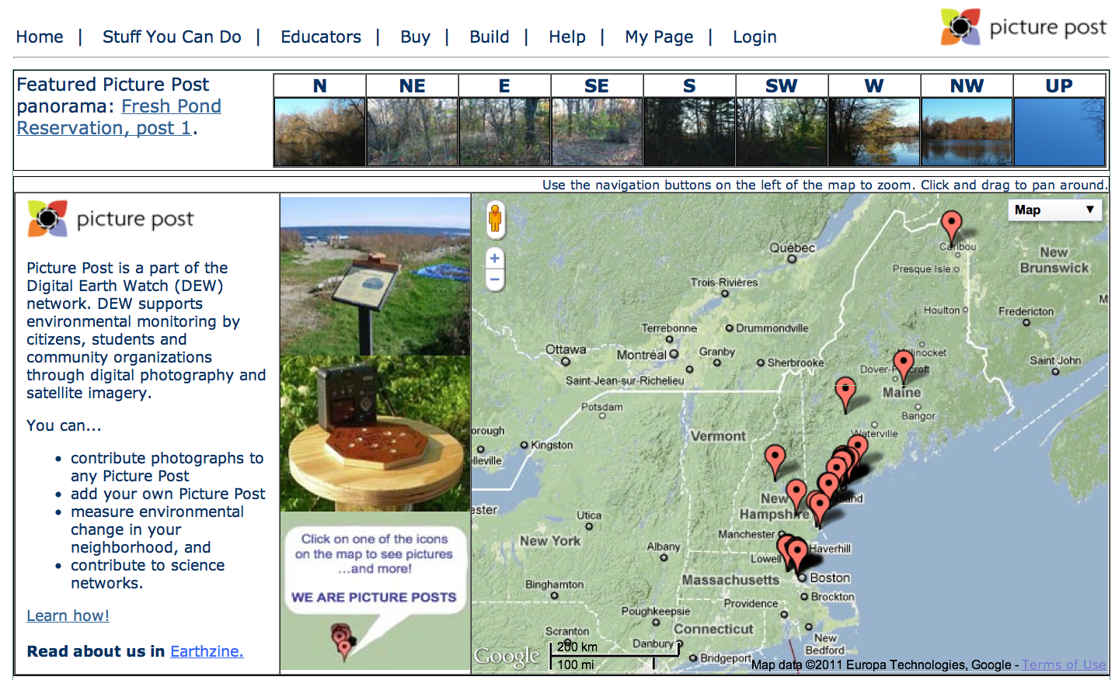
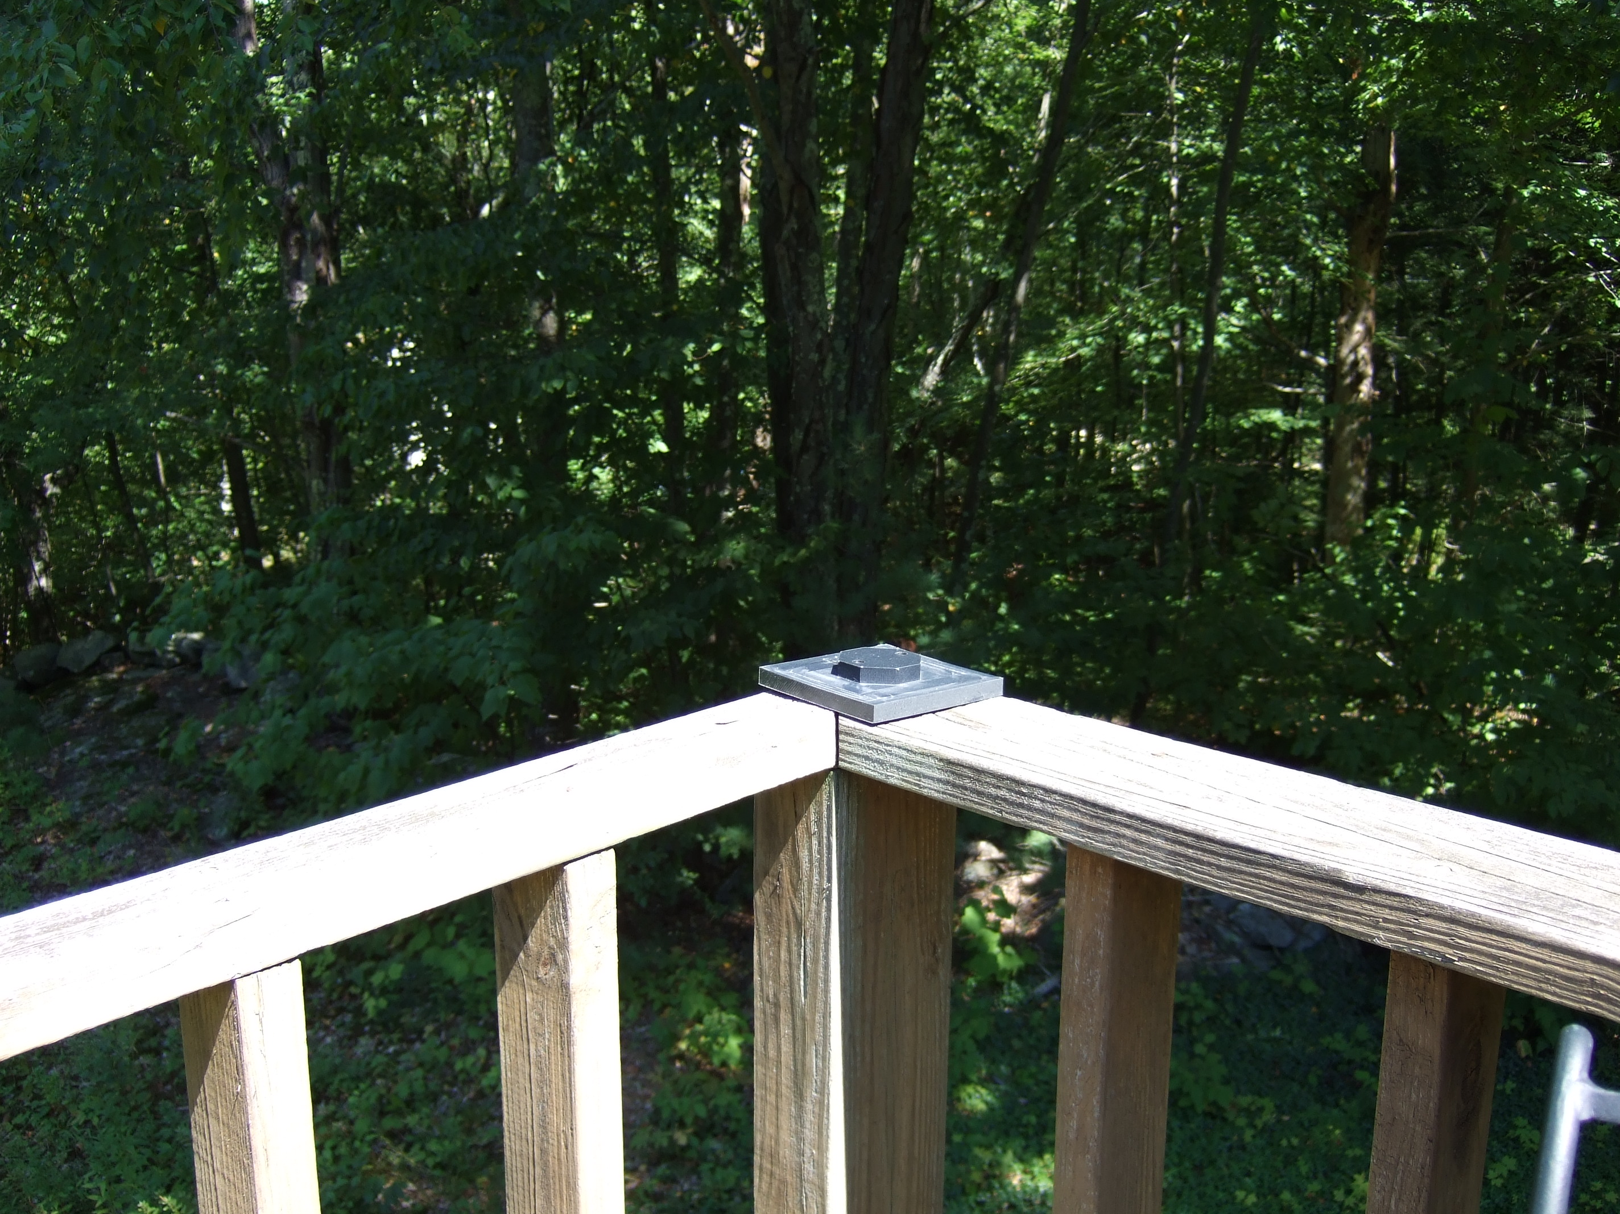
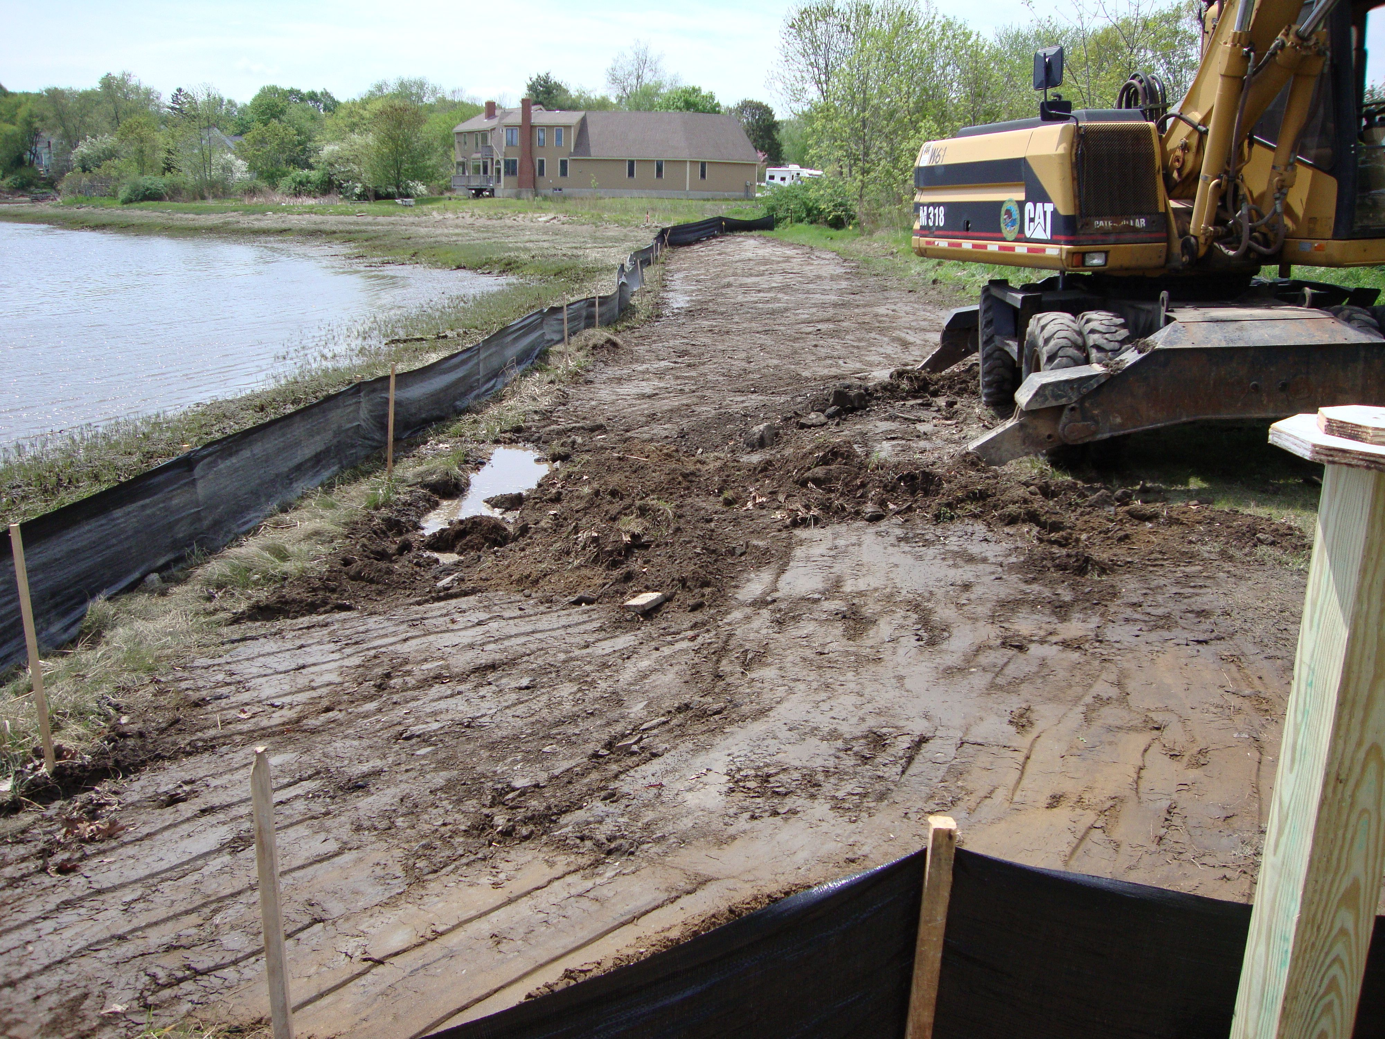
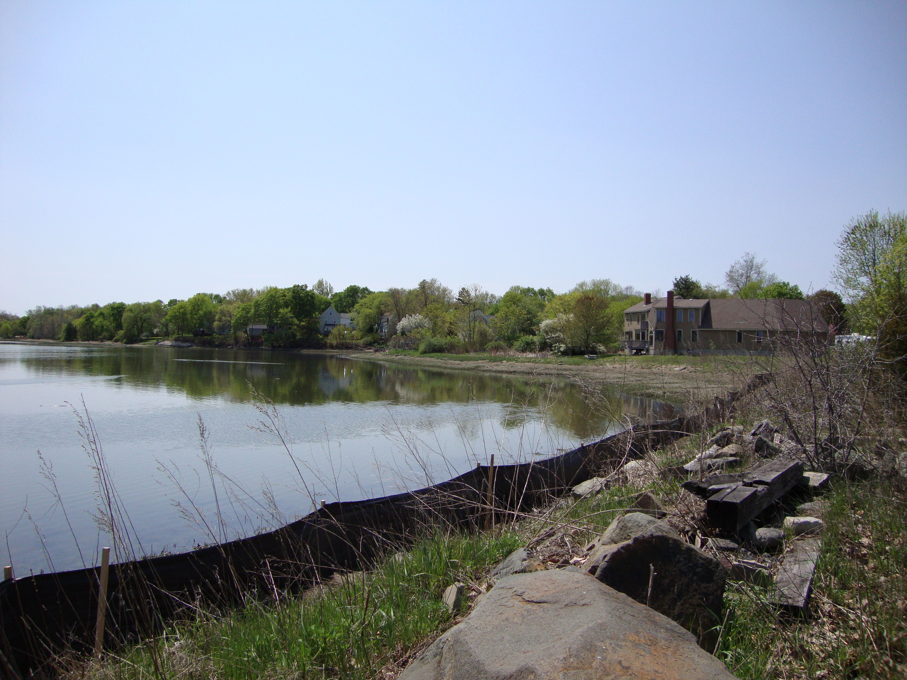
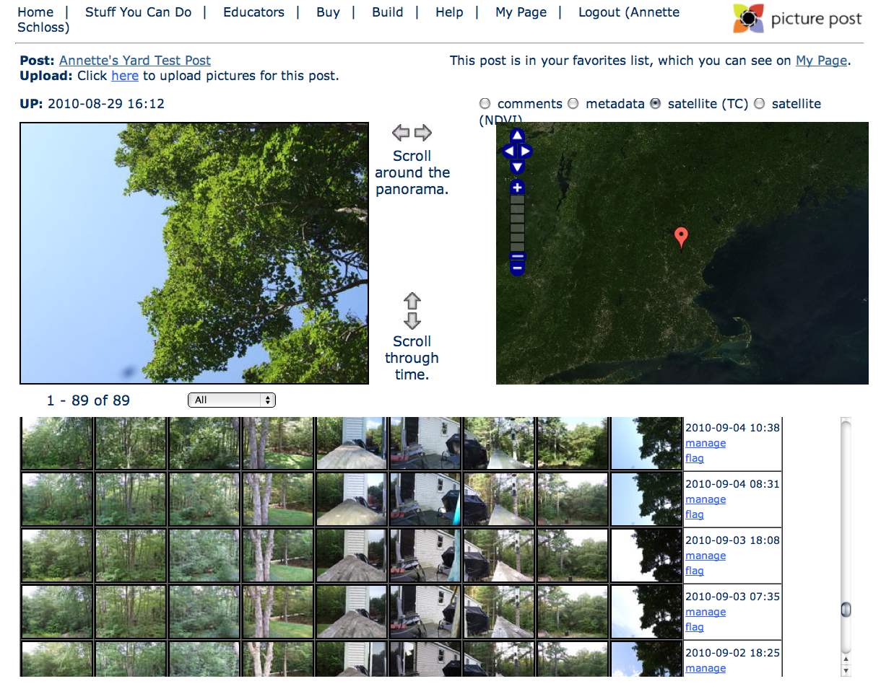
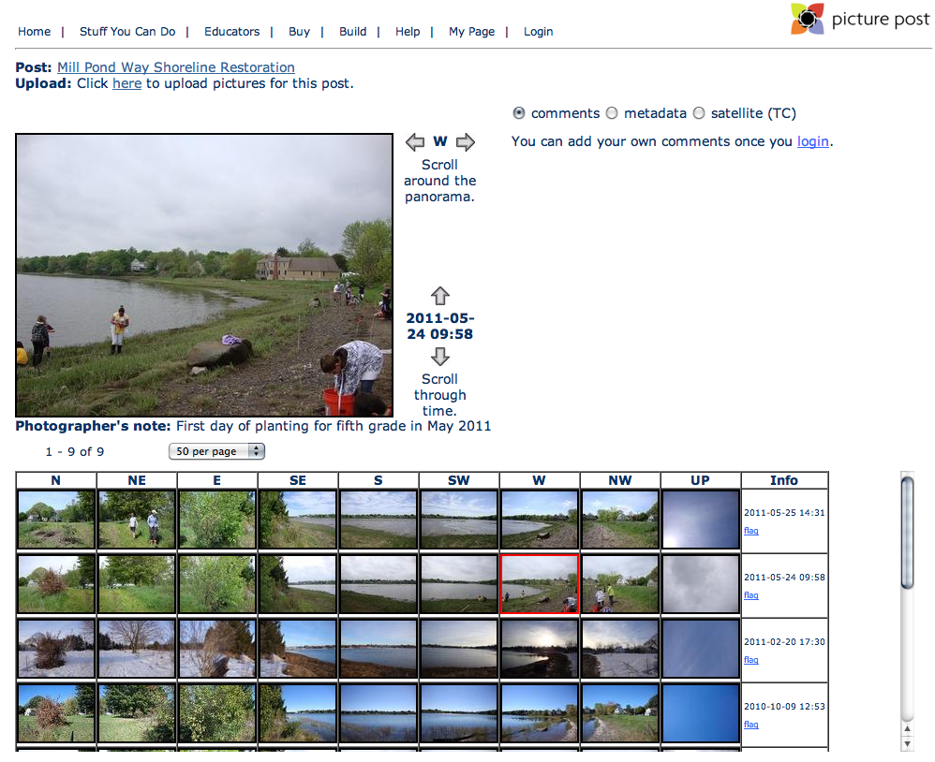
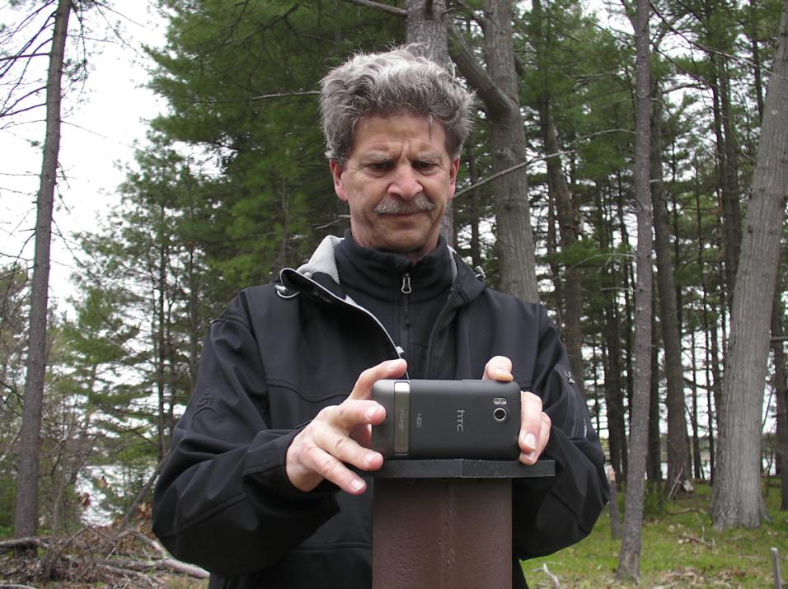
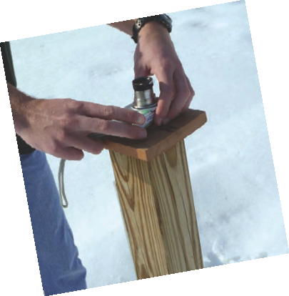
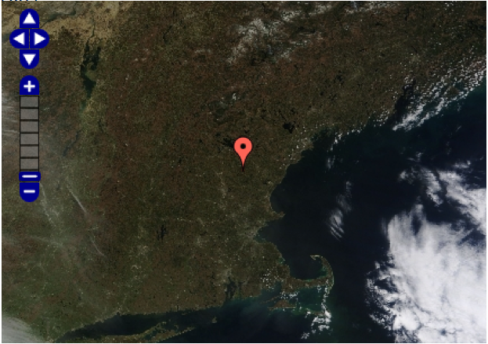
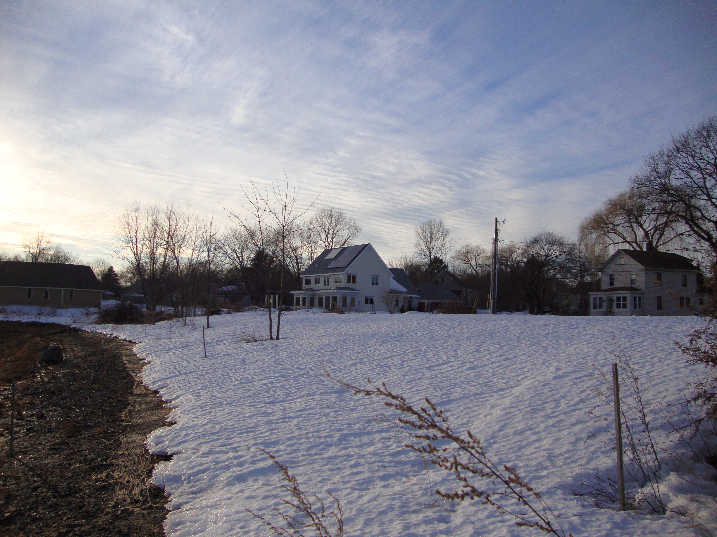
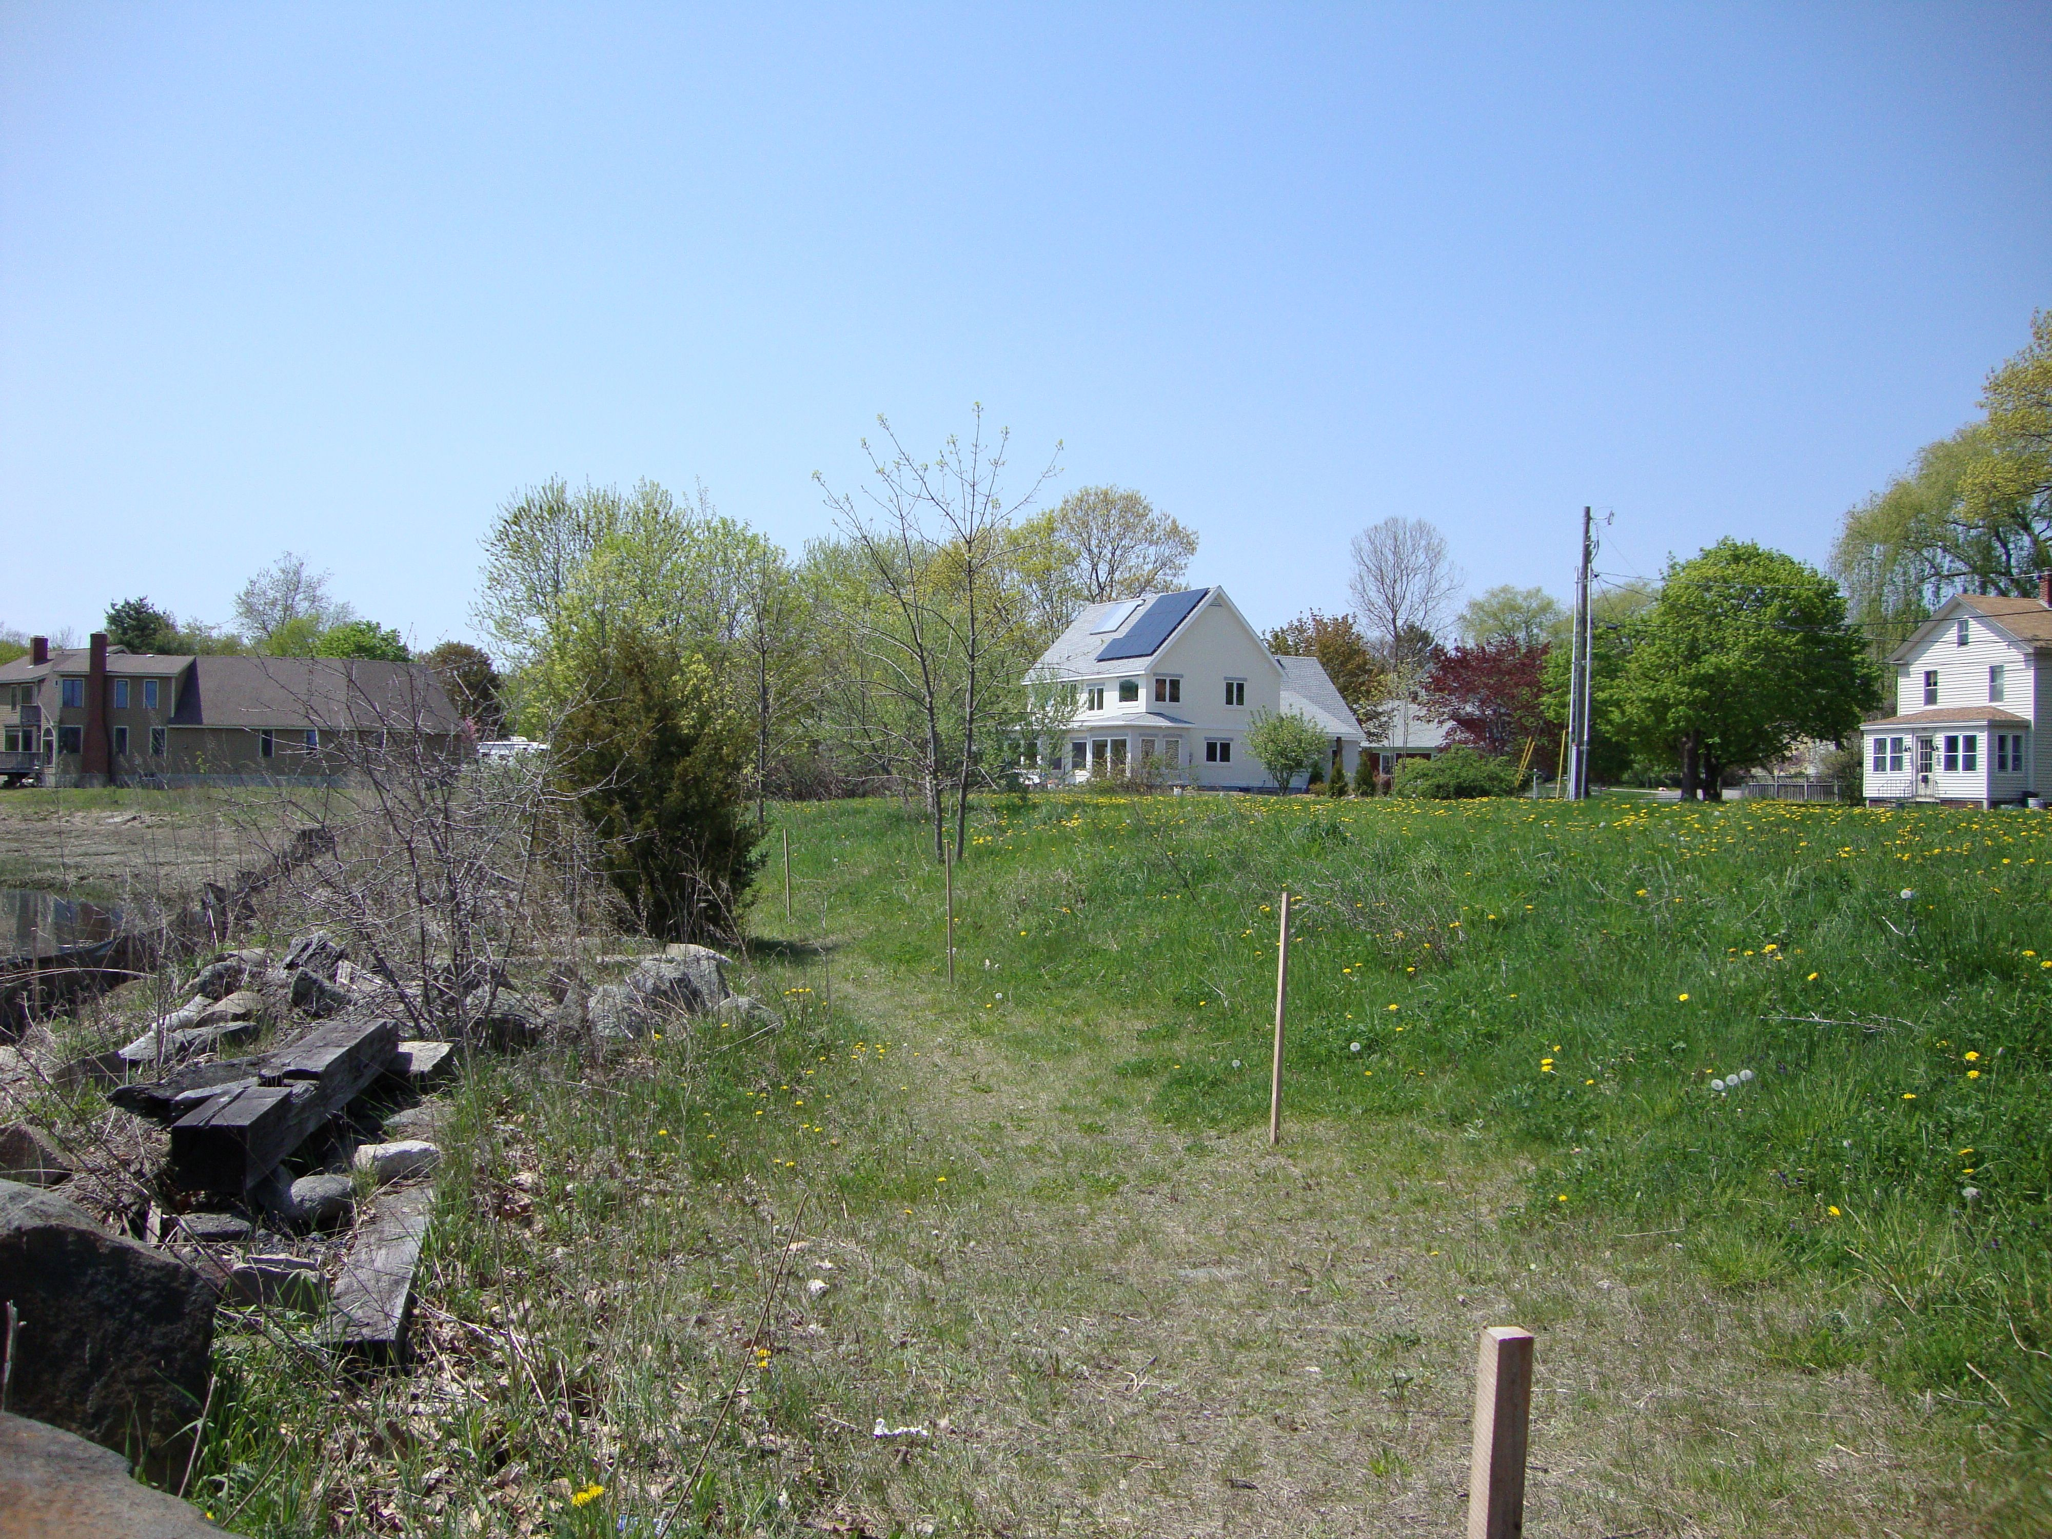
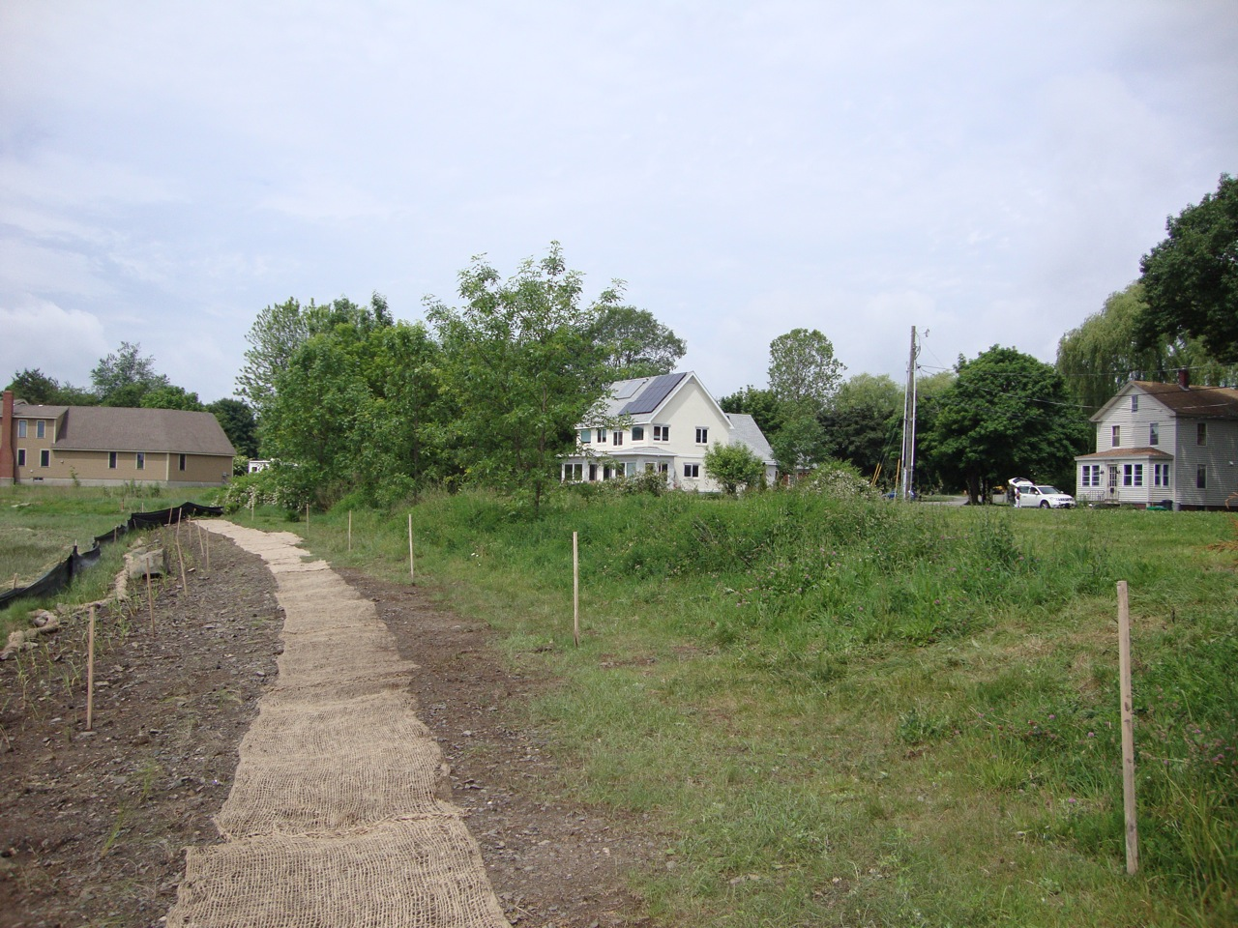
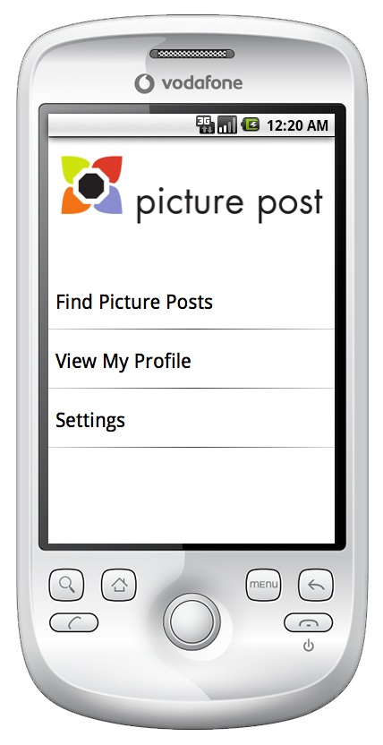
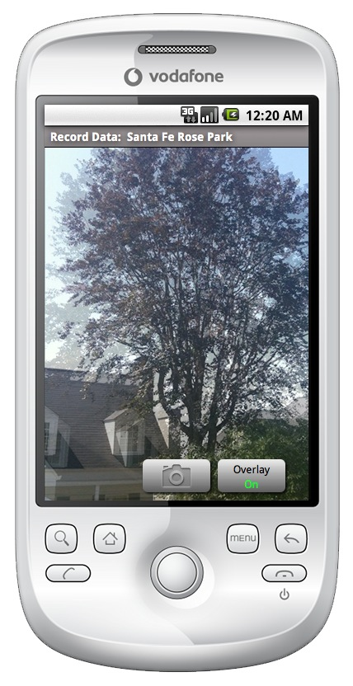
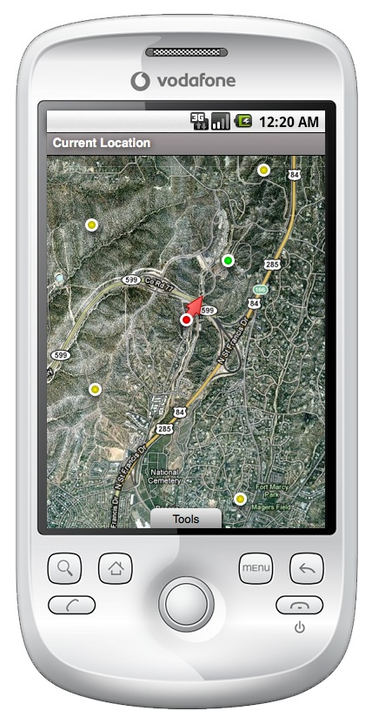
Local to Global Citizen Science Measuring the Environment through Digital Images
Backyard Monitoring
vegetation health and seasonal change
Community Action
Plants are like "green canaries”
The shoreline along North Mill Pond, a tidal pond and marsh, was badly damaged by construction.
The Picture Post as seen on the homepage map sits on the back deck with a view of the yard, garden boxes, and the woods behind.
Each post has its own page where you can:
Upload pictures for all 9 views of the site
Navigate through picture views
Comment on and tag pictures
Compare pictures with the daily image from the Moderate Resolution Imaging Spectroradiometer (MODIS) aboard NASA’s TERRA satellite.
Why take and analyze pictures?
Measure growth of trees & other change-over-time
Measure plant health
Monitor response of community to development, recovery, greening & sustainability efforts
Monitor water levels, floods, drought
Highlight invasive species
Compare to satellite imagery
A community group including a fifth grade class, worked together to restore the area and document their work with a picture post.
Observations on the phenophases (seasonal events) of the sugar maple tree in the UP view are reported to Project Budburst. The MODIS true color images on the right gives a birds-eye view of the day.
50% colored leaves
Leaf fall
Winter dormancy
Community Partners:
City of Portsmouth, NH
Jackson Estuarine Lab
Fifth grade students
at the Franklin School
Supporters:
US Fish and Wildlife Service
NH Charitable Foundation
Partners for Wildlife
First leaf
iPhone Mobile Application
20% full leaf size
DEW and Picture Post have been developed with support from NASA.
http://picturepost.unh.edu
For more information, contact Annette Schloss annette.schloss@unh.edu
or Jeff Beaudry jbeaudry@usm.maine.edu

