Slide 1
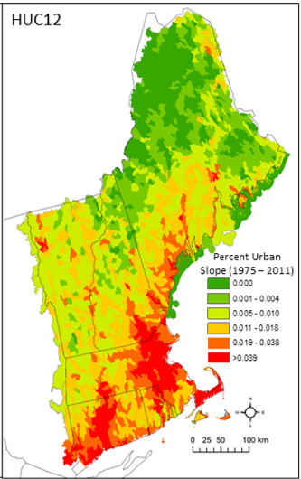
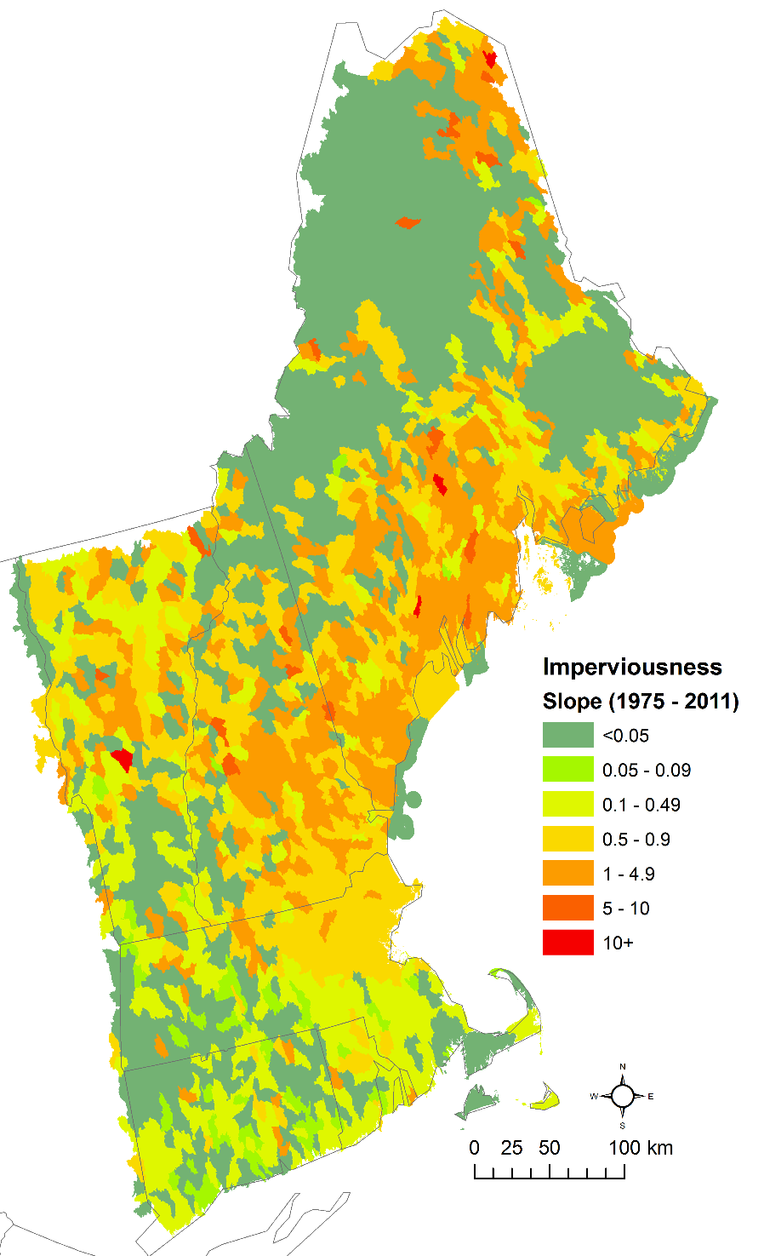
Mapping urban sprawl and impervious surfaces in New England over the past four decades to support watershed assessment and lake resource management
Megan Corbiere (mcorbiere@ags.io); Nathan Torbick Applied Geosolutions, 55 Main Street, Suite 125, Newmarket, NH, 03857, USA
Abstract
Methods
Results
Impervious surfaces (IS) are known to adversely impact water quality, volume, and flow rates. Mapping urban expansion and IS has become a useful tool for supporting watershed assessments. The lack of large area time series maps for these metrics created the need to develop an approach and products that can easily be scaled. The goal of this research was to map spatiotemporal changes in urban extent and IS over the past four decades to support watershed assessment and lake resource management. A Classification and Regression Tree (CART) using random forest classified Landsat imagery into a scheme matching the 2011 National Land Cover Database (NLCD). Relationships between NLCD 2011 IS values and corresponding Landsat TM Tasseled Cap transformations were used to map IS values across the study areas. The CART and IS models were applied to modern imagery and backcast to selected archived imagery to generate maps of urban and impervious surfaces. A spatiotemporal analysis routine identified rates of urban sprawl and IS dynamics at pixel and watershed scales. Multiscale spatiotemporal analyses show the highest urban expansion in watersheds along the coasts in southeastern New England and along highway corridors. Imperviousness intensity of urban existing in 1975 was highest in the coastal northeast between 1975 -2011. The products will be used to support lake risk management and help identify potential stressors to lake health in the northeast.
Box and whisker plots of Landsat indices used to train the CART model and backcast NLCD scheme maps.
Hierarchical classification outcomes for landcover maps were re-aggregated into urban vs non-urban classes.
Relationships between NLCD 2011 Impervious Surface values and corresponding Landsat TM Tasseled Cap transformations were investigated and used to map IS values.
A time series trend assessment was applied that examined the change rates across years and ultimately focused on slope across the four decade time span with six time steps (1975, 1985, 1996, 2001, 2006, 2011).
Four example areas of urban sprawl using the time series classification maps stacked chronologically to highlight patterns of sprawl. Results show growth corresponding to major travel routes, urbanized centers, and adjacent to waterbodies. A.) Lake Winnipesaukee, NH, B.) Burlington, VT, C.) greater Boston, MA region, and D.) Bangor, ME
Background
New England represents a range of landscapes, populations, history, and lakes.
Lakes and the coast are critical to the environmental and economic livelihood of the region.
There are over 10,000 waterbodies >8 ha located throughout the northeast where second homes, camps, recreation, and lake front property influence taxes, decision making, seasonal economies, and watershed health.
In NH, lakes generate an additional $247 million in property taxes and $1.5 billion in total sales from recreation and drinking water (NH DES).
Perceived declines in water clarity caused $100 million in lost sales and $25 million in lost income from 800 less jobs in the year 2011.
NLCD landcover and IS products are limited in temporal coverage.
Consistent classification schemes and IS mapping techniques across temporal windows and large areas are current obstacles for assessing the spatial and temporal patterns of changes in urban extent and impervious surfaces at the landscape scale across the northeast USA.
We take advantage of NLCD products and extend maps using a total of 81 scenes from Landsat time series archives dating back to the mid-1970s (targeting the epochs of 1975, 1985, 1992, 1996, 2001, 2006, and 2011).
Scatterplot (left) shows the modeled percent IS against the NLCD IS area (red dotted line represents linear fit and green line shows 1:1) with strong agreement (R²: 0.89) and n-folds validation plot (right) shows relatively robust ability (RSE: 10.92) to map urban percent IS using the Landsat Tasseled Cap OLS regression approach.
For MSS imagery, a modification was carried out.
Since the MSS spectral bands differ from TM wavelength coverage, the index approach trained on modern imagery was not appropriate for backcasting to the archives.
The 1975 imagery was classified using the CART approach with a 2-band TC image (Brightness and Greenness) using a 2011 training model and backcast to 1975 images with the same TC bands.
Trend assessment of urban extent changes from 1975-2011 at the HUC12 watershed scale
IS trend map from 1975-2011 at HUC12 scale (using only area that was classified as urban in 1975)
Watershed risk map synthesizing HUC12 watersheds across New England
Distinct spatial patterns of change are noticed when fusing the multiscale maps of urban expansion and IS trend. The coastlines, big cities, high density lake regions, and major travel routes tend to be associated with the watersheds that are identified.
Methods
Results
Conclusions
Cross validation of the random forest CART performed using withheld samples had an overall accuracy and kappa of 0.67% and 61% for the 15 NLCD 2011 classes.
Producer's and User's accuracy for Developed Open Space, Developed Low, Medium, and High Intensity were 0.40, 0.69, 0.80, 0.92, and 0.60, 0.71, 0.84, 0.95, respectively.
The regression approach to use Landsat TC indices to map IS across New England was relatively robust with strong measures of performance; R2: 0.89 (p-value <0.0001).
The CART utilizing random forest and Landsat indices was able to backcast models to Landsat archives to generate urban maps extending back nearly four decades across New England with high overall accuracy. The multiple linear regression technique using Tasseled Cap Brightness and Greenness indices was effective in characterizing Impervious Surfaces for urban land types. The aggregated urban vs non-urban maps had an overall accuracy of 95% and the IS model had a R² of 0.89. The techniques were relatively scalable and, to our knowledge, provide the first large area urban and Impervious Surface spatiotemporal assessment across New England. Multiscale assessment highlighted ‘hot spot’ regions and had related but different results emphasizing the importance of considering scale in applications. Coastal watersheds, major routes, and large cities were shown to have the highest rates of sprawl and increases in impervious intensity. The approach and products help identify patterns and potential threats to lake water quality and can help assist watershed management planning in reducing negative impacts on aquatic ecosystem integrity. This approach is relatively automated and potentially scalable to other regions or large study sites such as CONUS. Our next step will be to analyze the relationship between urban sprawl/IS and aquatic integrity for northern New England, with a focus on public health.
 | water | urban | barren | forest | shrub | herb. | crop | wetland
water | 31667 | 739 | 251 | 2507 | 15 | 1 | 54 | 1473
urban | 464 | 110873 | 516 | 59229 | 776 | 223 | 5855 | 7661
barren | 593 | 2120 | 9715 | 1173 | 98 | 41 | 407 | 475
forest | 532 | 23250 | 109 | 660357 | 788 | 110 | 6185 | 9595
shrubland | 31 | 4179 | 58 | 21382 | 3451 | 66 | 3543 | 1976
herbaceous | 12 | 1317 | 39 | 2609 | 137 | 1415 | 937 | 393
crop | 20 | 8266 | 158 | 16763 | 918 | 191 | 27999 | 2300
wetland | 2128 | 16126 | 159 | 88743 | 579 | 65 | 2621 | 33104
2011 NLCD landcover was used to train temporally matching Landsat TM indices (NDVI, SATVI, LSWI, MSAVI).
As a result, the classification model matches the NLCD class scheme. This enables the classification of time series mosaics using the same scheme across all epochs and therefore provides a mechanism for time series analyses.
Example error matrix using CART approach relying on single Landsat scene NDVI, LSWI, SAVTI, and MSAVI as inputs with reduced classification scheme which had an overall accuracy of 75%.
While south, central, and the southern coastal region New England had large expanses in urban growth, the overall level of imperviousness did not increase on the same order of magnitude relative to other regions identified.
This does not mean those regions had low IS; rather, the trend in IS for areas that were urban in 1975 was comparatively not as steep.
This work was supported in part by the National Institutes of Health (NIH) National Institute of Environmental Health Sciences (NIEHS) Grant R44 ES022103-03; National Science Foundation (NSF) Geography & Spatial Sciences (GSS) Grant 1433756.

