Slide 1
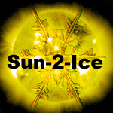
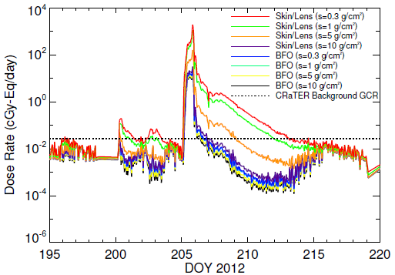
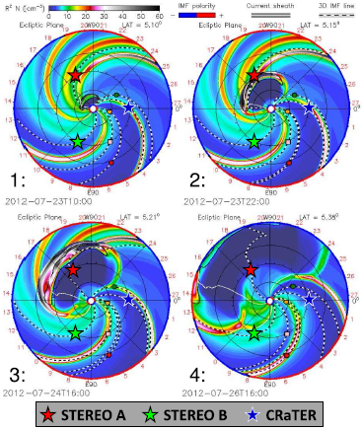
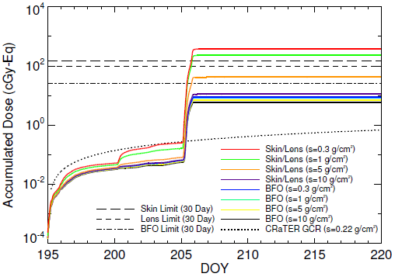
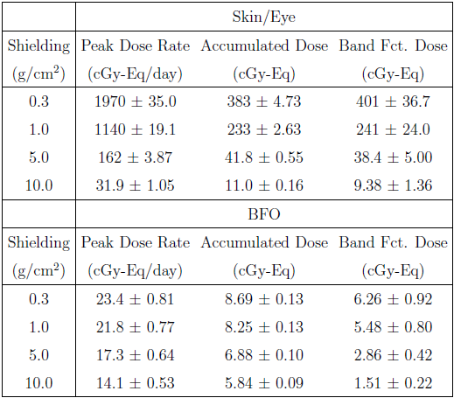
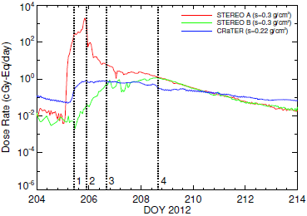
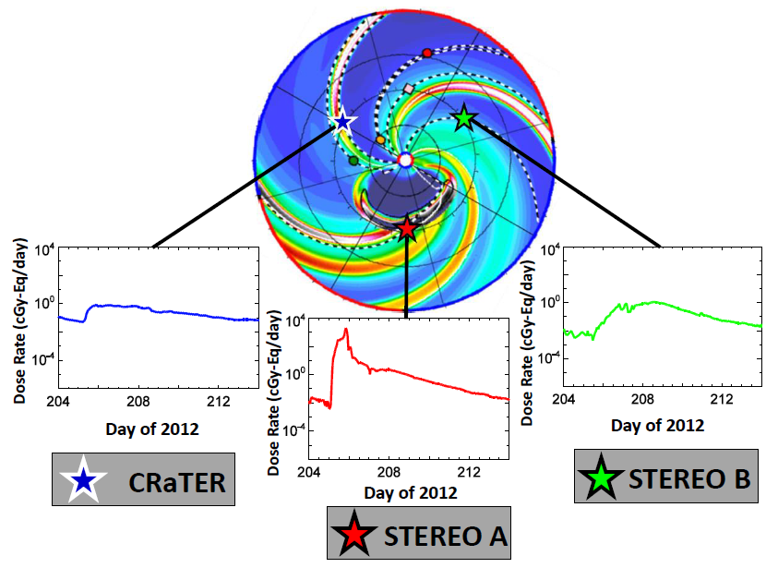
Analysis of the potential radiation hazard of the 23 July 2012 SEP event observed by STEREO A using the EMMREM model and LRO/CRaTER
C. J. Joyce,¹ N. A. Schwadron,¹ L. W. Townsend,² R. A. Mewaldt,³ C. M. S. Cohen,³ T. T. von Rosenvinge,⁴ A. W. Case,⁵ H. E. Spence,¹ J. K. Wilson,¹ M. Gorby,¹ M. Quinn,¹ and C. J. Zeitlin.⁶ ¹University of New Hampshire, ²University of Tennessee, ³California Institute of Technology, ⁴NASA/Goddard Space Flight Center, ⁵Harvard-Smithsonian Center for Astrophysics, ⁶Southwest Research Institute.
Email: cjl46@unh.edu
Introduction:
On 23 July 2012, a massive solar storm was observed by the STEREO A spacecraft.
The ICME missed the Earth, but drew initial comparisons to the historic Carrington Event of 1859 and has been the subject of several studies on the potential impact the storm may have had on the Earth’s magnetosphere.
Russel et al. [1] provided an analysis of the solar wind conditions measured by STEREO A during the event and concluded that its record speed (2780 km/s) and strong southward magnetic field (109 nT) would have caused a powerful geomagnetic storm had it impacted the Earth.
In this study we focus on the potential radiation hazards this event might have posed to astronauts had it encountered a spacecraft in transit.
We provide context for the event by comparing it to three recent large SEP events.
Longitudinal Variation of Radiation Impact:
We use dose rates computed at STEREO A, STEREO B and LRO/CRaTER to show how the position of the spacecraft relative to the ICME affects the observed radiation.
We use a simulation of the WSA-ENLIL+Cone model to show the propagation of the ICME as well as the magnetic field lines connecting to each observer.
The dose rates are in good qualitative agreement with Reames [5], who studied how the position of a spacecraft relative to an ICME affected measured intensity profiles.
CRaTER, on the eastern flank, sees a steep though modest initial increase in dose rate due to it’s magnetic connection to the flank of the shock early in the event.
STEREO A, centrally located, sees a steep increase due to its connection to the nose of the shock, peaking once the shock arrives.
STEREO B, on the western flank, sees the most gradual increase, not peaking until it is connected to the shock from behind.
Figure 1:Dose rates computed during event using BRYNRN model and STEREO A LET/HET data.
Figure 3: Radially-scaled density profiles at four different times during the event as generated by the WSA-ENLIL+Cone model and run by the CCMC . The dotted lines represent the magnetic field lines connecting each observer to the Sun. The position of each observer and their magnetic connection relative to the ICME are used to explain the observed dose rates.
Computation of Dose Rates During Event:
We use 1.8-100 MeV proton flux data from the STEREO A LET and HET instruments as input to the BRYNTRN model.
BRYNTRN solves for the propagation of energetic particles through materials of varying thickness and composition.
We compute dose rates and accumulated doses for both skin/eye and BFO (bone marrow) for four levels of shielding: spacesuit, heavy spacesuit, spacecraft and heavy protective shielding.
Figure 2: Accumulated doses during July 2012 event.
Analysis of Radiation Environment:
The peak skin/eye spacesuit dose rate is almost four times greater than the 2003 Halloween Storm and more than an order of magnitude greater than the January and March events of 2012 [2,3].
Due to the brevity of the event, however, the total dose for the event is more in line with the previous events, being about the same as the Halloween storm and significantly more than the 2012 events.
The NASA 30-day dose limits are exceeded only for skin/eye with spacesuit and heavy spacesuit shielding.
Table 2: Peak dose rates and total accumulated doses for event . Also shown are the total doses computed using a Band function [4] fit to the input spectra as opposed to the usual method of log interpolation used by EMMREM.
Figure 5: Illustration of how the position of the observer and magnetic connection relative to the ICME affect the observed dose rate time series.
Figure 4: Dose rates at STEREO A/B and CRaTER during event
Conclusions:
Peak dose rates for this event are much higher than those of other recent large SEP events.
The total dose for the event is among the largest of the recent events, despite its relative brevity.
We show how the position of spacecraft relative to ICME affects the observed radiation.
References:
[1] Russell et al. (2013), Astrophys J., 770, 38.
[2] Schwadron et al. (2010), Space Weather, 8, S00E02.
[3] Joyce et al. (2013), Space Weather, 11, 350-360.
[4] Band et al. (1993), Astrophys. J., 413, 281.
[5] Reames (1999), SSR, 90, 3-4, 413-419.
Table 1: Peak dose rates and total doses for skin/eye and spacesuit shielding for recently studied events.

