Slide 1
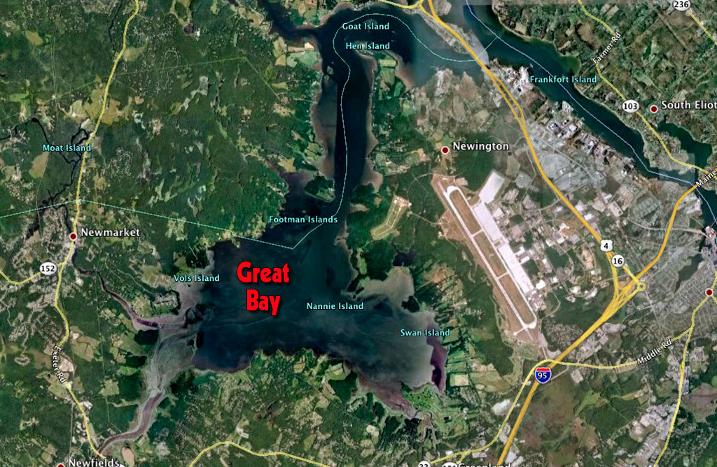
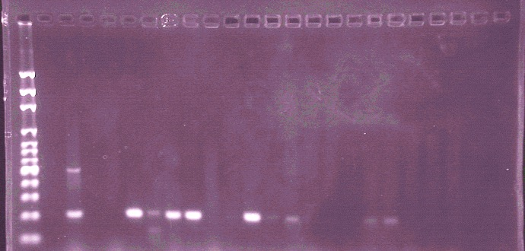
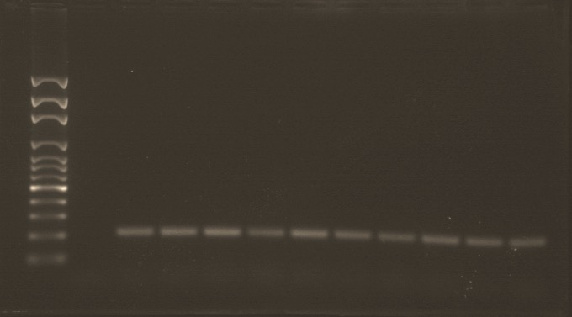
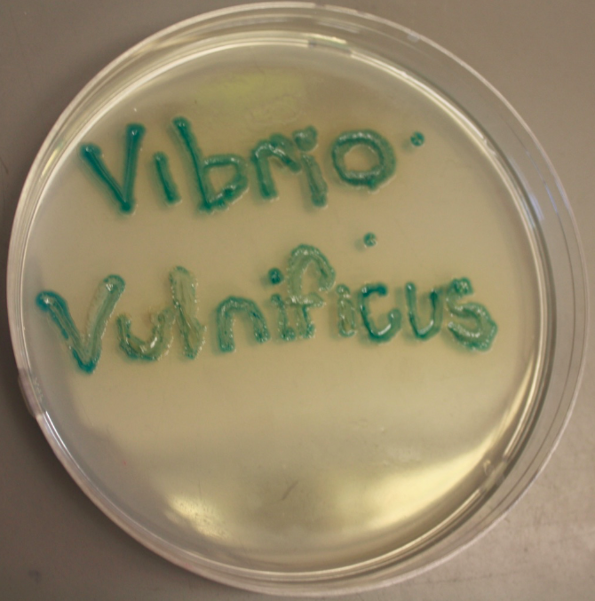
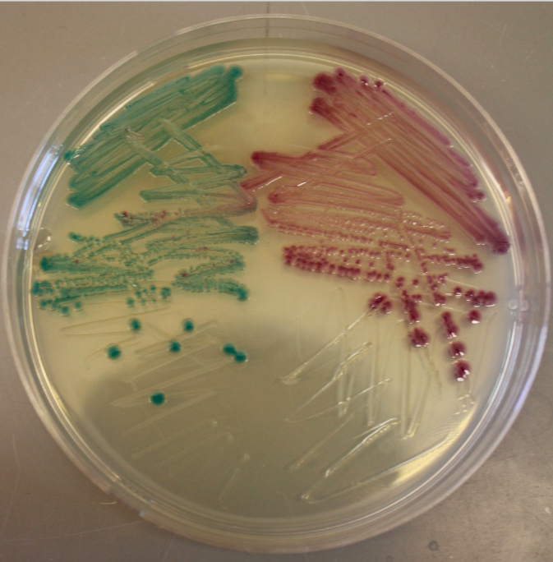
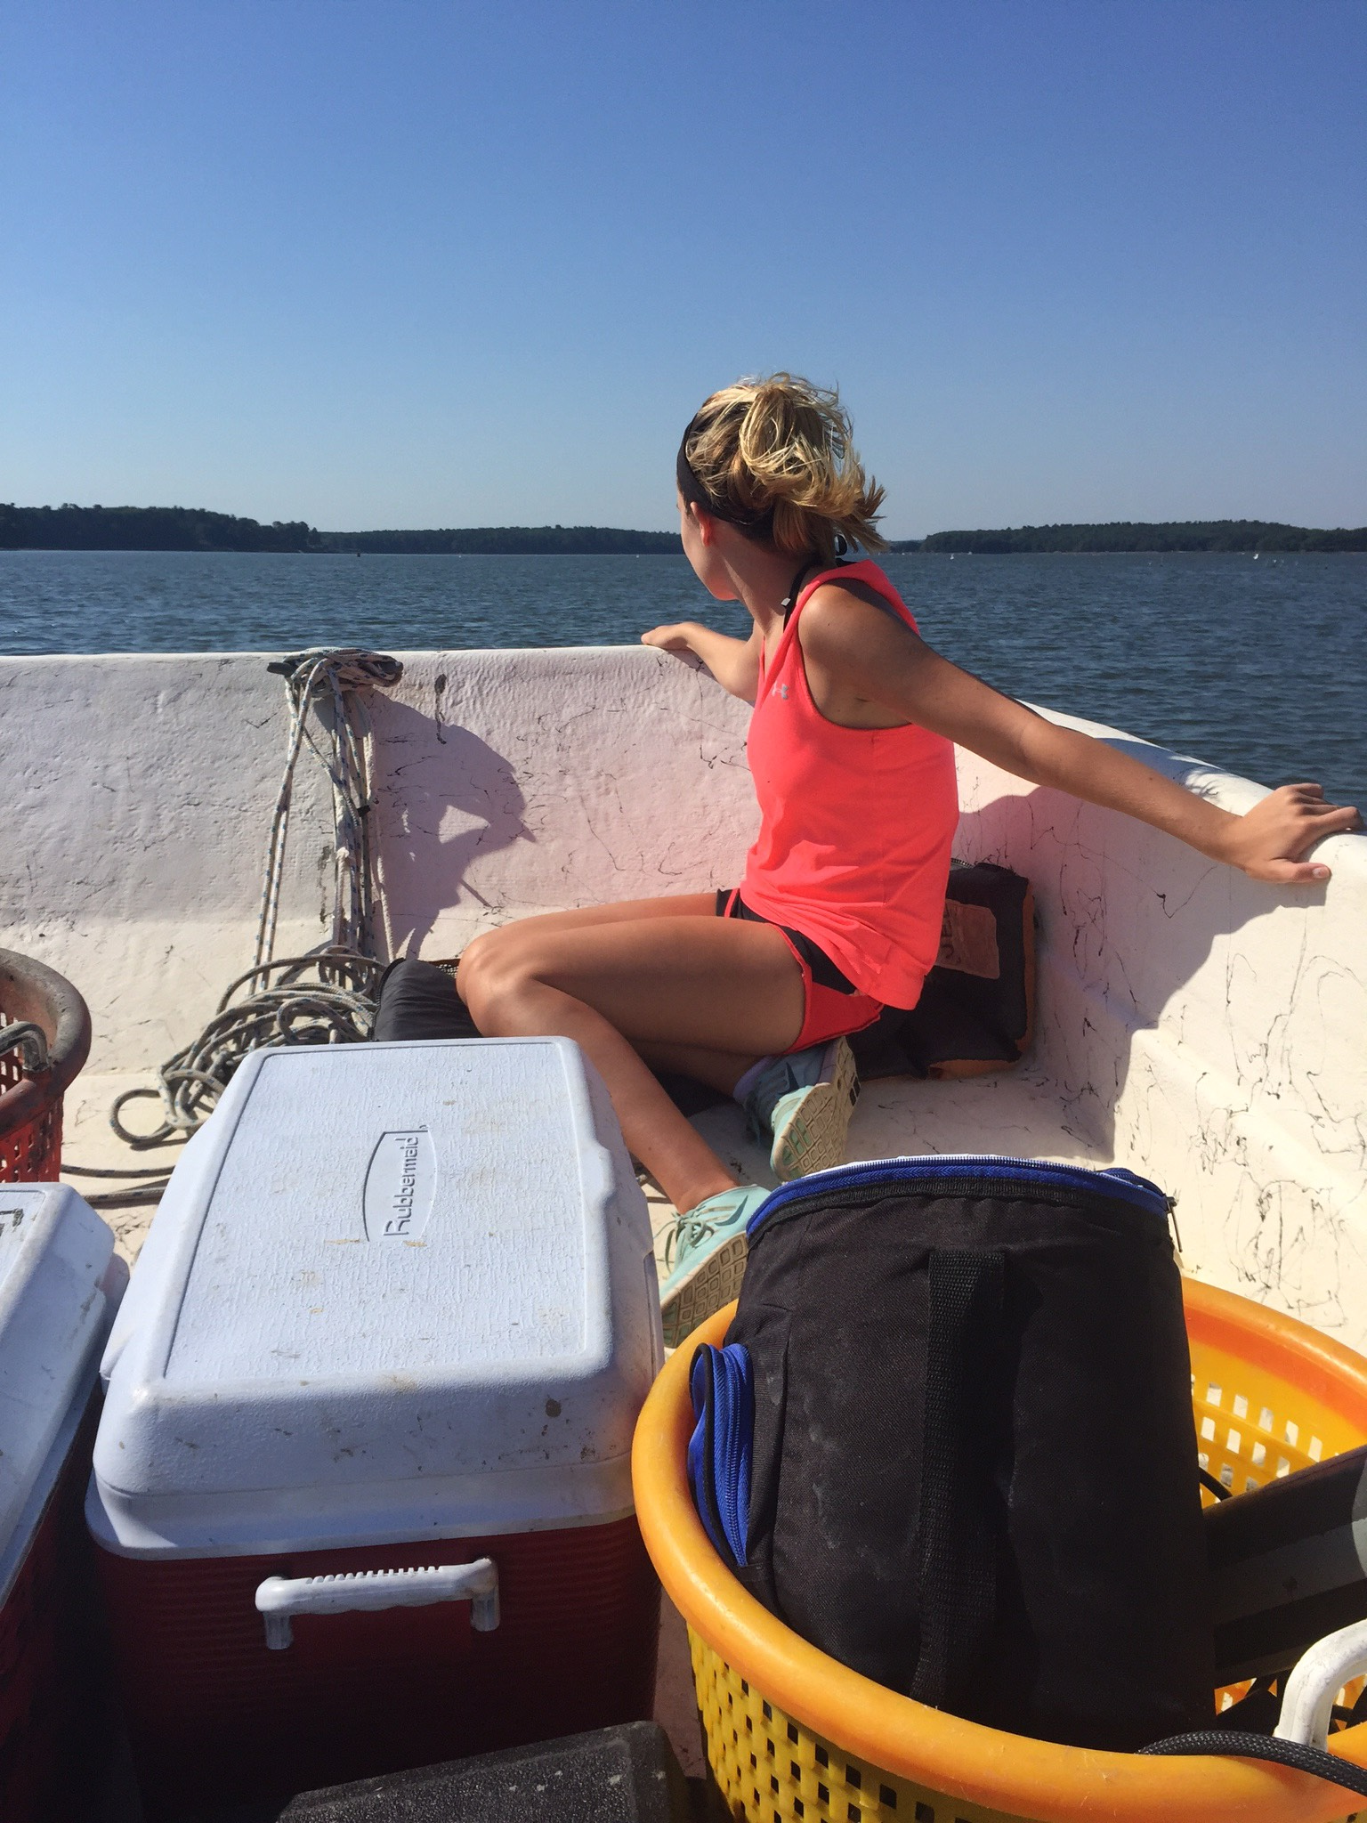
Isolation and Confirmation of Vibrio Species
Katherine Kiley, Dr. Steve Jones, Dr. Steven Hale
Department of Biological Sciences, University of New Hampshire
Abstract
Materials and Methods
Results
Vibrio species are bacteria found in coastal marine waters that can be harmful to humans if pathogenic strains of the bacteria are contracted. In particular, there are three species that cause health problems in people, Vibrio vulnificus (Vv), Vibrio cholerae (Vc) and Vibrio parahaemolyticus (Vp). Each of these species cause different medical issues, with V. vulnificus being the most detrimental of these species.
The ultimate goal of studying these bacteria is to discover why they have become more prominent in local waters in recent years, by monitoring bacterial levels and environmental parameters that may affect levels. We study these bacteria by isolating them to determine the species and to test isolated strains for potential pathogenicity.
Over the course of the 2015 field season, samples collected from Great Bay included oysters, sediment, plankton and water. The overwhelming majority of the species that were isolated and positively confirmed through polymerase chain reaction (PCR) assays and gel electrophoresis was V. parahaemolyticus, followed by V. vulnificus, and lastly very few V. cholerae isolates.
The V. vulnificus isolates that were positive for having the species identifying gene vvh were additionally tested for a potential pathogenicity gene, viu-B, but all were found to be negative.
The sampling and isolation process begins by a “surveillance” of two sampling sites in the Great Bay estuary of New Hampshire: Oyster River and Nannie Island. The two sites are sampled during low tide.
Figure 2. Map of Great Bay Estuary, NH
Grab sample and hydrographic profile readings are recorded at both sites. This includes the depth, temperature, salinity, pH, dissolved oxygen (DO) concentration and DO % Saturation.
Oyster, water, sediment and plankton (phytoplankton and zooplankton) are sampled from both sites.
Once the samples are gathered they then proceed through a “pipeline” process back at the lab.
Serial dilutions are made of each of the samples collected from both sites in alkaline peptone water. Then MPN (most probable number) dilutions are made of each in triplicate. They are then incubated over night.
To proceed in the pipeline process the dilutions that show any form of turbidity are then streaked onto ChromVibrio Agar for isolation. This media is selective and differential for Vibrio species. Any Vv and Vc growth is indicated as blue and Vp grows as purple colonies.
Both blue and purple isolated colonies are then moved on to tryptic soy agar (TSA), a nutrient rich media and incubated overnight. Then isolated colonies are moved to heart infusion broth (HI), another nutrient rich media, and incubated overnight for supplemental growth.
Lysates are made from each isolate and run through PCR (Bio-Rad T100 Thermal Cycler) for DNA gene amplification. This tests for the presence of species identifying and possible virulence genes.
Gel electrophoresis is run to visualize and confirm the presence, or lack of, any amplified genes.
During the 2015 summer there were 220 positive Vibrio isolates:
83.2 % were Vp Positive
15.9 % were Vv Positive
0.9 % were Vc Positive
Figure 3. Graph of Vibrio Isolates
All positive V. vulnificus isolates were tested using the vui-B primer
for the pathogenic virulence factor gene.
All the Vv isolates tested negative for the possible pathogenicity gene viu-B.
Introduction and Background
Figure 4. 1.2% Agarose Gel
Vibrio are bacteria species commonly found in estuaries, brackish waters and other marine communities.
V. vulnificus, V. cholerae and V. parahaemolyticus are the three potentially pathogenic species of vibrio that were studied.
The pathogenic strains of V. cholerae can cause the disease cholera, and the pathogenic strains of V. parahaemolyticus can cause gastrointestinal illness or septicemia.
Pathogenic V. vulnificus strains cause infections that can be life threatening and have a mortality rate from 15% or 50% if the infection progresses into septicemia.
V. vulnificus can be contracted through ingestion of raw seafood or though exposure to an open wound.
Microbiology techniques are used to isolate the Vibrio strains and to confirm their species and the potential pathogenicity of the isolate.
Future Works
Isolates will be used for more in-depth analyses for multiple projects in the Vibrio research center at UNH.
Vv isolates will be sent to Keene State College to be further analyzed.
Vv isolates will be categorized phenotypically and genetically at KSC.
References
Bross, Michael, Kathleen Soch, Robert Moarales, and Rayford Mitchell, "Vibrio vulnificus Infection: Diagnosis and Treatment." Am Fam Physician. 76.4 (2007): 539-44. Web. 29 July 2015.
Centers for Disease Control and Prevention. Centers for Disease Control and Prevention, 21 Oct. 2013. Web. 30 July 2015.
Richardson, Tom. SAT of Great Bay. Digital image. NewEnglandBoating.com. N.p., 21 Oct. 2010. Web. 30 July 2015.
Lemire, Astrid, David Goudenège, Typhaine Versigny, Bruno Petton, Alexandra Calteau, Yannick Labreuche, and Frédérique Le Roux. "Populations, Not Clones, Are the Unit of Vibrio Pathogenesis in Naturally Infected Oysters." The ISME Journal ISME J 9.7 (2014): 1523-531. Web
Muller, Wesley. "Hancock Shrimper Says His Days on the Water Are over after Vibrio Infection." The Sun Herald. N.p., 21 July 2015. Web. 25 July 2015.
Figure 3. ChromVibrio Agar plates streaked with Vibrio bacteria
Acknowledgments
This research was supported by the National Science Foundations Grant to NH EPSCoR #1330641
A special thanks to Kari Hartman, Jackie Lemaire, Liz Deyett, Meg Hartwick and Loren Launen
Figure 1. Field Work

