Slide 1

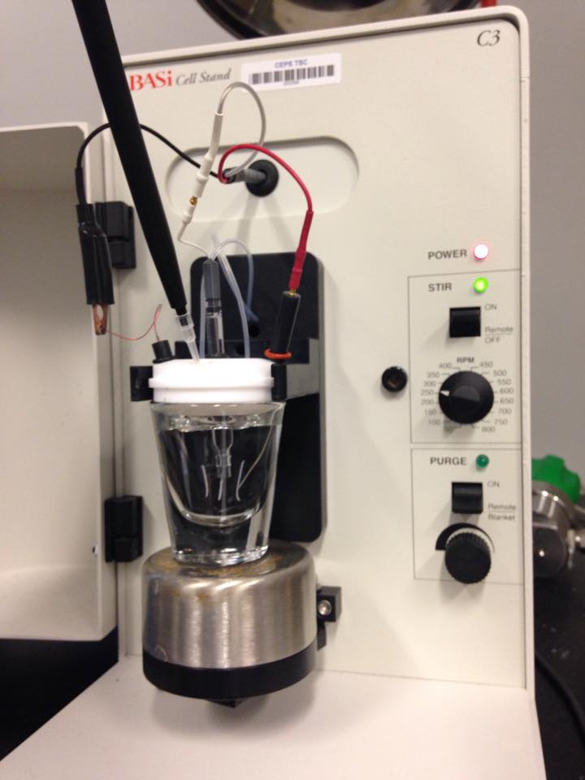
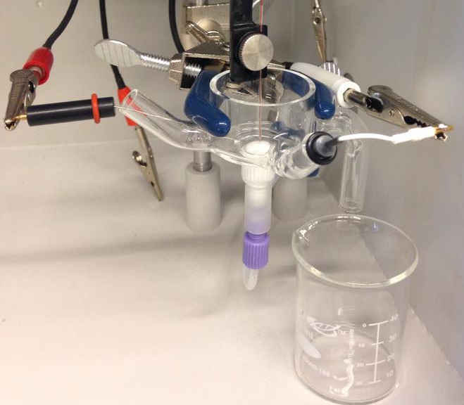
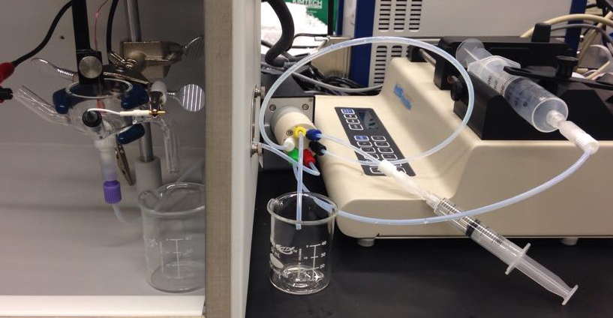
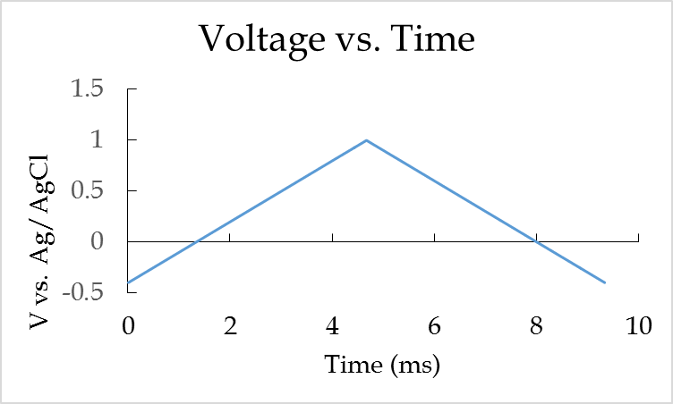
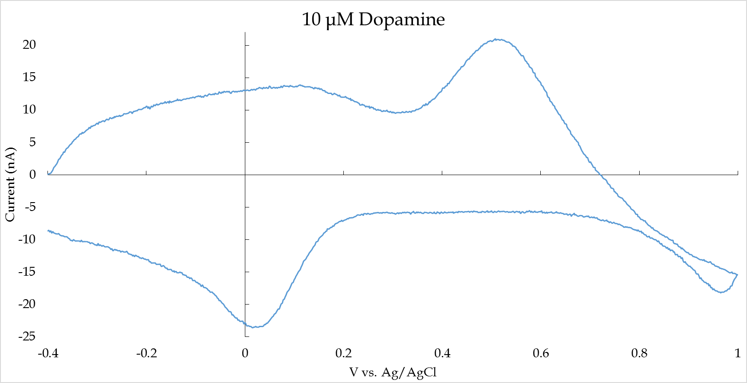
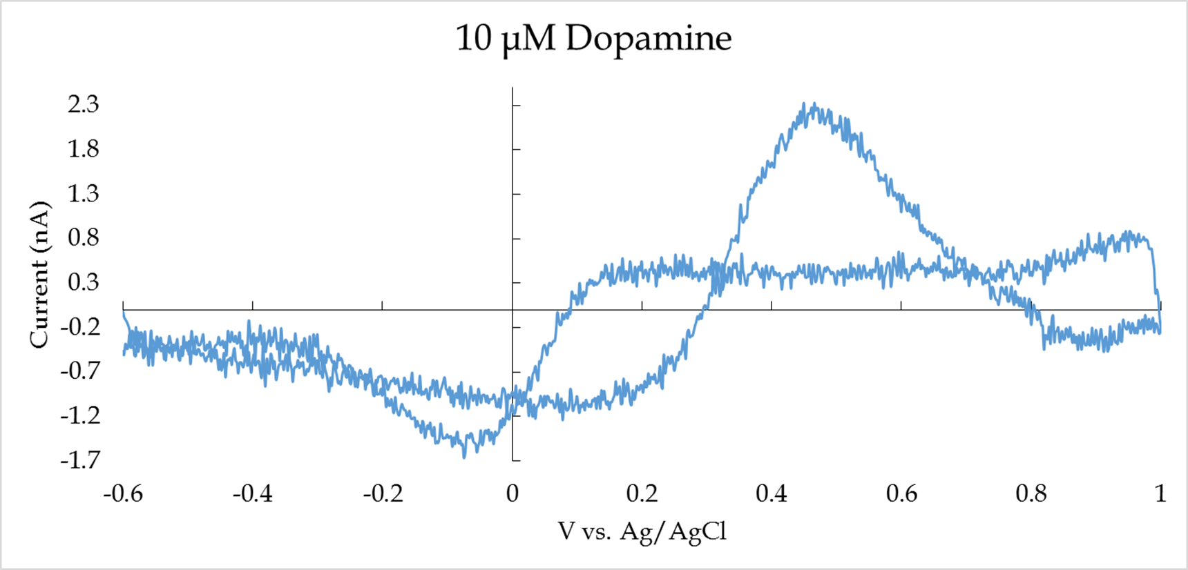
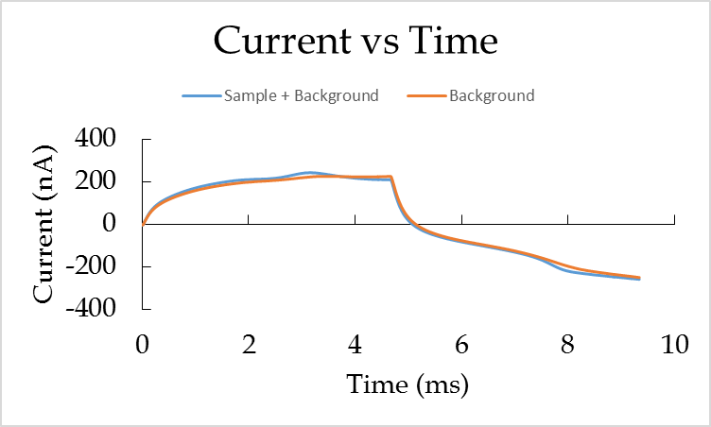
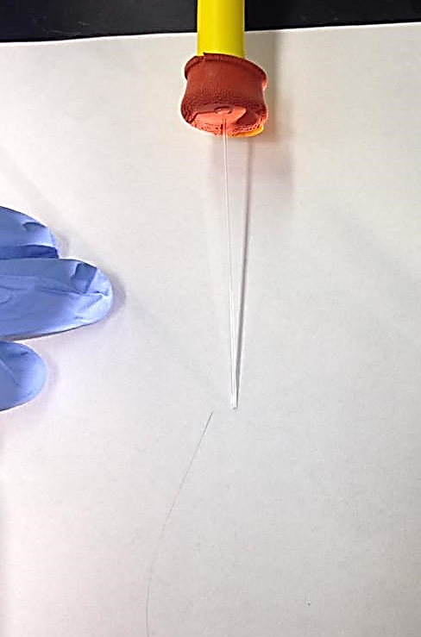
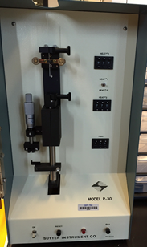
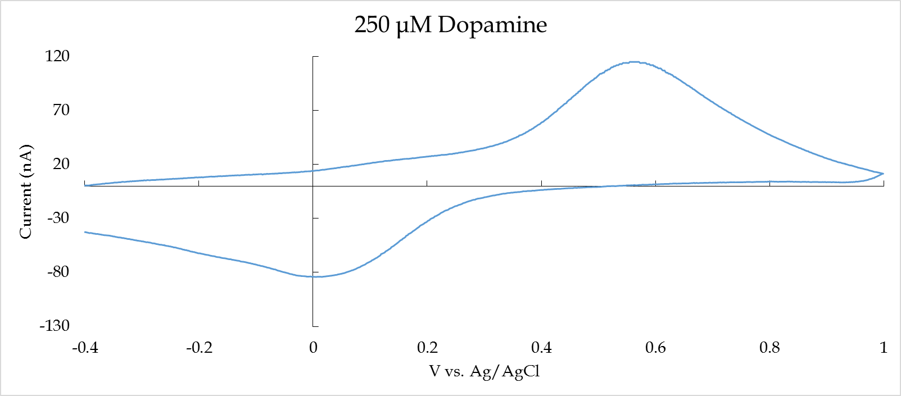
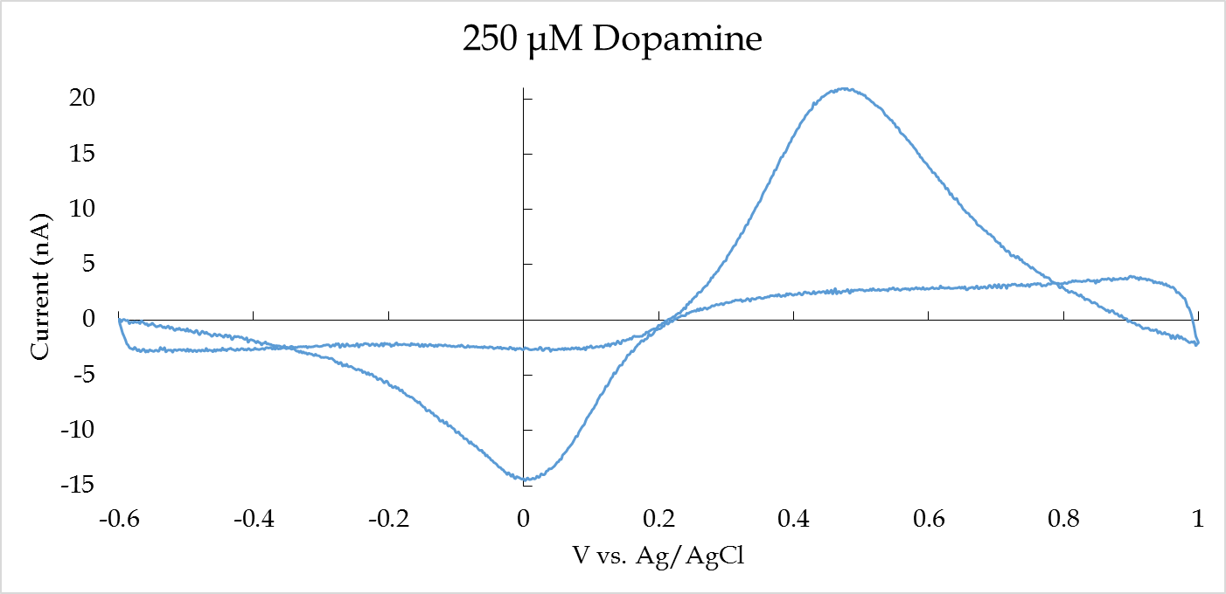
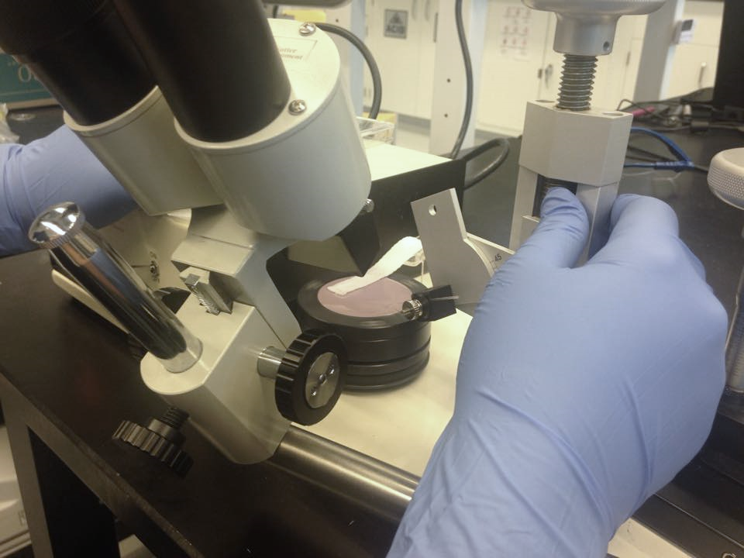
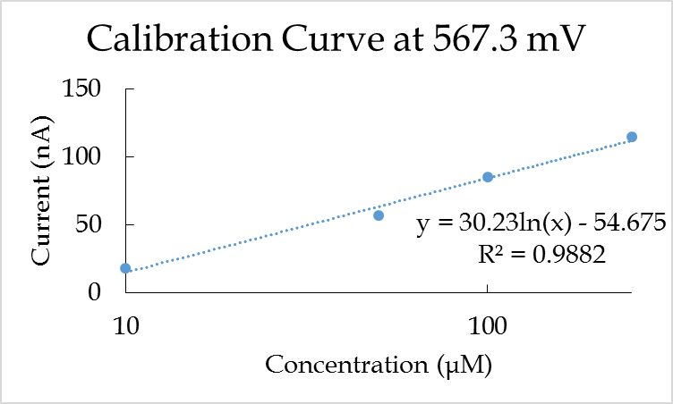
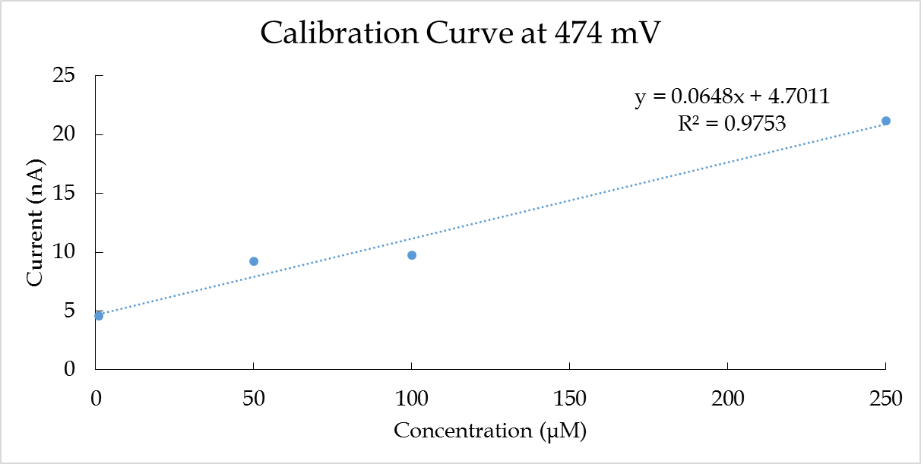

Comparison of Flow Cell vs. Static Cell
Kathryn Rose Verfaillie
Advisor: Dr. Jeffrey Halpern
Static Cell
Dopamine is added to the cell
  Increasing concentration from low to high with micro pipette
Uses stir bar to mix added samples
Background taken before each experiment
Flow Cell
Individual samples are made for each concentration
  Samples are injected freely via the sample loop
Sample is constant refreshed in situ
Takes background before each new sample
(ENG) 1132648
Overview of Project
What Was Done:
Assembled a flow cell
Tested dopamine in the flow cell and the C3 static cell
Will the curves from the two cells look the same or different?
Determined advantages and disadvantages of each cell
Benefits of Flow Cell:
Able to go backwards and forwards in the serial dilution
Able to do buffer between each serial dilution
Always refreshing the sample over the electrode
Uses smaller volumes than a static cell (5 mL vs 40 mL)
Voltammetric Analysis
Fast Scan Cyclic Volatammetry.
  Gamry Potentiostat
  Scan rate of 300 V/s
  Each electrochemically active species creates a signal
Background Subtraction
  Removes noise and background to get the pure dopamine curve
Ag/AgCl Reference
Platinum Counter
Carbon Working
Phosphate buffered saline solution
Sample Loop
Sample Addition
Platinum Counter
Carbon Working
Making Carbon Electrodes
Separate a singular 7 μm diameter carbon fiber
Use suction to draw the fiber into a capillary
Use the puller to make two pointed electrodes
Cut the electrode under the microscope to make a flush tip
Seal the electrodes with Epon Resin 828 and m-phenylenediamine epoxy
Bevel the electrode to create a flush disc electrode
Phosphate buffered saline solution with sample
Phosphate buffered saline solution
Ag/AgCl Reference
Static Cell Experimental Set Up - Photo by Elnaz Mohamadi
Sample
Flow Cell Experimental Set Up
2.
3.
Suction
Flow Cell vs. Static Cell
Pros:
Flow cell uses less volume
Two serial dilutions with 2.5 mL of sample
  Produces more data
  Less waste
Cons:
Less experience with equipment
Still needs to be perfected
Lower amplitude
The flow cell is better than the static cell:
Linear calibration curve
Needs more perfecting
Capillary
Carbon fiber
6.
Making Electrodes - Photos by Mohamadi & Thompson,
Acknowledgements
This research was supported with funding from the National Science Foundation’s grant to NH EPSCoR (ENG-1101245).
The RETE Program, Steve Hale
UNH, Alexis Mack, Mariah Arral, Garrett Thompson, Elnaz Mohamadi
PSU, Dr Susan Swope, Dr Jeremiah Duncan

