Slide 1

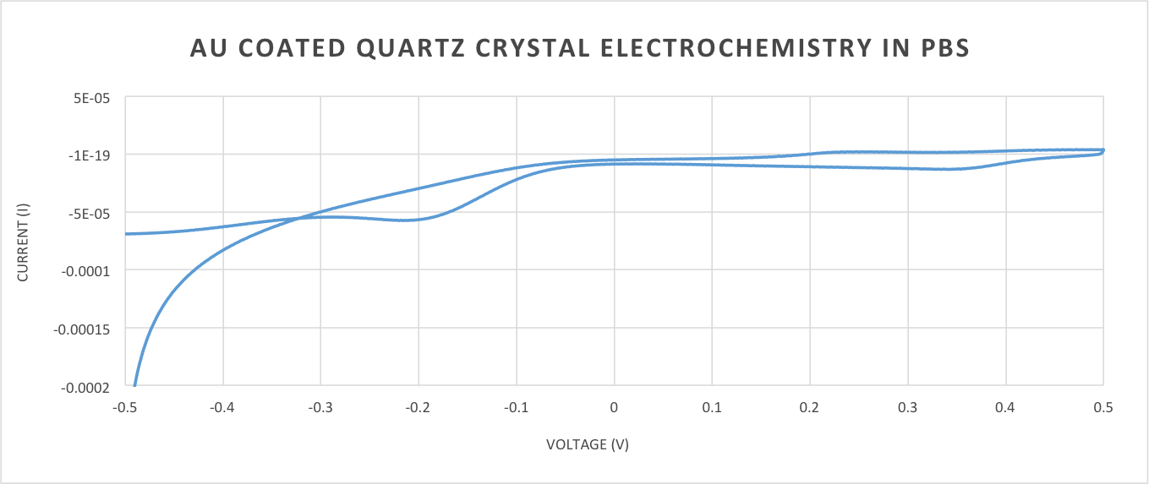
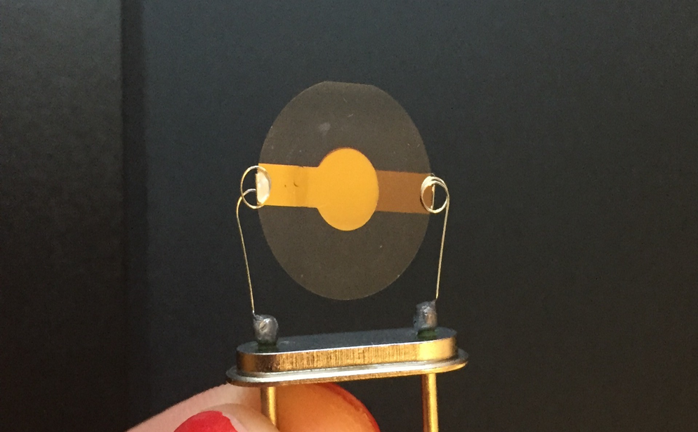
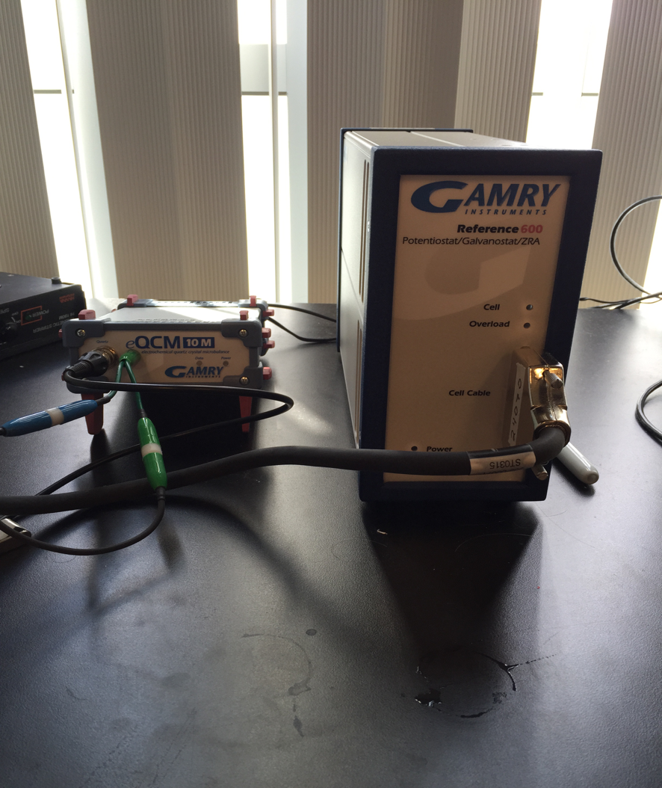
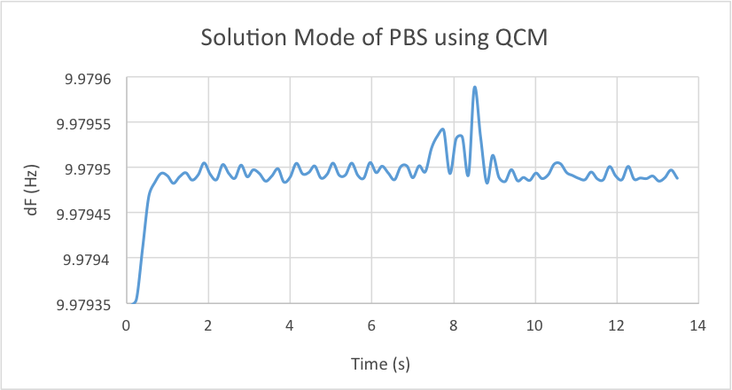
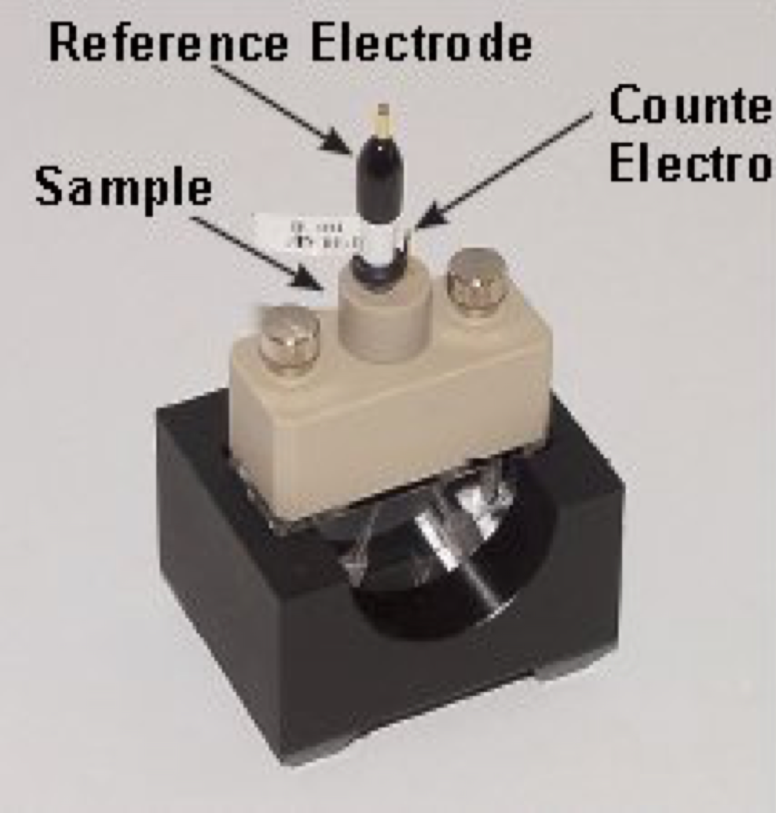
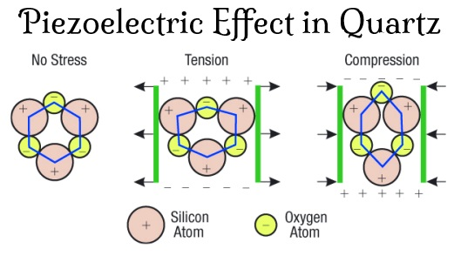
Electrochemical Quartz Crystal Microbalance for Biosensor Applications
Alexis Mack and Jeffrey M. Halpern
Dept. of Chemical Engineering, University of New Hampshire
Electrochemical Quartz Crystal Microbalance (eQCM)
Gold-coated quartz crystal acts as electrode surface in the eQCM setup
Measures mass changes at electrode surfaces when a current is introduced
Potentiostat drives electrochemical and QCM measurements
Microbalance based on the piezoelectric effect
Sauerbrey’s Equation:
△m= Change in mass A = Area
v_{q}= Volume of quartz f₀= Fundamental resonant frequency
ρ_{q}= Density of quartz △f= Change in frequency
Phosphate Buffer Saline Solution on eQCM
Gold portion where mass change is read
Resonant Frequency Changes on QCM
COUNTER ELECTRODE
Ref. 2
Purpose in our Laboratory:
Study mass with electrochemistry of specific analytes
Support readings from potentiostat
Understanding surface chemistry
Provide a control for electrochemical analysis
Ref. 1
Piezoelectric Effect
Mechanical pressure generates an electrical field
Analyte adsorption acts as mechanical stress on quartz crystal surface which changes the resonant frequency
Electrostriction is the mechanical deformation caused by an electrical field (opposite of the piezoelectric effect)
Ref. 3
Future Outlook:
Build flow cell for cyclic experiments
Begin experimentation on eQCM flow cell opposed to static cell
Modify quartz crystal surfaces for increased selectivity and specificity of analytes in a complex mixture
Elastin-Like Polymer research
Ref. 3
QCM flow cell demonstration of resonant frequency changes
Phosphate buffer saline solution, PBS, first followed by a salt injection
Collapse of molecules on surface reads as a change in resonant frequency
Drop in frequency = molecule collapses on surface
PBS flushes salt off quartz crystal and causes expansion of molecule again
Ref. 2
Our Lab’s Equipment
eQCM 10M™ Quartz Crystal Microbalance
Reference 600™
10 MHz Gold-coated Quartz crystals
10 MHz Carbon-coated Quartz crystals
References:
www.wonatech.com/ckseo/ALS/EQCM%20mode%201.jpg
http://paganpath.com/study/academy/crystals
Valiaev, Alexei, et al. "Microcantilever sensing and actuation with end-grafted stimulus-responsive elastin-like polypeptides." Langmuir 23.1 (2007): 339-344.
Acknowledgments: Research was funded by the University of New Hampshire, the College of Engineering and Physical Sciences, and the Department of Chemical Engineering

