Slide 1
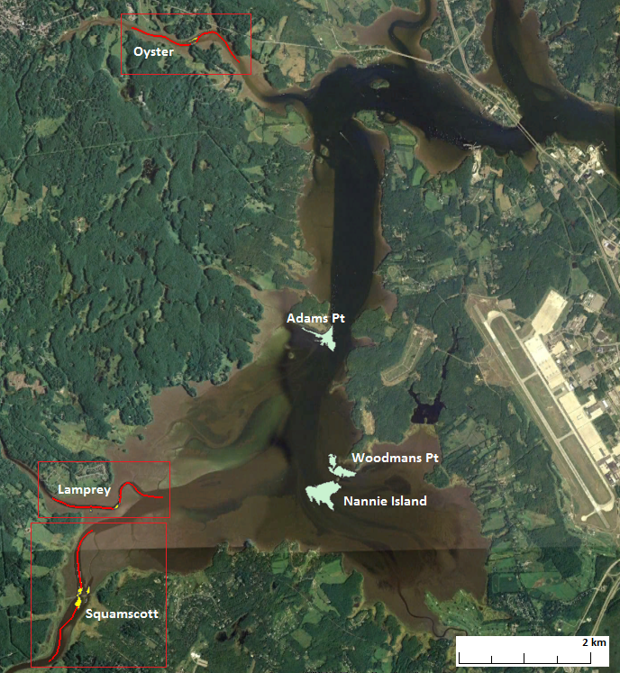
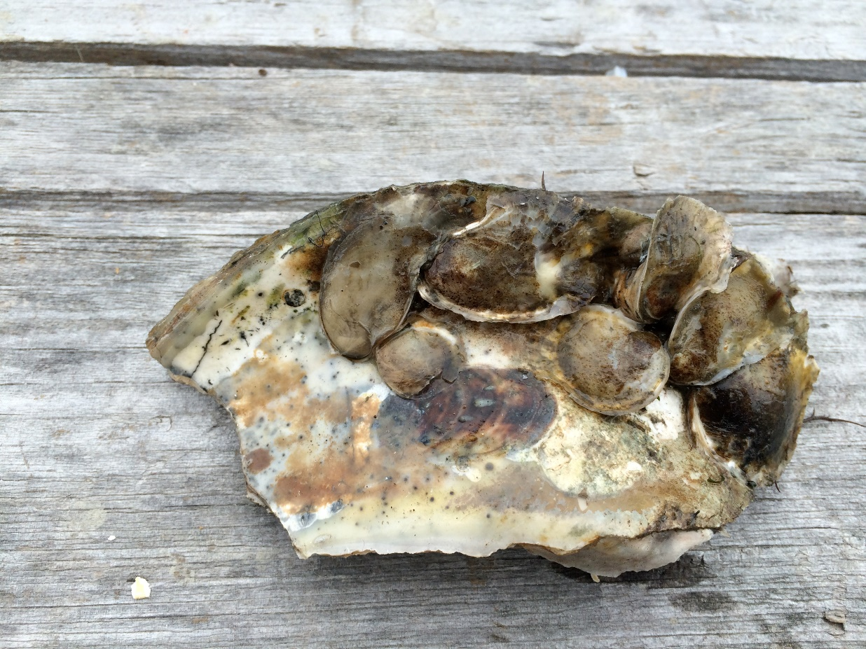
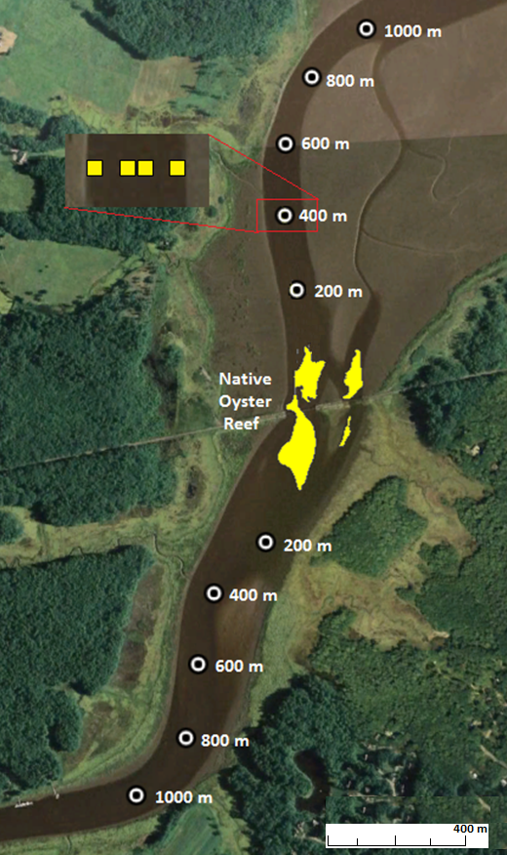
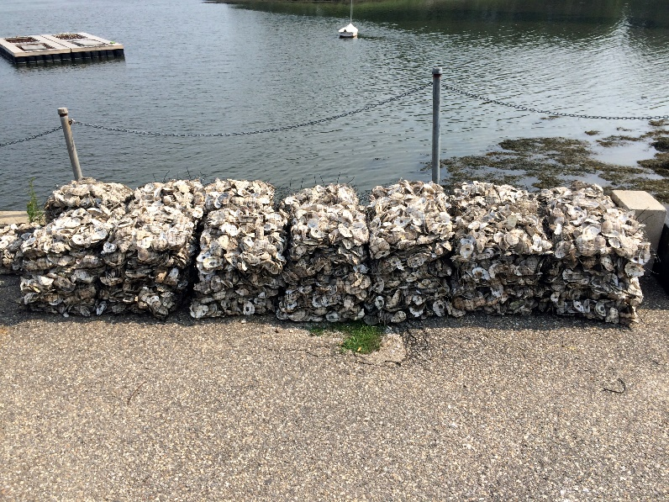
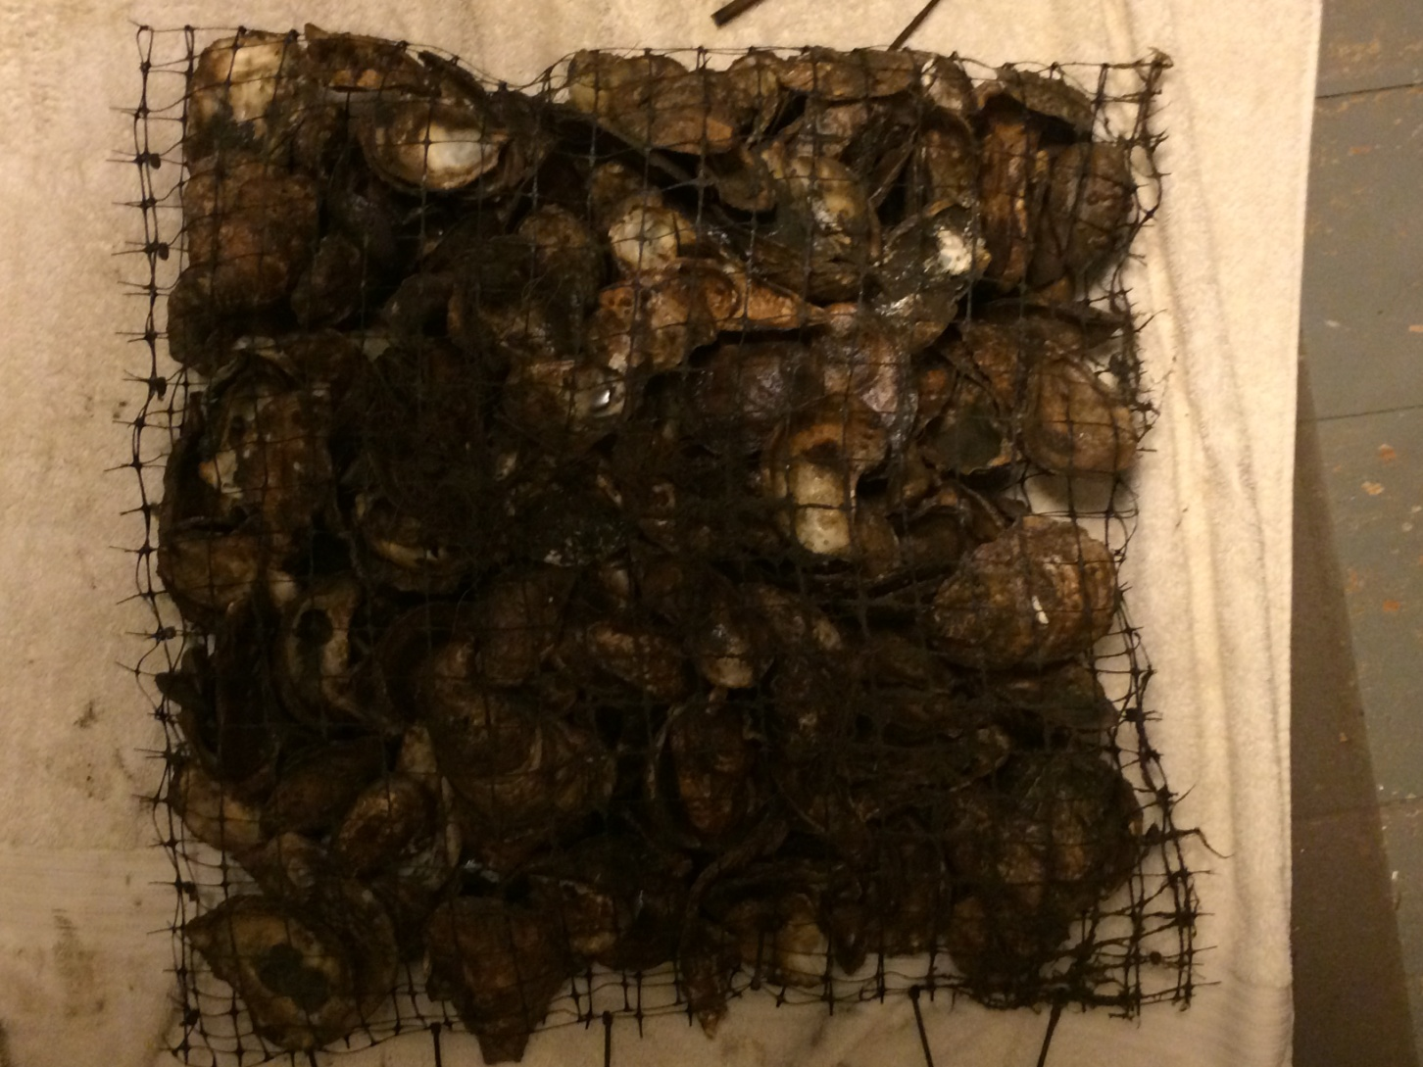
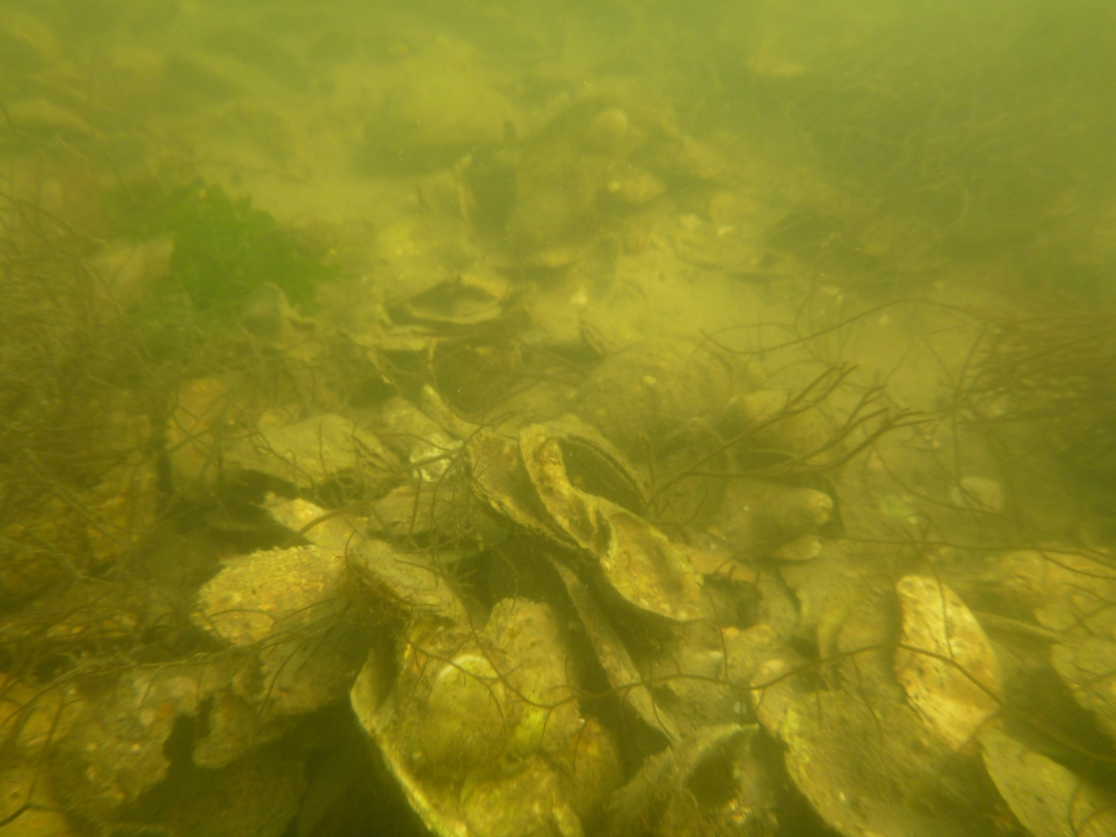
Spatial patterns of spat density in relation to distance from native oyster reefs
in Great Bay Estuary, New Hampshire
Robert L. Eckert & Raymond E. Grizzle
Department of Biological Sciences, University of New Hampshire, Durham, New Hampshire 03824
Introduction
Results
The Eastern oyster, Crassostrea virginica, populations along the east coast have been decimated by the combined impacts of disease, excessive siltation and past exploitation. The population of oysters in the Great Bay Estuary, NH have decreased by ~90% since the early 1990’s¹. Resource managers are relying on oyster restoration projects to restore the ecological functions of native oyster reefs.
Understanding how proximity to a native oyster reef affects recruitment patterns could assist in restoration site selection. Oyster larvae exhibit selective swimming; moving into the water column during flood tide and resting on bottom during ebb^{2,3}. Crassostrea virginica larvae are relatively weak swimmers, which would suggest that larvae may primarily be dispersed as passive particles. However, Tamburri et al. (1992), observed oyster larvae sinking or swimming downward in response to physical and chemical cues. In addition, oyster larvae are gregarious settlers and exhibit active substrate choices suggesting some degree of active transport during settlement⁵. Evidence for oyster settlement decreasing with increased distance away from spawning oysters was observed from a single source population of Pacific oysters, which are broadcast spawners, in 1932 and 1936⁶. In this study, spatial patterns of oyster recruitment were studied at three native oyster reefs in Great Bay Estuary, NH.
Spawning of oysters was observed the second week in July 2014 at all three study sites. Settlement of larvae occurred between the first and third week of August. Oyster spat ranged in size from 2 to 36 mm, with a mean of 11.4 mm for all sites combined. Ninety-percent of spat were less than 20 mm. There was a significant decrease in spat densities as proximity from a native reef increased (Figure 1), while recruitment was not significantly different upstream or downstream from a native oyster reef (Figure 2).
Figure 1. As distance from native oyster reef increases the spat density decreased.
A
B
Great Bay Estuary, NH
C
D
D
E
Research Objective
Quantitatively characterize the spatial patterns of oyster recruitment within 1 km of native oyster reefs.
Figure 2. Shell bags upstream and downstream of native oyster reefs did not differ significantly in spat density.
Figure 3. Shell bags along channel edge and in the center of the channel did not differ significantly in spat density.
Methods
The study was conducted at three study sites (Lamprey, Oyster, and Squamscott Rivers) in the Great Bay Estuary, NH. Shell bags were deployed during low tide the first week of July 2014 and retrieved during the third week of September 2014. At each study site, four shell bags were deployed upstream and downstream of the native oyster reef at 200, 400, 600, 800, and 1000 meters; eight shell bags were deployed on each of the oyster reefs. At each distance from the native reef, two shell bag were deployed both along the channel edge and in the center of the river channel at low tide. Upon retrieval of shell bags, all oyster spat were measured and enumerated.
Conclusions
There was a significant decrease in spat densities as proximity from a native reef increased. This may be due to the selective swimming behavior of oyster larvae during ebb and flood tides, along with responses to chemical cues from native oyster reefs. Results suggest that restoration efforts should consider extending the natural boundary of native oyster reefs to provide the greatest potential for natural recruitment and thus long-term reef development. Currently we are conducting this study again in the Fall 2015 and preliminary results are similar to results from Fall 2014.
Mesh shell bags (50 x 50 cm, mesh size 2.5 cm) were filled with ~250 oyster shells
Retrieved mesh shell bag. In Great Bay Estuary for 12 weeks
View of oyster reef at the Squamscott River
Squamscott River Study Site
References
Acknowledgements
1. Konisky, R., R. Grizzle, K. Ward, R. Eckert, and K. McKeton. 2014. Scaling-Up: A Fifth Year of Restoring Oyster Reefs in Great Bay Estuary, NH 2013 Annual Program Report. PREP Publications. Paper 40; 2. Carriker, M. R. 1951. Ecological observations on the distribution of oyster larvae in New Jersey estuaries. Ecol. Monogr. 21: 19-38; 3. Wood, L. and W. J. Hargis, Jr. 1971. Transport of Bivalve larvae in a tidal estuary. Pages 29-44 in D.J. Crisp (ed.) Fourth European Marine Biology Symposium. Cambridge University Press, New York; 4. Tamburri, M.N., R.K. Zimmer-Faust and M.L. Tamplin. 1992. Natural sources and properties of chemical inducers mediating settlement of oyster larvae: A reexamination. Biology Bulletin, 183:327-338; 5. Zimmer-Faust, R.K. and M.N. Tamburri. 1994. Chemical identity and ecological implications of a waterborne, larval settlement cue. Limnol. Oceanogr. 39:1075–1087; 6. Quayle, D.B. 1988. Pacific oyster culture in British Columbia. Canad. Bull. Fish. Aquat. Sci. 218:241.
Dr. Chris Neefus, Bruce Smith, Krystin Ward, Megan Glenn, Calvin Diessner, Eryn Murphy, Shane Conlin, and Lesley Atwood

