Slide 1


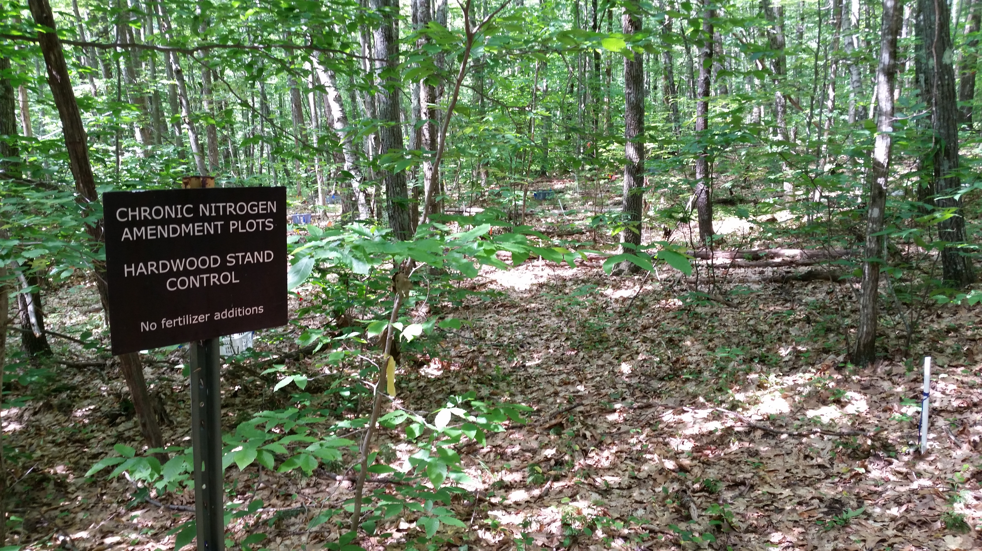
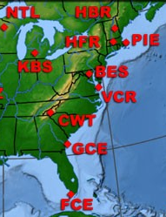
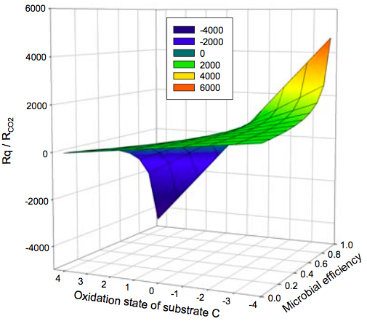
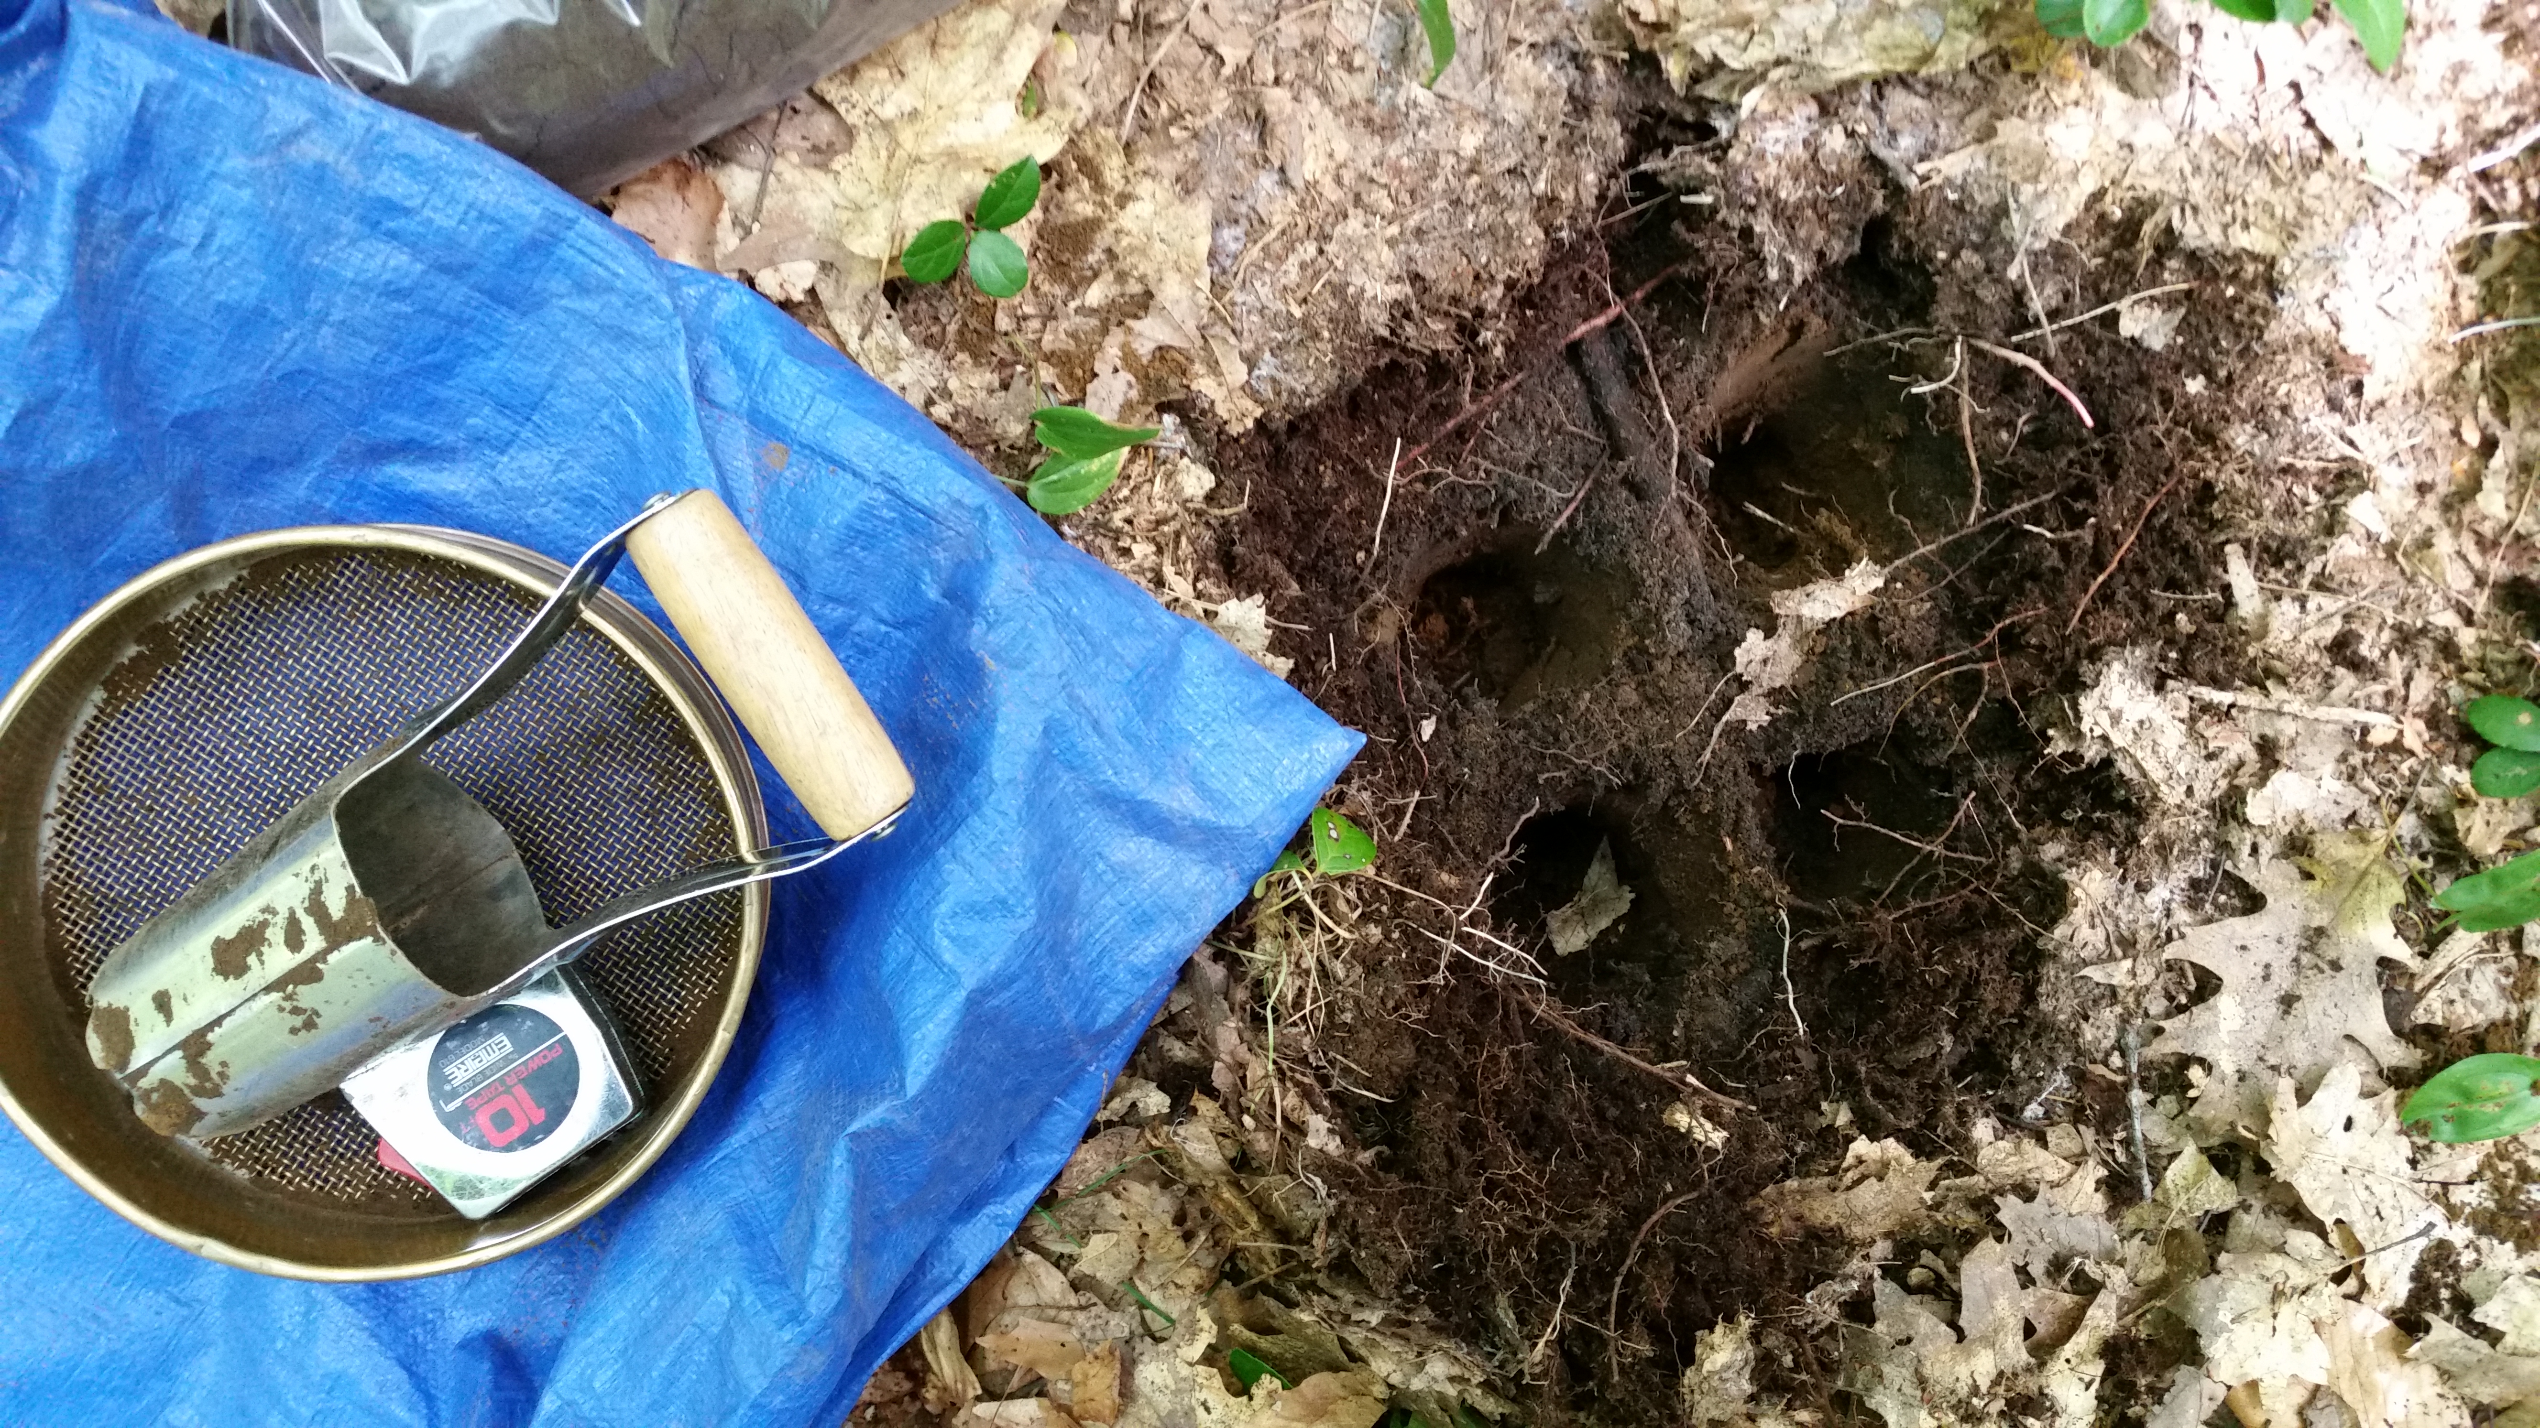
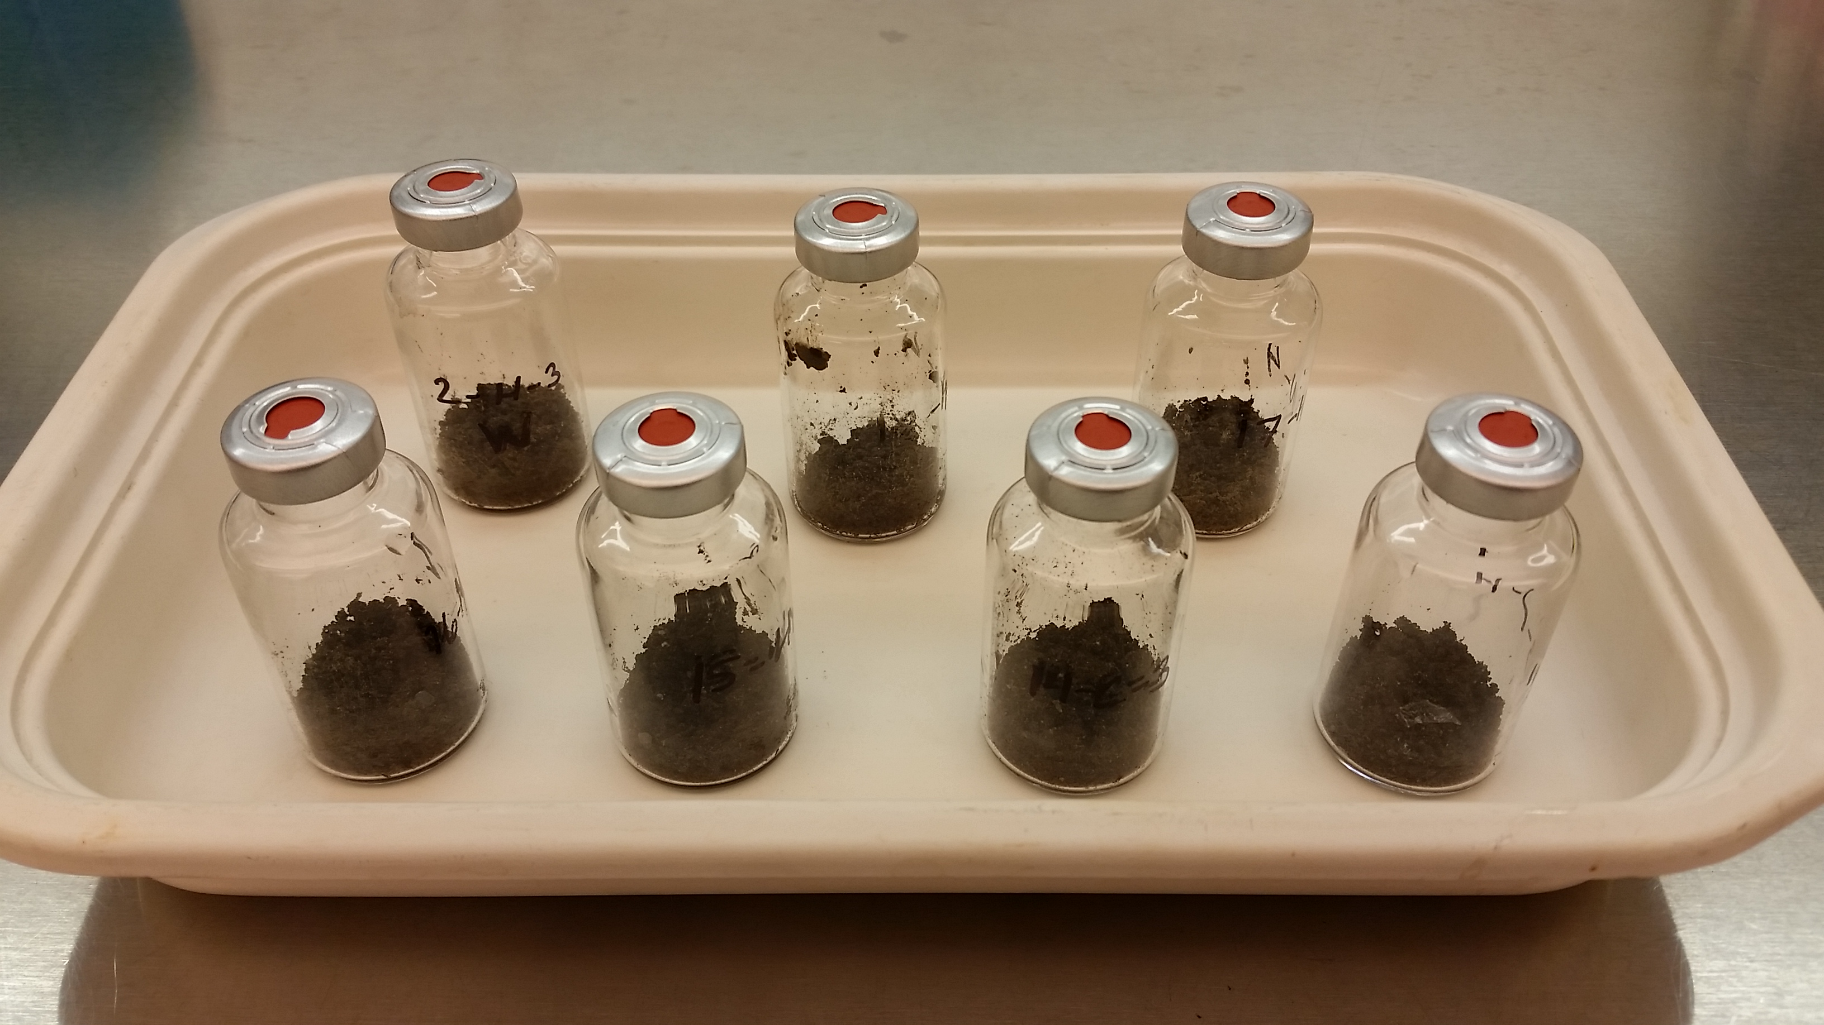
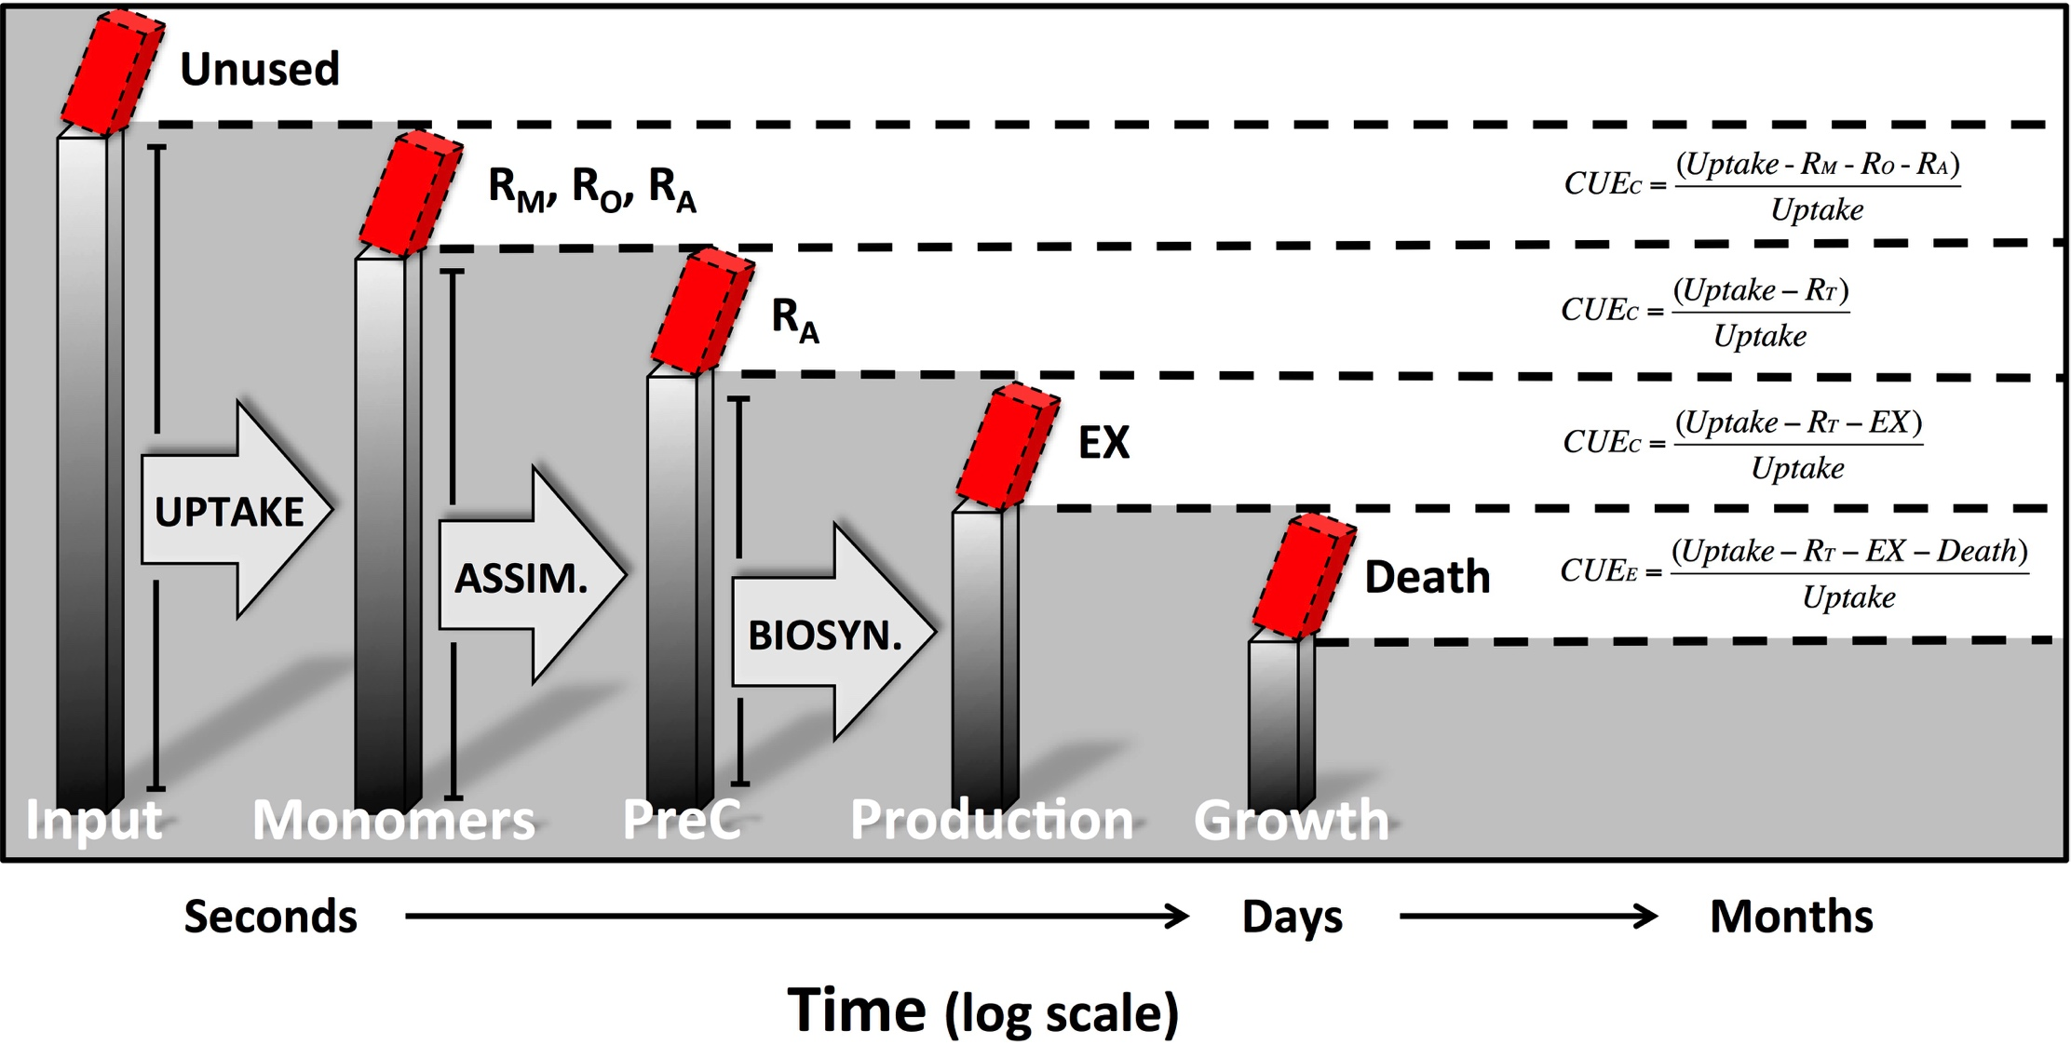

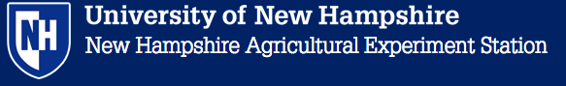

A Comparison of Methods for Measuring the
Efficiency of Microbial Metabolism
Kevin Geyer and Serita Frey
Department of Natural Resources & the Environment – University of New Hampshire, USA
New Hampshire Agricultural Experiment Station – Grant# NH0050
INTRODUCTION
Microbial carbon use efficiency (CUE) is the proportion of metabolized carbon that a microorganism uses to grow.
Although a simple concept, CUE is technically difficult to measure. Numerous methods exist for estimating microbial growth rates and substrate uptake in both soils and water¹.
CUE can also be estimated using calorespirometry, where the efficiency of microbial metabolism is related to the thermal output rate (R_{q}) and respiration (R_{CO2}) of a sample^{2,3}.
QUESTIONS
How do the CUE estimates produced by the following methods compare?
What pattern does CUE follow during soil incubation after amendment with a carbon substrate?
Which methods provide the optimal balance of accuracy and simplicity for use in surveying environmental samples for CUE?
RESPIRATION
SUBSTRATE
UPTAKE
MET
GROWTH
Growth
Δ biomass
growth rate
(Δ substrate – respiration)
Uptake
(Δ biomass + respiration)
(growth rate + respiration)
Δ substrate
METHODS
Soil was collected adjacent to the control plots from a long-term nitrogen addition study at the Harvard Forest LTER. Soil was sieved to 2mm, amended with 2mg glucose-¹³C and a weak nutrient solution, and incubated up to 96 hrs at 25C.
(where substrate C is reduced)
(where substrate C is oxidized)
¹³C-DOC ¹³C-CO₂
¹³C-MBC
¹³C-Soil ¹⁸O-DNA
Heat (Rq)
RESULTS and CONCLUSIONS
Fig. 5
Glucose is an increasing percent of the carbon used for catabolic processes during incubation and represents 100% of CO₂ during peak growth at 24 hrs (Fig. 5). Glucose remains at least half of all respired CO₂ even after 96 hrs.
Fig. 1
Heat flux (Fig. 1) and respiration (Fig. 2) both peak about 24 hrs after amendment before rapidly returning to background levels. Over this time period, R_{q}/R_{CO2} indicates a peak in efficiency between 24-48 hrs (Fig. 3). Values are corrected for a water control.
Fig. 4
CONCLUSIONS
DNA concentrations show a similar peak between 24-48 hrs after amendment (Fig. 4). Growth using amended glucose is not initiated until after 4hrs, and new biomass is rapidly lost by 72 hrs as substrate is exhausted and turnover causes a decline in DNA concentrations.
Growth, respiration, and heat flux all peak about 24 hrs after glucose addition.
R_{q}/R_{CO2} also peaks at 24-48 hrs after amendment.
Fig. 2
Fig. 3
These patterns suggest lag,
exponential, and declining
phases of metabolism where CUE (R_{q}/R_{CO2}) peaks during periods of both high respiratory and growth activity.
CUE during the lag phase may represent in-situ growth conditions, while the declining phase integrates turnover & necromass recycling.
References
¹Manzoni et al. 2012. Environmental and stoichiometric controls on microbial carbon-use efficiency in soils. New Phytologist 196:79-91.
²Frey et al. 2007. Microbial metabolism and soil organic matter dynamics: Microbial growth efficiency and soil carbon storage. Annual Soil Science Society of America Meeting, New Orleans, LA.
³Hansen et al. 2004. Use of calorespirometric ratios, heat per CO2 and heat per O2, to quantify metabolic paths and energetics of growing cells. Thermochimica Acta 422: 55-61.

