Slide 1
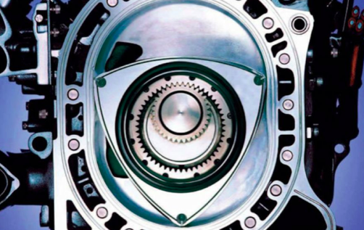
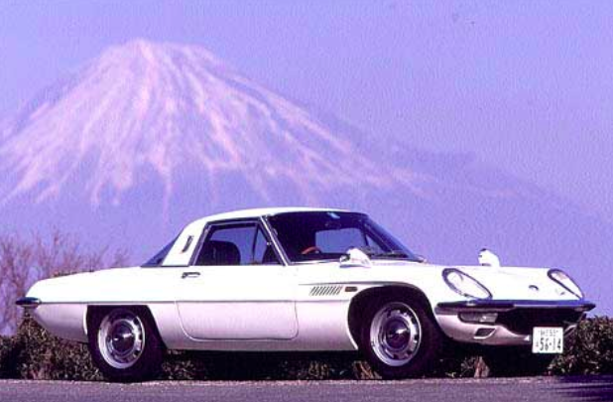
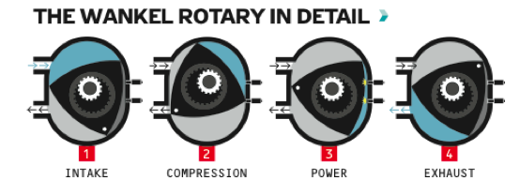
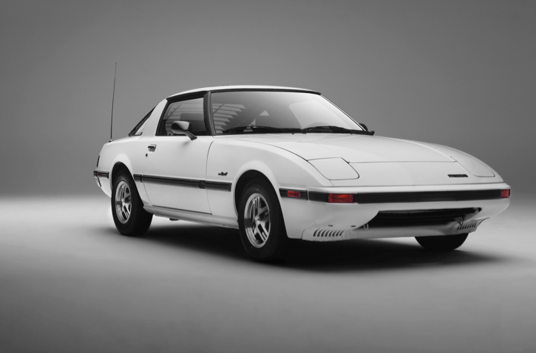
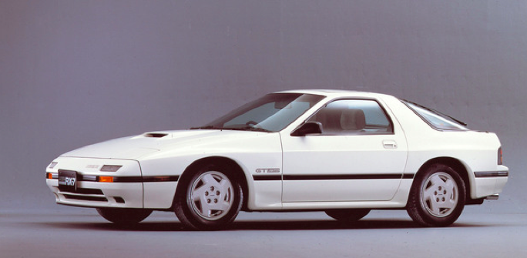
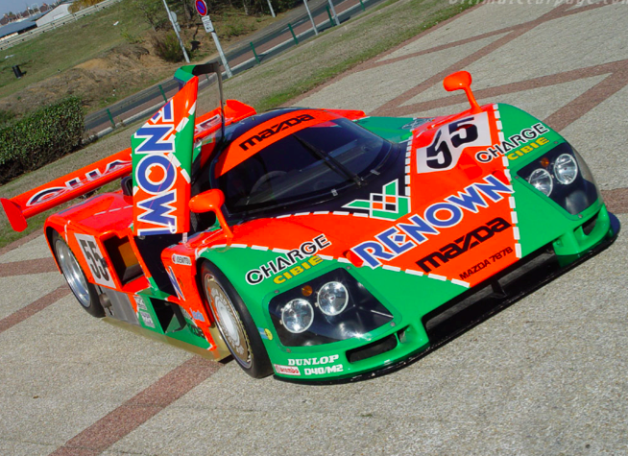
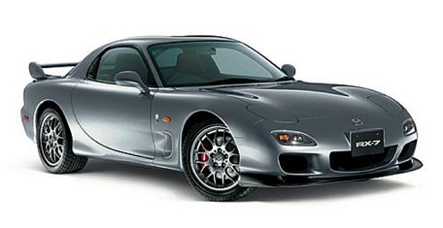
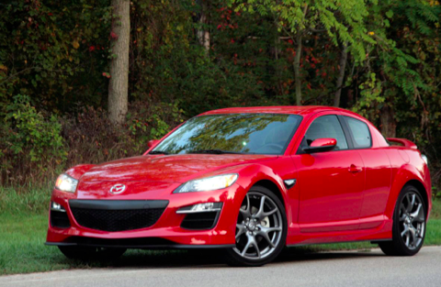
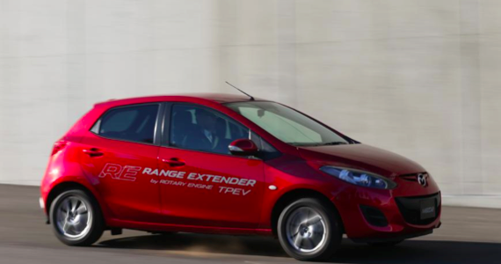
The Life, Death, and Future of the Rotary Engine
Alex McGinn, UNH ‘19
Introduction
How does a rotary engine work?
The year is 1924 and German engineer Felix Wankel is hard at work creating the first Rotary engine the world would ever see. By 1957 his creation had been tested and proven to be very efficient. Because of it’s unique design it did not require pistons which meant less moving parts which in turn meant the engine was less likely to face mechanical problems. This caught the eye of a Japanese automaker called Mazda. By 1963 Mazda had formed it’s RE(Rotary engine) research department to perfect the engine
History
Uses pressure created when combination of fuel and air is burned Pressure contained in chamber of engine formed by rotating triangle, hence why it’s called a rotary engine As the rotor moves around the chamber the three volumes of gas contract and expand This draws fuel and air into the engine compressing it to create power until the gases finally expand and are shot out through the exhaust
In 1967 Mazda released its first rotary powered car called the Cosmo.
1967 Mazda Cosmo 1978 Mazda Rx7 1986 Mazda Rx7 1991 Mazda 787B 1991 Mazda Rx7 2002 Rx7 2011 Mazda Rx8
1967 Mazda Cosmo Specifications: Dual rotor engine(first Mazda with a rotary engine) producing 110 horsepower in a 2000lb car. Power driven to the rear wheels . Had a 4 speed manual transmission. Verdict: Car was a huge hit with enthusiasts worldwide. Had more than enough horsepower for it’s weight and looks to kill. Very important car for Mazda( basically decided whether rotary engine would continue to be used). 1970: US introduces clean air act forcing Mazda to redesign the rotary( which released too many hydrocarbons at the time) to meet the new emission standards. 1973: Mazda’s new rotary was able to pass emission standards. Engineers were able to achieve this by using a thermal reactor system to burn hydrocarbon in exhaust. 1974: Mazda launches the Phoenix Project to deal with the oil crisis. They were able to improve their engines enough to achieve 50% more fuel efficiency thus keeping the rotary engine alive once again. 1978: Mazda Rx7 released as a mass produced rotary engine sports coupe.
1978 Mazda Rx7 Specifications: Rotary powered rear wheel drive 3 door coupe. Manual 4 speed with 128HP weighing in at 2171 Lbs. 0-60 in 8.5 seconds with a 124 mph top speed. Verdict: Forever will be known as a classic and is regarded as one of the best sports cars of all time. Raced in 24 hours of Daytona and claimed first place in it’s class on it’s debut. Also competed in 24 hours of Le Mans and the world rally championship racking up numerous victories. 1986: Mazda releases its generation 2 Rx7.
Why is this Engine Significant? Rotary engine is an extremely simple engine (much simpler than traditional piston engines). For its size it is an extremely powerful engine. For example the Rx8 had a 1.3 liter engine putting out 232 horsepower which is 178 horsepower per liter. If a Corvette with a 6.0 liter V8 was to match this stat it would have to produce 1068 horsepower which is more than twice what it has. If you want more power you can simply add more rotors as done in the 787B which has 4. Rotaries have an extremely high redline (9000rpm in the Rx8) so they can keep revving and producing power for a while until having to change gear. The sound Why is the Traditional Rotary Dead? Despite its small size the rotary never had great mileage. Usually getting a combined mpg of 20 which is incredibly poor from a 1.3 liter engine. The rotary burns oil as a result of the design. The emissions are not up to par with the modern automobile. Conclusion The rotary engine has left a legacy in the world of automobiles and racing however in a world that is eroding there is no place left for an engine like it. Fortunately engineers will always keep engineering and it appears Mazda is not so keen on letting the engine die just yet. With the technology of hydrogen power Mazda has achieved incredibly environmentally friendly results by using this to power a small rotary engine. Although it will most likely never return as a solely gasoline powered engine there is still hope for the rotary engine and this can let enthusiasts around the world breathe a sigh of relief. About Me My name is Alex McGinn and I am a first year student at UNH majoring in environmental engineering. You may be wondering why I would pick this topic. To most of you this research probably seems extensive and unnecessary since the engine is technically dead and it’s fame lives in the past. I grew up riding around in my uncles two Gen 1 Rx7’s and that’s where my love for the rotary began. To this day I still think it is one of the best cars I’ve ever experienced. From the distinct sound it’s engine makes to the fun you can have sliding it around it is more than just a car to me it is a piece of my childhood and I will always remember it as the gateway to my love of cars. However even a gear head like me can realize that the day’s of powerful gasoline fueled engines are coming to an end. The world is slowly dying and emissions from cars are only speeding that up. Being an environmental engineer inspires me to see Mazda refusing to give up on this engine and making it a viable option to be used in cars in the future. References History.com Staff, History.com, 2009, “Rotary engine inventor Felix Wankel born”, http://www.history.com/this-day-in-history/rotary-engine-inventor-felix-wankel-born, April 10, 2016, A+E Networks Julian Rendell, Autocar.co.uk, 2013, “Mazda2 EV Range Extender Prototype First Drive Review”,http://www.autocar.co.uk/car-review/mazda/2/first-drives/mazda-2-ev-range-extender-prototype-first-drive-review, April 10, 2016, 2015 Haymaker Media Group Foxnews.com Staff, Foxnews.com, 2015, “Mazda Rotary Engine May Loose its Spark”, http://www.foxnews.com/leisure/2015/11/16/mazda-rotary-engine-may-lose-its-spark/, April 10, 2016, Fox News Network Mazda.com Staff, Mazda.com, 2013, “Chapter III Entering a New Era and Looking Further into the Future”, http://www.mazda.com/en/innovation/stories/rotary/newera/, April 10, 2016, Mazda Larry Webster, Popularmechanics.com, 2015, “How it Works, The Mazda Wankel Rotary Engine”,http://www.popularmechanics.com/cars/a7103/how-it-works-the-mazda-rotary-engine-with-video/, April 10, 2016, ©2016 Hearst Communications, Inc. All Rights Reserved
Specifications: Modified 13b rotary engine from 1984 model. Engine had redesigned intake manifold, updated fuel injection, and larger intake ducts. Produced 146 HP to the rear wheels and had a perfect 50/50 weight distribution between front and rear wheels. Weighed in at 2656 lbs. Verdict: 0-60 in 7.6 seconds and a 131 mph top speed. Initially criticized for resembling the Porsche 944 however performance and handling soon persuaded the American public to make the gen 2 Rx7 the best selling sports coupe of the year. The Rx7 and rotary maintained their iconic status. 1991: Mazda achieved first place overall in the 24 hours of le mans with its rotary powered 787B prototype racer. They were the first Japanese carmaker to ever achieve a victory at Le Mans.
1991 Mazda 787B Specs: 700 hp four rotor engine. 1830 Lbs. Power driven to rear wheels. Verdict: Car was a rocket ship. 1st place at 24 Hours Le Mans a grueling and world famous race. Faced competition from Mercedes( one C11 was driven by F1 legend Michael Schumacher) , Jaguar, and numerous other proven race cars. 1991: After Le Mans victory Mazda releases its gen 3 Rx7. Specs: Twin turbo rotary powered RWD sports coupe. 236 hp 5 speed manual weighing in at 2866 lbs. Verdict: The last Rx7 to be produced went out with a bang and is many car enthusiasts favorite Rx7 model. 0-60 in 5.3 seconds with a 157 mph top speed. 2002: Rx7 ceases to exist. Economic downturn and bad mileage contributed to the suspension of development of the rotary engine. 2003: RENESIS program launched and a new rotary engine was developed. Naturally aspirated with sufficient power and immensely improved fuel economy keeps the rotary alive. Engine was introduced in new radical 4 door sports car called the Rx8. Won 2003 international engine of the year award. 2006: Mazda released the hydrogen powered RX8 Hydrogen RE. This was the first rotary powered hydrogen engine ever produced. 2011: Rx8 production ceases due to emission regulations and high production cost. 2011 Rx8 Specs: Twin turbocharged 1.3litre rotary engine producing 232 hp and weighing in at 3064 lbs. It was rear wheel drive and had a 6 speed manual transmission. Again it achieved perfect 50/50 weight distribution. Verdict: At its launch car was revolutionary combining four door capability with style and speed. 0-60 in 5.8 seconds and a top speed of 145 mph. Over time its performance figures stood the test and today it is seen as Mazda’s swan song for the rotary engine. The Future: Demio EV concept premiered in 2013. Uses hydrogen powered rotary engine coupled to an electric engine to achieve a driving range of 800 miles. The coupling of the rotary engine and hydrogen power has potential to be an incredibly environmentally friendly engine and Mazda has stated it will continue to further development on the concept.
2013 Mazda Demio EV

