Slide 1
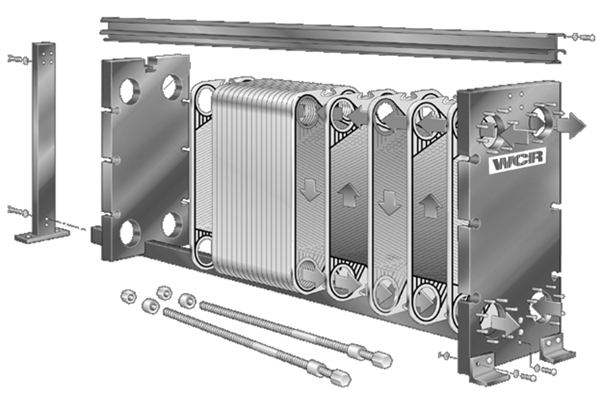
Heat Exchanger Comparison
Christian Giotas, Sun Juanfeng, Edward Stenovitch, Department of Chemical Engineering
University of New Hampshire
Introduction
Results
Design Problem
Purpose:
Compare three common types of heat exchangers (dual pipe, shell-and-tube, and plate) via direct comparison of overall heat transfer coefficients. In addition to heat exchanger type, the effect of flow rate and flow pattern on the overall heat transfer coefficient was investigated.
Log Mean Temperature Difference Method:
Assuming no heat loss to the surroundings, all heat from hot stream is transferred to cold stream
$$q={\dot{m}}_{h}C_{p,h}\left(T_{h,i}−T_{h,o}\right)={\dot{m}}_{c}C_{p,c}\left(T_{c,o}−T_{c,i}\right)$$
Using log mean temperature difference, the overall heat transfer coefficient, U, can be calculated using either q_{hot} or q_{cold}
$$q=UA_{s}∆T_{lm}$$
$$∆T_{lm}=\frac{∆T_{2}−∆T_{1}}{\ln{{∆T_{2}}/{∆T_{1}}}}$$
Overall heat transfer coefficient was calculated for each type of heat exchanger in co-current and counter-current flow patterns.
A liquid reactant stream with a mass flow rate of 3 kg/s has to be heated from 20°C to 50°C before it enters a reactor using an available hot water stream at 80°C. Specify the type, configuration, and size of the heat exchanger.
Assumptions:
Steady state
No heat loss to surroundings
Mass flow rates of cold and hot streams are equal
10 plates (allows for reasonably sized plates)
Length (L) of plate (horizontally) is 20 times larger than width (W) between each plate
Solution Procedure:
Solution:
Plate heat exchanger operating in a counter-current flow pattern
10 plates, 0.429 m wide by 1.06 m tall
Total heat exchange surface area of 4.55 m²
Hot Flow Rate: Plate HE Dual Pipe HE Shell and Tube HE Cold Flow Rate: Plate HE Dual Pipe HE Shell and Tube HE
Overall heat transfer coefficient as it changes with flow rate; counter-current flow pattern.
Overall heat transfer coefficient as it changes with flow rate; co-current flow pattern.
The plate heat exchanger exhibited the highest overall heat transfer coefficient, followed by the shell and tube, and then the dual pipe.
Contrary to expectations, overall heat transfer coefficient for plate exchanger was significantly higher in counter-current flow pattern.
Since overall heat transfer coefficient is not a function of flow pattern, total heat transferred was compared between co-current and countercurrent flow.
Total heat transfer was compared for counter current versus co-current flow for all heat exchangers.
Q=m_{c}c_{p,c}(T_{c,o} – T_{c,i})
(Re)_{lab} = (Re)_{scale}
D_{H,scale} = $\frac{4lw}{2l+2w}$
T_{h,o} (assumption 2)
ΔT_{lm}
L and W of cross-section
A_{suf} = $\frac{Q}{U\text{Δ}\text{T}\text{lm}}$
Methods
conclusions
Inlet and outlet temperatures of the hot and cold streams were recorded at various flow rates. Flow rates according to the following experimental design:
Plate heat exchanger yielded highest U
U was independent of flow patter for shell and tube and dual pipe heat exchangers
Total heat transferred from hot to cold streams is greater in counter-current flow patterns
 | Hot Water Flow Rate (L/min)
Cold Water Flow Rate (L/min) |  | 1 | 2 | 3
 | 1 |  | X
 | 2 | X | X | X
 | 3 |  | X
Total heat transferred in plate, shell and tube, and dual pipe heat exchangers as flow rate for the hot and cold streams are constant at 2 L/min
References
Counter-current flow pattern resulted in a greater amount of total heat transfer from the hot to the cold stream as compared to co-current flow.
Geankoplis, CJ. Transport Processes and Separation Process Principles. 4th ed. New York: Prentice Hall, 2003. Print.
WCR, Plate Heat Exchanger. 2016. http://www.wcrhx.com/images/uploads/1393880556/flow_diagram_WCR.png.

