Slide 2
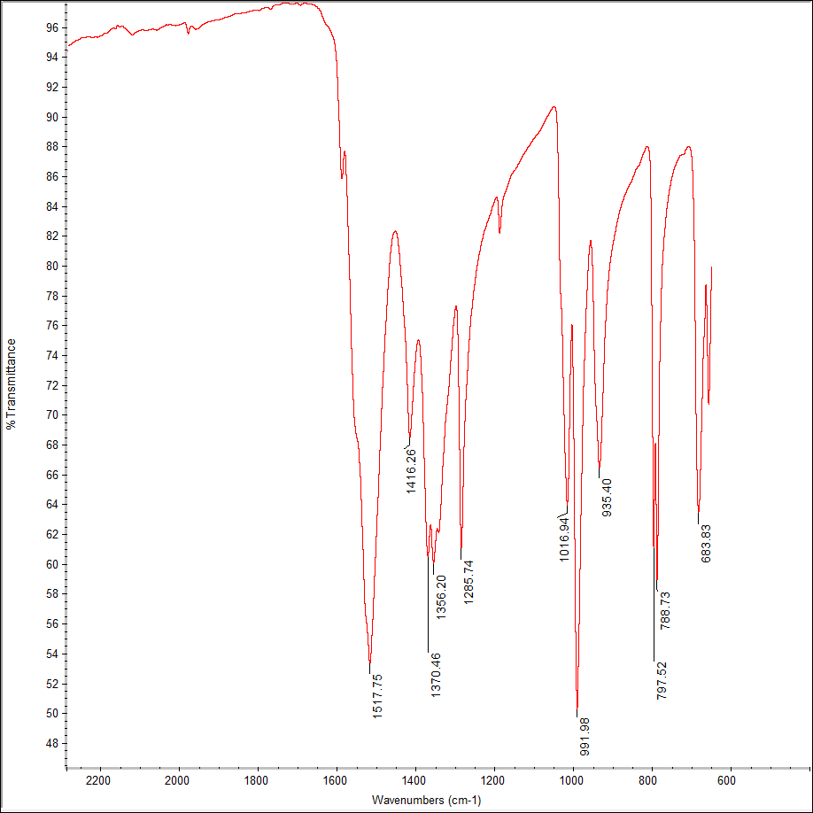
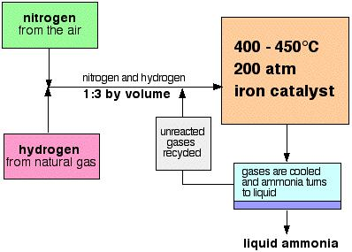
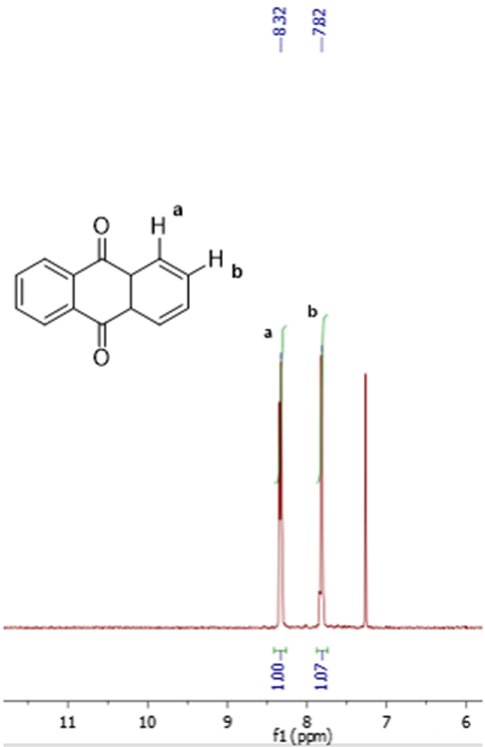
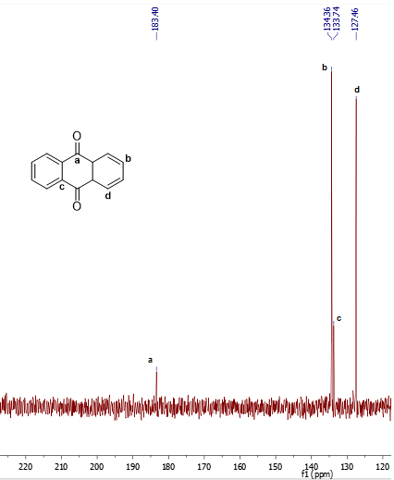
Development of a Facile Synthesis of Anthraquinone via Oxidation of Anthracene With a Vanadyl Catalyst
Ian Martin, Cynthia Gerber, Lea Nyiranshuti, and Dr. Roy Planalp*. Department of Chemistry, University of New Hampshire.
Synthesis of Vanadyl Acetylacetonate Catalyst
Introduction
Catalytic Efficiency of VO(acac)₂
Transition metal complexes play an important role in catalysis in the chemical industry. The applications are wide-ranging throughout. Regarded as one the most important advances and applications of chemistry in modern times, the Haber-Bosch process of producing ammonia from N₂ and H₂ gas, an iron based catalyst is used (Figure 1).¹ This is extremely important for the production of fertilizers for farms, which invariably led to a more stable world food supply.¹
Figure 1. Schematic Diagram of the Haber-Bosch Process.¹
Conditions | TON | Yield (%)
Normal* | 12 | 40
Half H₂O₂ | 8 | 26
Double catalyst@ | 7 | 46
1 h | 2 | 6
1.5 h@ | 12 | 41
*500 mg anthracene, 25 mg catalyst, 20 mL ethyl acetate, 15 mL 30% of hydrogen peroxide solution at reflux for 2 h. @Reaction performed by Gerber.
Scheme 1. Synthesis of vanadyl acetylacetonate (VO(acac)₂).
VO(acac)₂ catalyst was synthesized by a ligand substitution of a sulfate group bound to a vanadium atom with an acetylacetone group in one step.
The characteristic IR bands of the vanadyl catalyst are seen by the C-O stretch (~1518 cm⁻¹), V=O stretch (~992 cm⁻¹), and the methyl group stretches (fingerprint region).
Table 1. Turnover number and percent yield for the oxidation of anthracene with varying reaction conditions.
b c
d
e
Figure 2. FT-IR spectrum of vanadyl acetylacetonate.
Summary and Conclusions
Synthesis of Anthraquinone
This research serves to explore the oxidation of anthracene to afford anthraquinone by the use of a vanadyl catalyst. Four conditions were chosen to test the efficacy of this catalyst and the data gathered from the experiments were consistent with literature precedents.^{2,3}
The main objective of this project is to prepare a vanadium catalyst and study its activity in the oxidation of anthracene to anthraquinone.
To determine the ideal conditions that will afford the highest percent conversion, several different reaction conditions will be tested and the TON (turnover number) of the catalyst will be determined. The TON is defined as the number of moles of substrate that a mole of catalyst can convert before it becomes inactivated.
TON = moles of product
Acknowledgements
I would like to thank Lea Nyiranshuti, Lucas Fulton, and Dr. Roy Planalp for their guidance throughout this project. I would also like to thank the University Instrumentation Center and the UNH Chemistry Department.
References
Equation 1
Figure 3. ¹H spectrum of anthraquinone. Figure 4. ¹³C spectrum of anthraquinone.
Smil, Vaclav (2004). Enriching the earth : Fritz Haber, Carl Bosch, and the transformation of world food production, Cambridge, Mass.: MIT.
Charleton, K. D. M.; Prokopchuk, E. M. J. Chem. Educ. 2011, 88, 1155–1157.
Men’shikov, S. Y.; Vurasko, A. V.; Petrov, L. A.; Molochnikov, L.S.; Novoseiova, A. A.; Skryabina, Z. E.; Saloutin, V. I. Russ. Chem. Bull. 1992, 41, 619–622.
moles of catalyst
The oxidation of anthracene to anthraquinone in the presence of a vanadyl catalyst was modeled after literature precedent² under varying conditions (Table 1).

