Slide 1
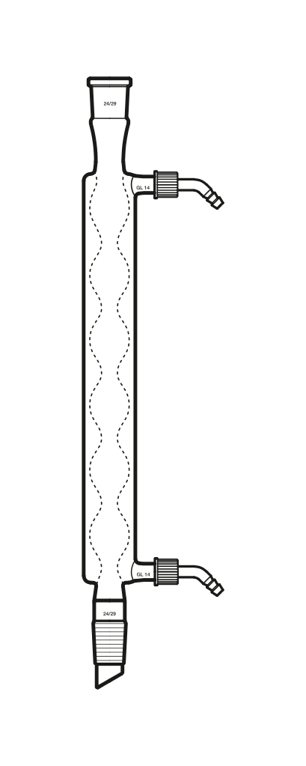
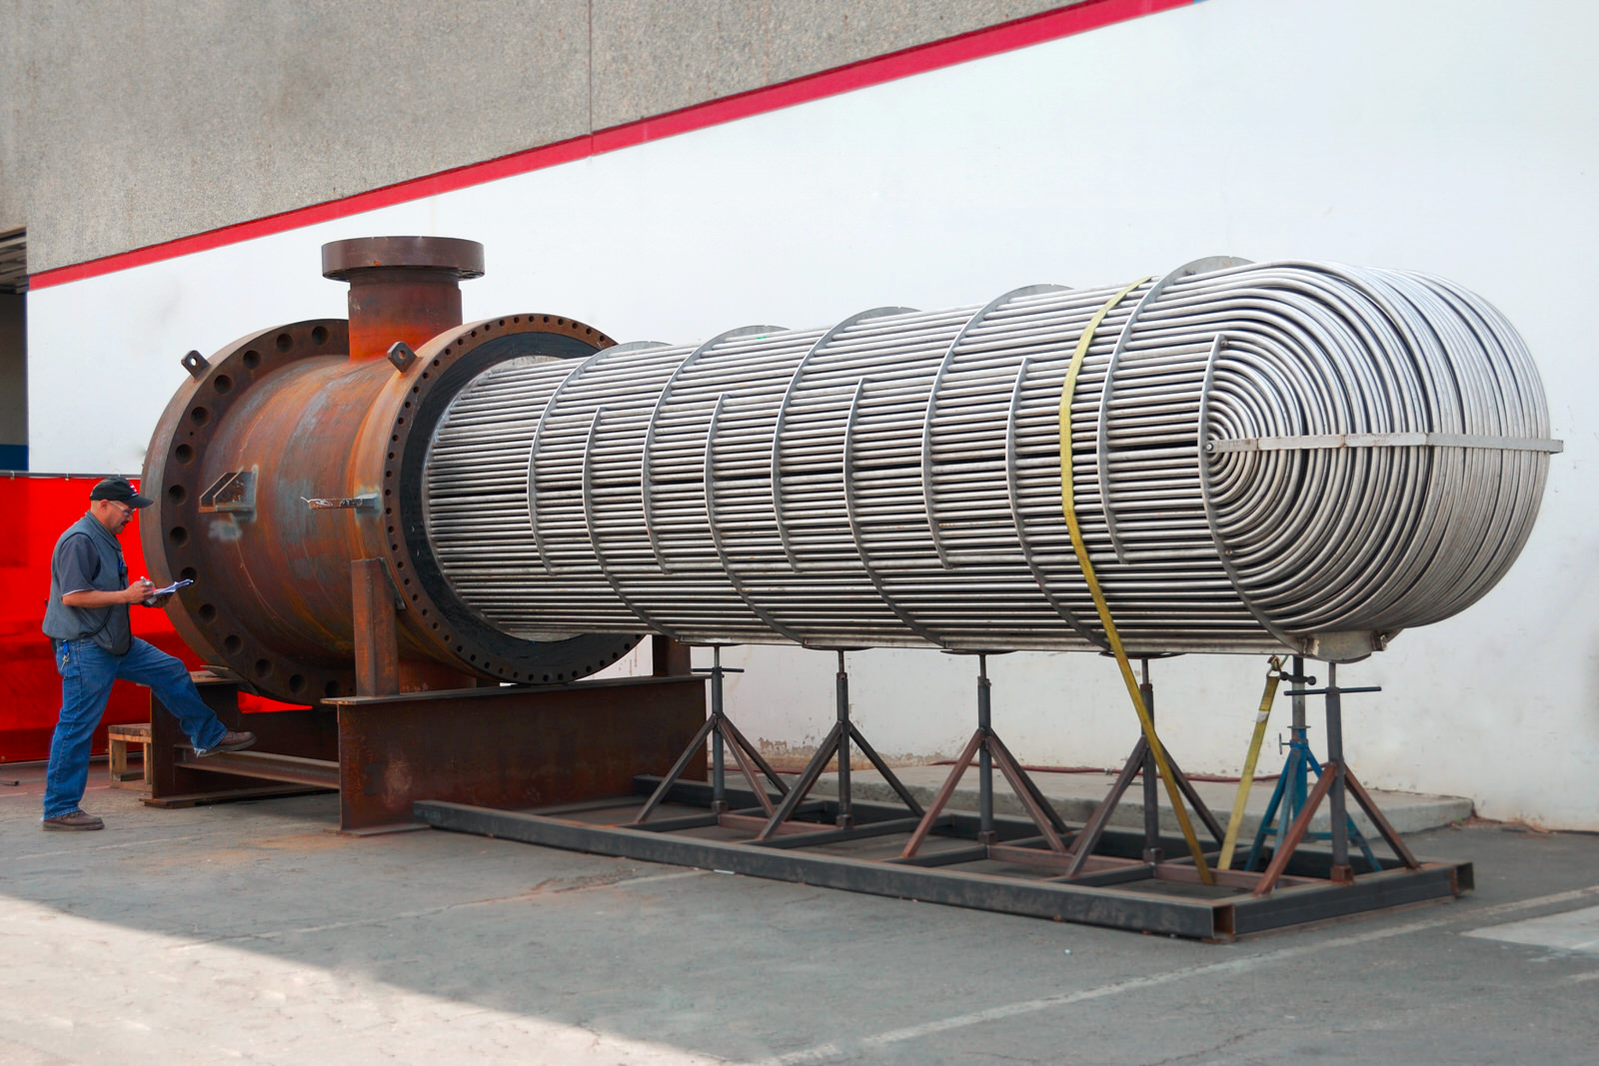
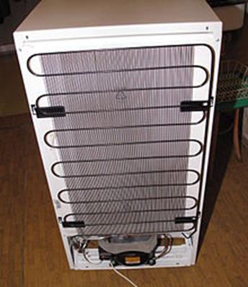
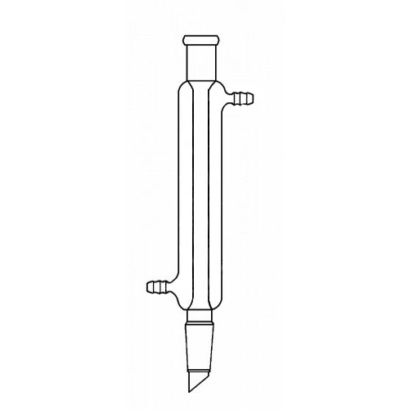
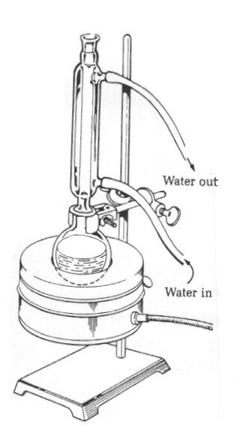
Correlating Parameters of Heat Exchange in Condensers
Leif Burgess, Nick Schedeler, Ryan Lamers
Introduction
Results
Design Problem
The heat transfer coefficient increased with cold stream flow rate for all trials except parallel flow in the Allihn condenser
The Liebig condenser has a larger overall heat transfer coefficient then the Allihn condenser and is therefore more effective.
Determine outlet temperature, and inner/outer diameter
600 SCFM Steam
Water
T_{h,i} = 100˚C
T_{h,o} = 100˚C
The effect of condenser type and flow pattern on the overall heat transfer coefficient (U) was analyzed using the following:
Reynold’s number (N_{Re}) was used to correlate relevant parameters of our system to the overall heat transfer coefficient
T_{c,o}
T_{c,i} = 15˚C
Water out
Water in
 | q$={{mC_{p}∆T=UA}_{s}∆T}_{LM}$ | (1)
 | $N_{Re}={ρDV}/μ$ | (2)
Methods
Measured Variables: inlet/outlet temperatures, heat transfer area, flow rates
Figure 1: Condensers studied in experiment
Cold Stream Flow Rates (m³/s): 9.58∙10⁻⁶, 2.08 ∙10⁻⁵, 3.29 ∙10⁻⁵
Flow rates were tested in triplicate
Liebig
Allihn
Figure 5: Dimensionless comparison to the overall heat transfer coefficient for the hot flow stream
Parallel Flow
Counter Flow
Figure 3: For the Liebig condenser, as the flow rate of the cold stream increased the overall heat transfer coefficient increased as well. The magnitude of this correlation was greater for counter flow.
Condensation point
Figure 6: Dimensionless comparison to the overall heat transfer coefficient for the hot flow stream
h
Compare $hot stream N_{Re}$ to max U
Compare cold stream flow rate to max U
Calculate D_{o}
Water out
Steam
Calculate D_{i}
Compare cold stream $N_{Re}$ to max U
Use Eq. 1 to calculate T_{c,o}
Water in
Final Answers:
Inner Diameter= 38.195 mm , Do= 38.199 mm, & Tc,o= 16.59˚C
Figure 4: For the Allihn condenser, as the flow rate of the cold stream increased the overall heat transfer coefficient increased with counter flow and decreased with parallel flow.
References
Figure 2: Process Flow Diagram
Transport Processes and Separation Process Principles, 4th ed., Prentice-Hall, Inc. Upper Saddle River, NJ, 2003, pp. 291-300.

