Slide 1
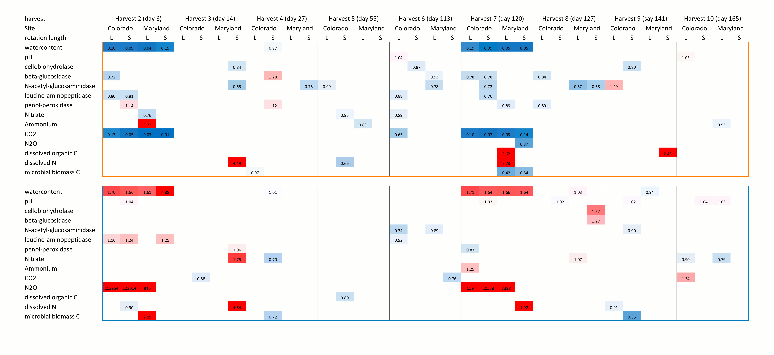
Does crop rotational diversity increase soil microbial resistance and resilience to drought and flooding?
Jörg Schnecker¹, A. Stuart Grandy¹, D. Boone Meeden¹,
Francisco Calderon², Michel Cavigelli³, Michael Lehman⁴, and Lisa Tiemann⁵
¹Department of Natural Resources and the Environment, University of New Hampshire, NH, USA; ²Central Great Plains Research Station, USDA-ARS, Akron, CO, USA; ³Sustainable Agricultural Systems Laboratory, USDA-ARS, Beltsville, MD, USA; ⁴North Central Agricultural Research Laboratory, USDA-ARS, Brookings, SD, USA; ⁵Department of Plant, Soil and Microbial Science, Michigan State University, MI, USA
Objective and experimental setup:
To test how crop diversification affects the response of soil microbial processes to drought and flooding and reoccurring drought and flooding, we manipulated water regimes in lab incubation experiments using soils from two long term crop rotation experiments (Colorado and Maryland). Replicate sets of samples were either allowed to dry out, were gradually flooded or kept at a constant water content (control). We destructively harvested samples during and after the first and during and after the fifth stress cycle to determine the response of microbial processes and functions to the respective stress.
Summary:
Our results show that all investigated soils from different sites and rotation length respond to drought and flooding (Fig.1) but return to control levels as soon as the water content is back to control levels Fig. 2 and Fig. 3.
While we also found that the amplitude of stress response especially for CO₂ and N₂O (Fig. 4 and 5) production seems do decrease with reoccurring stress, this might be attributed to the reduction in available substrate during the course of the incubation. The only significant difference between long and short rotation length was detected in the N₂O production patterns where only soils from Maryland short rotation did not produce N₂O when flooded (Fig. 5).
% of max. waterholding capacity
Harvest 1
Fig 1. Heatmap of stress-response Response ratios are calculated as treatment/control. Only significant differences from control are shown. Blue colors indicate decrease relative to control, red colors indicate increase relative to control.
Harvest 2 (day 6)
Harvest 3 (day 14)
Harvest 4 (day 27)
Harvest 5 (day 55)
Harvest 6 (day 113)
Harvest 7 (day 120)
Harvest 8 (day 127)
Harvest 9 (day 141)
Harvest 10 (day 165)
response to drought
Colorado:
USDA-ARC Akon, Colorado
MAT: 9.8°C
MAP: 421 mm
short rotation (S): wheat-millet
long rotation (L): wheat-corn-millet-pea
CO₂
N₂O
Fig. 4 Respiration
In all soils from both sites and both rotation regimes soil respiration was significantly reduced by drought, while flooding did not affect CO₂ production.
Maryland:
USDA-ARC Beltsville, Maryland
MAT: 13.6°C
MAP: 1192 mm
short rotation (S): corn-soy
long rotation (L): corn-soy-wheat-alfalfa-alfalfa
response to wetting
CO₂
N₂O
Legend:
 | Colorado long rotation control
 | Colorado long rotation drying
 | Colorado long rotation wetting
 | Colorado short rotation control
 | Colorado short rotation drying
 | Colorado short rotation wetting
 | Maryland long rotation control
 | Maryland long rotation drying
 | Maryland long rotation wetting
 | Maryland short rotation control
 | Maryland short rotation drying
 | Maryland short rotation wetting
Harvest 2
Harvest 3
Harvest 7
Harvest 8
Fig. 5 Nitrous oxide production
Soils from the long and short rotation in Colorado as well as the long rotation in Maryland produced significant amounts of N₂O. Soils from the short rotation in Maryland did not.
Fig. 2 Principal component analysis of all measured factors during and after first stress
During peak stress, samples mainly cluster by treatment (control, drying and wetting). As soon as the water conditions were back to 50% WHC treatments are not distinguishable and samples cluster by site and in the case of Maryland by rotation length.
Fig. 3 Principal component analysis of all measured factors during and after fifth stress
During peak stress, samples mainly cluster by treatment (control, drying and wetting). As soon as the water conditions were back to 50% WHC treatments are not distinguishable and samples cluster by site and in the case of Maryland by rotation length.
This material is based upon work that is supported by the National Institute of Food and Agriculture, U.S. Department of Agriculture, under award number 2014-67019-21716

