Slide 1
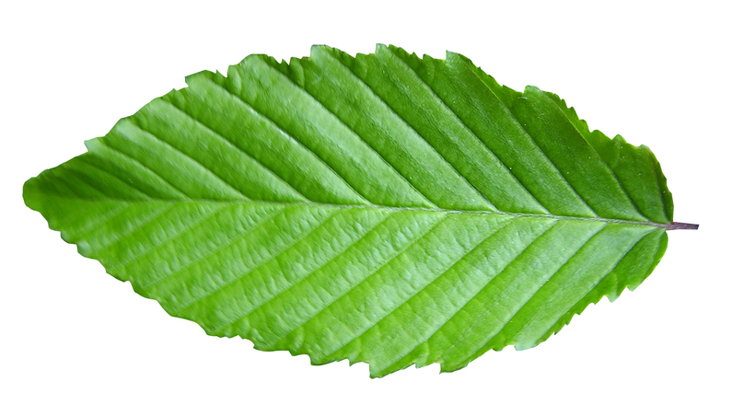





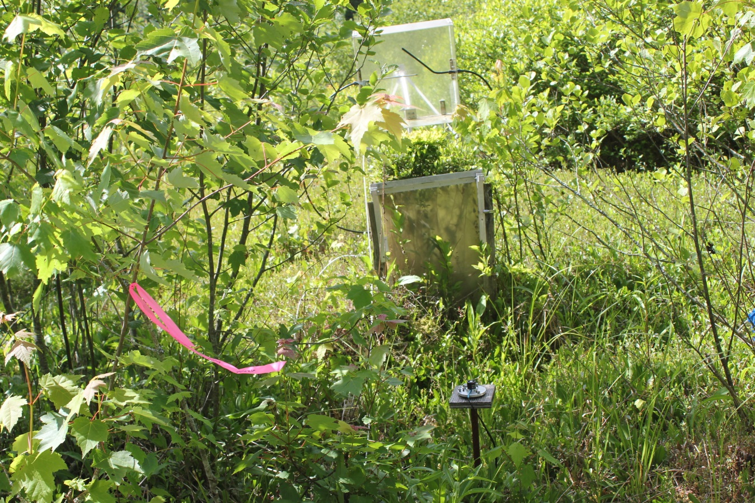
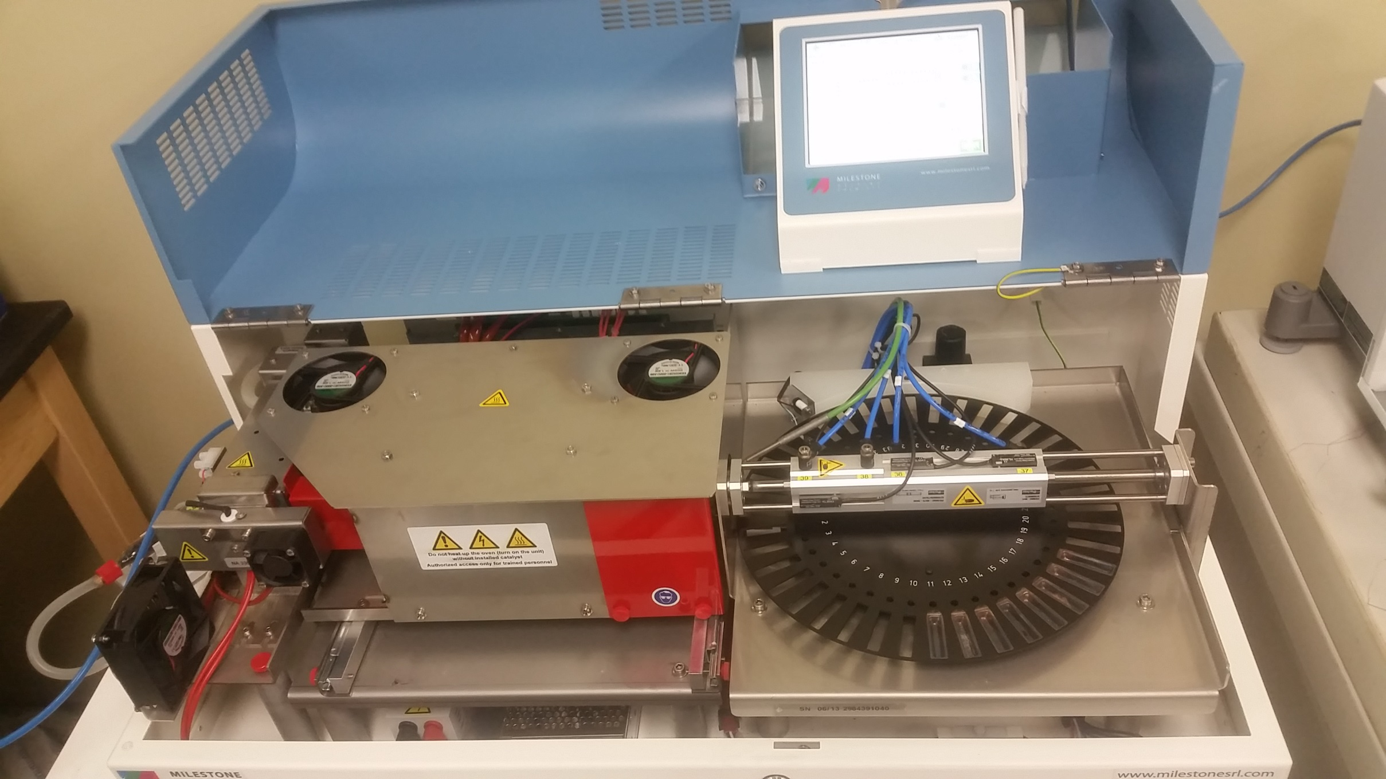
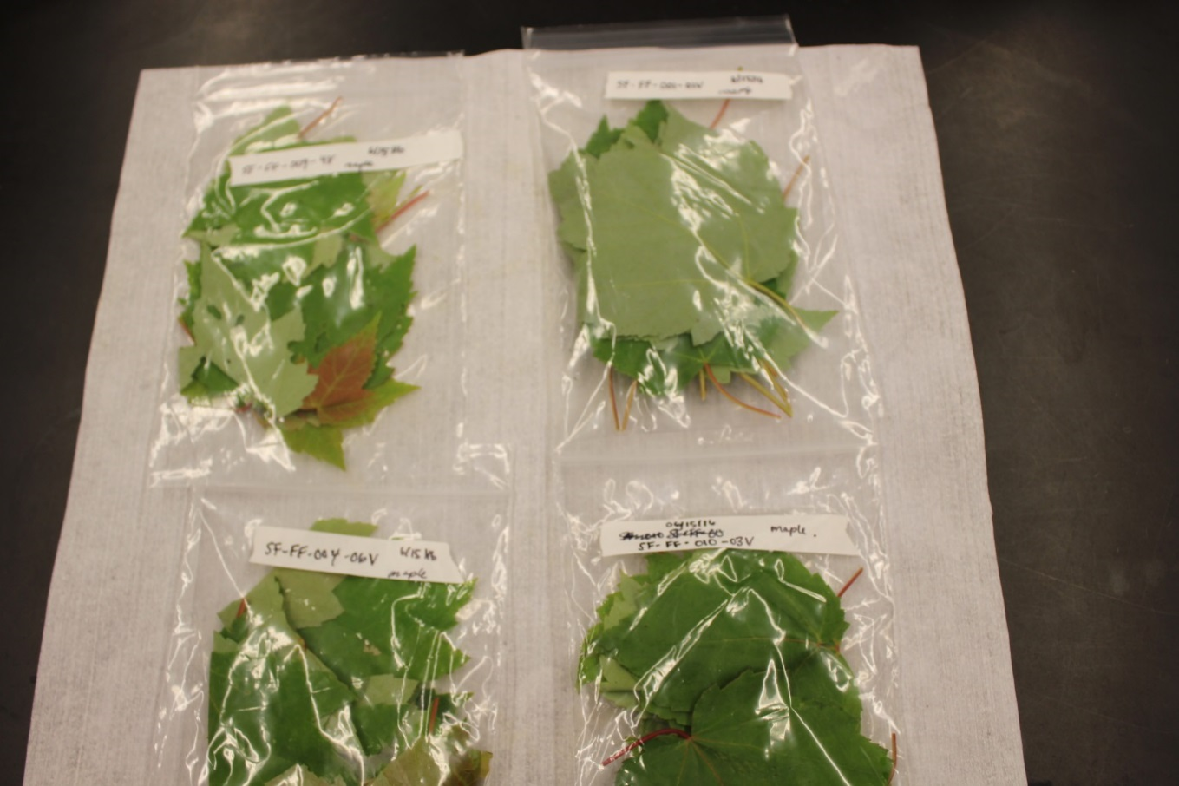
Characterization of Mercury in Wetland Flora of Sallie’s Fen
Stephen M. Pascucci¹, M. Florencia Fahnestock², Julia G. Bryce², Ruth K. Varner^{2,3,4}
¹Science Department, Farmington High School, Farmington, NH; ²Department of Earth Sciences, University of New Hampshire, Durham, NH;
³Institute for the Study of Earth, Oceans and Space, University of New Hampshire, Durham, NH;
⁴Joan and James Leitzel Center for Mathematics, Science and Engineering Education, University of New Hampshire, Durham, NH
Mercury’s Deal:
Any amount of mercury is biologically harmful.¹
Readily forms a variety of ions and complexes.¹
Easily Integrates, transfers, and biomagnifies within and between ecosystems.
Economic loss due to decreased IQ & productivity: $8.7 billion²
Species sampled at site #1 consistently tested highest in [Hg].
Only sphagnum and White Pine hold their leaves year-round. All other species are deciduous.
Both Sphagnum and White Pine will have a large surface area potentially allowing for increased mercury deposition.
Sphagnum mats have been shown to accumulate high amounts of Hg³. This has been attributed to high ion exchange capacity, pore size and large surface area^{4, 5}.
Some plants draw mercury from their roots to their leaves⁶. Other plants are able to prevent this. What is the behavior of the plants sampled?
Within 1 standard deviation:
[Hg] loss: 8
No [Hg] change: 8
[Hg] gain:5
Net [Hg] change (all samples): +2.65 μg/kg
About Wetlands
Have the ability to acquire, store & release significant amounts of mercury.
Transfers mercury to and from the atmosphere, hydrosphere, and various levels of the food chain.
Rinsing samples does not provide a consistent effect.
Variability between samples may be masking any potential trend.
Future sampling will determine the significance of the rinse protocol for vegetation sampling.
Meet The Plants
Sphagnum
White Pine
Highbush Blueberry
Red Maple
Sheep Laurel
Sedge
Ideas For Future Study
Future sampling should control for new leaves versus old leaves, time of the year (time within the growing season), and time of the day as well as identifying differences in stomatal density and leaf surface area.
Guiding Questions
What is the typical range of [Hg] for each species?
What is the nature of the mercury content? Is there deposited Hg that can be washed off the leaf?
Does the location of the sample within the wetland impact [Hg]?
Leatherleaf
False Solomon
Box Alder
Sources:
S. Bose-O’Reilly, K.M. McCarty, N. Steckling, B. Lettmeier (2010) Mercury Exposure and Children’s Health
L. Trasande, P.J. Landrigan, C. Schechter (2005) Public Health and Economic Consequences of Methyl Mercury Toxicity to the Developing Brain
Ri-Qing Yu et al. (2003) and references within, Mercury methylation in Sphagnum moss mats and its association with sulfate-reducing bacteria in an acidic Adirondack forest lake wetland.
Schofield WB, (1985) Introduction to Bryology. Macmillan Publishing Company, New York.
McLelland JK and Rock, CA (1988) Pretreating landfill leachate with peat to remove metals. Warer Air Soil Poll 37: 203-215
R. Azevedo, E. Rodriguez (2012) Phytotoxicity of Mercury in Plants: A Review
Methods
Sample are split & one half is rinsed (first half of the sample remains unmodified)
Acknowledgements
This research was funded by a grant from the national science federation and New Hampshire EPSCoR (grant #1101245)
Many thanks to the Frey Lab for generous access tot heir freeze drying equipment.
Special thanks to Stephen Hale for his thoughtful and positive support and guidance throughout this project.
Additional thanks to all the teachers in the RET/RETE/EPSCoR community for their camaraderie and willingness to share and listen to each others’ experiences.
Frozen (24 hours)
Vacuum freeze dried (minimum 24 hours)
Ground into near-homogeneous sample.
Leaves were sampled from the wetland, stored in individual bags and chilled for transport.
Mercury analysis using a DMA-80.

