Slide 1
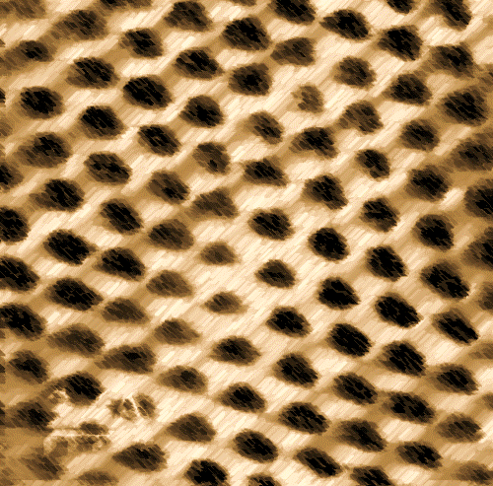


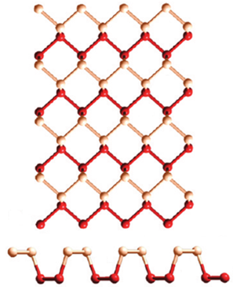
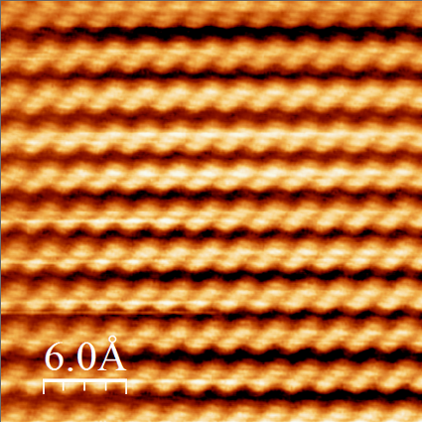
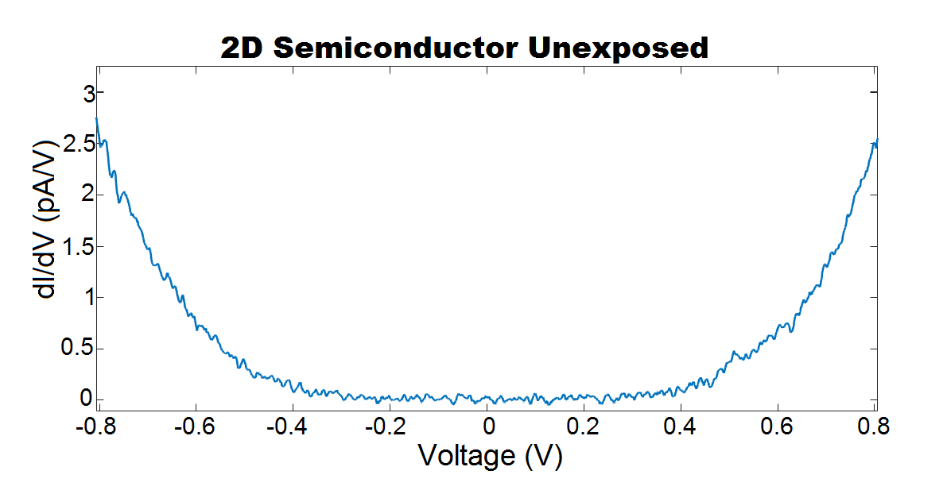
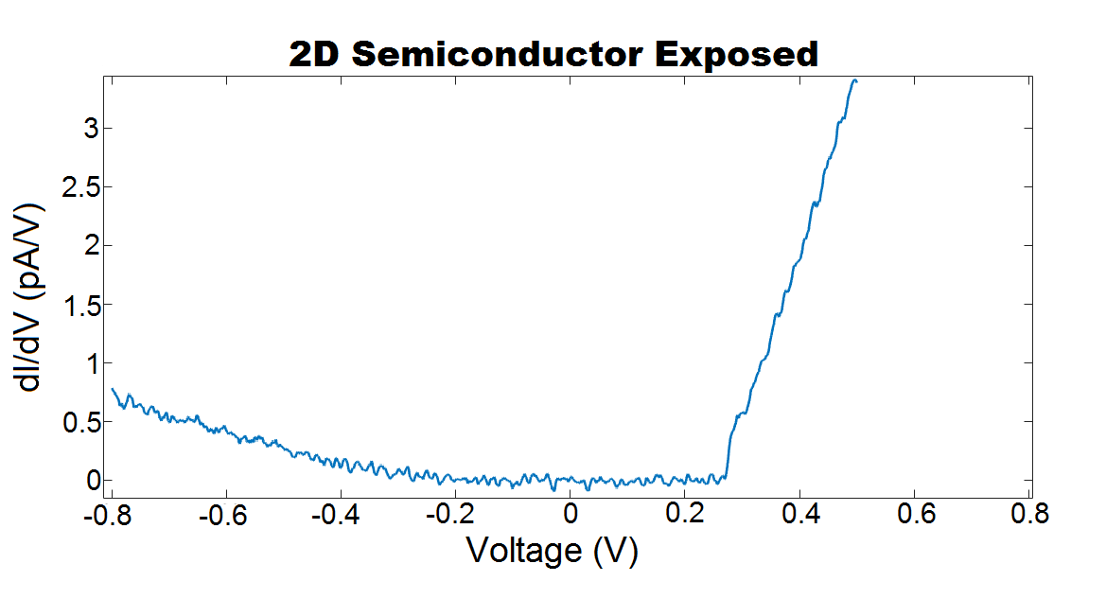
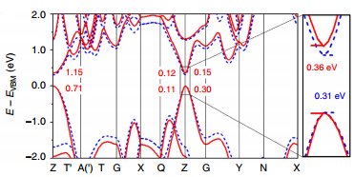
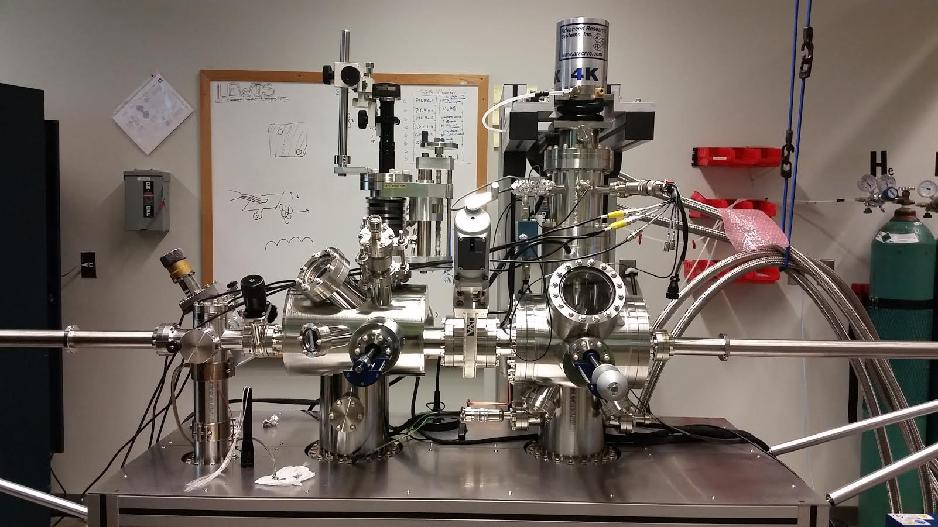
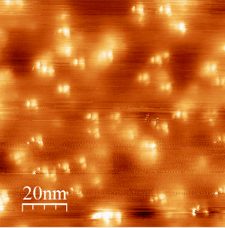
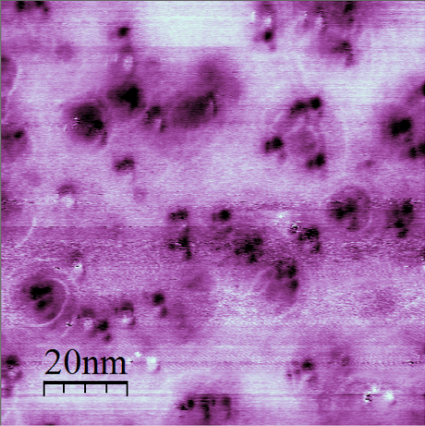
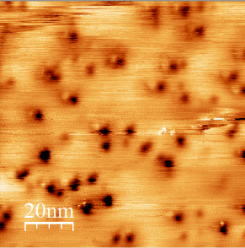
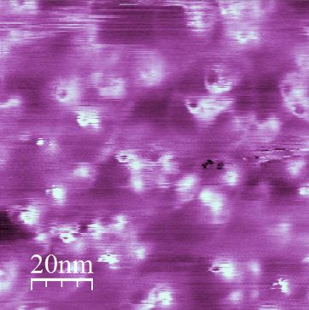
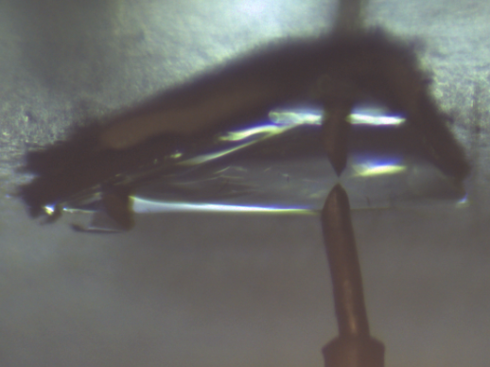
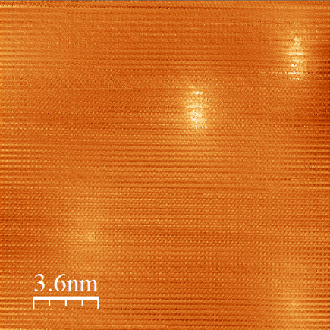
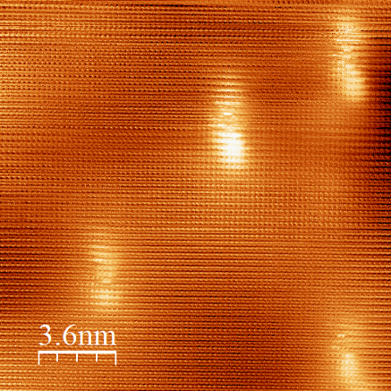
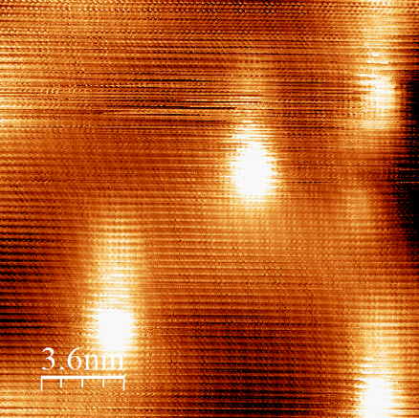
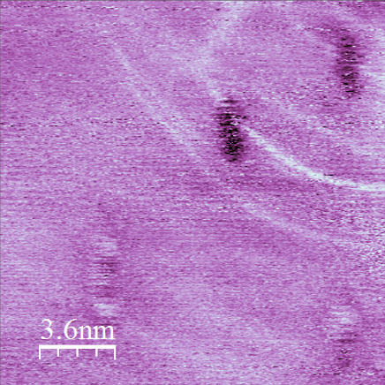
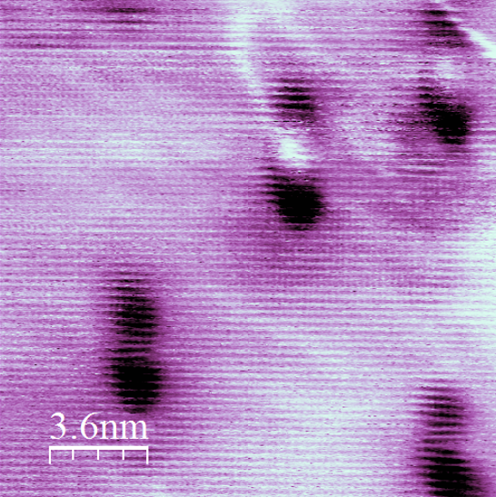
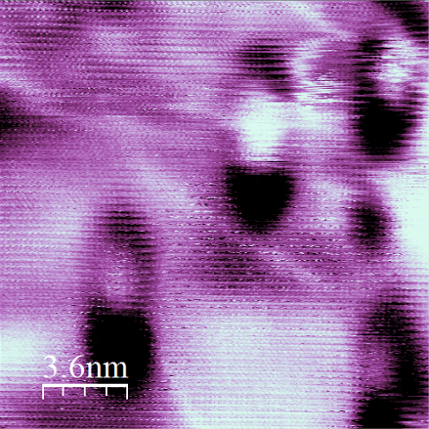
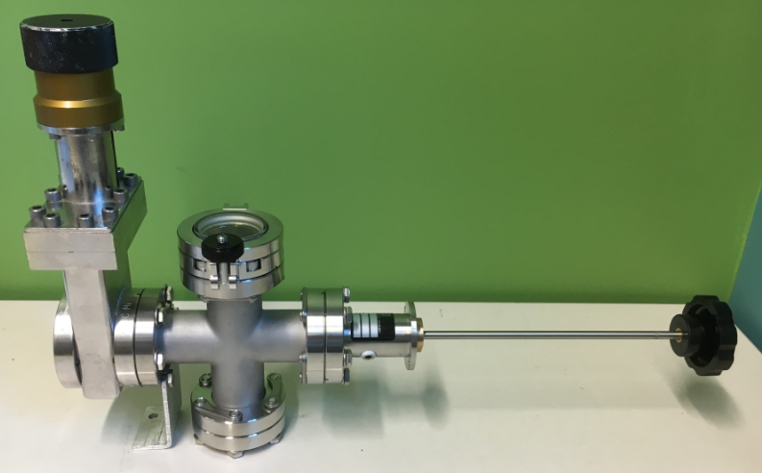
Defects in Black Phosphorus Probed by Scanning Tunneling Microscopy and Spectroscopy
Jake Riffle, Cameron Flynn, Charlie Ayotte, Christine A. Caputo, and Shawna Hollen
Department of Physics, University of New Hampshire, Durham, NH 03820
Introduction
Results
Black Phosphorus in Chemistry
Two-dimensional (2D) crystalline materials have the potential for flexible components that remain highly conductive. Applications range from circuit components to energy generation.^{[1]} Black Phosphorus (BP) is a semiconducting crystal recently isolated in a 2D sheet. The electronic bandgap of bulk BP is 0.3 eV, but it is expected to increase to 2 eV in its 2D form. This band gap has created an interest for field effect transistor applications. A draw back of black phosphorus is its rapid oxidation in air, which degrade its electrical properties and make the material difficult to work with.
The bandgap of the bulk crystal had discrepancies in measurements by STM, either being a predicted 0.33eV or a “decoupled top-layer” measurement of 2eV. ^{[2],[3]}
Using a low-temperature, ultra-high vacuum scanning tunneling microscope (STM) from RHK Technologies, we were able to investigate this bandgap disagreement, while also observing inherent and air-exposure defects within the top few layers of the bulk crystal.
a)
b)
y
Atomic resolution image (Fig.1) shows the atomic structure of BP. Only alternating atoms in the first layer of the material (cream color in Fig. 1) are imaged due to its buckled geometry.
Using dI/dV spectroscopy, we measured a bandgap of 0.4 eV consistently for both sources of material.
We compared dI/dV spectra of samples before and after the bulk crystal was exposed to air and found an asymmetry developed (Fig 2a,b).
The calculated band structure of bulk BP is expectedly symmetric (Fig 2c). ^{[4]}
Black phosphorus that has been exfoliated down to the “quantum dot” regime has been shown to possess photo-physical properties that are desirable for catalytic systems.^{[8]} When these materials are irradiated with light, electrons from the valence band get excited into the conduction band and can then be transferred to target molecules (or a co-catalyst) to drive chemical reactions
x
Energy
CB
Target molecule or co-catalyst
e⁻
Light (hν)
VB
Figure 1. (a) Top and cross-sectional view of the BP structure and (b) atomic resolution of BP#2 bulk exposed at 350mV.
Samples are generated by grinding bulk black phosphorus and suspending it NMP followed by sonication via probe (high power) and/or bath (low power) sonicators. Conditions still need to be optimized, however, as current results show samples are comprised of larger-than-desired flakes as shown to the left.
a)
b)
c)
We compared samples from two different sources, 2D Semiconductors (BP#1) and HQgraphene (BP#2), and found a consistent 0.4 eV bandgap. We also studied inherent defects, which were similar in both source materials and charged.
Figure 2. Measured dI/dV spectra of (a) BP#1 bulk unexposed and (b) BP#1 bulk exposed to air, showing similar bandgaps, yet significantly different dI/dV curves. (c) The calculated band structure of bulk black phosphorus. ^{[4]}
STM imaging and dI/dV-map imaging of the black phosphorus surface shows charged defects (Fig 3a-d). Imaged defects consistently appear bright at negative voltages, and dark at positive voltages. From the apparent brightness/darkness of the defects (Fig 5a, c), we can determine that the majority are positively charged.
All of these defects appear with dumbbell shapes and oriented along the rows, or perpendicular to the rows. This can be most clearly seen in Fig 3a. Since STM probes electronic states, in addition to topography, point defects can have a shape that reflects their electronic structure. ^{[5]}
Faint rings can be seen encircling several of the defects in the dI/dV-map images, Fig 5b, d. These rings are likely signatures of charging and discharging the defects via the STM tunneling current and can be explained through semiconductor band-bending and tunneling models. ^{[6],[7]}
a)
b)
Conclusions
y
The main conclusions of this project are:
The bandgap of bulk black phosphorus is 0.4eV, regardless of material source. This is consistent with expectations from band structure calculations.
Bulk BP#1 unexposed has a symmetric band structure. BP#1 exposed, BP#2 unexposed, and BP#2 exposed show asymmetric spectra.
Inherent defects are charged and appear dumbbell shaped, with dumbbells aligned with atomic rows. These defects are inherent to the source material.
New defects were observed with direct air exposure of the surface. These defects are consistently dark, regardless of imaging parameters.
In future black phosphorus investigations, we plan to image thin, exfoliated BP flakes. We would like to directly compare four-point probe resistance measurements on flakes to STM measurements of the flakes without exposure to air.
x
Methods
c)
-300mV
d)
-300mV
We prepared black phosphorus bulk crystals for these experiments in two different ways.
1) Samples prepared in nitrogen were mounted with melted indium and cleaved in UHV. This prevented foreign materials from adsorbing onto the surface. Transportation of samples from nitrogen atmosphere to STM was via custom-designed transportation chamber.
a)
c)
e)
+400mV
+400mV
Figure 3. (a) Topographical, 100nm image of BP#2 Exposed at -300mV and (b) corresponding dI/dV-map. (c) Same 100nm area of BP at +400mV and (d) corresponding dI/dV-map.
2) Air-prepped samples were mounted with epoxy. Cleaving was still performed in UHV.
View of the STM tip approaching the bulk BP
A 9 Kelvin UHV RHK SPM was used to image the surface of BP using platinum-iridium cut tips.
-700mV
-400mV
-200mV
Close-up topography and dI/dV-map images of dumbbell defects are shown in Fig 4 at three different voltages. A clear dumbbell shape can be seen in the defects when imaged at a less negative voltage.
Positively-biased tips were found to move the defects as the tip scanned, so our range of workable voltages was limited to the negatives.
References and Acknowledgements
Z = variable
Z = constant
b)
d)
f)
We are glad to acknowledge that funding for this project was provided by the UNH Center for Advanced Manufacturing and Materials Innovations (CAMMI) Seed Grant Program.
Scan
Nathan, A., Ahnood, A., Cole, M. T., Lee, S., Suzuki, Y., Hiralal, P., … Milne, W. I. (2012). Flexible electronics: The next ubiquitous platform. Proceedings of the IEEE, 100(SPL CONTENT), 1486–1517. http://doi.org/10.1109/JPROC.2012.2190168
Zhang, C. D., Lian, J. C., Yi, W., Jiang, Y. H., Liu, L. W., Hu, H., … Gao, H. J. (2009). Surface Structures of Black Phosphorus Investigated with Scanning Tunneling Microscopy. The Journal of Physical Chemistry C, 113(43), 18823–18826. http://doi.org/10.1021/jp907062n
Liang, L., Wang, J., Lin, W., Sumpter, B. G., Meunier, V., & Pan, M. (2014). Electronic bandgap and edge reconstruction in phosphorene materials. Nano Letters, 14(11), 6400–6406. http://doi.org/10.1021/nl502892t
Qiao, J., Kong, X., Hu, Z.-X., Yang, F., & Ji, W. (2014). High-mobility transport anisotropy and linear dichroism in few-layer black phosphorus. Nature Communications, 5, 4475. http://doi.org/10.1038/ncomms5475
Lee, D., & Gupta, J. a. (2011). GaAs with Defect-Induced Band Bending. Nano Letters, 11, 2004. http://doi.org/g
Brar, V. W., Decker, R., Solowan, H.-M., Wang, Y., Maserati, L., Chan, K. T., … Crommie, M. F. (2011). Gate-controlled ionization and screening of cobalt adatoms on a graphene surface. Nature Physics, 7(October 2010), 43–47. http://doi.org/10.1038/nphys1807
Wong, D., Velasco, J., Ju, L., Lee, J., Kahn, S., Tsai, H.-Z., … Crommie, M. F. (2015). Characterization and manipulation of individual defects in insulating hexagonal boron nitride using scanning tunnelling microscopy. Nature Nanotechnology, 10(11), 949–53. http://doi.org/10.1038/nnano.2015.188
Wang X., Sun G., Li N., & Chen P. (2016) Quantum dots derived from two-dimensional materials and their applications for catalysis and energy. Chem. Soc. Rev., 45, 2239 http://doi.org/10.1039/c5cs00811e
e⁻
e⁻
-700mV
-400mV
-200mV
Topography Imaging
Spectroscopy (dI/dV)
Fig 4. (a) (a) Topographical, 100nm image of BP#1 Exposed at -300mV and (b) corresponding dI/dV-map. (c) Same 100nm area topography image at -400mV with (d) corresponding dI/dV-map and (e) topography image at -200mV with (f) corresponding dI/dV-map.
a)
b)
Air exposure experiments were done by exposing the crystal surface to a low pressure of air in the UHV chamber load lock. Air pressure was raised to 200mbar for 30 seconds before being pumped back down to vacuum.
Exposure to air significantly increased defect population density (Fig. 4). Many dark defects appeared, and their contrast does not change with tip-sample bias. These differences are evidence that the new defects are different from the inherent charged defects.
These defects are consistent with oxidation of phosphorus, which would show up as ‘pits’ in the STM imaging due to a lower tunneling current.
-1V
-1V
UVH transportation chamber
Figure 5. (a) -1V, 100nm image of unexposed surface and (b) -1V, 100nm image of BP surface that has been air-exposed.

