Slide 1

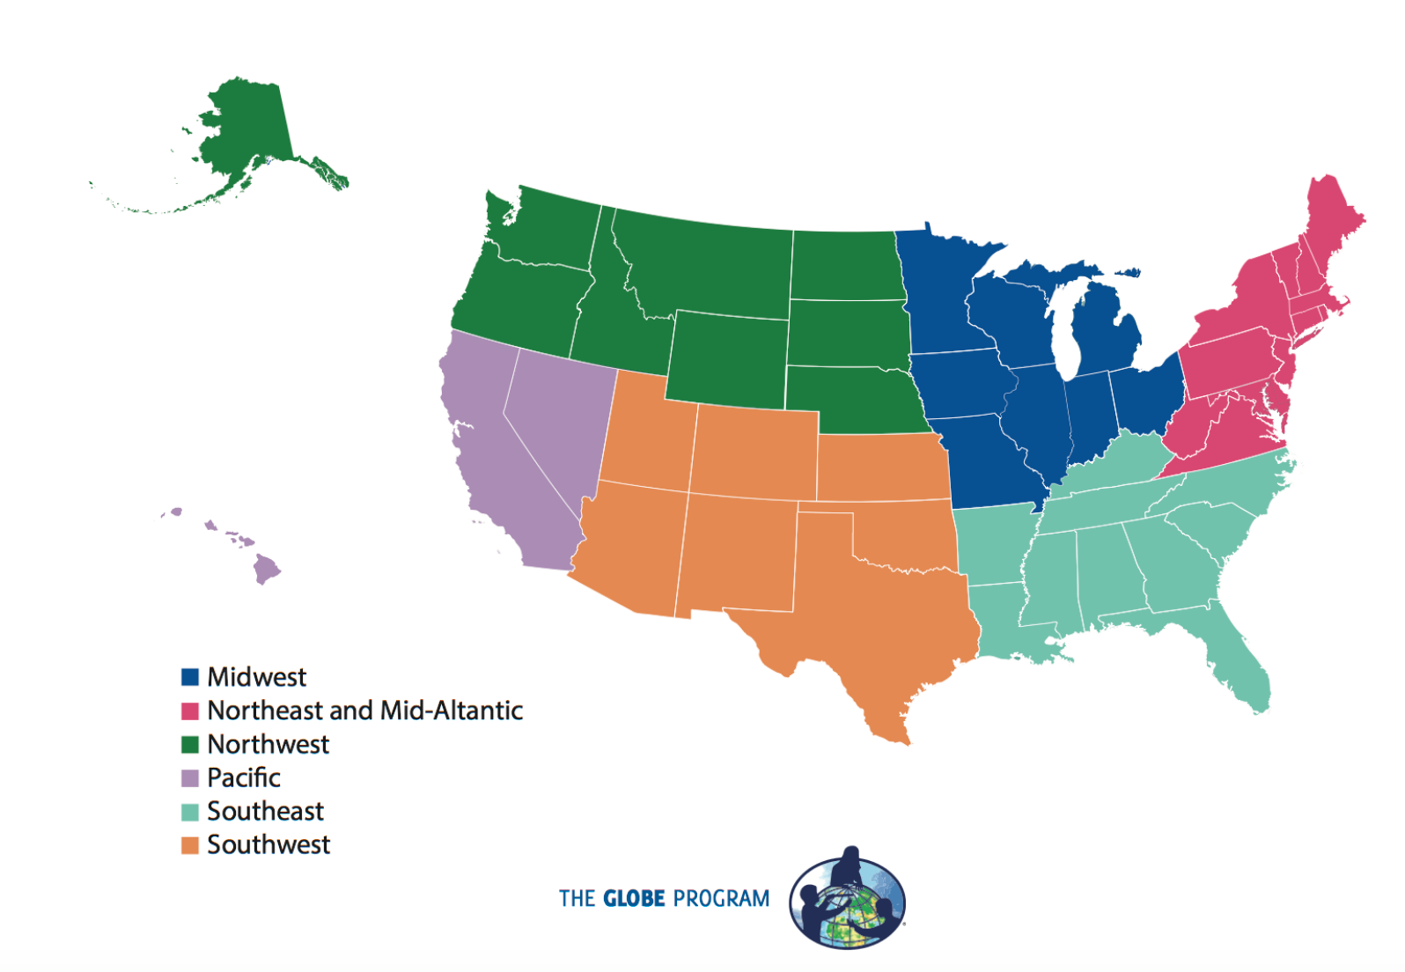

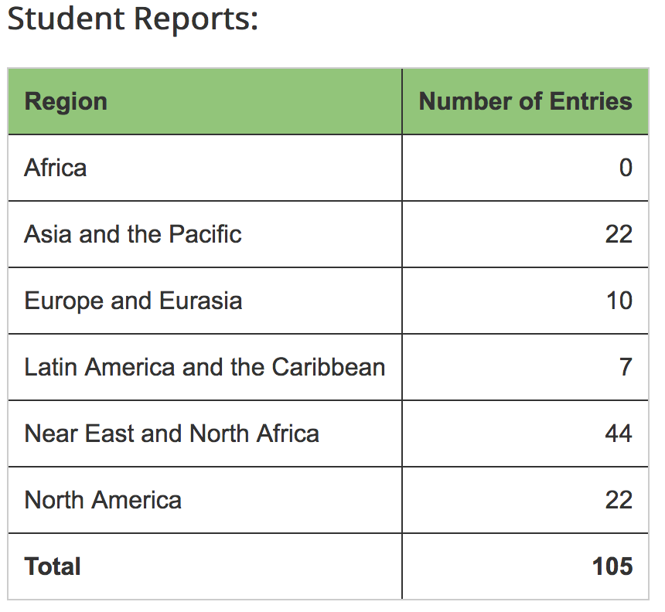
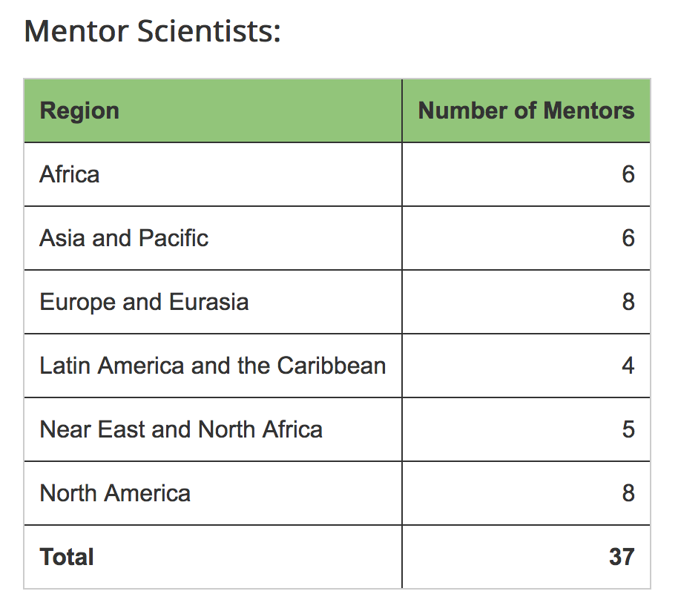
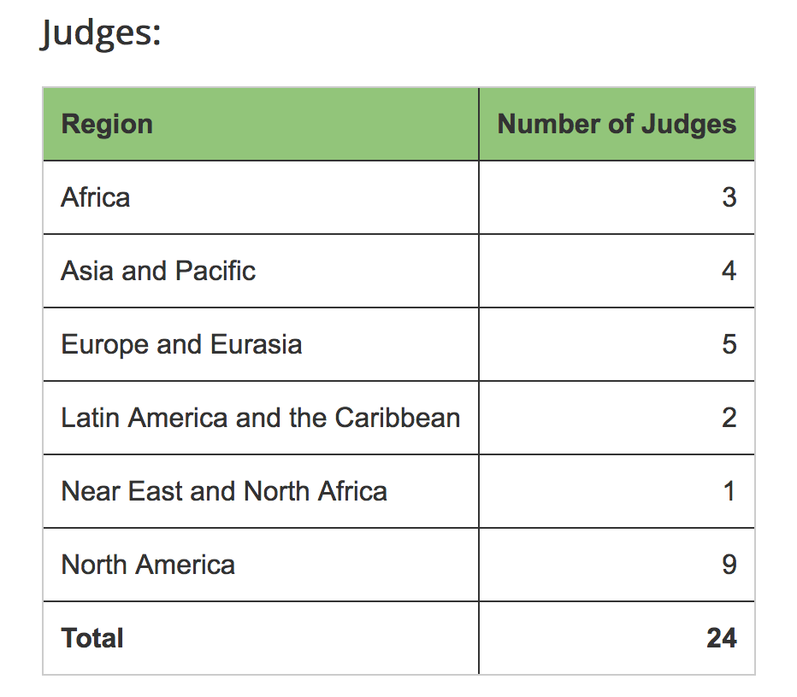


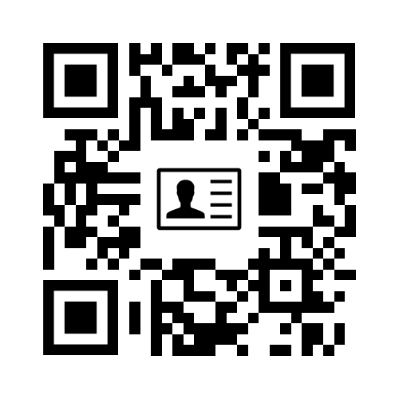
GLOBE Cornerstones:
Advancing Student Research Worldwide through Virtual and Regional Symposia
Jennifer Bourgeault¹, Julie Malmberg², Tony Murphy², Svetlana Darche³, Paul Ruscher⁴, Michael Jabot⁵, Michael Odell⁶ and Teresa Kennedy⁶
¹University of New Hampshire (Durham, NH), ²GLOBE Implementation Office (Boulder, CO), ³WestEd (San Francisco, CA), ⁴Lane Community College (Eugene, OR),
⁵State University of New York, Fredonia (Fredonia, NY), ⁶University of Texas Tyler (Tyler, TX)
Student Research Symposia
The GLOBE Program, an international science and education program, encourages students from around the world to participate in authentic scientific research of the Earth system. Students use scientific protocols to explore their local environments, compare their findings with other GLOBE schools both in the U.S. and in other participating countries, and then share their findings via the GLOBE.gov website. In order to facilitate scientific communication, GLOBE held an international virtual science fair and a series of six regional face-to-face science fairs in 2016.
REGIONAL U.S. SCIENCE FAIRS
How and What was Submitted:
Metrics
Northeast & Mid-Atlantic
Each student project included the
following components and was
submitted via the Virtual Science Fair
Report Tool.
Abstract or Summary: A 200 word or less description of the research project.
Research Report: The complete research report as .PDF or .DOCX/.DOC. If it included more than one language, the report was still one file. Elements of the Research Report were described in the rubrics.
Presentation: Students could either submit a link to an uploaded video hosted on an online video sharing site (YouTube, Vimeo, TeacherTube, etc) or the presentation poster. Whether presented as a video, a narrated PowerPoint, or as a poster, the presentation described the student research. Videos were to be 10 minutes or less.
Thumbnail Image: An image to be displayed with the student report.
Photo Release Forms: All individuals who appear in photos or video must send in a photo release as one file submission.
Students could also compete for one or more digital badges in addition to the Research Badge.
March 10-11, 2016
NASA Goddard
32 Students
12 Projects
“Backstage Tour”
Northwest
May 19-20, 2016
World Forestry Center
20 Students
10 Projects
Beautiful Visitor Center and right next to the zoo!
Pacific
April 29-30, 2016
Jet Propulsion Lab
17 Students
7 Projects
“Backstage Tour”
Southwest
May 19-20, 2016
University of Texas-Tyler, Houston Engineering Center
33 Students
11 Projects
Space Center Houston
Southeast
May 5-6, 2016
Mississippi Museum of Natural Science
22 Students
6 Projects
Bonfires and S’mores
2017 Planning
In 2016, each U.S. Partner could request up to $4000 for travel to support a team of students and teacher(s). Most Partners expended $2000 or less.
Regional leads were allotted $5000 plus a $1000 stipend to hold the events and cover costs. In most cases, this was adequate. Leads found outside support, free or reduced room rentals and used dorm/camp housing to keep costs low.
Several students (independently) requested that a “Peer Award” be added to supplement a “Director’s Award.”
Judges wanted to recognize outstanding components of good projects as a learning experience, prior to the awards. This was well-received.
To model a science conference, it is important to build in time for the students to review each other’s projects.
Midwest
May 13-14, 2016
University of Toledo
40 Students
24 Projects
Staying in dorms, scavenger hunt and flying kites.
QR Corner
Acknowledgement: This material is based upon work supported by the National Science Foundation Grant No. 1546713. Any opinion, findings, and conclusions or recommendations expressed in this material are those of the authors(s) and do not necessarily reflect the views of the National Science Foundation.

