Slide 1

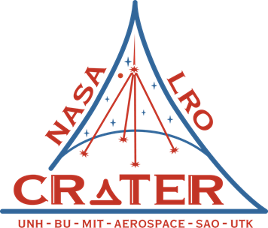
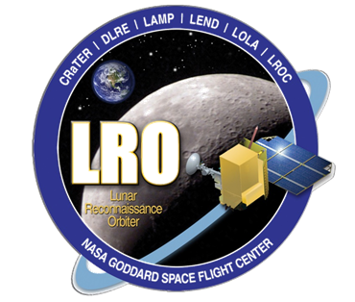
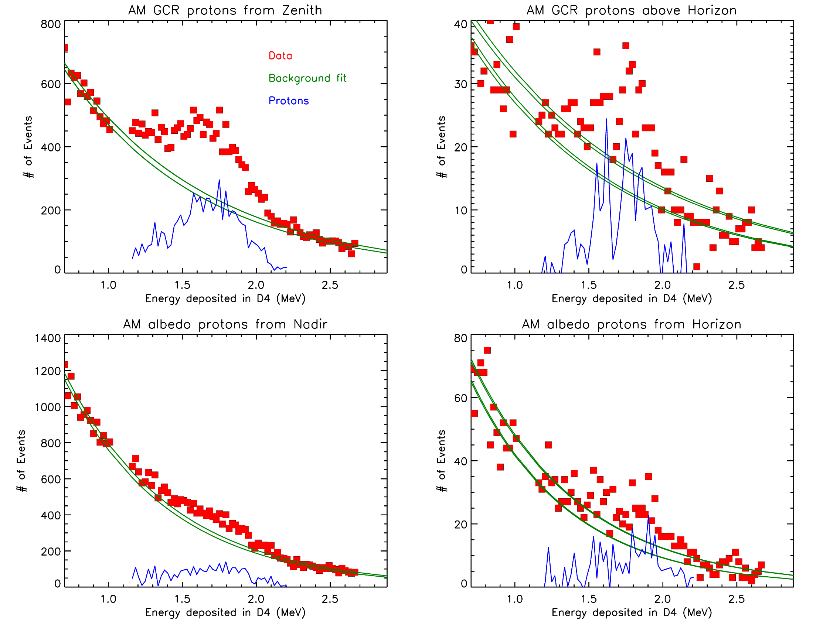
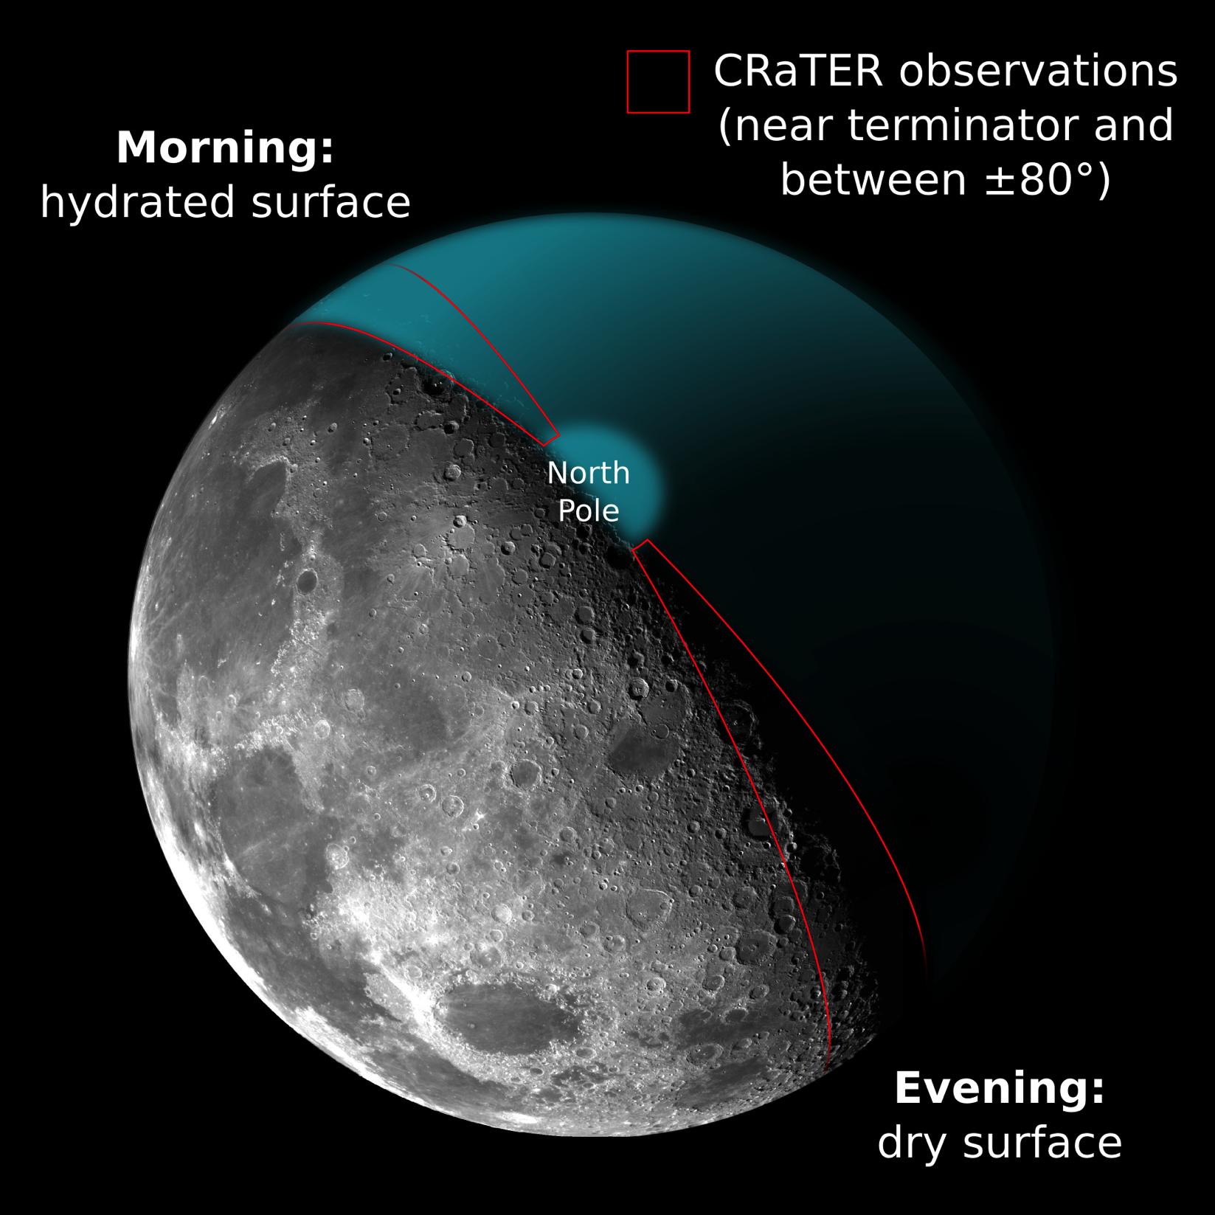
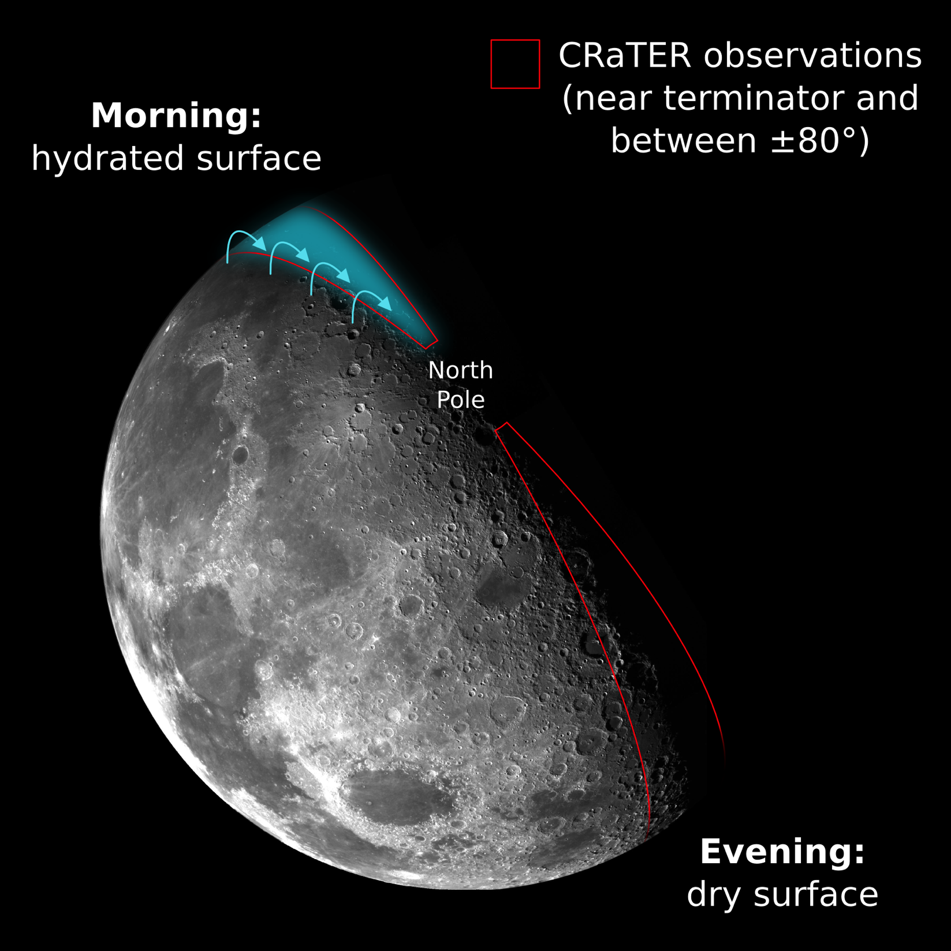
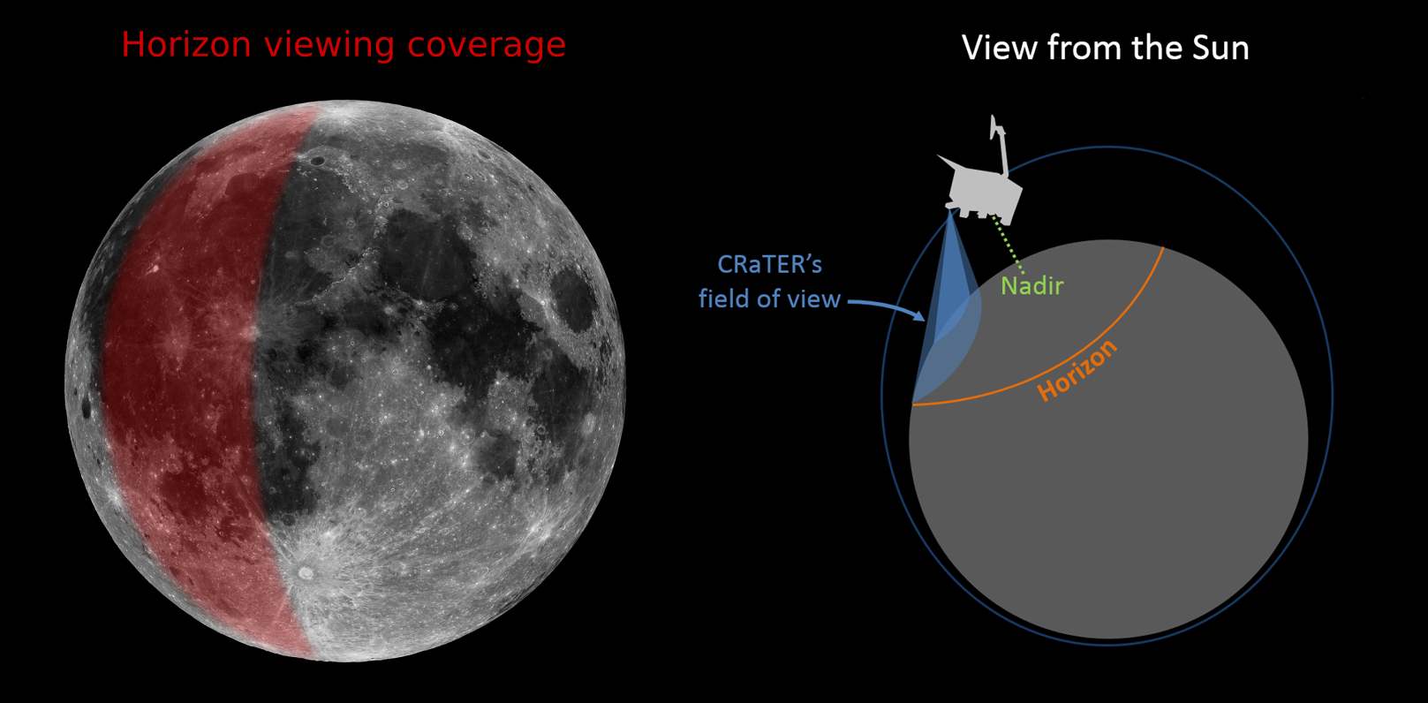
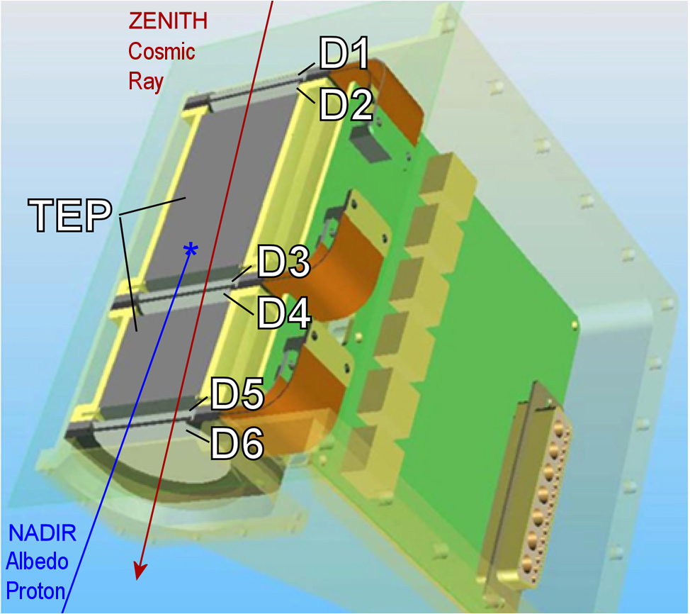
Hydration of the Lunar Regolith at Local Sunrise
J. K. Wilson¹, N. A. Schwadron¹, A. P. Jordan¹, M. D. Looper², C. Zeitlin³, L. W. Townsend⁴, H. E. Spence¹, T. J. Stubbs⁵, D. M. Hurley⁵, W. M. Farrell⁵, N. E. Petro⁵, C. Pieters⁶ (1)University of New Hampshire, Space Science Center, Durham, NH (jody.wilson@unh.edu, nschwadron@unh.edu), (2)The Aerospace Corp., El Segundo, CA, (3)Leidos, Houston, Texas, (4)Department of Nuclear Engineering, Univ. of Tennessee, Knoxville, TN, (5)Goddard Space Flight Center, Greenbelt, MD, (6)Brown University, Planetary Sciences Group, Dept. of Earth Environmental and Planetary Sciences, Providence, RI.
Overview
The CRaTER instrument on LRO has detected the signature of hydrated lunar regolith at the local dawn sector of the Moon, using a new type of horizon-viewing observation in 2015 and 2016. The yield of ~100 MeV lunar albedo protons at dawn is larger than that of the dusk sector; presumably hydrogen (whether atomic or in a molecule like H₂O) is more abundant on the lunar surface just before sunrise, and galactic cosmic rays (GCRs) scatter the free protons out of the regolith via forward-scattering knock-on collisions, thus enhancing the number of albedo protons per incident GCR.
Data reduction
Rather than assuming fixed lineal energy transfer (LET) proton tracks and fixed background LET spectra as in previous analysis [1] we create sparsely-populated cross-plots (below left), cull more than half of the detection events to select for only one direction of arrival (zenith or nadir) and then co-add the cross-plots into one-dimensional LET spectra, resulting in good signal-to-noise ratios, as shown below right (red points).
Discussion
Schwadron et al. [2] found a 1% high-latitude enhancement in the nadir-viewing proton yield using CRaTER, and concluded that the small signal required ~1% H by mass (~10% H₂O equivalent) to depths of 10-20 cm in the regolith, which is roughly the maximum depth from which the observed albedo protons can escape.
The size of the dawn yield enhancement seen in this study suggests that a significant population of hydrogen or H-bearing molecules are mobile over the surface of the Moon at depths of ~10 cm or less, and are concentrated near the morning terminator; this is supported by Schorghofer’s [3] model of mobile lunar H₂O which predicts a dawn H₂O regolith concentration that is orders of magnitude larger than at pre-sunset.
Observations
CRaTER observed the horizon at the mare-rich longitudes of Oceanus Procellarum (red band in figure below left) for a total of 65 hours. Each observation was made at either local sunrise or local sunset. Control data (nominal nadir-viewing data) was gathered within 72 hours of each horizon observation. Two small solar particle events occurred within the control data windows, and we do not include that data in the analysis.
Subtracting the background (green lines) from the data gives a proton-only LET spectrum (blue lines), which we co-add to obtain the number of detected protons. We divide the number of albedo protons arriving from the Moon by the number of cosmic ray protons arriving from space to derive a “yield” of albedo protons. As the table below shows, the measured yield depends on where CRaTER is pointed (nadir-zenith vs. horizon) and on the time of day (sunrise vs. sunset).
In the LRO Cornerstone Mission, CRaTER is conducting horizon observations over the entire Earth-facing hemisphere of the Moon to look for compositional effects on this process. In future mission phases we will observe the horizon at a range of local times.
Results: Albedo Proton Yields
 | Limb (65 h) | Nadir (41 d)
Sunrise (AM) | 0.98 ± 0.25 | 0.52 ± 0.04
Sunset (PM) | 0.77 ± 0.18 | 0.36 ± 0.03
Average | 0.88 ± 0.15 | 0.44 ± 0.03
References
[1] Wilson, J. K. et al. (2012) JGR planets.
[2] Schwadron, N. A. et al. (2016) Icarus.
[3] Schorghofer, N. (2014) GRL.
This work submitted to Planetary and Space Science (Schwadron et al. 2017)
CRaTER's six detectors can discriminate different elements in the galactic cosmic ray (GCR) population above ~10 MeV/nucleon, and can also distinguish between GCRs arriving from deep space and secondary particles traveling up from the lunar surface. http://crater.sr.unh.edu/
This work is supported by the NASA LRO mission and the NASA DREAM² program.

