Slide 1
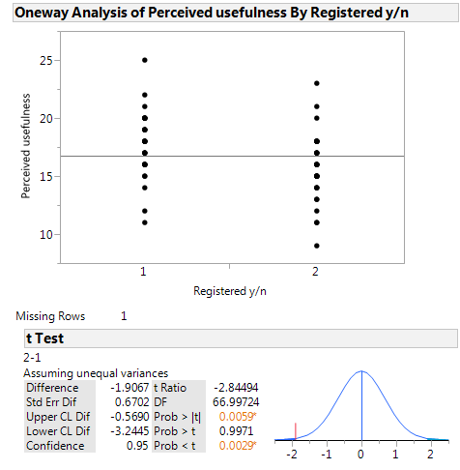
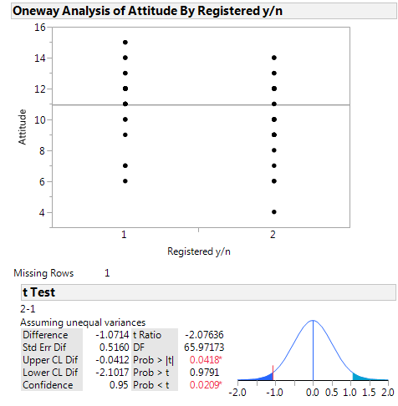
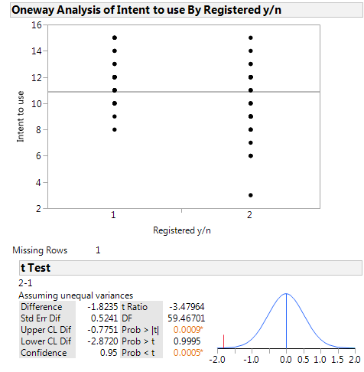
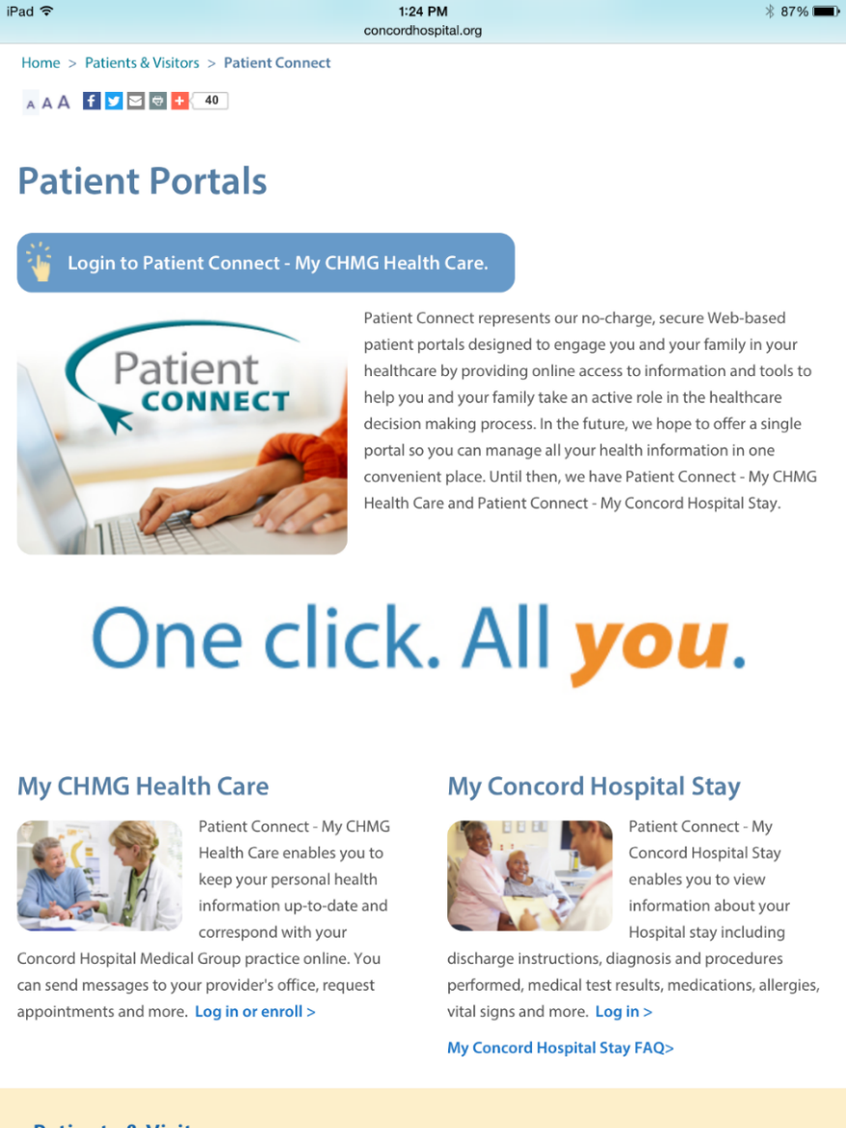
Patient Portal Use in a Community Medical Group: A Healthcare Improvement Project
Pamela S. Kallmerten, DNP, RN, CNL University of New Hampshire, Durham, New Hampshire
Introduction
Evaluation Strategy: Phase I
Findings
American Recovery and Reinvestment Act (ARRA) and the Health Information Technology for Economic and Clinical Health Act (HITECH) 2009
Promote the adoption and meaningful use of health information technology
Meaningful Use Financial Incentives & Penalties for Eligible Providers
Tethered Personal Health Record also known as the patient portal: theorized to increase patient engagement which has been associated with:
Improved Clinical Outcomes
Decreased Cost of Care
Increased Patient Satisfaction
Current facility benchmarks are >50% of unique patients seen by an EP will be registered to use the patient portal
100,109 unique patients
21,221 completed registrations for portal use
Percentage registered & use the patient portal suboptimal at 21%
79% have not registered to use the patient portal
Patient Connect-My CHMG Survey to identify the factors that affect a patient’s intention and decision to use a patient portal
Adapted from: A Questionnaire on Development of a Health Information Technology Acceptance Model (Kim and Park, 2013)
Reliability-Cronbach alpha = 0.853.
Content Validity-Confirmed by a group of HIT experts.
Total 271 completed survey responses (235 users, 36 non-users)
Perceived Usefulness Attitude
Intent to Use
Project Goals
Global Aim: Optimize patient engagement with the use
of a patient portal
Specific Aim: Increase the percentage of patients
who register to use the patient portal to the benchmark
of >50%
Logistic Regression for Perceived Usefulness
Odds Ratio 1.44 Lower 95% 1.20 Upper 95% 1.75
Chi Square 30.09, df=7, p=<0.0001
Project Description
Improvement: Phase II
Conclusions & Implications
Two-part Research Translation and
Health Care Improvement DNP Project
Phase I: Survey the CHMG patients &
analyze the results
Phase II: Implement a trial of Open Notes
Phase II: Implement a strategy likely to address the specific aim:
Increase the percentage of patients who register to use the patient portal from the baseline of 21% to the benchmark of >50% through the release of the office visit note through the patient portal
Provide education: Frequently Asked Questions (FAQs)
about Open Notes
Survey the patients’ perceptions of the benefits and risks associated with viewing their office visit
Overall findings from this specific population are consistent with a review of the literature.
Perception of usefulness is a key process which impacts attitude, intent to use and ultimately portal registration and use.
More data is necessary to identify why a non-user is not registering for the patient portal
DNP Project Team: Joanne Samuels, PhD, RN, CNL
Paul R. Clark, MD, FACP
Donna Pelletier DNP, APRN, FNP-BC

