Slide 1
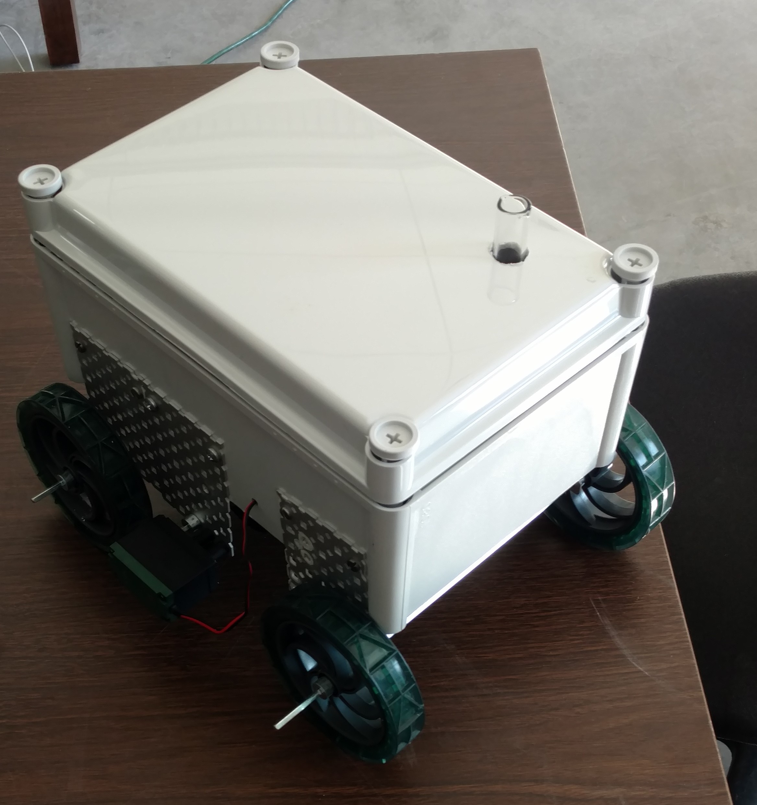
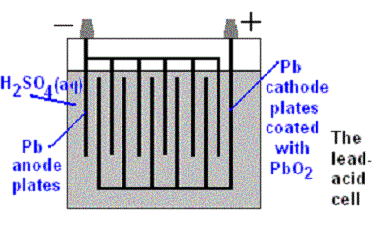
NAN YO BUSINESS
UNIVERSITY OF NEW HAMPSHIRE CHEME CAR
JAMES DILIEGRO, JOSHUA TEIXEIRA, SERGE BOUCHER, SRIGANA PADAMATI, SEAN MCNEILL, CURTIS LALONDE, THOMAS GENDE, ALTAI PERRY, DARRELL OROZCO, JOHN PRUD’HOMME, JOSHUA CAVALLARO
Power Source
STOPPING MECHANISM
Lead plates will be placed in a small container with 1M sulfuric acid solution. The plates will be charged using a 6 Amp car charger for 25 minutes, forcing electrons into the positive plates. During operation the negative ions in the electrolyte will move to the lead plates causing a voltage difference and this discharge will be used to run the motor of the car. As the sulfate comes into contact with the lead plates, lead sulfate will form.
Pb_{(s)} + PbO₂ _{(s)} + 2H 2SO_{4(aq)} → 2PbSO_{4(s)} + 2H₂O_{(l)}
clock reaction will be used to stop the car. The iodine clock reaction requires two solutions to be mixed together to be successful. The first solution of the iodine clock reaction consists of Sodium Iodide (NaI), sodium thiosulfite (NaHS3O3), and starch. The second solution consists of hydrogen peroxide (H₂O₂) and sulfuric acid (H2SO4). Inside the car there will be a photo sensor and a light source that is powered by the battery. The photo sensor and light will be placed at opposite sides of the test tube that contains the iodine clock reaction solution. The iodine clock reaction causes the solution to turn dark blue at a specific time. When the solution changes dark blue, the light can no longer reach the photo sensor and thus cuts the power to the wheels stopping the car.
Slow reaction: H₂O_{2(aq)} + 2I– _{(aq)} + 2H⁺ _{(aq)} → I_{2(aq)} + 2H₂O_{(l)}
Fast reaction: 2S₂O₃^{2–}_{(aq)} + I_{2(aq)} → S₄O₆^{2–}_{(aq)} + 2 I– _{(aq)}
9
0.6273
211.93
250
Time (sec) v.s. NaS2O3 (g)
200
Time (seconds)
150
100
50
0
0
0.1
0.2
0.3
0.4
0.5
0.6
0.7
NaS2O3 (g)

Slide 2
This poster template provided courtesy of
UNH ESRC Poster Printing Services
Trust us to make your poster look GREAT!
Website: http://posters.unh.edu
Poster Guide: http://goo.gl/1E7TJY
DELETE THIS SLIDE BEFORE PRINTING

