Slide 1
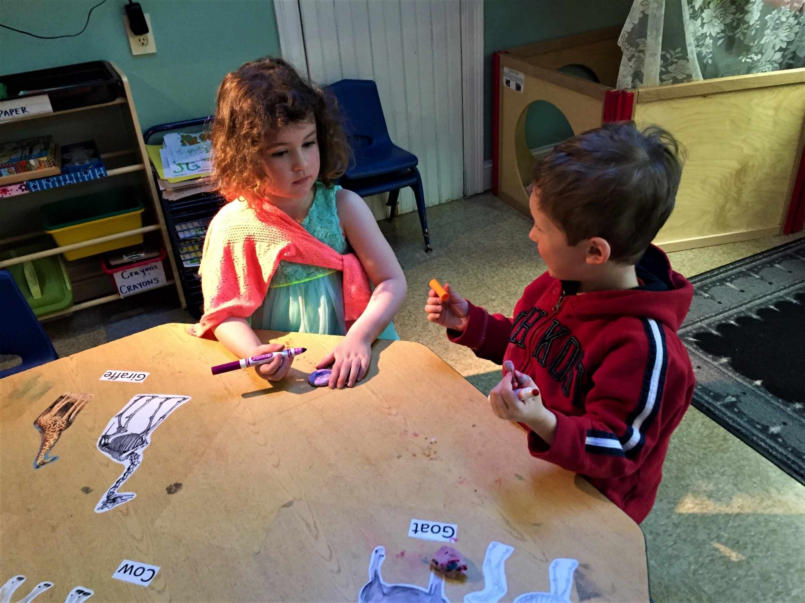
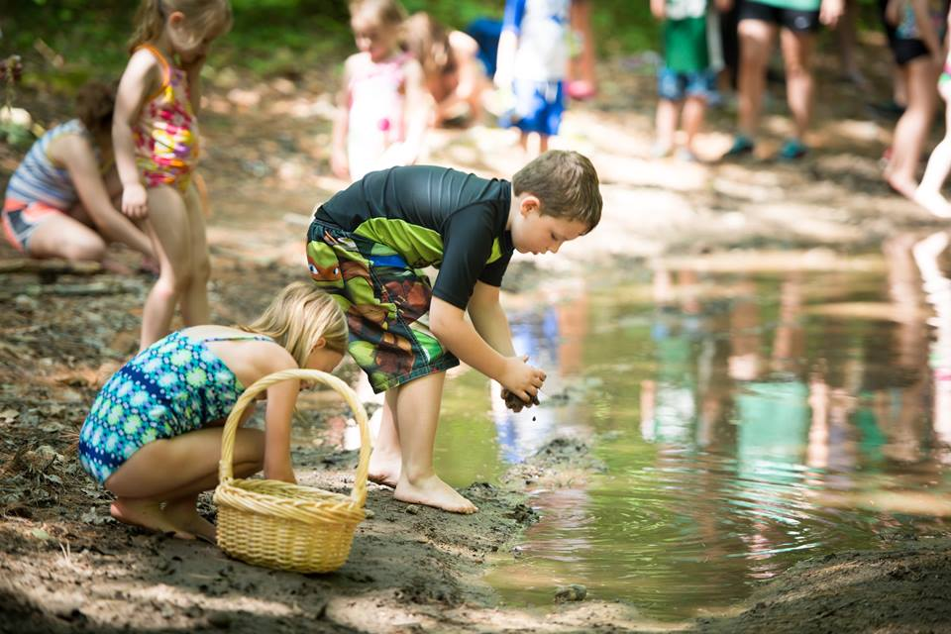
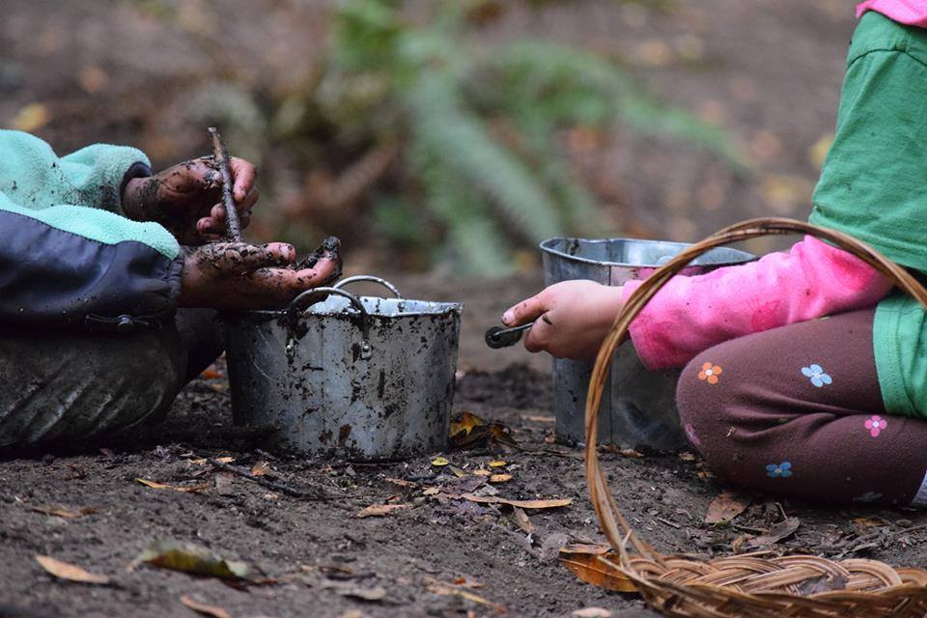
The Influence of the Environment on the Quality of Social Interaction Among Children During Play
Angela Tirabassi, OTS
University of New Hampshire
Background
Results
Children’s free play is decreasing, and as a result, they are losing opportunity for developmental benefits that occur with free play, particularly social skills ¹
Environmental Supportiveness – TOES
The two environments, nature-based camp and typical play environment, differed in their supportiveness in:
Children are not only playing less, their outdoor play time is decreasing and often directed by adults ¹
Natural/fabricated objects availability
Space amount and configuration
Sensory opportunity
Discussion
Researchers have begun establishing play environments with natural opportunity for children to explore ^{2,} ³
Environments that offer greater opportunities of objects, space, and sensory exploration appear to support better quality of social interaction
Current research does not explore how the environment influences social interaction skills during play
t-value | p-value | df
3.362 | .006 | 11
Sufficient quality and quantity of objects motivate children’s play and interaction
Research Question
Quality of Social Interaction – ESI
Play within appropriate amount and configuration of space creates proper boundaries
Does the environment influence the quality of social interaction during play among children?
The quality of social interaction differed in the two environments
t-value | p-value | df
6.167 | .000 | 11
Sensory rich environments offer invitation to play
Methodology
This research has the potential to guide parents, child-care providers, and teachers in providing an environment that promotes child-initiated play and social interaction for children
Quasi-experimental design
12 children
6 boys
6 girls
Ages 4-8
Mean age 6
Median age 6
Observations during play at:
Nature-based camp
Typical play environment (home or playground)
Assessments
Test of Environmental Supportiveness (TOES) (Bundy)
Evaluation of Social Interaction (ESI) (Fisher & Griswold)
Implications
Consider how to modify the environment to be more supportive of social interaction and play
Suggest how specific environmental factors may be modified to support social interaction in intervention for children who lack developmentally appropriate social skills
Occupational therapists should evaluate performance skills and the environment using standardized assessments
Photo courtesy of TimberNook Program
References
The Camp
1. Burdette, H. L., & Whitaker, R. C. (2005). Resurrecting free play in young children: Looking beyond fitness and fatness to attention, affiliation, and affect. Arch Pediatric Adolescent Medicine, 159(1), 46-50. doi:10.1001/archpedi.159.1.46
One week day camp
2. Bundy, A. C., Naughton, G., Tranter, P., Wyver, S., Baur, L., . . . Brentnall, J. (2011). The Sydney playground project: popping bubblewrap – unleashing the power of play: A cluster randomized controlled trial of a primary school playground-based intervention aiming to increase children’s physical activity and social skills. BMC Public Health, 11(680), 1-9. doi:10.1186/1471-2458-11-680
Encourages child-directed play using a nature-based approach
3. Dowdell, K., Gray, T., & Malone, K. (2011). Nature and its influence on children’soutdoor play. Australian Journal of Outdoor Education, 15(2), 24-35.
Promotes social interaction, risk-taking, problem-solving, independent thought, creativity, and sensori-motor development
Acknowledgements
Special thanks to Lou Ann Griswold, PhD, OTR/L, FAOTA University of New Hampshire Hamel Center for Undergraduate Research & TimberNook Program
Photo courtesy of TimberNook Program

