Slide 1
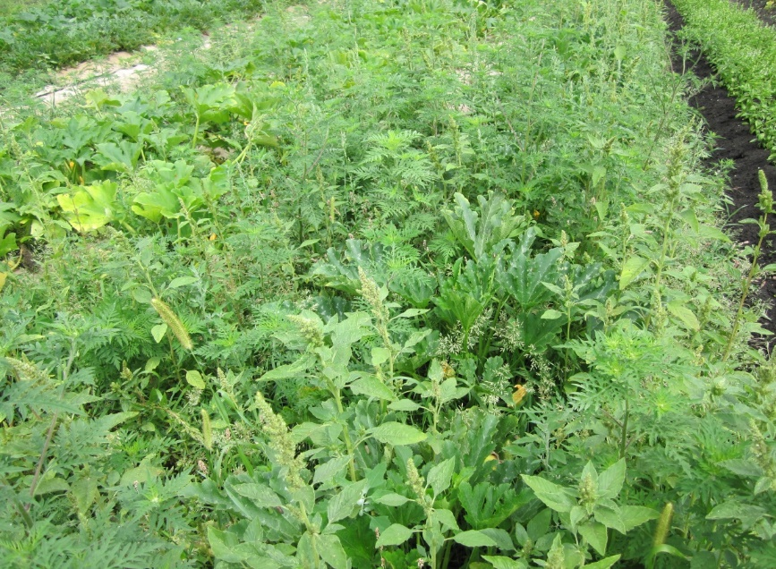
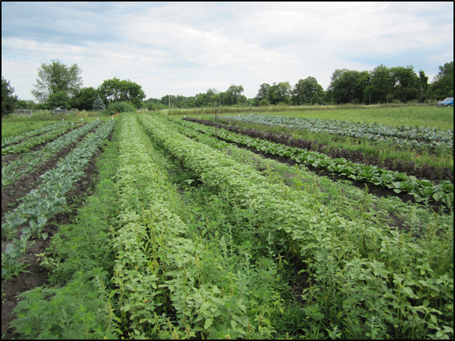
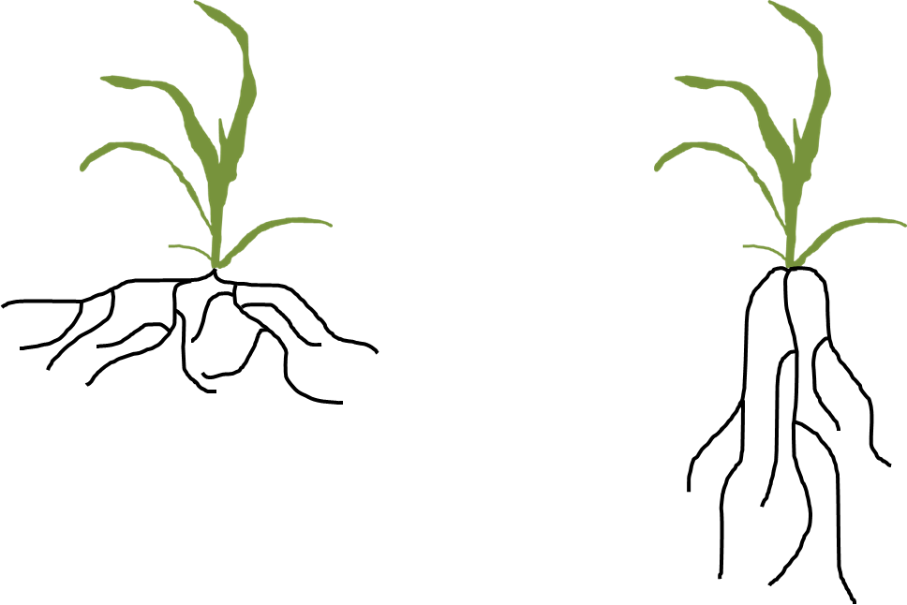
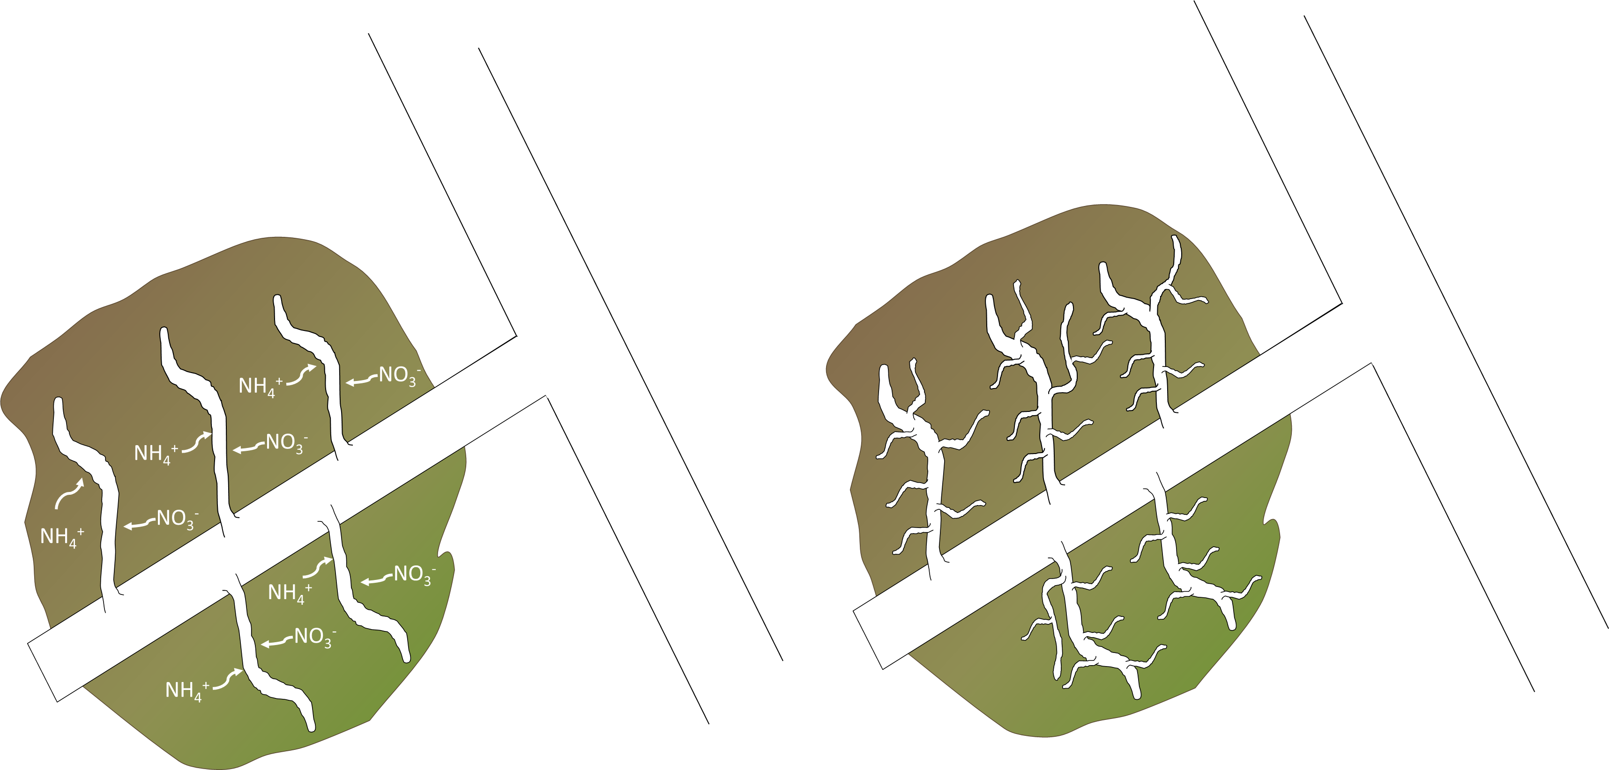
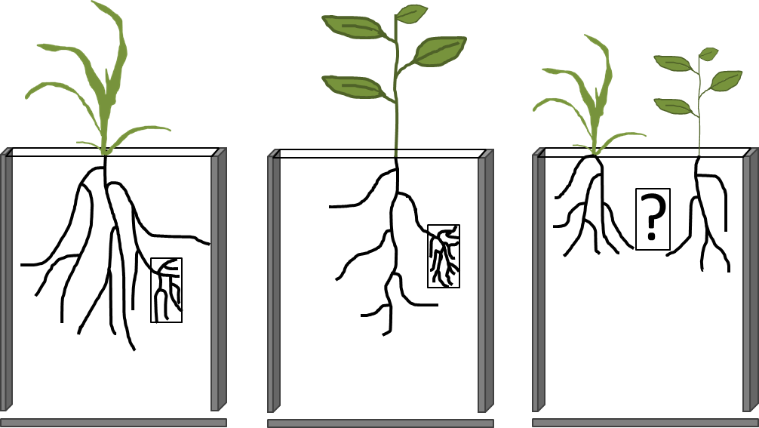
Root Foraging and Crop-Weed Competition
Carolyn Lowry, Postdoctoral Researcher; Richard Smith, Assistant Professor
Department of Natural Resources and the Environment
Weed Competition: How can we reduce competition from weeds in low-input cropping systems?
Weed competition is a major source of yield loss in low-input cropping systems.
Belowground (or root) competition may occur earlier, and have a greater impact on yield, than aboveground competition.
Research is limited on the mechanisms of belowground competition, despite the evidence showing its importance to plant productivity and yield.
Root Foraging: Do crops and weeds differ in their ability to forage for nutrients?
Root foraging encompasses the responses utilized by roots to exploit heterogeneously distributed resources in the soil.
Some plant species have root architecture that enables them to forage throughout the topsoil, while some forage deeper into the soil.
Species may also vary in how they can forage for nutrients via localized responses to nutrient-rich patches in the soil.
Deep-soil Forager
Physiological Plasticity
Morphological Plasticity
Increase nutrient uptake
Increase root proliferation
Nutrient Patch
Topsoil Forager
Root foraging likely influences competitive outcomes between crops and weeds, and improved understanding of how crops and weeds differ in root foraging can assist in developing fertilization strategies that increase crop competitiveness. Additionally, if variation exists between varieties of a single crop, we may be able to breed for crop varieties that are more effective at competing for soil nutrients.
The goal of this project is to compare root foraging strategies among maize and common agricultural weeds, and evaluate how spatially heterogeneous resources within the soil influence root foraging and crop-weed competition.
Research Questions:
Do maize varieties differ in their root foraging responses (root proliferation within nutrient rich patches); and can we predict root foraging based on root system architecture?
How does the presence of a competing weed influence maize root foraging, and do maize varieties differ in their response to roots of a competing weed?
Methods: Why use “Window-Boxes”?
Studying belowground competition is very challenging because it is difficult to trace roots back to their owner. Unlike the aboveground portion of the plant, all roots tend to look the same.
“Window boxes” force the roots to grow in an almost 2-dimensional plane. This will allow us to trace the roots back to their original owner and understand how plants adjust root growth in response to nutrient patches, as well as to roots from a competing individual.
Root Foraging Research:
Phase 1: Maize
Phase 2: Weeds
Phase 3:
Maize vs. Weeds
Future Implications and Broader Impacts:
Our research will increase our understanding of the belowground mechanisms that mediate crop and weed competition.
Results from this work will contribute towards efforts to breed more competitive crop varieties.
Improving the capacity of crop roots to capture soil resources will reduce the need for irrigation and fertilizer, while simultaneously increasing crop competitiveness against weeds and reducing the need for herbicides.
This research is supported by a Postdoctoral Fellowship from the National Institute of Food and Agriculture.

