Slide 1
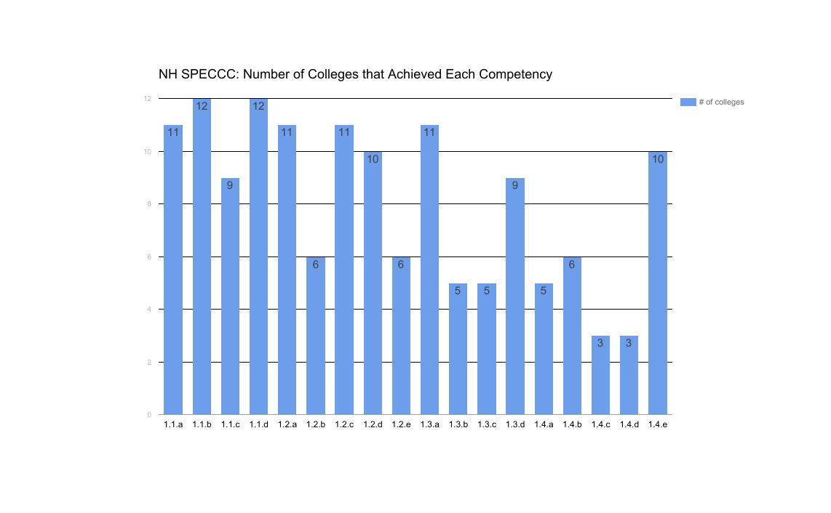
NH Shared Professional Early Childhood Core Competencies Kerri Hughes, B.S.Ed., Education Trainee
LEND: Leadership Education in Neurodevelopmental and Related Disabilities
LEND is a leadership education program on neurodevelopmental and related disabilities. It provides a leadership internship for all trainees to learn about initiatives for children with neurodevelopmental or a related disability at the state level.
Spark NH
Spark NH is a governor appointed advisory council that supports a cohesive system of early childhood programs and services across New Hampshire.
Results
Thirteen colleges and universities participated in this study.
Only two colleges did not respond.
The colleges and universities of New Hampshire are comprehensively covering the foundation of child development.
Sensory processing, mental health, developmental, and health concerns are not specifically addressed in child development courses.
Behavior as a form of communication is not covered in course objectives.
Verbal and non-verbal communication is not specifically covered in the course objectives for child development courses.
Aesthetic environment tends not to be addressed in child development courses.
Positive reinforcement as well as natural and logical consequences are not covered thoroughly in the course objectives for child development courses.
Routines and self-regulation are not specifically addressed in the child development course objectives.
Conclusions
Students across disciplines are learning the same high quality content and have similar foundational knowledge of child development.
When children and families work with professionals in various fields (such as doctors, teachers, and social workers) they are getting the same information and not contradictory information.
When students transfer colleges or disciplines, their credits will be able to transfer and will have the same foundational child development knowledge as the students that attended the child development class at that college.
It is a possibility that the NH SPECCC that are not covered in the child development course may be covered in other courses.
NH SPECCC: New Hampshire Early Childhood Core Competencies
The NH SPECCC are intended to be used as a resource for all professionals who work with and on behalf of expectant families, children from birth through grade 3, and their families, with a particular focus on the fields of family support, health and early learning. The Workforce and Professional Development Committee of Spark NH set a priority to encourage articulation between institutions of higher education for early childhood students. To that end we support the SPECCC competencies for Early Childhood Development be covered in all child development courses across disciplines (education, nursing, pediatrics, psychology, etc.) and colleges and universities in New Hampshire.

