Slide 1
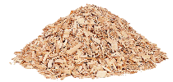
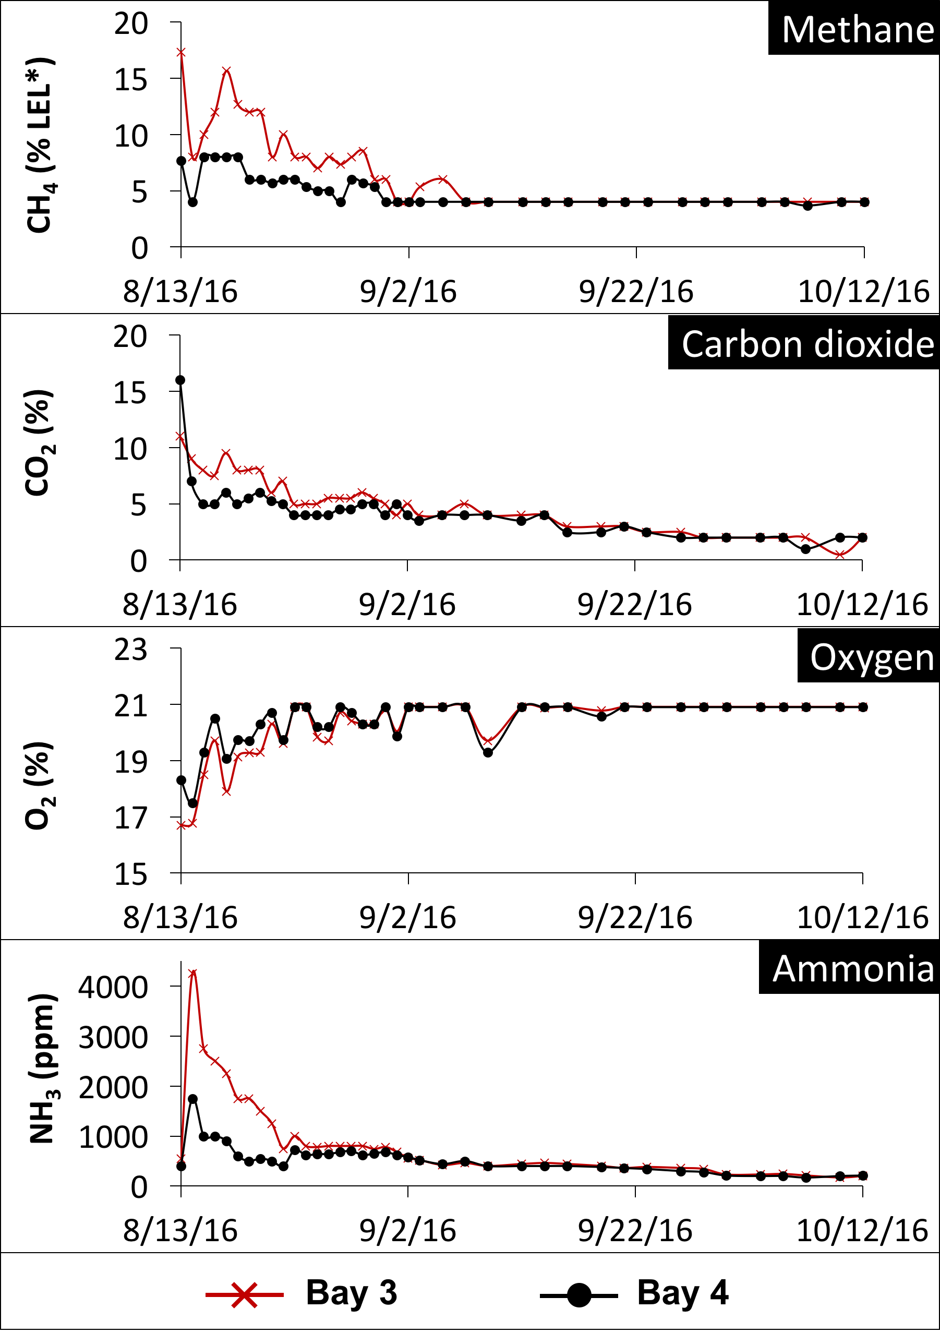
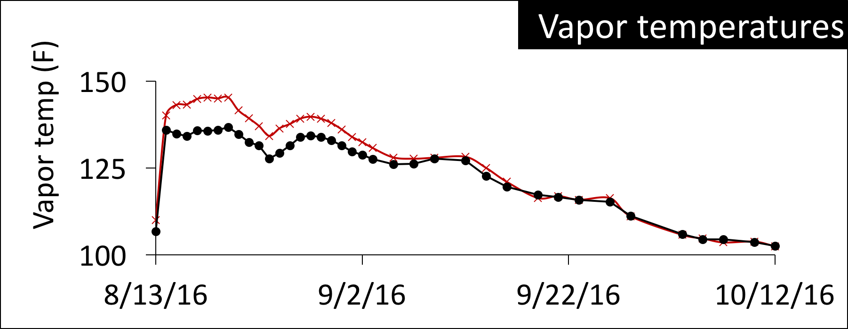
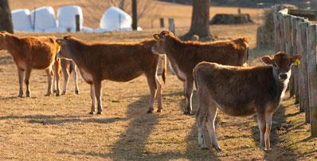
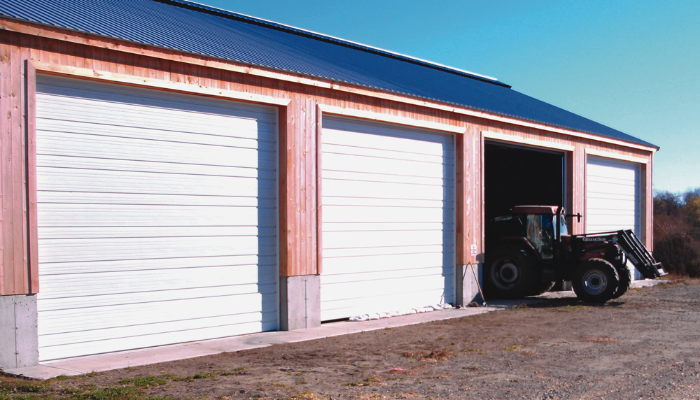
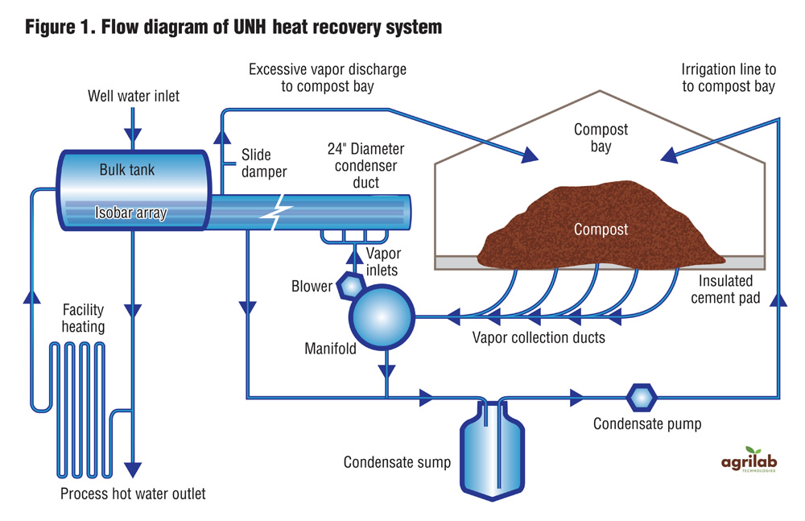
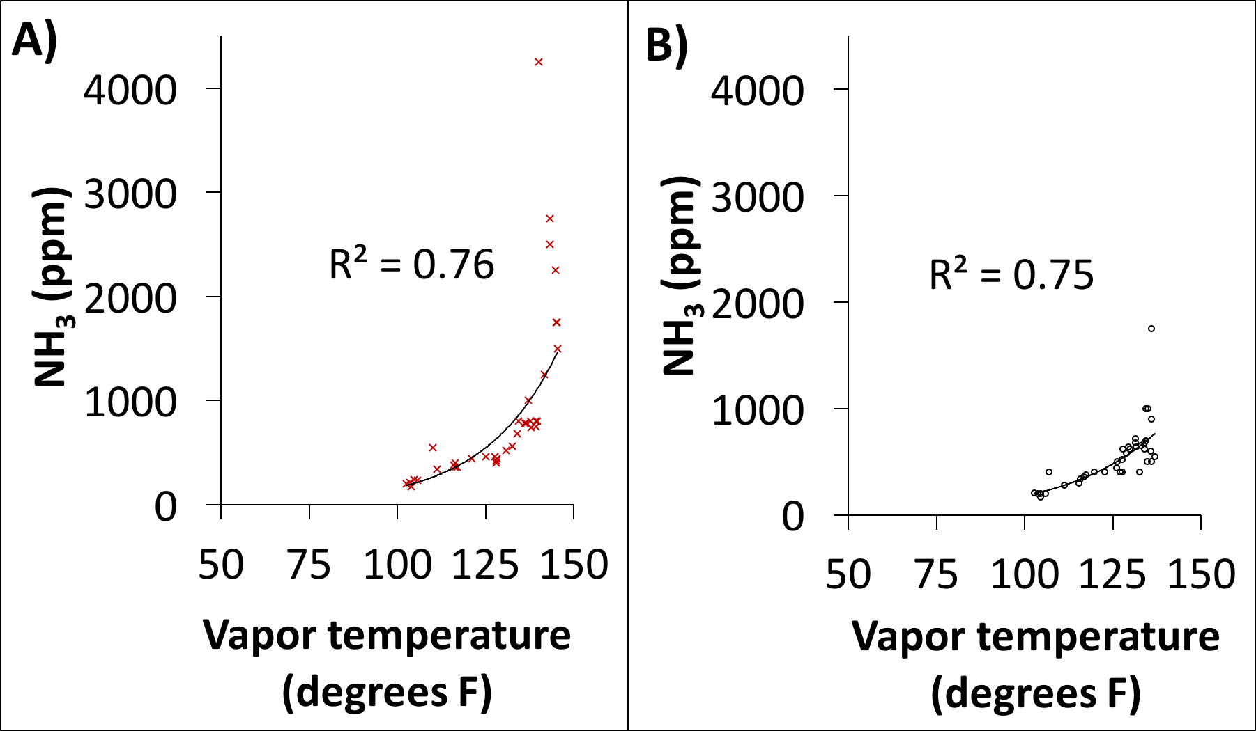
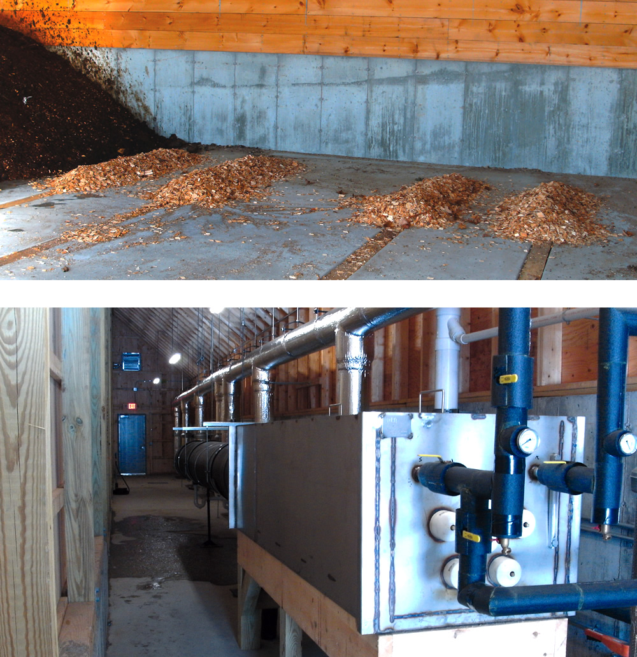
Closing the agricultural loop:
Capturing and utilizing compost gas exhaust from aerated static pile composting
Allison M. Leach¹, John D. Aber¹, Matthew Smith¹
¹University of New Hampshire, Durham, New Hampshire, USA
College of Life Sciences and Agriculture
NH Agricultural Experiment Station
INTRODUCTION
METHODS
Aerated static pile (ASP) heat recovery composting:
Mix once – no turning
Constant aeration maintains high oxygen concentrations
Reduces generation of methane relative to non-aerated piles
Generates vapor temperatures exceeding 150F
Airflow allows capture of heat for on-farm use
Also allows capture and use or treatment of waste gases produced
1. Characterizing compost gas exhaust vapors
2. Estimating avoided pollution (future work that will not be presented here)
Data set
Measurement
Analysis
a) Compost
b) Biofilter
c) Greenhouse
Gas concentrations
NH₃, CO₂, O₂, CH₄
Gas temperatures
For 60-day compost cycle on paired bays
Draeger and RAE Gas Detection Tubes (NH₃, CO₂)
RKI Eagle gas analyzer (CH₄, O₂)
Compare trends and drivers across data sets
Determine total gases emitted
CH₄
N₂O
NH₃
Emissions avoided by
using manure for compost
Emissions captured by a biofilter
Emissions that
crops could use
Research objectives:
Characterizing compost gas exhaust: Measure the NH₃, CO₂, CH₄, and O₂ concentrations from the UNH ASP facility over the 60-day composting process.
Estimating avoided pollution: Explore methods to quantify the potential of this facility to divert NH₃, CH₄, and CO₂ emissions from environmental loss.
Potential for avoided pollution will be explored with measurements and theoretical calculations in a future study.
RESULTS
Gas exhaust concentrations
Correlations with temperature
Summary & next steps
STUDY SITE
Compost gas exhaust:
Emissions of pollutants (NH₃, CO₂, CH₄) peak early in composting cycle and then stabilize (Figure 3)
Early peak in CO₂ and CH₄ due to anaerobic conditions
→ Important to capture composting emissions early in composting life cycle
Correlations with temperature:
Vapor temperature (Figure 4) may be a predictor of NH₃ concentrations
NH₃ is strongly correlated with vapor temperatures (Figure 5)
Next steps:
Collect more measurements
Determine the total gases emitted across composting life cycle
Estimate potential for pollution avoidance from:
Composting manure instead of direct land application;
Constructing a biofilter to capture emissions; and
Connecting the compost facility to a greenhouse
Burley-Demeritt Farm, Lee, NH, also known as the Organic Dairy Research Farm (Figure 1)
Includes the UNH Joshua Nelson Energy Recovery Compost Facility – unique in university setting
Composting facility supports continuous low-volume aeration of mixed animal, bedding, and hay wastes generated on the farm (Figure 2)
Figure 4. Vapor temperatures of compost exhaust.
Temperatures are recorded every minute using sensors. Temperatures recorded at the same time as gas sampling (Figure 3) for bay 3 (red line) and bay 4 (black line).
Figure 3. Compost gas exhaust concentrations. Concentrations shown (CH₄, CO₂, O₂, NH₃) are for two paired bays for the 60-day composting cycle in fall 2016.
*%LEL (Lower Explosive Limit) for CH₄ is 5%
Figure 5. Correlations between vapor temperature and ammonia concentrations for A) bay 3 and B) bay 4.
Trendlines are fitted using exponential linear regression.
Figure 2. Flow diagram of UNH heat recovery aerated static pile composting system. Source: Smith and Aber 2014
Figure 1. UNH Burley-Demeritt Organic Dairy Research Farm and Joshua Nelson Energy Recovery Compost Facility. Source: Smith and Aber 2014
FOR MORE INFORMATION
ACKNOWLEDGMENTS
Smith M and Aber J (2014). Heat recovery from compost. BioCycle 55, 27.
Visit our website: http://aberlab.net/
Watch a video about the UNH compost facility: https://youtu.be/YNTX5vqN2Fs
Contact: Allison.Leach@unh.edu
We appreciate data collection and analysis support from interns Andrew Moriarty, Margaret Phillips, and Nicole Williamson.
Funded by the USDA Sustainable Agriculture & Research Education Program
and the New Hampshire Agricultural Experiment Station

