Slide 1
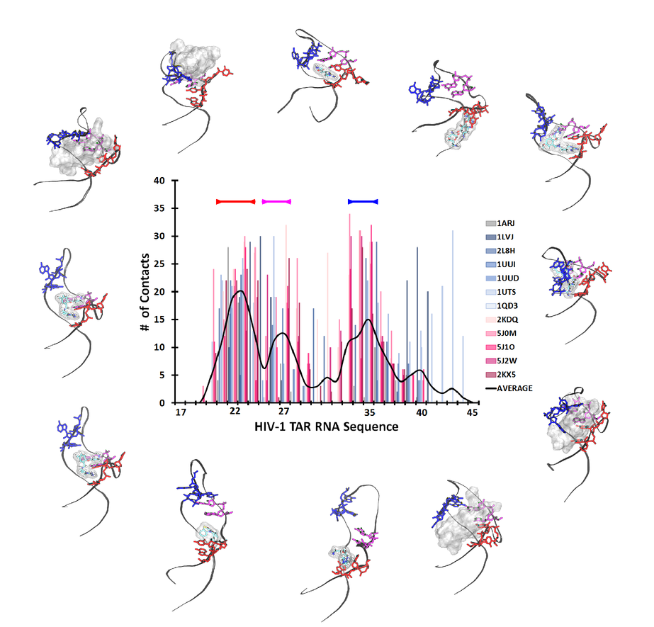
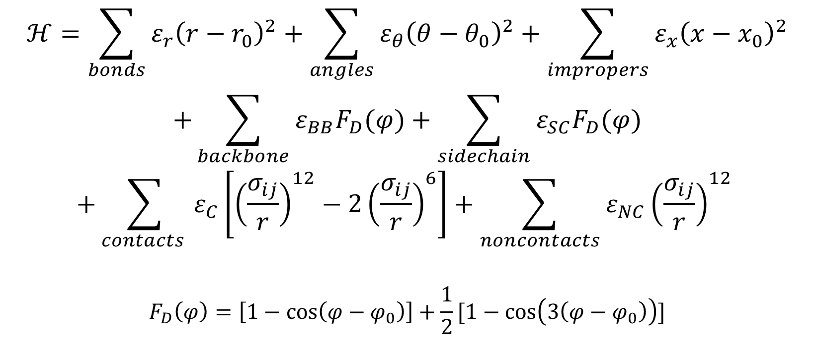
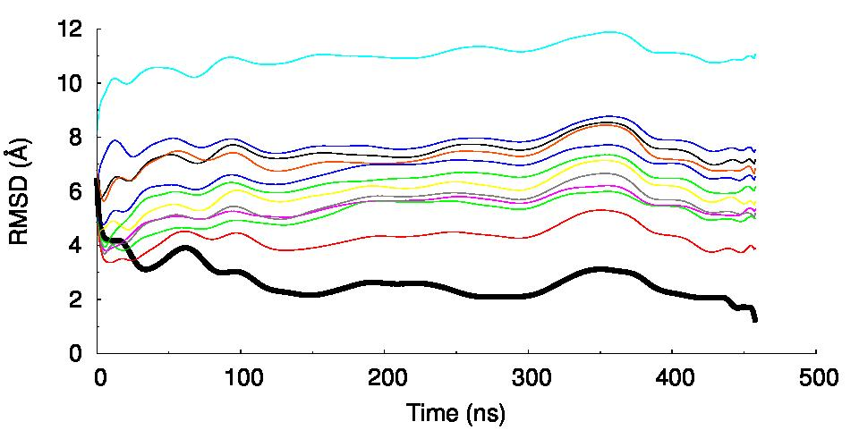
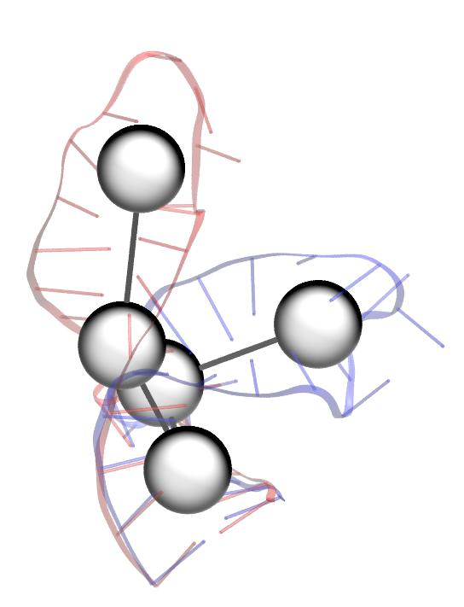
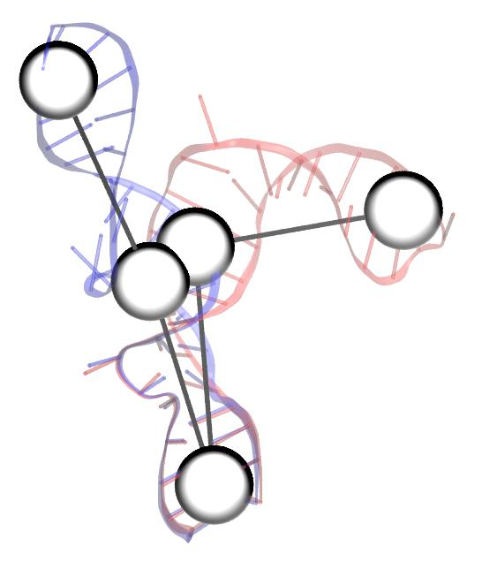
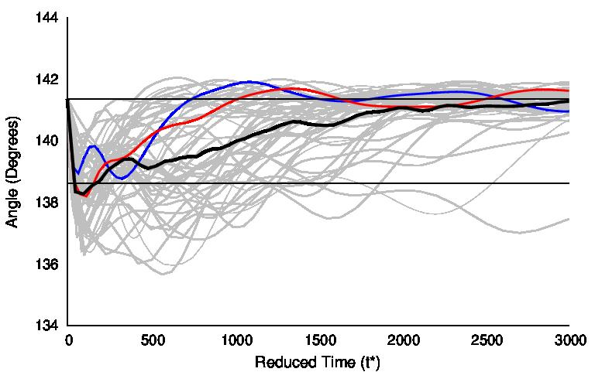
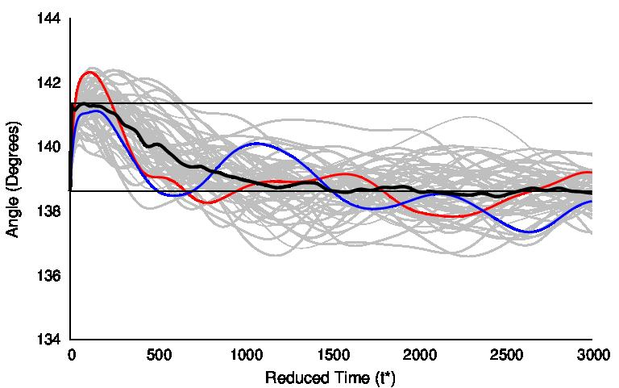
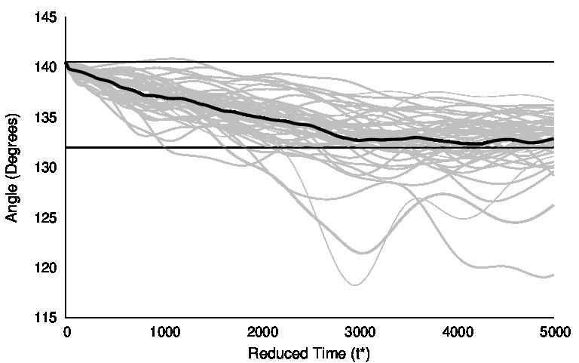
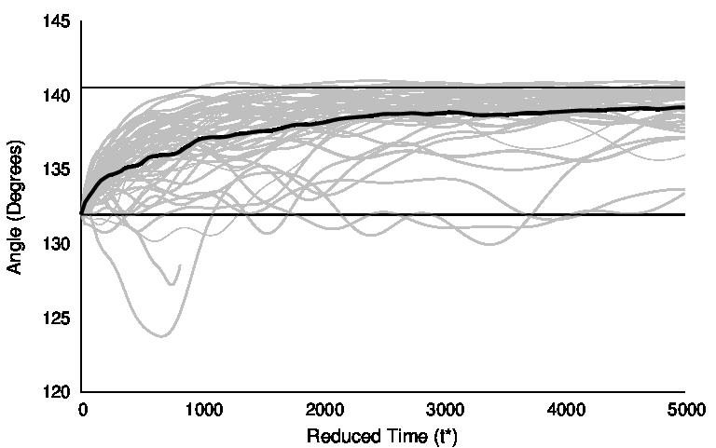
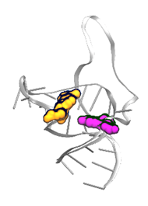
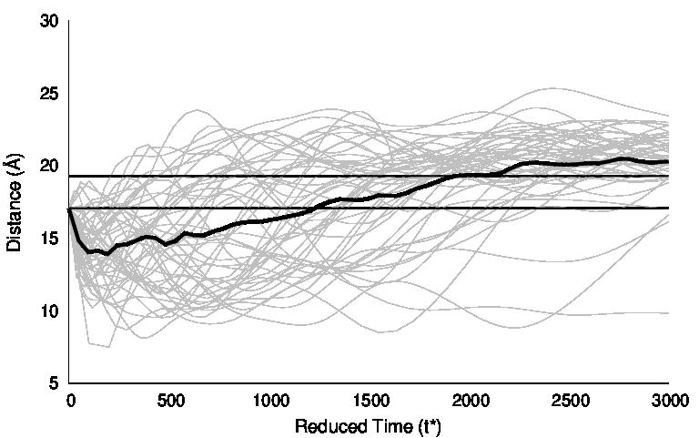
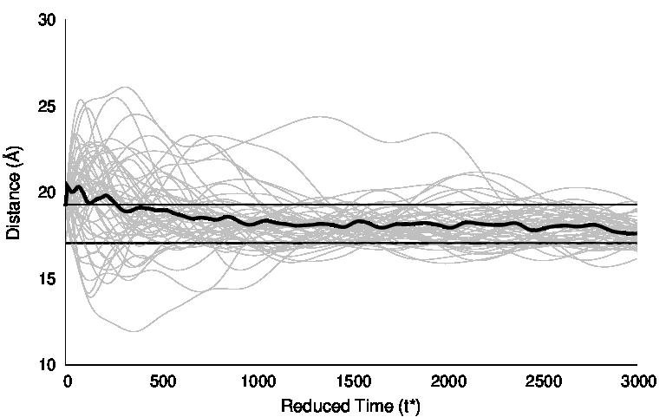
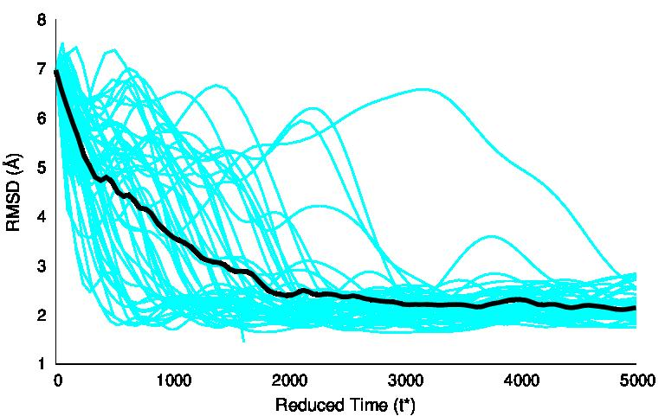
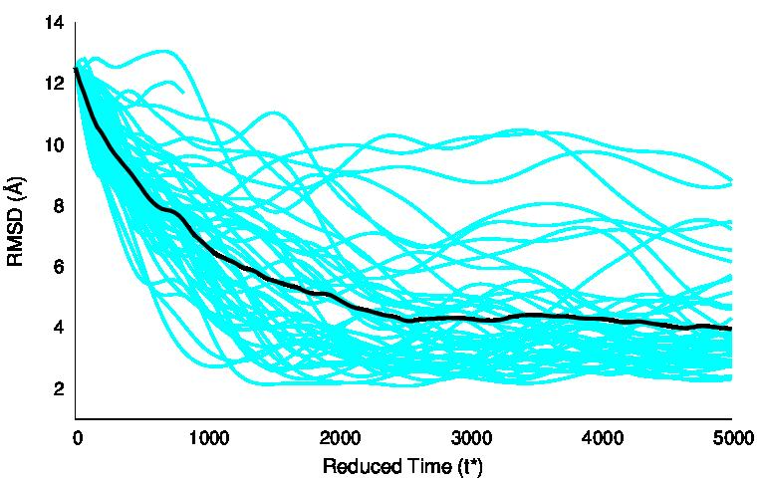
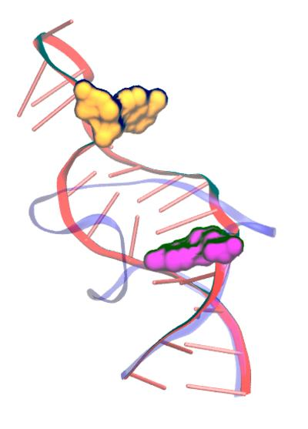
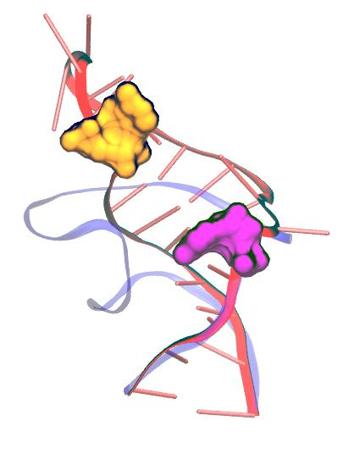
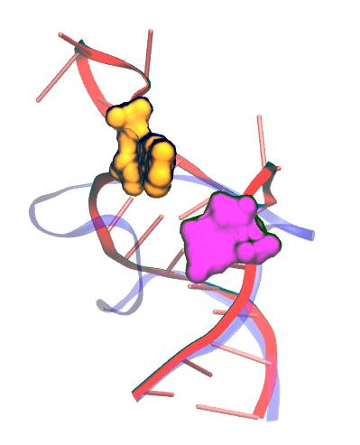
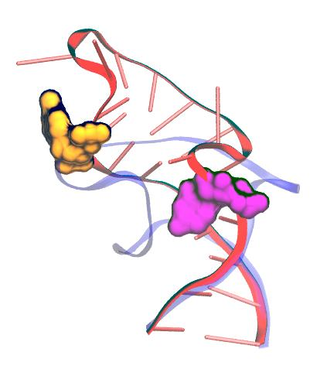
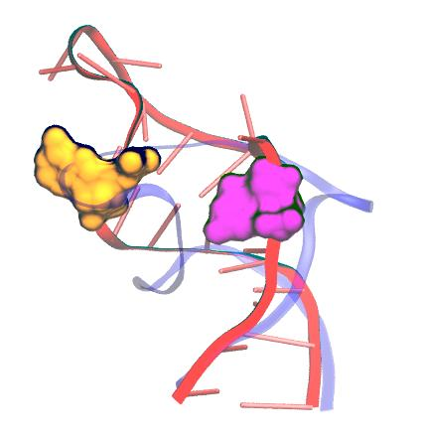
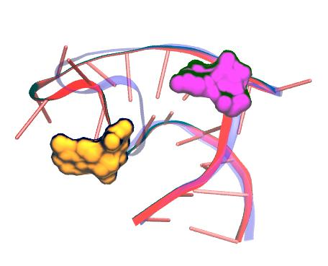
Characterizing RNA dynamics using structure based models Rhiannon Jacobs and Dr. Harish Vashisth Department of Chemical Engineering, University of New Hampshire, Durham, NH 03824
CBET-1554558 (CAREER)
Abstract
Structural Flexibility of HIV-1 TAR RNA
Goals
Theory of SMOG Models
Nucleic acids are known to perform a variety of biological functions inside cells. Particularly, small ribonucleic acids (RNAs) are found to be of higher biological significance due to their ability to perform both catalytic and regulatory functions via conformational rearrangements. Multiple known structural conformations for the same RNA have been experimentally characterized, yet information regarding the transitions between states remains uncharacterized. Characterization of these transition pathways is potentially useful for drug discovery and delivery. The aim of this project is to identify transition pathways between known conformations of small RNA molecules, identify other stable or metastable intermediate states, and develop methods for characterizing these transitions. Structure-based SMOG models for three model RNA systems, the transactivation response element (TAR) RNA from the human immunodeficiency virus Type-1, the stem-loop domain-1 (SL-1) RNA from the HIV-1 packaging signal, and the signal recognition particle (SRP) RNA from E.coli, revealed that multiple transition pathways exist and further allowed for physical characterization of the dynamic motions in between known structural conformations and identification of transition states. The identification of important structural rearrangements allows for the development of new collective variables to better study the energy landscape of small RNA molecules, thereby yielding new methods for the binding of novel ligands.
Characterize transition pathways between known conformational states
Identify physical properties that can act as collective variables
Identify important transition states
Convergence of apo-HIV-1 TAR RNA to ARG Bound State
Molecular Dynamics Simulations
Computer based approach to statistical mechanics which allows for an estimation of equilibrium properties and dynamics
$$F_{i}=m_{i}a_{i}=−∇_{i}U(r)$$
Structure-based Models
HIV-1 TAR RNA
SL-1 Domain RNA
Identification of Important Physical Variables
Identification of Important Physical Variables
144
142
140
138
136
134
State 1 → State 2
144
142
140
138
136
134
State 2 → State 1
State 1 → State 2
State 2 → State 1
145
140
135
130
125
120
115
145
140
135
130
125
120
115
Angle (º)
Angle (º)
Angle (º)
Angle (º)
Transition Pathways
0 1000 2000 3000
0 1000 2000 3000
Transition Pathways
Reduced Time (t*)
Reduced Time (t*)
0 1000 2000 3000 4000 5000
8
6
4
2
0
State 1 → State 2
30
20
10
State 1 → State 2
30
20
10
State 2 → State 1
8
7
6
5
4
3
2
1
State 1 → State 2
Reduced Time (t*)
Distance (Å)
RMSD (Å)
Proposed Transition Pathway
RMSD (Å)
Distance (Å)
0 1000 2000 3000 4000 5000
0 1000 2000 3000
0 1000 2000 3000
0 1000 2000 3000 4000 5000
Reduced Time (t*)
Reduced Time (t*)
Reduced Time (t*)
Reduced Time (t*)
10
8
6
4
2
0
State 2 → State 1
Proposed Transition Pathway
14
12
10
8
6
4
2
State 2 → State 1
RMSD (Å)
RMSD (Å)
Acknowledgements & References
We are thankful for funding from NFS CAREER Award (CBET #1554558) and XSEDE Computational Resources (TG-MCB16083) as well as the UNH’s Supercomputing cluster (Trillian) and the Department of Chemical Engineering.
0 1000 2000 3000 4000 5000
0 1000 2000 3000 4000 5000
Noel JK and Onuchic JN. (2012) "The Many Faces of Structure-Based Potentials: From Protein Folding Landscapes to Structural Characterization of Complex Biomolecules" in Computational Modeling of Biological Systems, Part 1, pg 31-54, DOI: 10.1007/978-1-4614-2146-7_2
Reduced Time (t*)
Reduced Time (t*)

