Slide 1

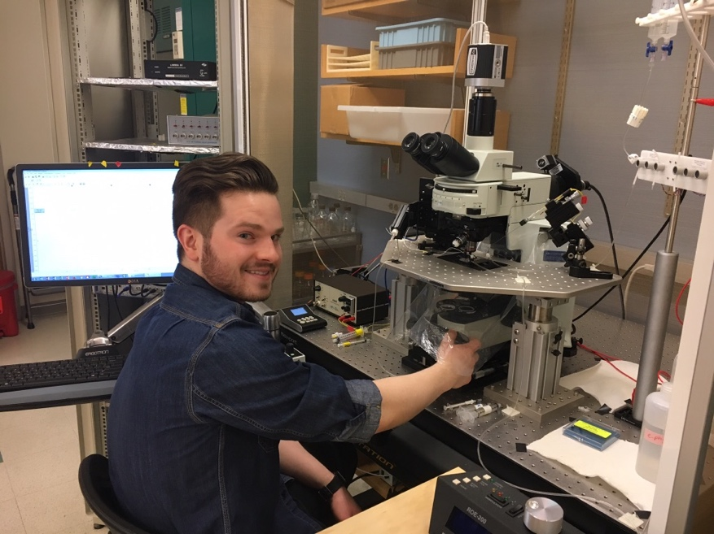
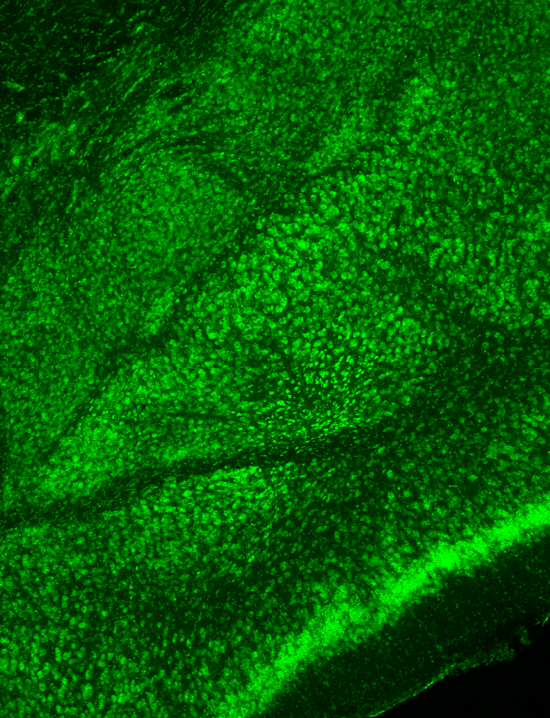
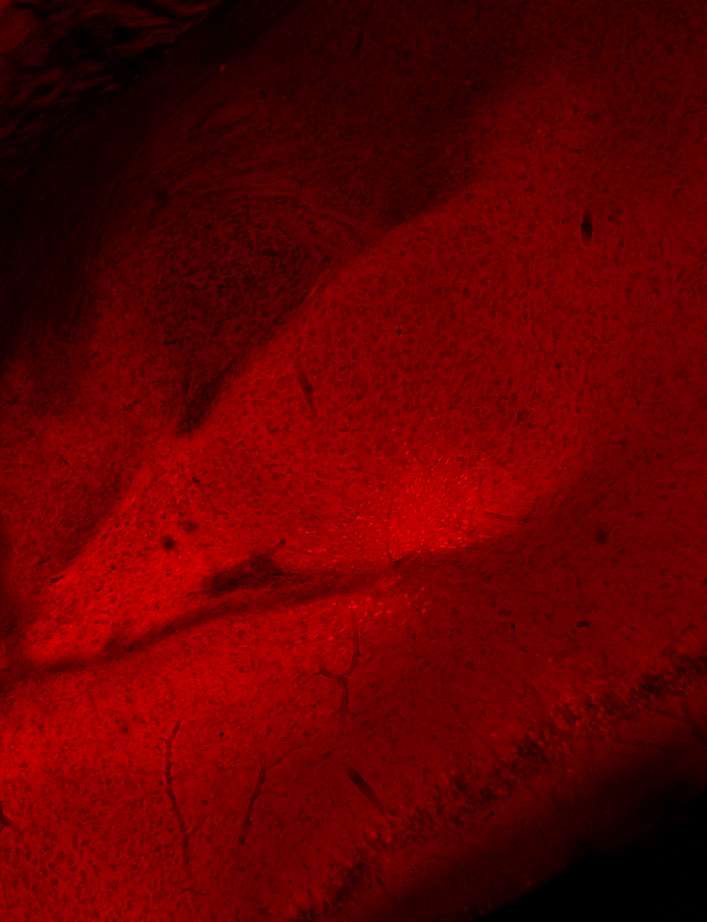
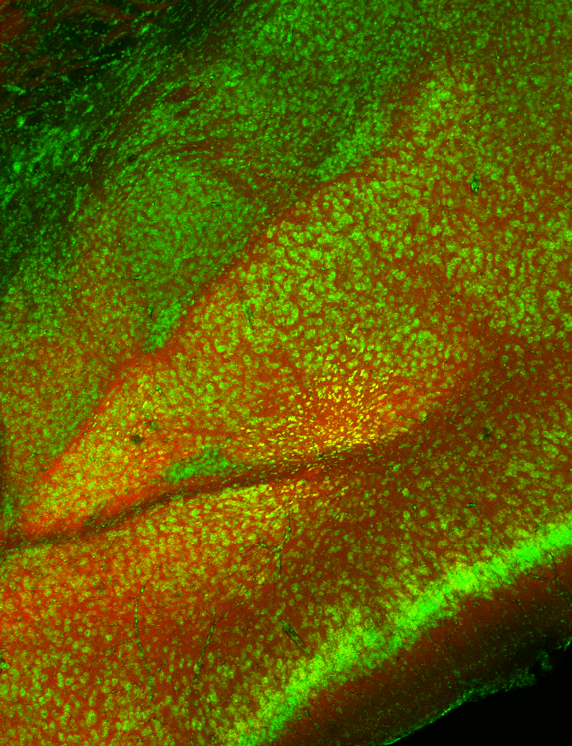
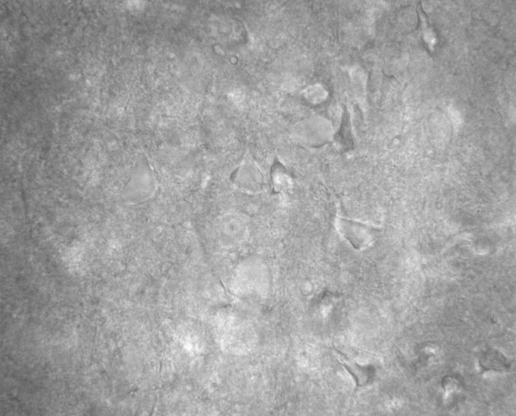
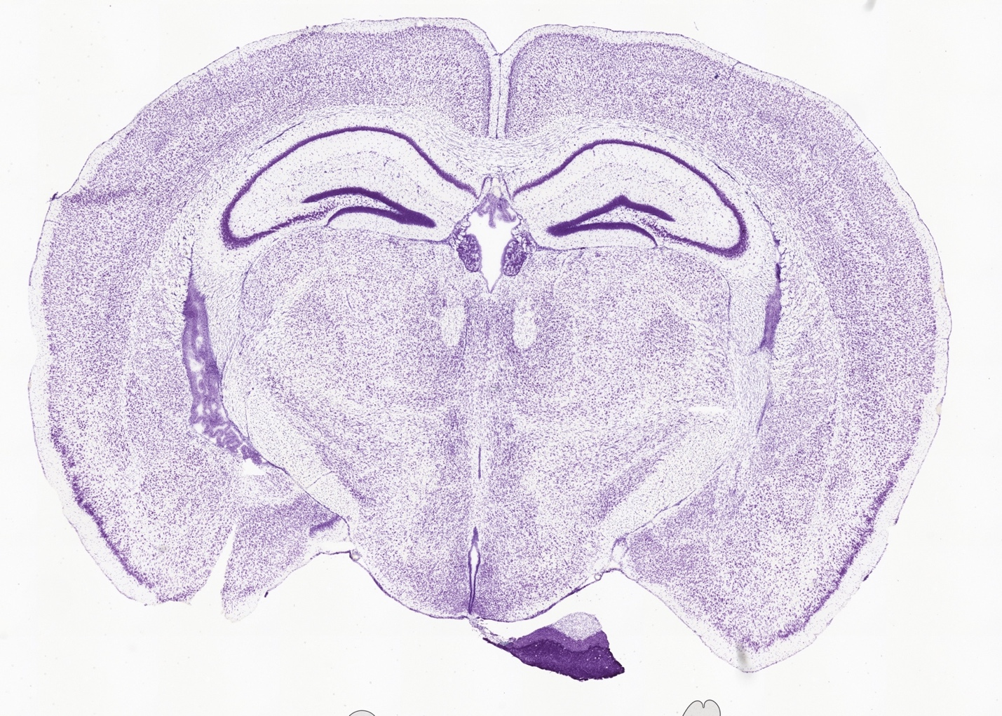
Presynaptic N-type calcium channel-dependent transmitter release in the BLA
Blazon M, LaCarubba B, Bunda A, Andrade A
Department of Biological Sciences, University of New Hampshire, Durham, NH 03824
Introduction
Identification of CCK+ cells in the BLA
Materials & Methods
In the US, anxiety disorders affect 40 million adults, with a lifetime prevalence of 28.8% and healthcare costs upwards of $42 billion per year^{1,2}.
Dysfunction of the amygdala is implicated in anxiety disorders³
The basolateral amygdala (BLA) is the amygdala's primary output, containing excitatory pyramidal cells (P-cells) which project to the central amygdala, hippocampus, bed nucleus of the stria terminalis, anterior cingulate cortex, and prefrontal cortex
P-cells receive excitatory connections from the cortex and inhibitory inputs from local interneurons. P-cell activation correlates with anxiety-like behavior⁴
Presynaptic N-type (Ca_{V}2.2) calcium channels control the release of glutamate (excitatory) and GABA (inhibitory) neurotransmitters in the nervous system⁵
Certain drugs that target Ca_{V}2.2 have anxiogenic effects (i.e. Prialt®)
The BLA contains several types of inhibitory interneurons including cholecystokinin (CCK+) basket cells (BCs)
In the hippocampus, research has shown that neurons expressing the peptide CCK use Ca_{V}2.2 channels in neurotransmission^{6,7,8}
The role of Ca_{V}2.2 in controlling neurotransmitter release by glutamatergic and GABAergic inputs onto P-cells of the BLA has not been described
Mouse Models
Immunohistochemistry
Transgenic Mice
Mice used in immunohistochemistry stains were CCK+/ TdTomato+ to show CCK localization in the amygdala. Tissue was sliced and fixed in 4% PFA. A 5% BSA/PBT solution was used as a blocking agent
We used a mouse line expressing channelrhodopsin-2 under the CCK promoter to record light evoked IPSCs
Brain Slice Electrophysiology
Mice were anesthetized with isoflourane and decapitated. Their brains were removed and placed in oxygenated artificial cerebral spinal fluid (aCSF) to maintain neuronal health
Hemi-coronal slices (350 μm thick) containing the amygdala were obtained with a Leica® vibratome
Excitatory and inhibitory post synaptic currents were recorded via whole-cell patch clamp in constant aCSF perfusion
To study cortical inputs to the BLA, a concentric stimulation electrode was placed in the amygdala capsule
Neurons were visualized using differential interference contrast (DIC) microscopy
Figure 2: CCK-Cre mice were bred with loxP-STOP-loxP-TdTomato mice. Adult mice were 3-4 months old during immunohistochemistry stains and 4-6 weeks old during electrophysiology recordings.
Figure 3: Confocal images of the BLA in a CCK+/TdTomato+ (red) transgenic mouse. SYTO 13 stained nucleic acids and thus all cell bodies (green). Brain sections were mounted and then imaged to study CCK expression in the BLA (red). Co-localization of SYTO 13 and TdTomato (yellow) shows cell bodies that express CCK.
Identification of P-cells in the BLA
A
Conclusions & Next Steps
B
Conclusions
P-cells can develop both inhibitory and excitatory postsynaptic currents
We can record both excitation from cortical inputs and inhibition from local CCK+ basket cells
Stimulation via a concentric electrode induced both inhibitory and excitatory postsynaptic currents
Optogenetic stimulation induced inhibitory postsynaptic currents
Next Steps
Apply a specific Ca_{V}2.2 blocker (ω-conotoxin GVIA) to both IPSCs and EPSCs
Apply a GABA_{A} chloride channel blocker (picrotoxin or biccucline) to IPSCs
Generally, reveal more information on the contribution of Ca_{V}2.2 to postsynaptic currents in P-cells
?
?
C
Figure 4: Electrophysiological recordings from P-cells in the BLA. A) DIC image of the BLA showing a concentric stimulation electrode placed in the amygdala capsule. B) DIC image of BLA P-cells, 40x zoom. Note pyramidal morphology C) Current-clamp electrophysiological recording of a P-cell. This response is characteristic of an accommodating firing pattern typically seen in P-cells and demonstrates accurate identification.
A
C
Figure 1: Localization of the amygdala and BLA circuitry. A) Nissl-stained coronal brain section, location of the amygdala is indicated with a red square. B) Subdivisions of the amygdala (Allen Mouse Brain Atlas). amc, amygdala capsule; BMA, basomedial amygdala; CEAi, central nucleus amygdala; BLA, basolateral amygdala; LA, lateral amygdala. C) Proposed schematic of cortical and CCK+ BC connections to P-cells in the BLA. Question marks indicate our research question.
P-cells receive inhibitory and excitatory connections
Inhibitory Postsynaptic Currents
Excitatory Postsynaptic Currents
A
B
A
B
Objective & Aims
Acknowledgements
Primary Objective
To determine if presynaptic N-type calcium channels control excitatory and inhibitory transmitter release in synapses of the BLA.
Aims
Quantify the amount of Ca_{V}2.2-dependent glutamate release in cortico/P-cell synapses.
Quantify the amount of Ca_{V}2.2-dependent GABA release in CCK+ BC/P-cell synapses.
C
D
We are grateful for funding from the NIH (R00-MH099405)
References
Figure 5: Outward, inhibitory postsynaptic currents (IPSC) from P-cells held at 0 mV. A) Electrically evoked IPSC. B) Electrically evoked paired-pulse IPSCs displaying pre-pulse inhibition. This suggests a high probability of transmitter release. C) Optogenetically evoked IPSC from P-cell in CCK+/ChR2+ mouse, 480nm blue light. D) Optogenetically evoked dual IPSC from P-cell in CCK+/ChR2+ mouse. Displays pre-pulse inhibition and suggests high probability of transmitter release.
Figure 6: Inward, excitatory postsynaptic current evoked while holding P-cells at -60 mV. A concentric electrode was placed in the amygdala capsule. A) Electrically induced EPSC in C57BL/6J male using whole-cell voltage patch clamp on P-cells. B) Electrically evoked dual EPSC which illustrates pre-pulse facilitation and a low probability of transmitter release.
[1] Kessler et al., 2005
[2] Bystritsky et al., 2013
[3] Janak & Tye, 2015
[4] Johansen et al., 2010
[5] Patel et al., 2017
[6] Ali et al., 2011
[7] Lee et al., 2015
[8] Szabó et al., 2014
[9] Morse et al., 2017

