Slide 1
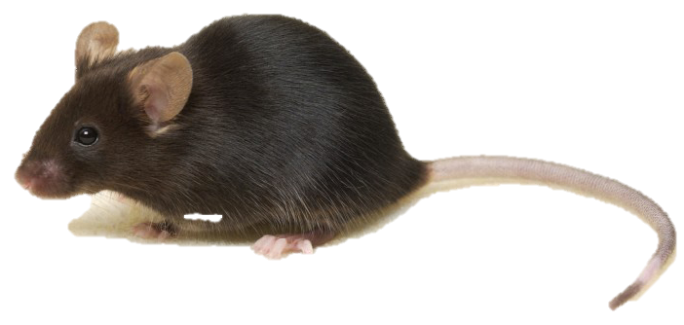
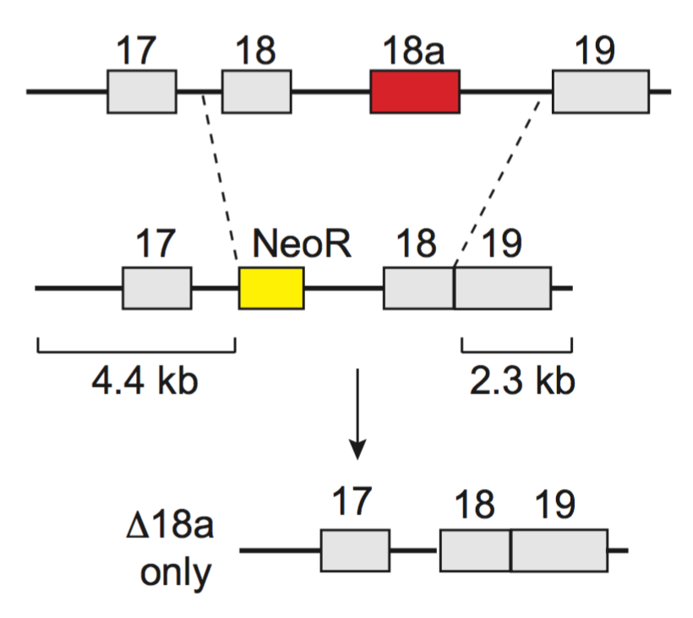
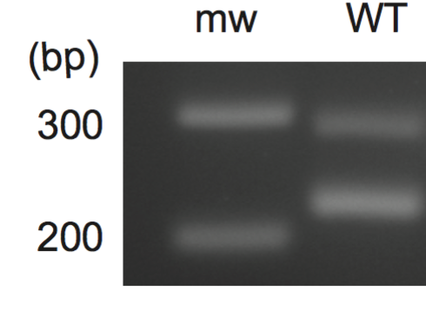
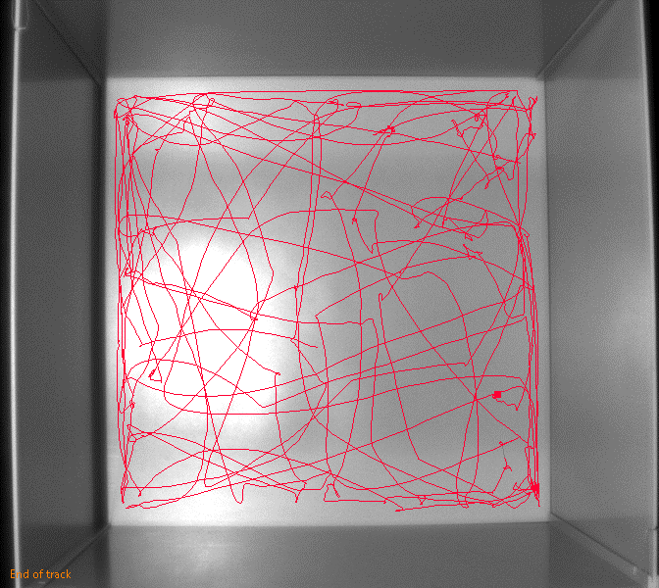
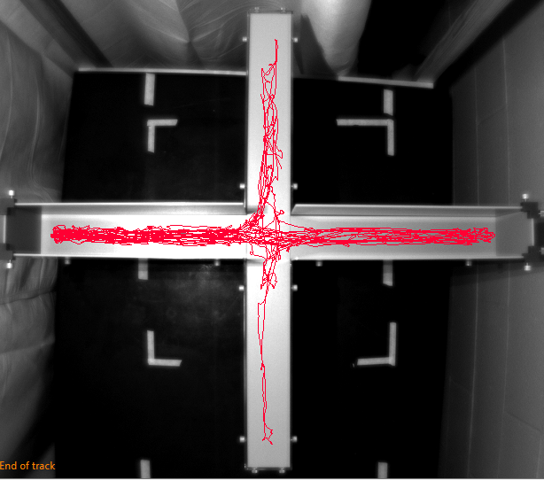
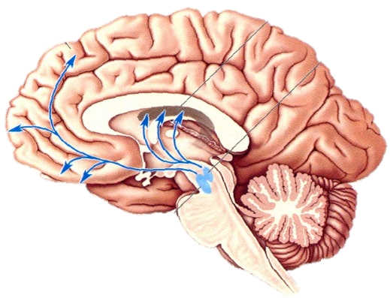
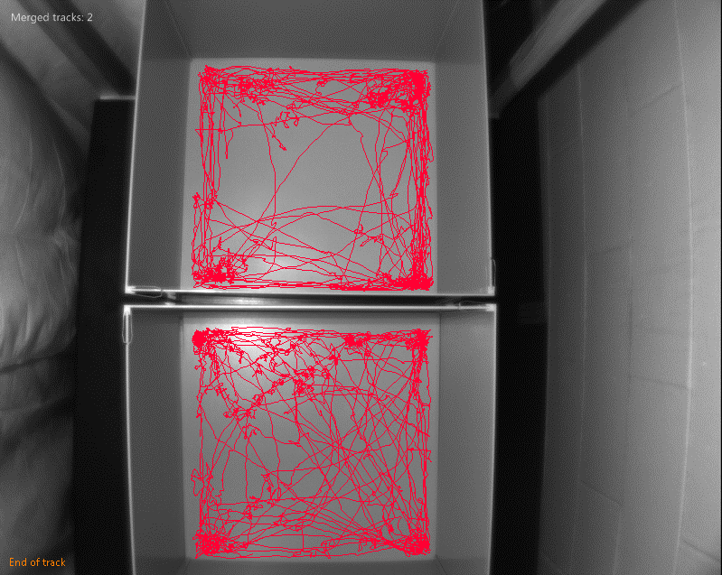
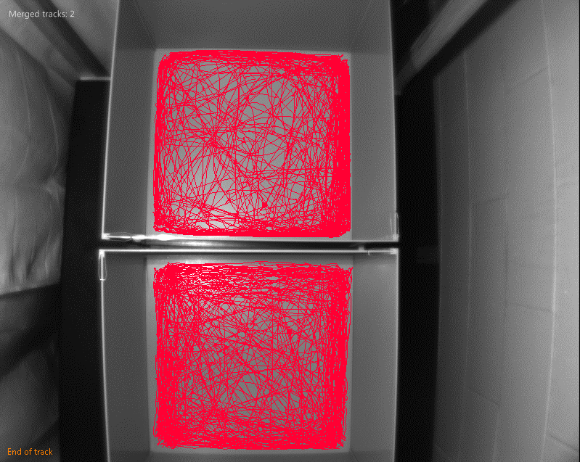
Investigating the role of alternative splicing of Ca_{V}2.2 pre-mRNA and its influence on monoamine release
University of New Hampshire
Alexandra Bunda, Brianna LaCarubba and Arturo Andrade PhD | Department of Biological Sciences
Introduction
Mouse Model
Results
Presynaptic N-type (Ca_{V}2.2) voltage-gated calcium channels control transmitter release in various areas of the nervous system. Alternative splicing of the cassette exon 18a on the cytoplasmic II-III linker of Ca_{V}2.2 generates two splice isoforms (18a and Δ18a) with unique biophysical properties. 18a isoforms are more resistant to closed-state inactivation following repetitive stimulation, and produce larger calcium currents than Δ18a isoforms. This suggests that 18a isoforms allow more calcium influx than Δ18a isoforms. Expression of 18a is dominant over Δ18a expression in monoaminergic brain areas such as ventral tegmental area, substantia nigra, locus coeruleus, and raphe nuclei (~60% vs ~40%). Furthermore, previous studies have shown that N-type calcium channels control the release of dopamine and norepinephrine, suggesting a role of 18a isoform in the release of monoamines. To test this, we generated mice that globally expresses only the Δ18a isoform of Ca_{V}2.2, but not 18a, thereby eliminating the expression of 18a in monoaminergic brain areas. To assess changes in monoaminergic-related behaviors, we measured overall locomotion at basal levels and after administration of a single dose of methamphetamine. Our current experiments compare locomotion of WT and Δ18a mice in response to methamphetamine. These preliminary studies are some of the very few assessing the effects of alternative splicing of presynaptic calcium channels on behavior related to the monoaminergic system.
Homologous Recombination
Exon 18a does not influence basal locomotion
A
B
Figure 2. A novel mouse line was generated to eliminate expression of 18a isoform of Ca_{V}2.2 using homologous recombination. The homologous junction indicated between intron 18 and intron 19 was replaced with exon 18 (e18), resulting in e18 fused to e19, thus eliminating e18a as a splice option by the system.
Figure 4. Mean distance traveled during 5-minute open field (A) or 10-minute EPM (B) trials for WT and Δ18a males and females. No significant difference was found between groups for open field or EPM (p > 0.05). Males; WT: 1885 ± 53 cm, Δ18a: 1868 ± 95 cm. Females; WT: 1993 ± 131 cm, Δ18a 1980 ± 262 cm.
Experimental Mice
A
B
Exon 18a does not influence Methamphetamine-induced locomotion
+18a isoform
A
Δ18a isoform
Figure 3. Mouse models to study the 18a isoform of Ca_{V}2.2. (A) Shows the structure of the pre-mRNA for each mouse line. The WT line has normal splicing patterns whereas Δ18a line expresses pre-mRNA in which exon 18 is fused to exon 19, therefore not allowing the inclusion of exon 18a. (B) Shows the RT-PCR result for WT and Δ18a mice, indicating solely the presence of the Δ18a isoform in the transgenic mouse line.
A
Saline Methamphetamine
Saline Methamphetamine
Calcium ion
outside
Methods
B
|
18a
H₂N
I
II
III
IV
inside
Open Field and Elevated Plus Maze
B
17
18
|
18a
18a
19
COO⁻
A
B
Open field (A; 5 minute trials) and elevated plus maze (B; 10 minutes trials) were used to establish basal levels of locomotion for each genotype and sex
Males and females tested at 4-6 weeks of age
EthoVisionXT software was used to record and analyze each trial. Red line indicates direction of travel.
Ca_{V}2.2 pre-mRNA N-type
Figure 5. (A) Distance traveled during saline trials compared to amphetamine trials for WT males and +18a males. Points and lines indicate paired comparisons for each individual mouse. (B) Methamphetamine-induced mean percent (%) increase in locomotion. No significant difference was found between groups (p > 0.05). Males; WT: 65.3 ± 18 cm, Δ18a: 75.5 ± 16 cm. Females; WT: 52.1 ± 9 cm, Δ18a 67.3 ± 30 cm.
Ca_{V}2.2 mRNA N-type
+18a isoform
Δ18a isoform
Figure 1. (A) Drawing of Ca_{V}2.2-pore forming subunit both folded (left) and unfolded (right) with the putative location of e18a within the primary sequence of the channel relative to the cell membrane. (B) The alternative splicing of cassette exon 18a results in two unique isoforms of Ca_{V}2.2 (+18a and Δ18a).
Conclusion
Future Aims
Mesolimbic Pathway
Striatum
Methamphetamine-Induced Locomotion
Global expression of Δ18a does not have a direct impact on basal or methamphetamine-induced locomotion for males or females of either genotype. These results suggest exon 18a is not involved in the release of dopamine or norepinephrine.
Other monoamines may be impacted by global expression of the Δ18a isoform.
Alternative brain areas predominantly expressing 18a can be targeted for behaviors (i.e. dorsal raphe nuclei) to determine the phenotypic role of the +18a isoform of Ca_{V}2.2.
Monoamine neurotransmitters are involved in various processes, i.e. memory, emotion and arousal.
Dopamine is a monoamine involved in reward behaviors and motor control. Stimulation of dopamine release is a primary target for many addictive drugs, including methamphetamine.
Substantia nigra
A
B
Dose: 2mg/kg body weight
Day 1: Saline administered via IP injection
Day 2: Methamphetamine administered via IP injection
Trial duration: 30 minutes
Mice: males and females 6-8 weeks, allowing for stabilization of 18a expression
EthoVisionXT software was used to record and analyze each trial. Red line indicates direction of travel following saline (A) and methamphetamine (B) injections
Ventral tegmental area
References
Acknowledgements
Hypothesis
Ghasemzadeh, M. B., Pierce, R. C., & Kalivas, P. W. (1999). The monoamine neurons of the rat brain preferentially express a splice variant of a1B subunit of the N-type calcium channel. J. Neurochem., 73, 1718–1723.
Thaler, C., Gray, A. C., & Lipscombe, D. (2004). Cumulative inactivation of N-type Ca V 2 . 2 calcium channels modified by alternative splicing, 101(15), 5675–5679.
UsersContent2.emaze.com. (2015) Retrieved April 07, 2017 from https://userscontent2.emaze.com/.
Yourgenome.org. (2015, July 01). Retrieved April 07, 2017, from http://yourgenome.org/.
Mouse line generation: Dianne Lipscombe, Sylvia Doname, and Summer Allen
Funding: R00-MH099405
Project Approval: IACUC
Exon 18a in Ca_{V}2.2 plays a role in the regulation of monoamine release. To test this hypothesis, a transgenic mouse model was generated to test methamphetamine-induced locomotive behavior.

