Slide 1
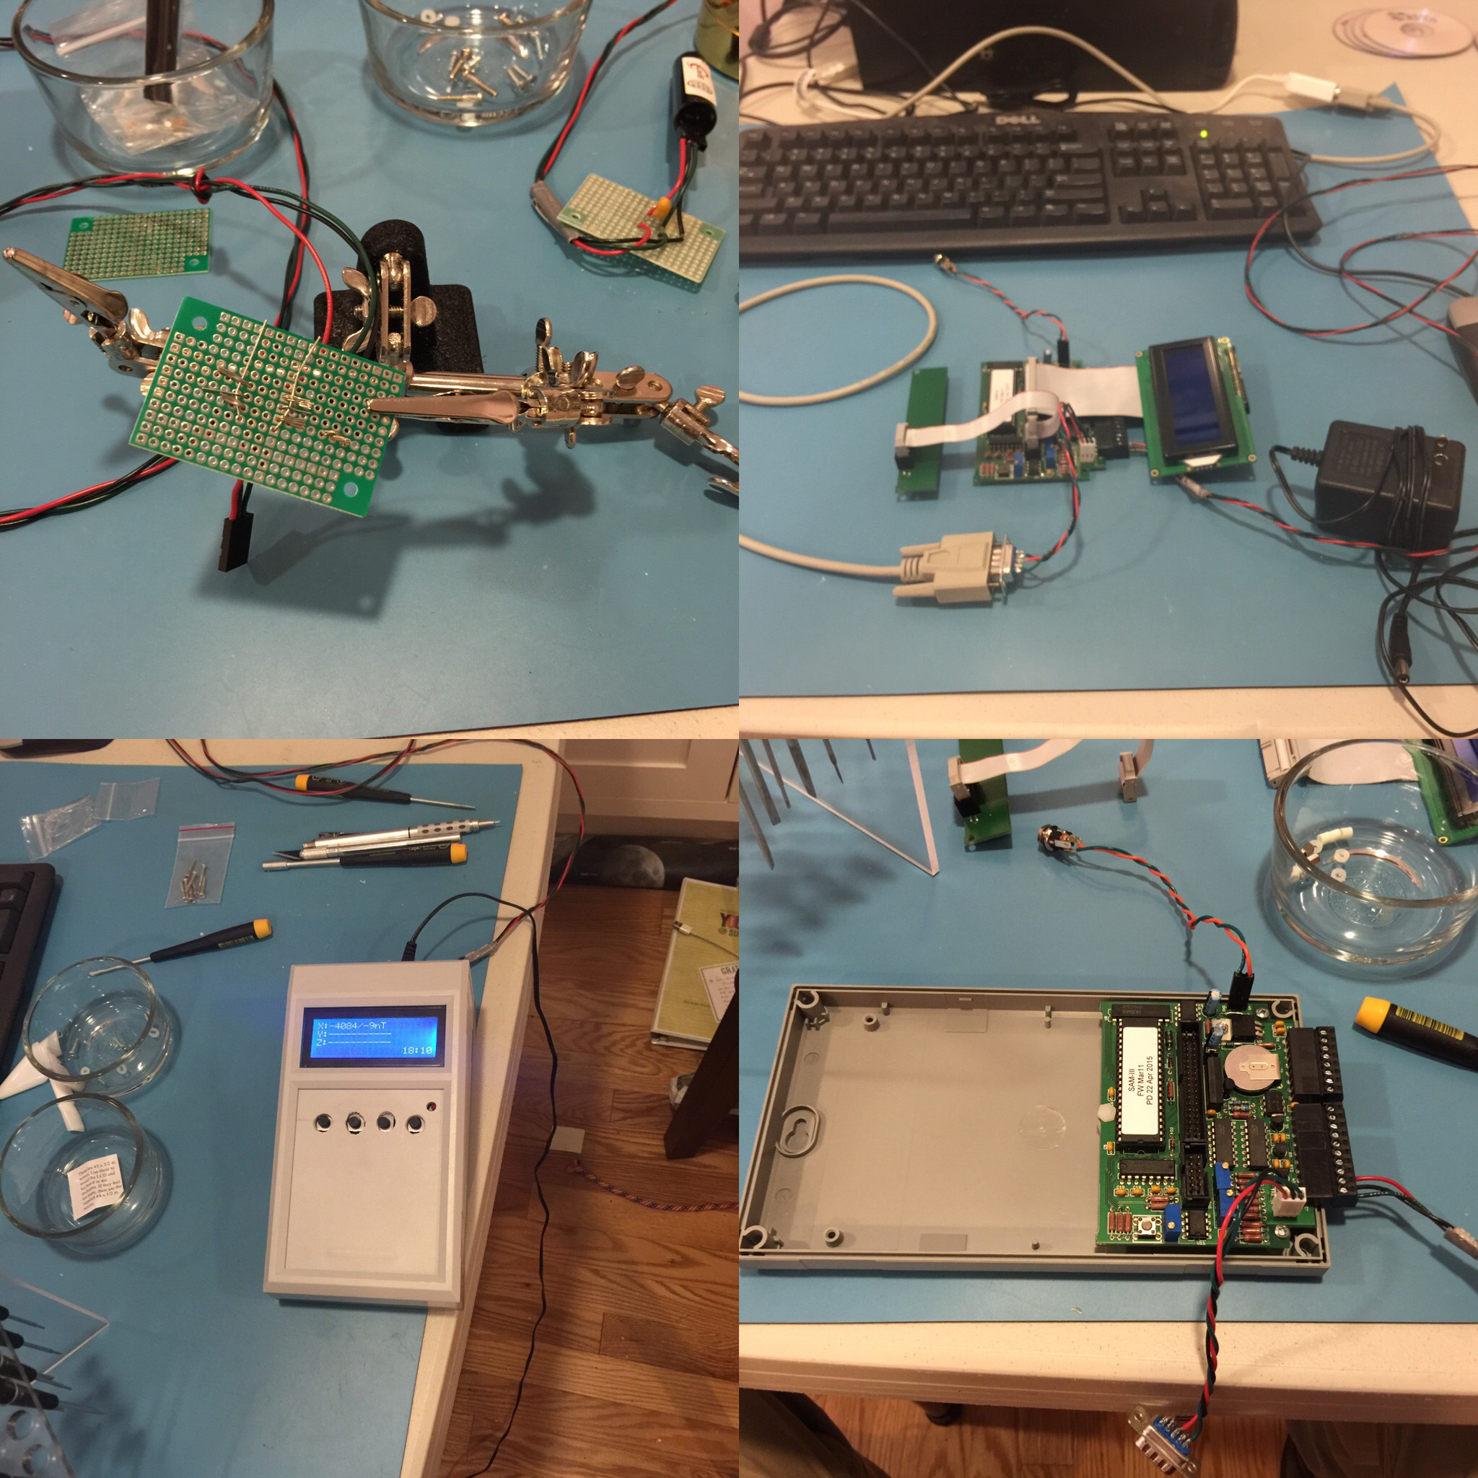
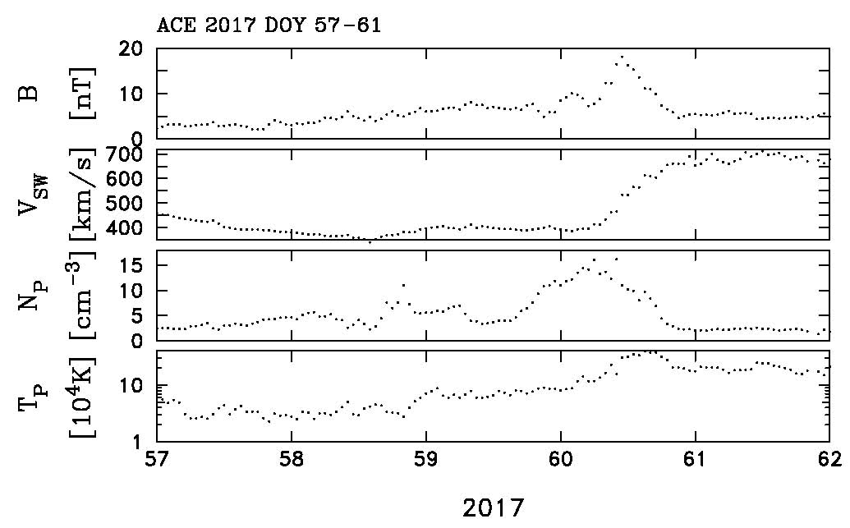
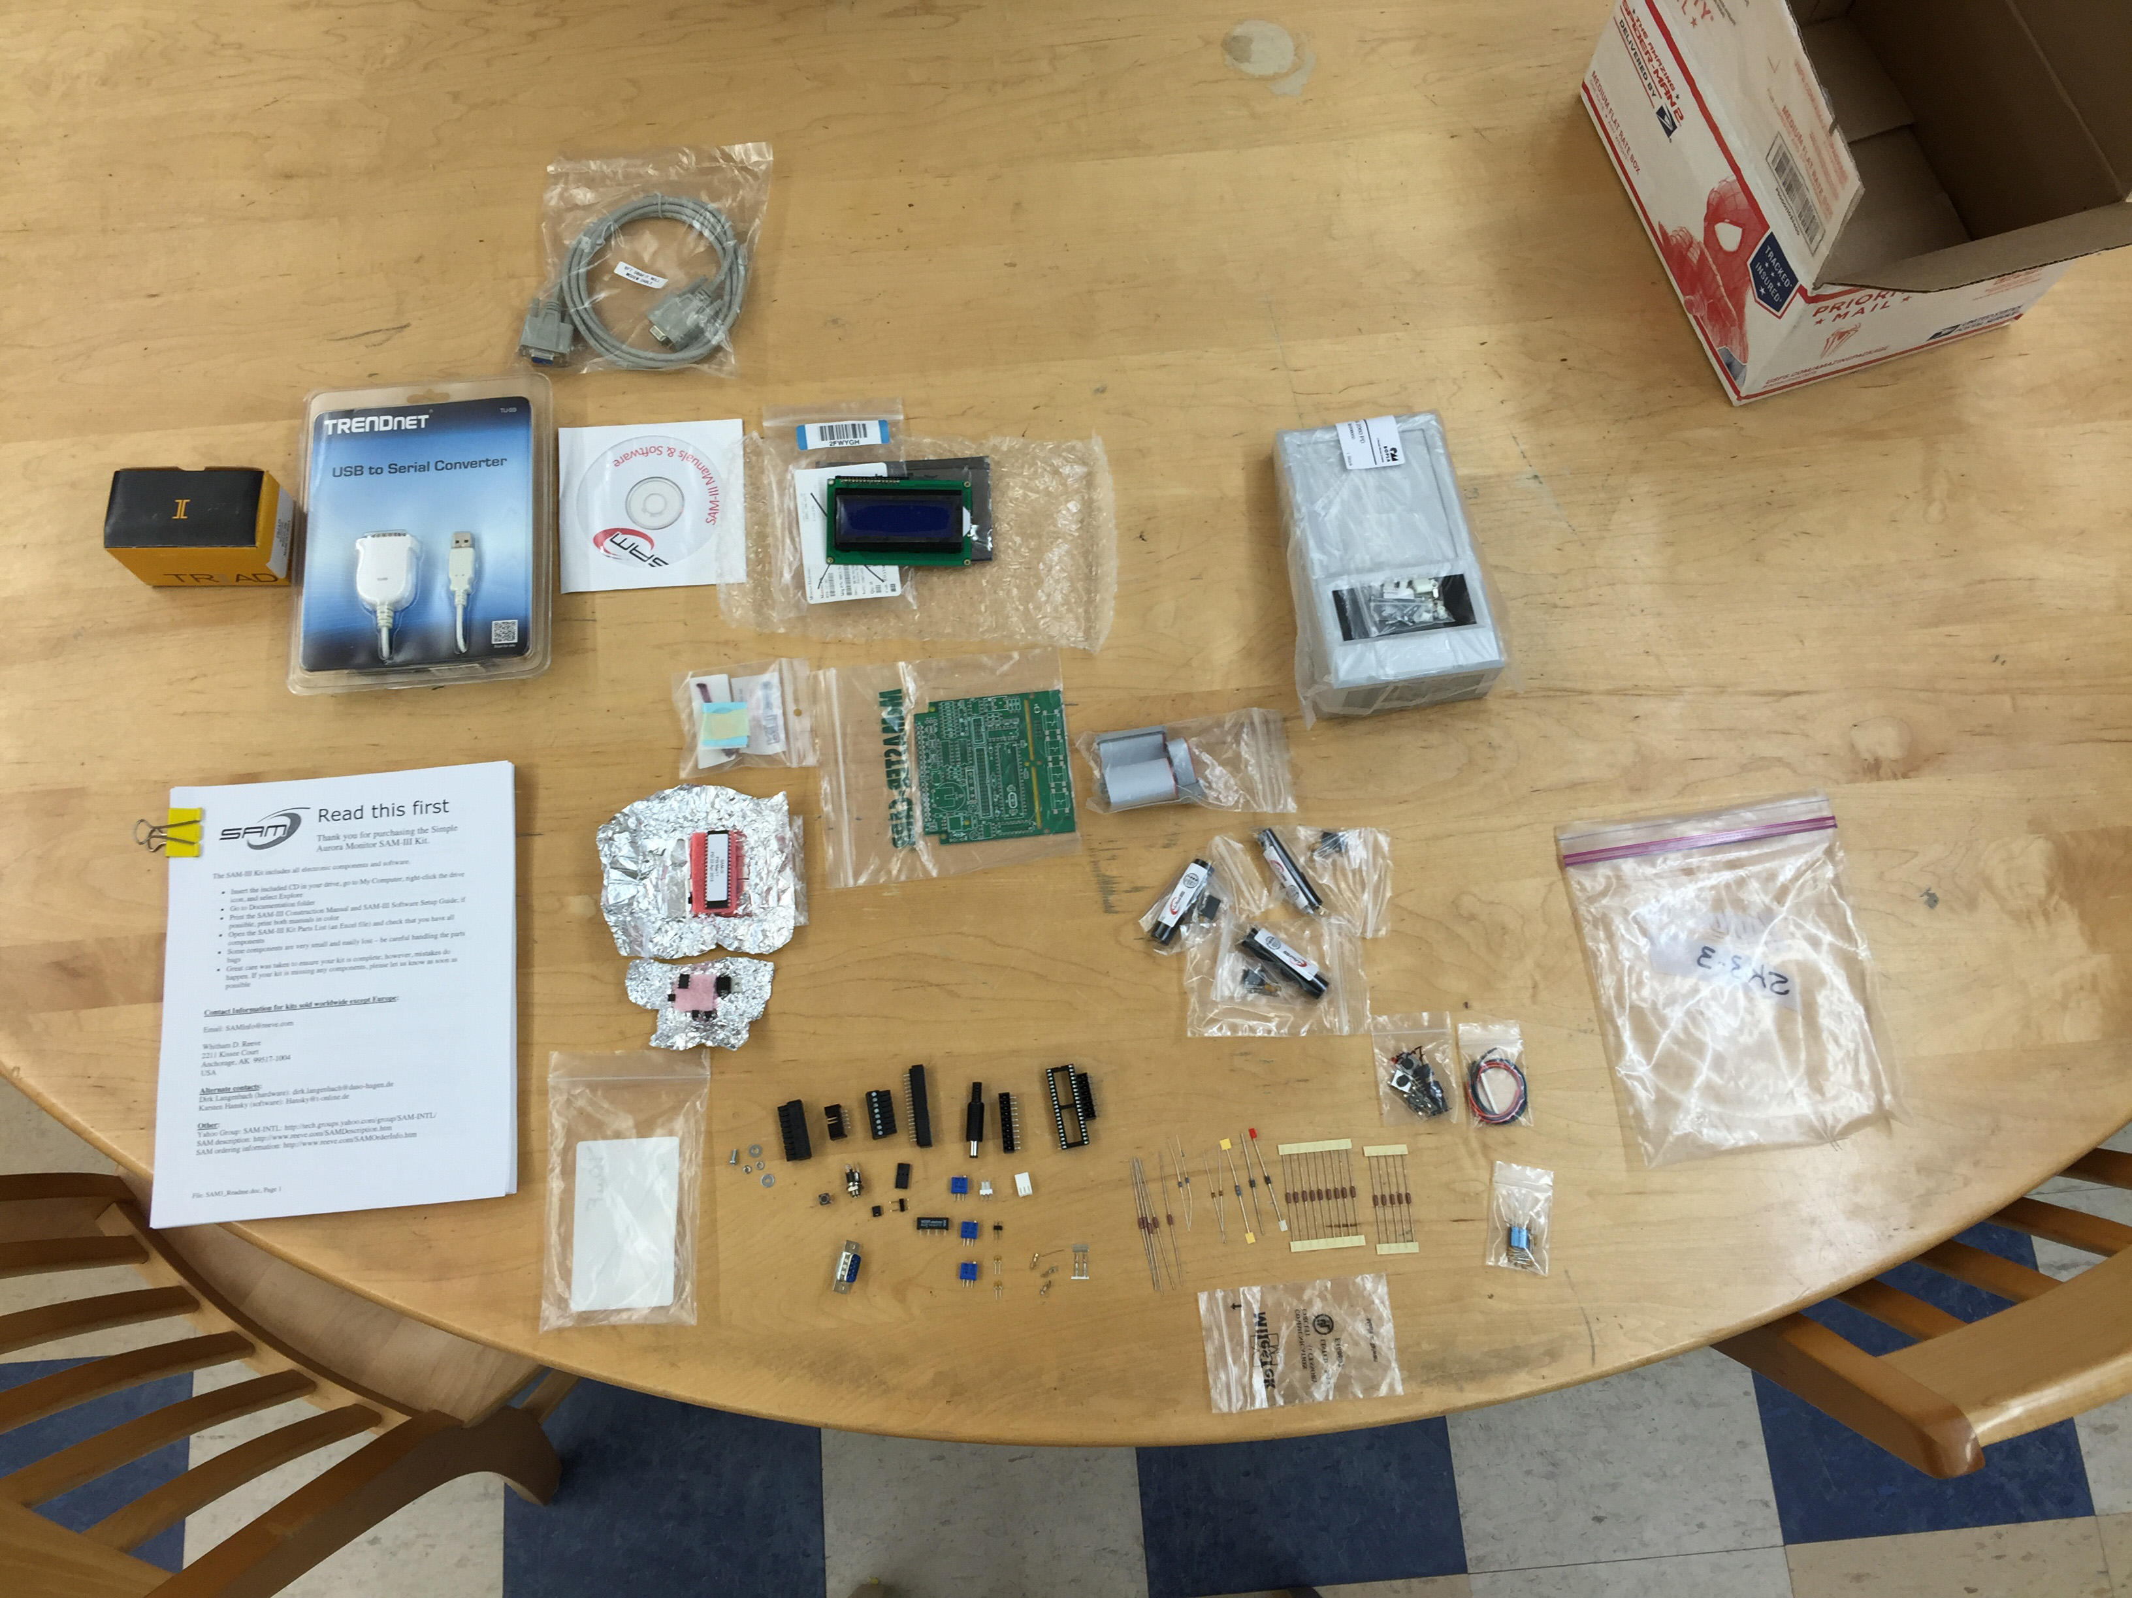
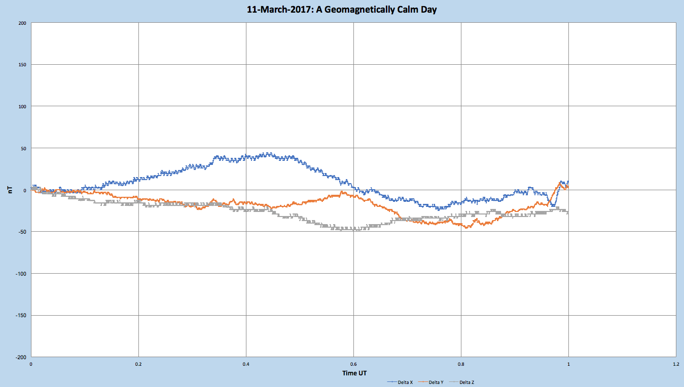
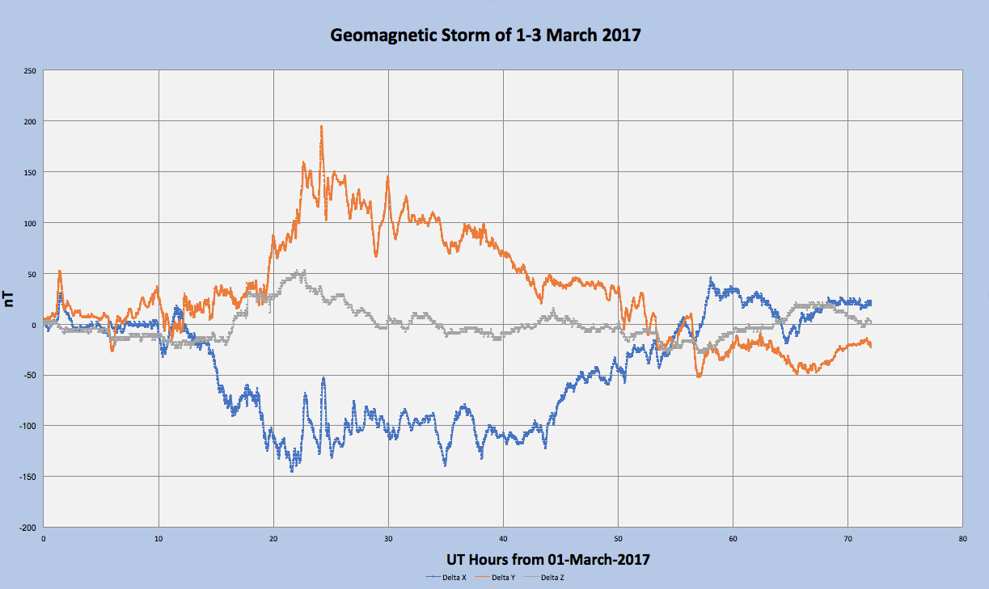
3-Axis Magnetometer Construction and Data Collection for Space Weather Monitoring
J. Blackwell, A. Pereira, M. Ramiz, K. Young
Phillips Exeter Academy, Exeter, NH, USA.
Abstract
In collaboration with 6 other high schools and the University of New Hampshire, Phillips Exeter Academy has completed the building of two fluxgate magnetometers to operate as part of the seven school network. This network will collect 3-axis geomagnetic data to monitor space weather and assist in research to that end. We present details on the construction and functionality of the initial magnetometer installation.
Construction
The magnetometer arrives as a kit. The circuit boards are pre-etched and drilled for components, all of which must be fitted and soldered into place. Included are some 167 component parts (see Figure 1), power supply, serial cable, and CD ROM with instructions, tutorial and other pertinent information.
Construction was done in phases to allow for simplicity and testing. The initial stage is to install all power supply components: resistors, capacitors, voltage regulators, and connectors. The board is given its initial power-up test with voltages measured and adjusted to be within tolerances before continuing with the build.
Stage two involves installation of the logic circuitry which contains the on-board clock, sensor reading ports and chips to hold the operating system software.
The unit is then connected to its LCD screen and push button controls and is ready for initial power-on with software. The extant software on the device's chips is not the run time operating system but a test suite. Once this boots, the unit is connected to a PC and the operating system is uploaded to the magnetometer’s boards.
Installation
Installation is a critical aspect of correct magnetometer use. The key is to maintain distance away from all ferromagnetic materials so as not to overwhelm the sensors and to avoid erroneous data. It is recommended that the device be placed away from human activity and buried. The burial is to avoid temperature swings from affecting the data. All sensors must also be aligned with magnetic north, east and z-axis (perpendicular to both N and E). Sensors must also be placed far enough apart so as not to cause the system to induce currents from one sensor coil to another (coupling).
We decided to utilize the time tested LEGO® method of aligning the sensors at right angles as you see in our demonstration unit at this poster. LEGO®, while an excellent toy, is also a perfect engineering solution in this case; LEGO® are waterproof, non magnetic, affordable, and easily configured into right angles for sensor alignment.
At this time, the installation resides inside a quiet corner of our observatory structure at a remote location on campus.
Results
Results have been encouraging at this early stage of testing. At this time, our magnetometer is the only one producing data on a daily basis in southern New Hampshire, so validation is our primary challenge.
http://regulusastro.com/magnetometer/
Geomagnetically quiet days are readily recognizable as when the variations in the magnetic field are below 50nT from the start of the UT day. See figure 4 for such an example.
We have been fortunate to have the system running long enough to capture a few minor geomagnetic storms (G1 level). One such event began on 1 March 2017 and continued for two days, caused by an Earth-facing coronal hole allowing higher velocity solar wind to hit our planet’s magnetosphere. That storm’s data is shown in Figure 5. Confirming the incoming high speed solar wind is data from the NASA Advanced Composition Explorer satellite which shows the impact date/time of the event, corresponding with our magnetometer’s data as seen in Figures 3 and 5.
Design
The magnetometer is a 3-axis Simple Aurora Monitor, known as the SAM-III¹. Its purpose is to sense changes in the Earth’s geomagnetic field, which allows detection of small changes (in the nT range) in the local magnetic field which correspond to solar events such as coronal mass ejections and changes in solar wind flux.
The sensors in the SAM-III are of the fluxgate design, with sensor outputs including K-index and date/time displayed on a liquid crystal screen. One convenient feature of the model is that there is an alarm that can be set to trigger when the K-index exceeds a certain point, making it a useful indicator of events such as auroras.
When connected to a PC, the SAM-III can be programmed to send data to the PC which collects and logs all the data. With the corresponding software one may view graphic files based on this data.
We are using a Raspberry Pi-3² to collect data from the magnetometer and store that data in a flat text file which is then made available to an internet feed.
Conclusion
The construction and initial installation of the SAM-III magnetometer system has been a valuable learning experience for our students. Students learn the engineering of board design, soldering, and installation engineering methods. The physics of magnetometry and of space weather are also key topics learned.
As we move forward with the other schools in the network, we will decide upon permanent installation options (deep in the woods or remaining resident in our observatory) and the various software/data handling methods that prove to be the most efficacious.
Figure 3: Data from the NASA Advanced Composition Explorer satellite (ACE)³ for 1 March 2017 showing the date of impact (day 60 = 1 March) of the high speed solar wind stream that caused the G1 storm detected by our system.
Figure 2 Above: The major construction stages. From top left: The soldering of connector components for the sensors; The completed circuitry connected to a computer for programming and testing; The boards were installed into a case; Sensors are then connected and tested.
Figure 1: The kit as unpacked from the shipping container. ICs and other static sensitive equipment are packaged in aluminum foil for protection.
References
¹http://www.reeve.com/SAMDescription.htm
²https://www.raspberrypi.org/
³http://www.swpc.noaa.gov/products/ace-real-time-solar-wind
Background Image: NASA https://svs.gsfc.nasa.gov/11298
We gratefully acknowledge support and mentoring from the University of New Hampshire.
Figure 4: Plot of the magnetic field variance for March 11, 2017, a geomagnetically calm day.
Figure 5: Plot of the magnetic field variance for March 1-3, 2017 during a class G1 geomagnetic storm initiated by a high speed solar wind impact upon the earth’s magnetosphere.

