Slide 1
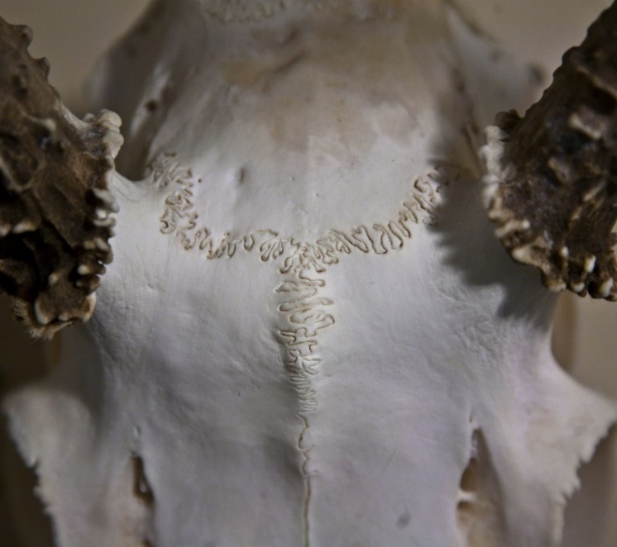
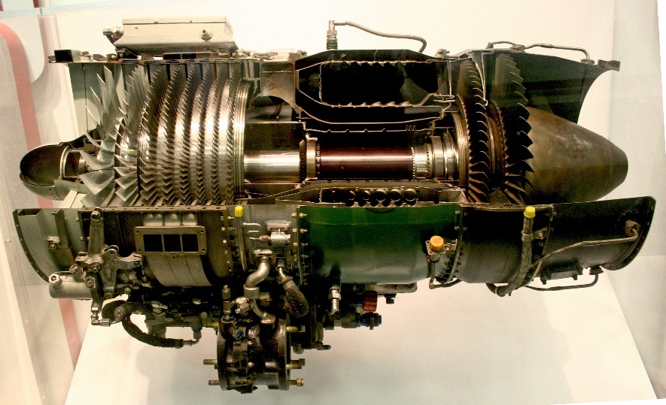
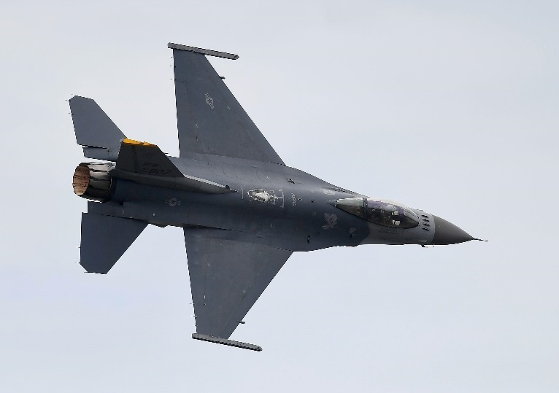
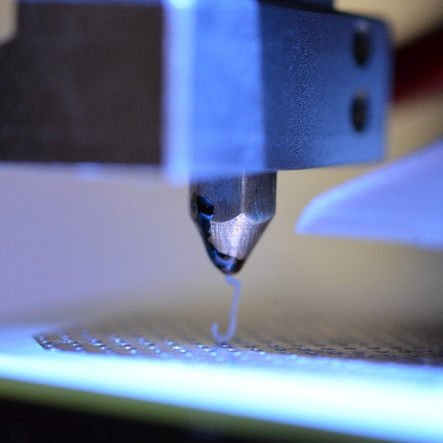
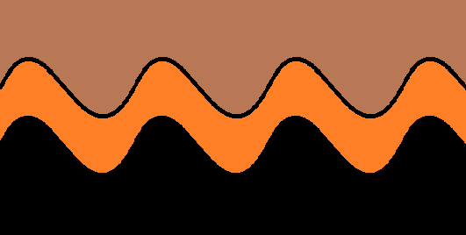
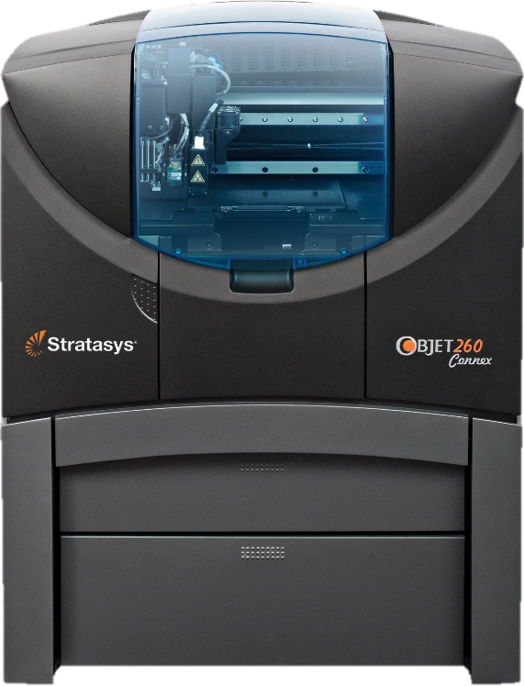
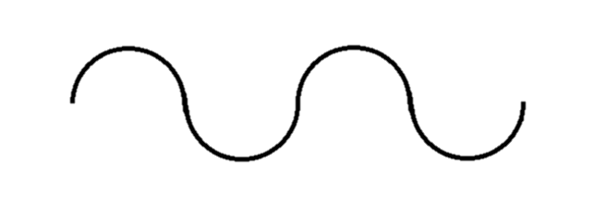
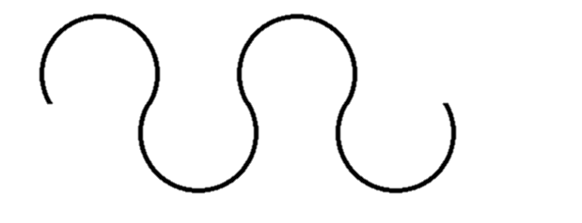
Additive Manufacturing of Bio-Inspired Mechanical Interlocking
Richard Nash
Advisor: Yaning Li, PhD
University of New Hampshire,
Department of Mechanical Engineering
Background & Motivation
Objectives & Tasks
Mechanical interlocking can be found in nature in the form of sutures
The red-bellied woodpecker’s beak sutures (left) [1]
The Aulacoseira lirata, a marine micro organism (middle), has a sinusoidal like suture geometry [2] & [3]
Cranial sutures on a deer (right)
Adhesion can be a preferred method of bonding dissimilar materials for some Aerospace applications such as bonding polymers and ceramics
The bonding of dissimilar materials through adhesion alone is difficult due to their mismatch in moduli and coefficients of thermal expansion, especially in high temperature applications such as engines
Objectives:
Devise a way to test the influence of bio inspired mechanical interlocking on the mechanical properties of adhesive bonds
Tasks:
Design and fabricate a single lap shear specimen to
Optimize a mechanical interlocking surface structure to aid in the adhesion of dissimilar substrates.
Polymer
Adhesive
Ceramic
Methodology
Geometry Design
Mechanical Interlocking Design
Finite Element Analysis
3D Printing and Mechanical Experiments
Periodic arcs are designed that are dependent on the wavelength of the arc and the arc angle
Single lap shear specimen with wavy and flat adhesive interfaces are designed in order to understand how the wavy geometries influence the mechanical properties of the bond
The lap shear specimen tests are then modeled in Abaqus, a finite element (FE) tool, in order to understand the effects of bond line rotation, identify regions of high stress, and to eventually predict the mechanical behavior of new specimen
The Objet Connex 260 multi material printer was utilized to print the lap shear piece with Vero White, and the adhesive layer with Tango Plus.
$$θ$$
$$λ$$
$$θ<180°$$
The wavy geometries used in the adhesive layers have arc angle of 120 and 180 degrees, both with the same wavelength
$$θ=0°$$
Once printed, the Zwick material testing machine was used to test the samples in shear.
$$θ=180°$$
$$θ=120°$$
The specimen are tested at a quasi-static rate of .025mm/s, and dynamic rates of .25mm/s and .5mm/s.
$$θ<180°$$
$$θ=180°$$
Results
Theoretical Correction and Finite Element Simulations
Mechanical Experiments
The specimen will rotate during deformation, influencing the accuracy of the measurement
More constraints will reduce the rotation, for example adding metal plates at the boundaries
A theoretical method was developed to reduce the rotation effects
Quasi-Static Load
Displacement Data
1
2
3
Shear Strain Distribution
Along the Bond Line
Unaltered Model
Ideal Model
(.$025\frac{mm}{min}$)
The shear strain is:
Higher in the flat interface than in both of the wavy interfaces
Differs along the bond line of the wavy interfaces more than the flat interface
As the waviness increases so does the maximum force the bond can withstand
Added Plate Model
5mm
A
Un-deformed layer
C
$α=\tan^{−1}\left(\frac{A_{y}{−C}_{y}}{A_{x}−C_{x}}\right)−$ $\tan^{−1}\left(\frac{A_{y0}{−C}_{y0}}{A_{x0}−C_{x0}}\right)$
$\overline{\text{δ}}=δ_{total}−δ_{elongation}$
$\overline{F}=F\cos\left(α\right)$
$γ=\tan^{−1}(\frac{\overline{\text{δ}}}{t})$
B
β1
β2
t
D
A
γ
Deformed layer
C
t
B
β1
β2
D
δelongation
$$\overline{\text{δ}}$$
Calculating the rotation of the bond line ($α$), effective force ($\overline{F}$), and effective displacement ($\overline{\text{δ}}$), shows that the rotation can be accounted for and that plates will not be necessary.
Images were captured of the specimen under test at uniform time intervals. The location of the dots are then tracked in order to determine the shearing strain at different locations along the interface.
Unaltered Aluminum plate
Ideal Steel Plate
Load Displacement Curves
Rotation of the Bond Line
Effective Load Displacement Curves
High stress concentrations can be seen at the corners of the adhesive layers
Lower stresses can be found throughout the wavy adhesive layers
Rotation of the bond line increases with the waviness
Von Mises Stress Contour in the Adhesive Layer
.$5\frac{mm}{min}$
.$5\frac{mm}{min}$
1.010MPa
.$25\frac{mm}{min}$
.$25\frac{mm}{min}$
.$025\frac{mm}{min}$
.$025\frac{mm}{min}$
0.511MPa
0.011MPa
Energy of the adhesive layer is not directly related to its volume
This indicates the stress state changes with the waviness
The load displacement curves for all three interfaces are strain rate dependent and increase with the strain rate.
The 180 degree wave is not shown because the Vero White lap piece broke at higher strain rates instead of the adhesive layer.
Future Work
Acknowledgements
References
Preform micro indentation across the interface of 3D-printed specimens
Design, simulate, print and test more specimens with varying arc angle
Explore the influences of the adhesive layer thickness on its mechanical properties
Implement a new edge design to eliminate high stress concentrations in the corners of the adhesive layers
Explore the influences of printing direction on the mechanical properties
National Science Foundation (NSF)/REU under grant 1362893
US Air Force Office of Scientific Research (AFOSR) under grant FA9550-16-1-0011
Summer Internship Opportunity at the Air Force Research Lab, Write Patterson AFB, RXCC
UNH Mechanical Engineering Department
[1] Nayeon Lee, M. F. Horstemeyer, Hongjoo Rhee, Ben Nabors, Jun Liao, Lakiesha N. Williams
J. R. Soc. Interface 2014 11 20140274; DOI: 10.1098/rsif.2014.0274. Published 8 May 2014
[2] Y. Li, C. Ortiz, and M. C. Boyce, “A generalized mechanical model for suture interfaces of arbitrary geometry,” Journal of the Mechanics and Physics of Solids, vol. 61, no. 4, pp. 1144–1167, 2013.
[3] English, J., and Potapova, M. (2011). Aulacoseira lirata. In Diatoms of the United States. Retrieved April 10, 2017, from http://westerndiatoms.colorado.edu/taxa/species/aulacoseira_lirata
[4] Y. Li, C. Ortiz, and M. C. Boyce, “Stiffness and strength of suture joints in nature,” Physical Review E, vol. 84, no. 6, Article ID 062904, 2011.

