Slide 1


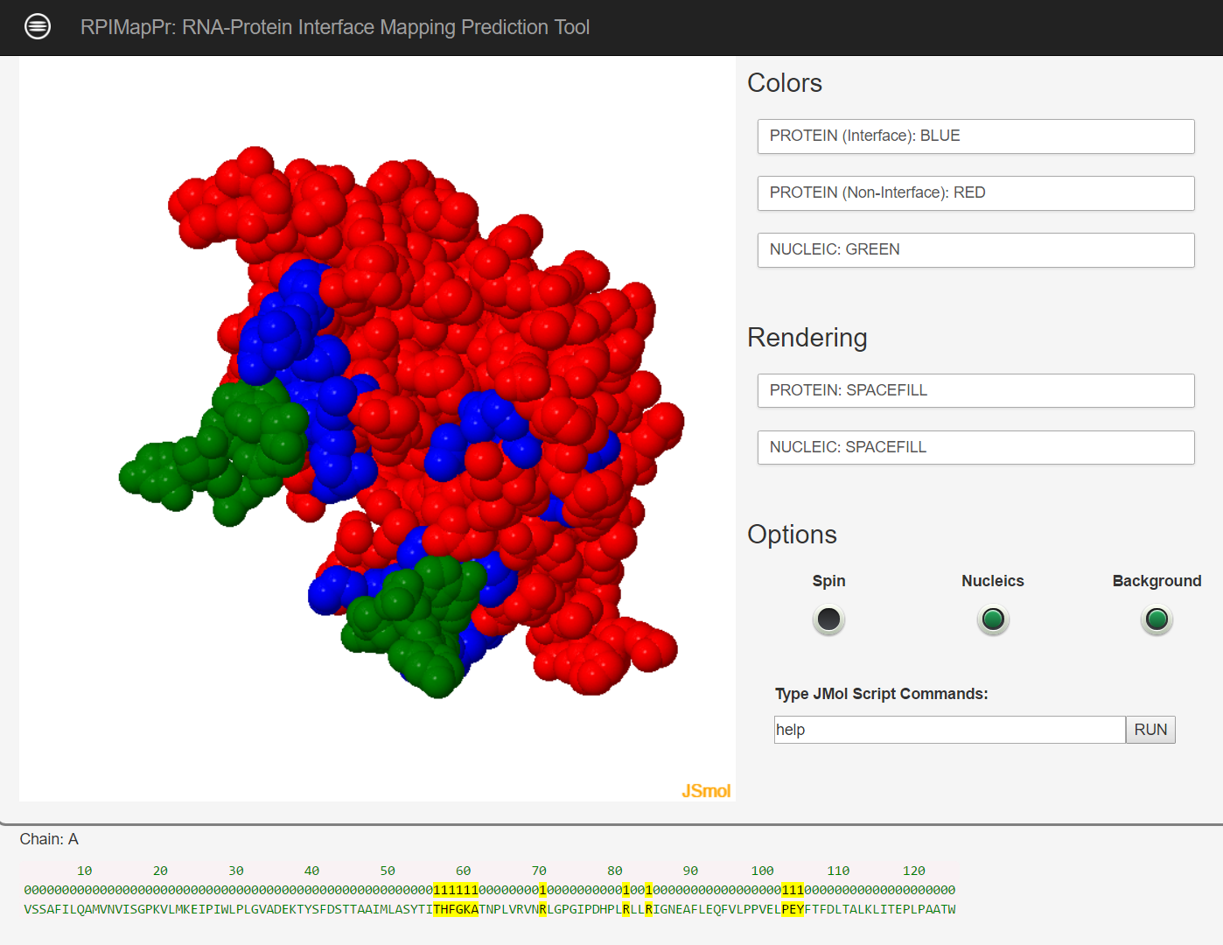
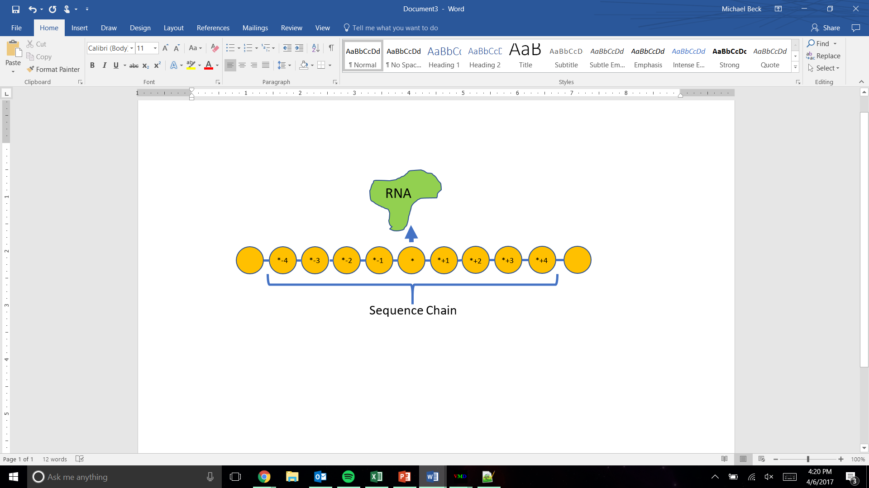
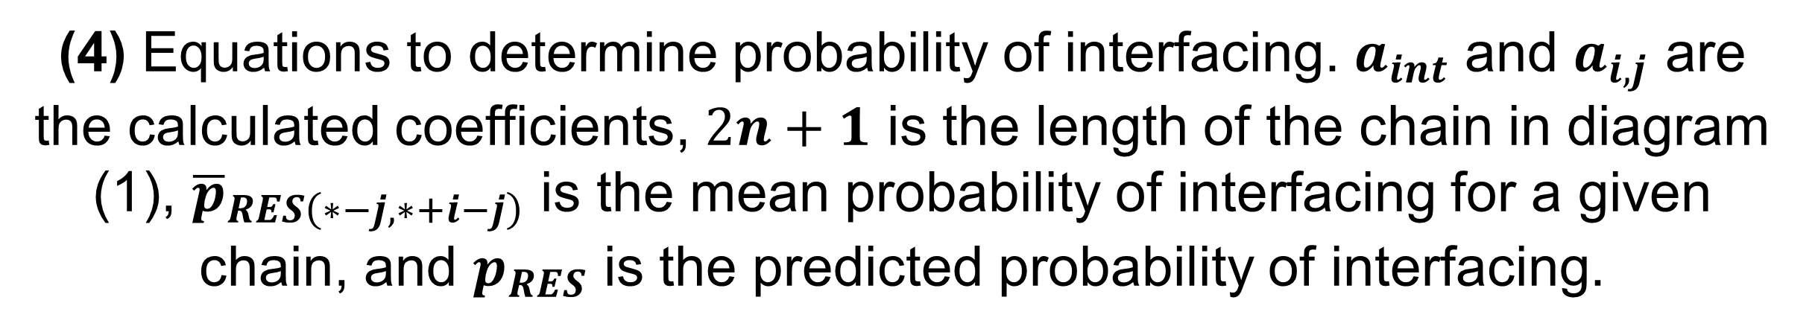
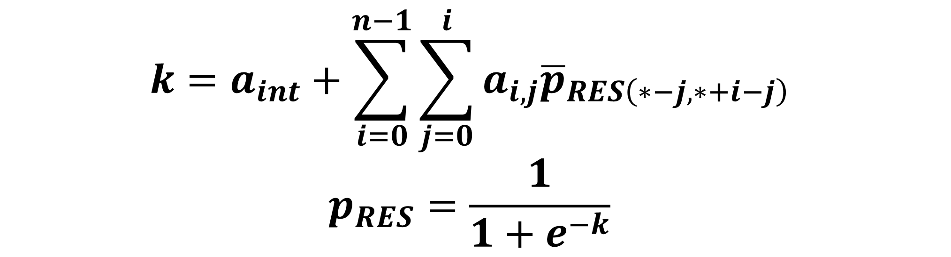
RPIMapPr
A Novel Approach to Predicting Interfacing Protein
Residues in RNA-Protein Complexes
Michael Beck [mpj59@wildcats.unh.edu]
Dr. Harish Vashisth (Advisor) [Harish.Vashisth@unh.edu]
Department of Chemical Engineering, University of New Hampshire, Durham, NH
NSF Grant Number: CBET-1554558 (CAREER)
Introduction
Results
RNA-protein interactions account for many key biological processes, including gene regulation, viral replication, and expression of protein complexes
Experimental determination of RNA-protein complexes is difficult, therefore computational methods are often used
The goal of this project is to produce a unique and efficient computational method/tool for predicting RNA-protein interfaces
Methods
All PDB files (dataset DS1) available on Protein Data Bank containing only a protein-RNA complex were downloaded and data mined
Partially independent dataset RB111 was also collected and data mined
(1) Diagram of sequence chain used in probability equation.
Multiple lengths of amino acid chains (up to 5 amino acids long for this project) that the central amino acid is part of has the probability of amino acid-nucleic acid interaction
Probabilities are then combined with calculated coefficients in the formula to the right to create probability of interaction
(2) Example of RPIMapPr webserver output for PDB file 1h2d.
 | ACC | S_{n} | S_{p} | MCC
RPIMapPR | 0.865 | 0.52 | 0.91 | 0.38
FastRNABindR | 0.751 | 0.61 | 0.76 | 0.24
RNABindR v2 | 0.720 | 0.63 | 0.73 | 0.22
BindN+ | 0.835 | 0.43 | 0.87 | 0.24
PPRInt | 0.761 | 0.48 | 0.79 | 0.18
KYG | 0.775 | 0.47 | 0.80 | 0.19
PRIP | 0.752 | 0.45 | 0.78 | 0.15
(5) Interface coloring of example files of dataset DS1, including actual coloring and prediction coloring by RPIMapPr and PPRInt. Orange represents noninterfacing and blue represents interfacing.
(3) Comparison of different RNA-protein predictive tools for confusion matrix metrics for dataset RB111. ACC: Accuracy; S_{n}: Sensitivity; S_{p}: Specificity; MCC: Matthew Correlation Coefficient
Conclusions
$$k=a_{int}+\sum_{i=0}^{n−1}{\sum_{j=0}^{i}{a_{i,j}{\overline{p}}_{RES\left(∗−j,∗+i−j\right)}}}$$
$$p_{RES}=\frac{1}{1+e^{−k}}$$
RPIMapPr was a successful achievement of the goal
RPIMapPr is able to accurately predict 86.5 % of residues as either noninterfacing or interfacing based solely on sequence
Does as well as or outperforms competitors in confusion matrix metrics while being a statistical method
Visual comparisons with PPrint in dataset RB111 confirms this, while also showing that RPIMapPr is visually similar to the actual interfacing
Webserver is available at: rpimappr.appspot.com
(4) Equations to determine probability of interfacing. $a_{int}$ and $a_{i,j}$ are the calculated coefficients, $2n+1$ is the length of the chain in diagram (1), ${\overline{p}}_{RES\left(∗−j,∗+i−j\right)}$ is the mean probability of interfacing for a given chain, and $p_{RES}$ is the predicted probability of interfacing.

