Slide 1
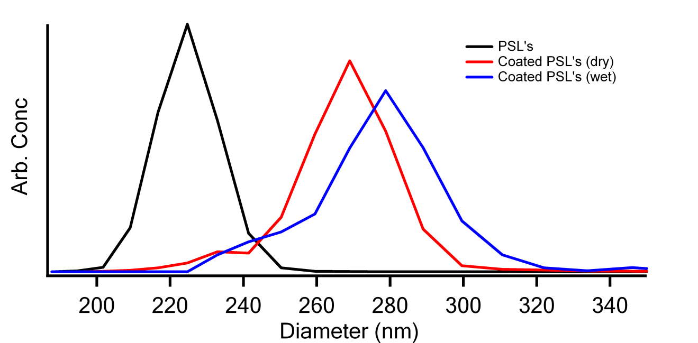
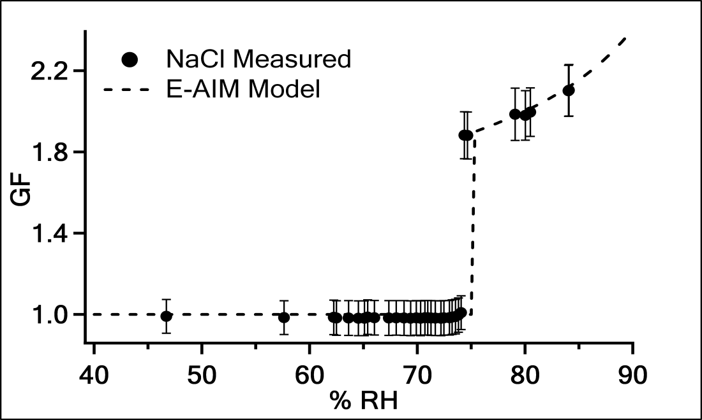
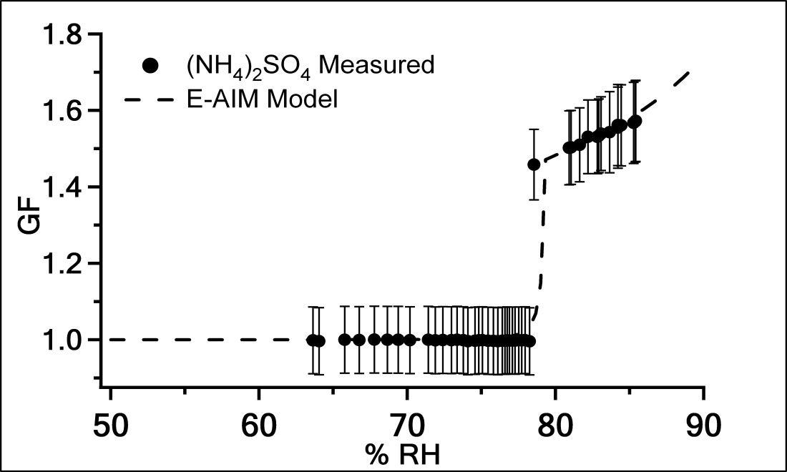
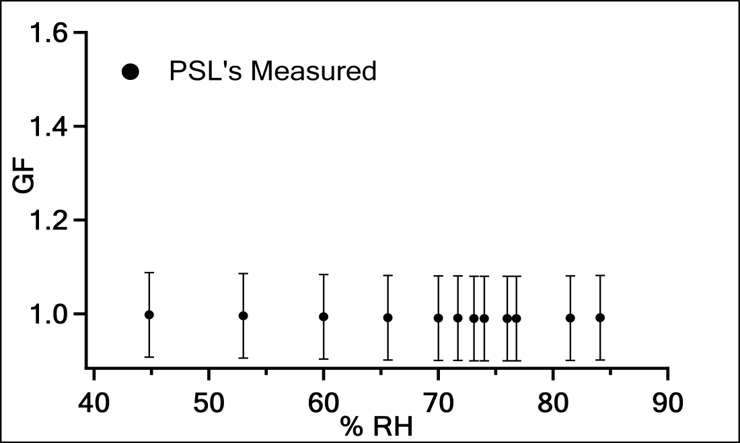
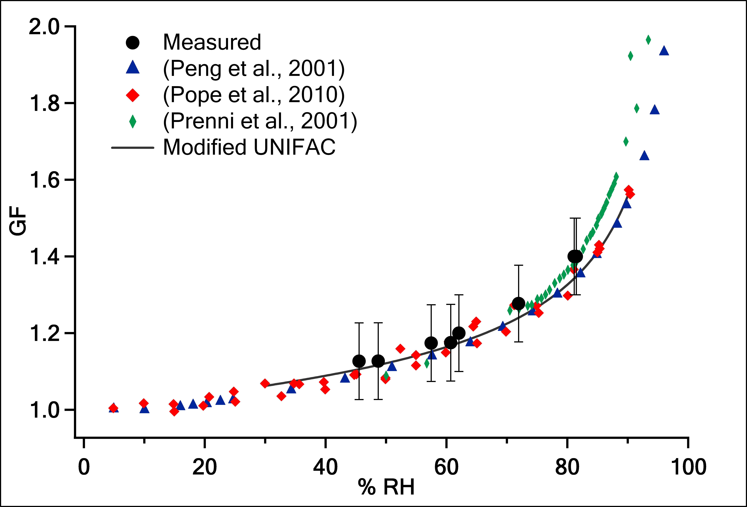
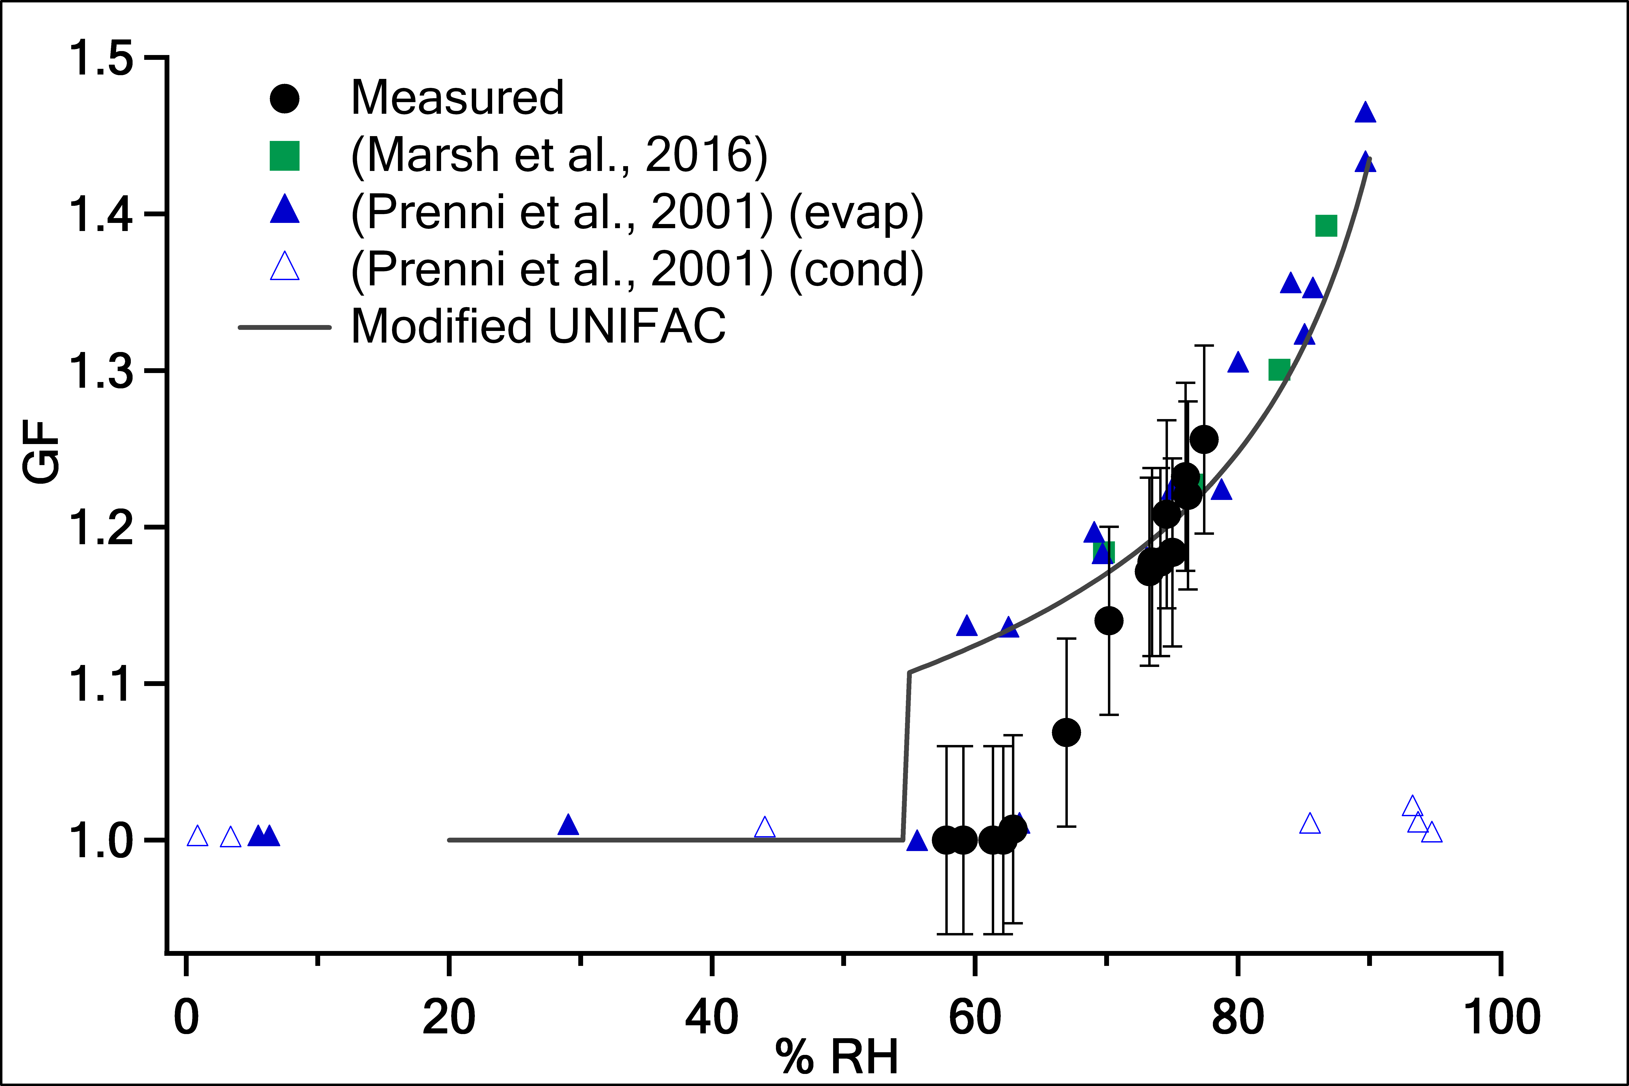
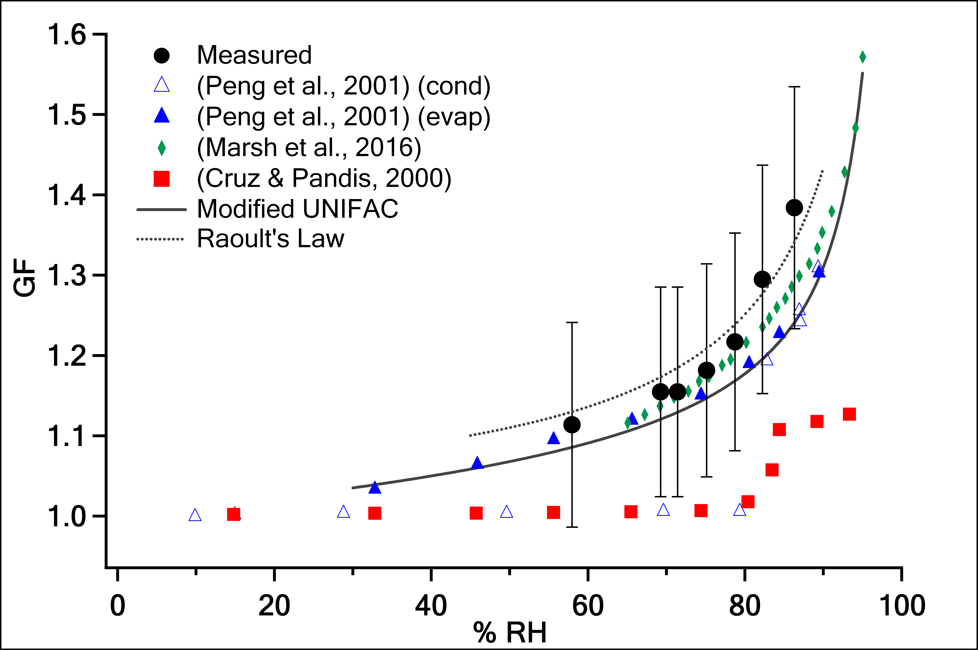
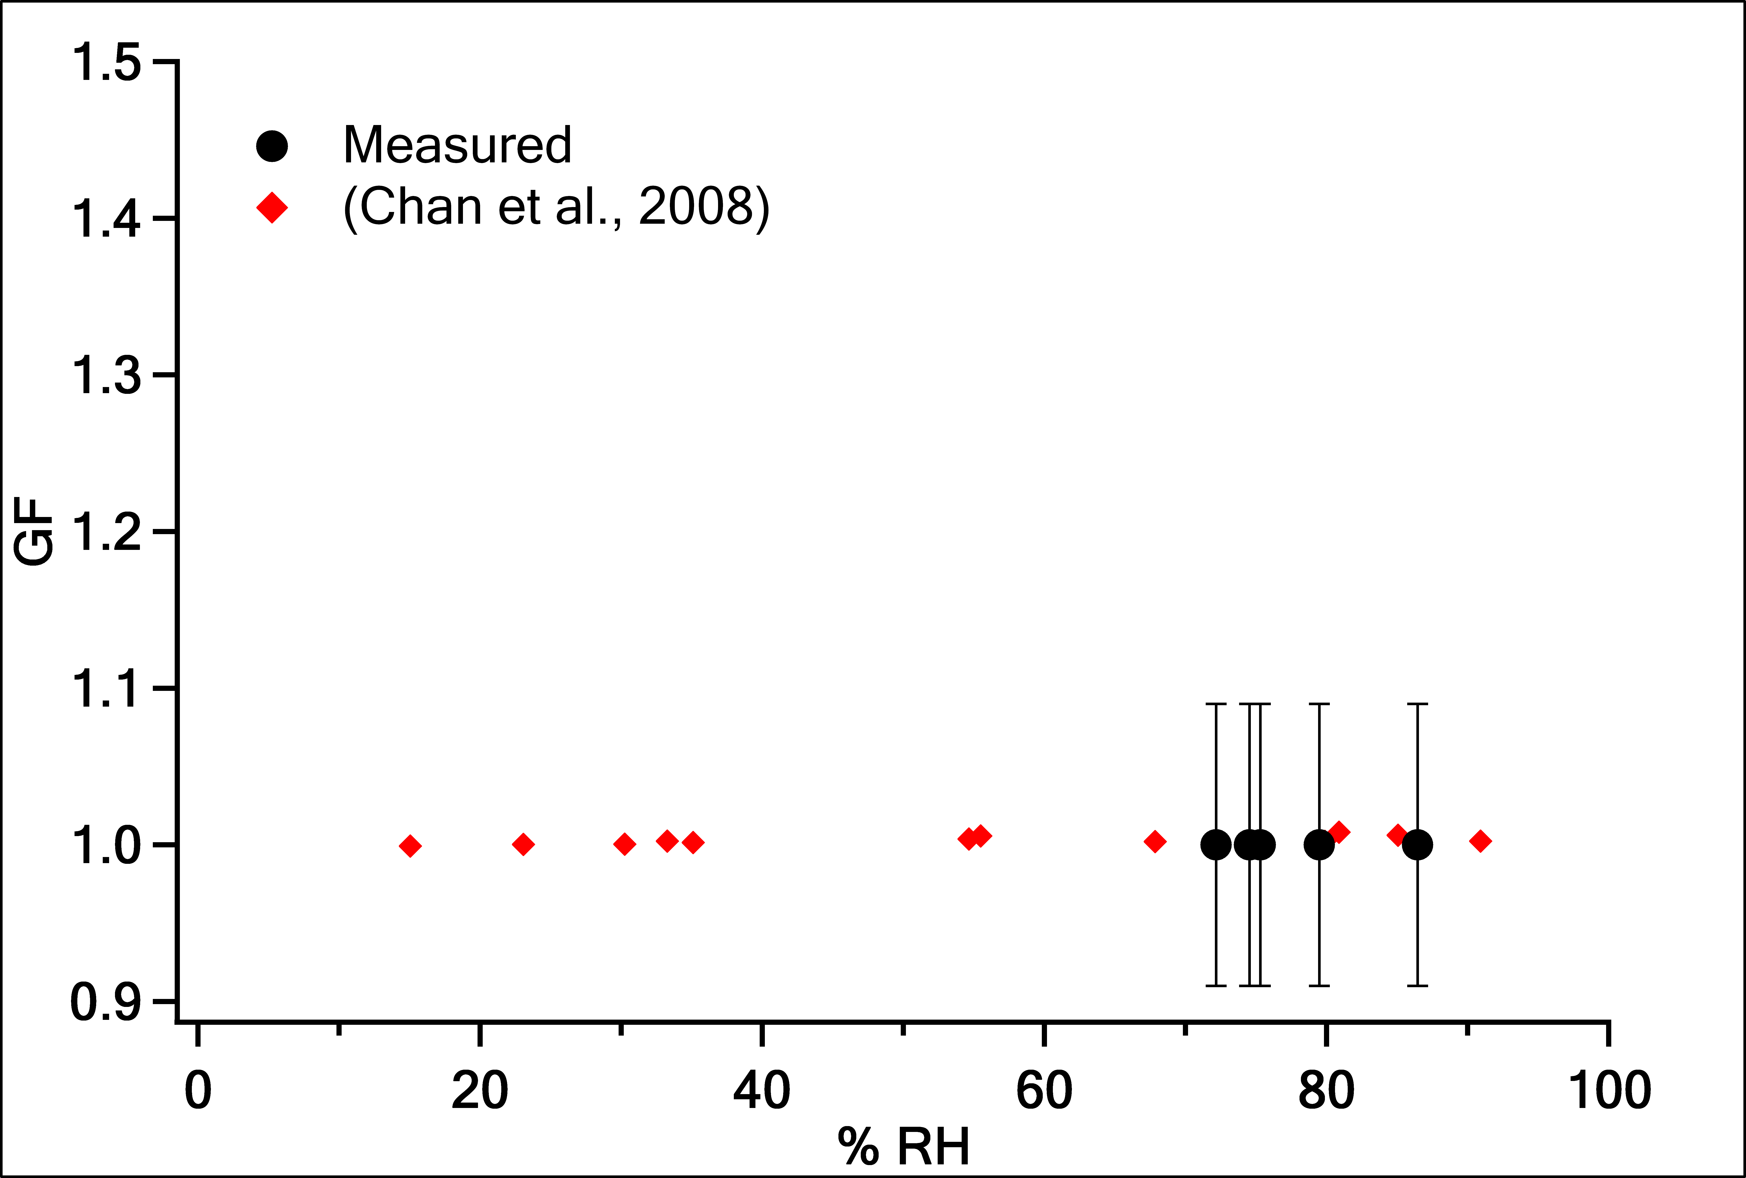
Dicarboxylic Acid Shell on an Inert Aerosol Core:
A Variable Controlled Hygroscopicity Investigation with Unexpected Results
Brent Lawson, Margaret E. Greenslade
University of New Hampshire, Chemistry Department, Durham, NH 03824
Introduction
Discussion
The growth curves for NaCl and (NH₄)₂SO₄ show the experimental set up works as expected with accurate measurements.
The PSLs are a valid proxy to represent a nonhygroscopic inert core.
Malonic acid: The growth curve matches both theory and previous data very well. At all RHs, the malonic acid shell acts as a liquid and does not go through deliquescence. Often liquid particles are associated with water, but no water should be present in this DCA coating.
Succinic Acid: The shell did not take up water below 60-65% RH, at which point it gradually took up water until 75% RH and then it followed the theoretical model. Succinic acid should deliquesce at 99% RH. The shell seems to act like a glass or amorphous solid instead of the expected crystalline solid.
Glutaric Acid: The shell continuously takes up water similar to malonic acid instead of deliquescing at 80–90% RH as expected. Despite formation of the glutaric acid shell in dry conditions, the shell acts like a liquid, easily taking up water.
Adipic Acid: The shell does not take up any water and matches previous measurements. This indicates the shell formed a crystalline solid.
Both succinic acid and glutaric acid have two observed crystalline polymorphs. When condensed from vapor to the surface of the particle, both polymorphs can exist simultaneously preventing stable crystallization. This might lead to a glass or amorphous solid shell which can exist stably on relatively large timescales.
Amorphous solids and glasses exhibit different hygroscopic properties from their crystalline counterpart due to a different viscosity and diffusivity coefficient with water.
(Koop et al., 2011)¹⁰ found the growth curve for an amorphous solid as a function of RH to be similar to that measured for succinic acid.
Measurement of the organic shell independent of the core, indicates some unexpected and new results. This work represents a significant advancement of experimental data supporting core shell models.
External Mixture
Well-Mixed
Internal Mixture
Core Shell
Internal Mixture
Atmospheric aerosols play a significant role in the Earth’s energy balance and atmospheric processes, specifically their interaction with water vapor are one of the largest sources of uncertainty in global modelling¹.
They exist typically as complex mixtures of organics, salts, dust or soot in one of three possible mixing states.
The mixing state of an aerosol depends on how it was formed initially and secondary changes while in the atmosphere (e.g. seawater spray evaporating leaving salt and organic aerosol, soot from forest fire coated in organics from forests or cities).
Both internal mixing states have been commonly observed in field measurements though lab data is mostly well-mixed due to experimental cababilities^{2,3}.
The core shell model needs to be better understood especially how each component interacts with water vapor independently and together.
Dicarboxylic acids are often used to study how organics take up water in aerosols since they are often observed in field research and have been well characterized and modeled.
In this work, a new method was designed to simulate the hygroscopicity of an organic shell condensed onto an inert nonhygroscopic core.
The benefits are
New data on the core shell model using dicarboxylic acids
Ability to determine if the organic shell follows bulk models and previous research
Reduction in the mass transfer effect that might arise with organics by having high surface area to volume ratio
Goal: To measure the water uptake over a range of relative humidities (RH) of different dicarboxylic acids coated onto an inert polystyrene latex microsphere (PSL) core.
In the first panel, uncoated PSLs pass through a heated region with a high concentration of the organic vapor. In the second panel, coated PSLs (dry) form by the condensation of the organic vapor onto the surface of the PSLs due to the decrease in temperature between the two regions. In the final panel, coated PSLs (wet) form as the dry coated PSLs are exposed to a humidified region and take up water.
$$GF=\frac{{dp}_{wet}}{{dp}_{dry}}={\left(\frac{{Vol}_{wet}}{{Vol}_{dry}}\right)}^{1/3}$$
Results
Malonic Acid
Succinic Acid
Experimental Methods
Future Work
Aerosol Core Particle Generation
Make measurements of organic shells on larger and smaller diameter PSLs to determine if size has any effect.
Find an alternative instrumental method to identify the phase state of the organic shell on the PSL core such as aerosol particle bounce or FTIR spectroscopy.
Determine hygroscopic growth curves for larger dicarboxylic acids and other types of organics such as terpenes, saccharides, or carboxylic acids.
N₂
gas
Atomizer
PSLs in H₂O
Diffusion Dryer
Flow
Equalizer
Diffusion Dryer
Differential
Mobility
Analyzer
Condensation
Particle
Counter
Coat and Humidify Aerosol
Glutaric Acid
Adipic Acid
Acknowledgments
Differential
Mobility
Analyzer
RH Probe
Humidifier
Condensing Tube
Coating Oven
PSLs were atomized from an aqueous suspension and dried to < 10% RH before size selecting 220 nm PSLs with the differential mobility analyzer (DMA).
They were then passed through a coating oven (60-80 °C) saturated with the dicarboxylic acid (DCA) vapor, where solid DCA was deposited inside the tube.
As the PSLs exit the oven and the flow cools to room temperature, the organic vapor condenses on the PSLs with a shell thickness dependent upon the coating oven temperature.
Once a stable thickness is achieved, the coated PSLs are humidified to variable % RH and the change in size is measured by another DMA with humidity control.
The measured physical growth factor (GF) of the organic shell was calculated as a function of RH and was compared to theoretical models and previous research.
Funding from UNH College of Engineering and Physical Sciences, the Chemistry Department and URA support from the UNH Hamel Center
Dr. Greenslade and the Greenslade Group
References
1. Intergovernmental Panel on Climate Change. (2013). Climate Change 2013—The Physical Science Basis: Working Group I Contribution to the Fifth Assessment Report of the IPCC. Cambridge: Cambridge University Press.
2. Ramachandran, S.; Srivastava, R. Environ. Sci. Pollut. Res. 2016, 23, 11109-11128.
3. Maskey, S.; Chong, K. Y.; Kim, G.; Kim, J.; Ali, A.; Park, K. Particuology. 2014, 13, 27-34.
4. Peng, C.; Chan, M.N.; Chan, C.K. Environ. Sci. Technol., 2001, 35, 4495-4501.
5. Pope, F. D.; Dennis-Smither, B. J.; Griffiths, P. T.; Clegg, S. L.; Cox, A. R. J. Phys. Chem. A. 2010, 114, 5335-5341.
6. Prenni, A.J.; DeMott, P.J.; Kreidenweiss, S.M.; Sherman, D.E.; Russell, L.M.; Ming, Y. J. Phys. Chem. A., 2001, 105, 11240-11248.
7. Marsh, A.; Miles, R. E. H.; Rovelli, G.; Cowling, A. G.; Nandy, L.; Dutcher, C. S.; Reid, J. P. Atmos. Chem. Phys. Discuss., in review, 2016.
8. Cruz, C. N.; Pandis, S. N. Environ. Sci. Technol. 2000, 34, 4313-4319.
9. Chan, M. N.; Kreidenweis, S.M.; Chan, C. K. Environ. Sci. Technol., 2008, 42, 3602-3608.
10. Koop, T.; Brookhold, J.; Manabu, S.; Poschl, U. Phys. Chem. Chem. Phys., 2011, 13, 19238-19255.

