Slide 1

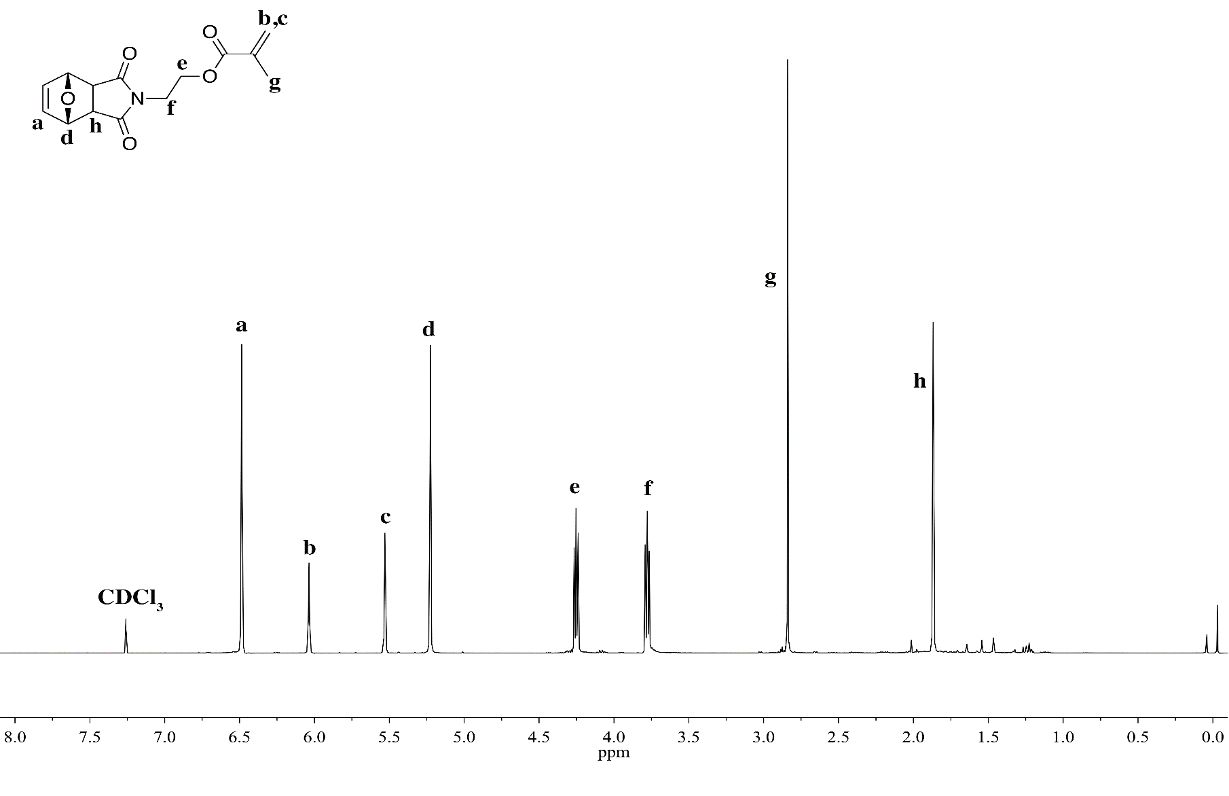
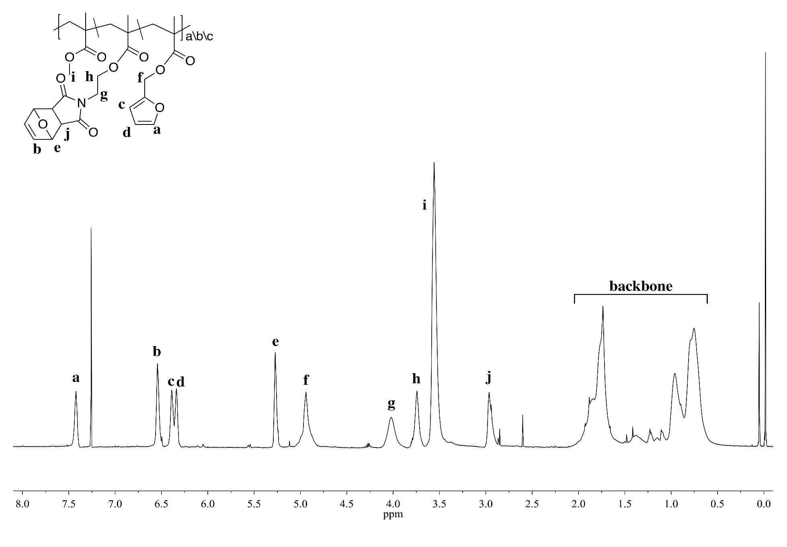
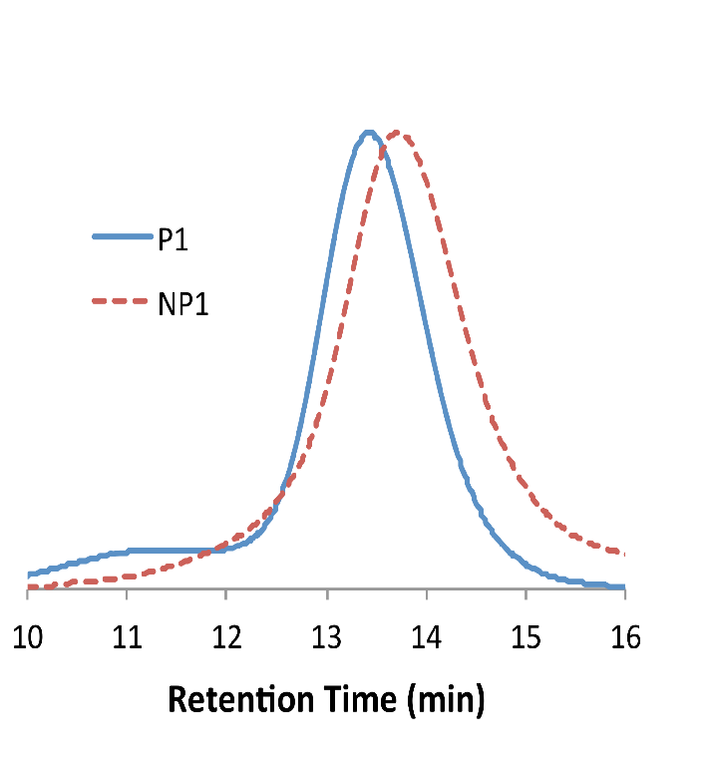
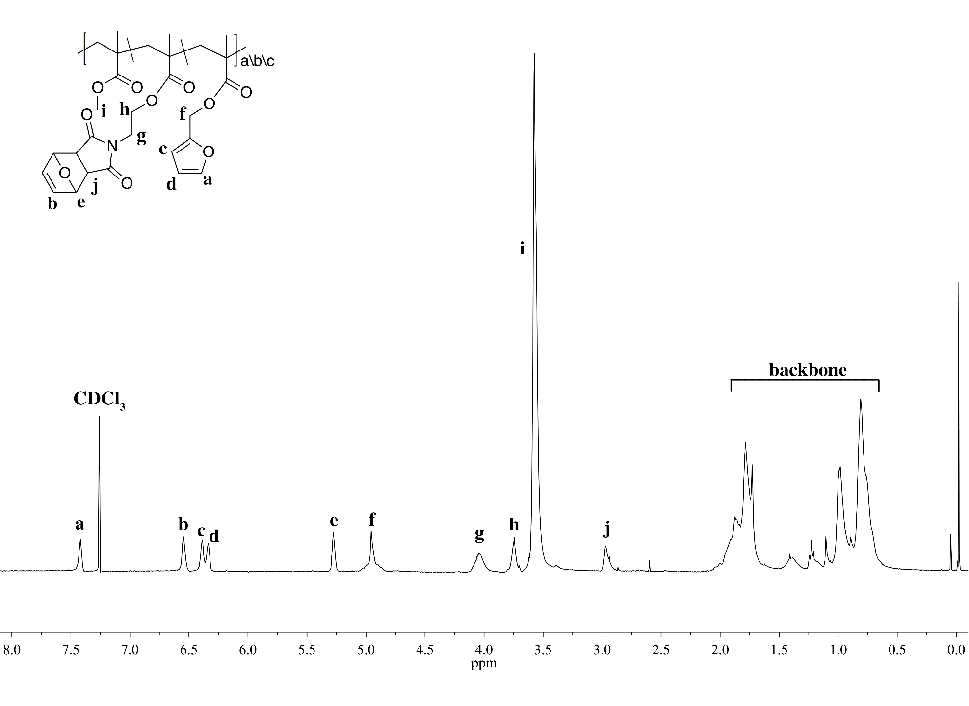
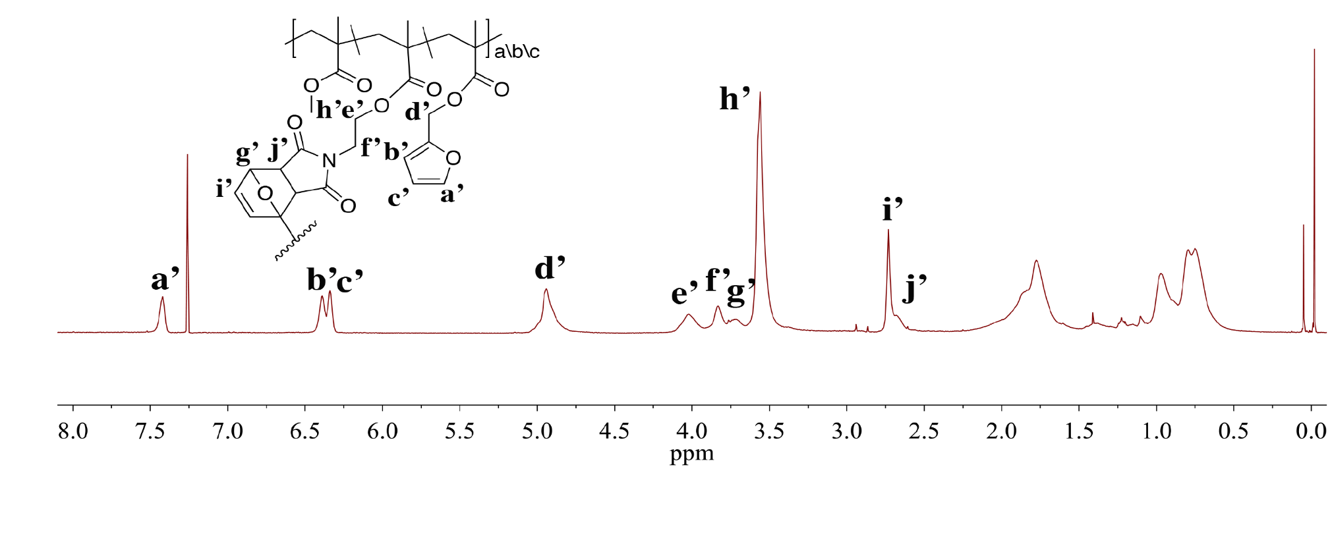
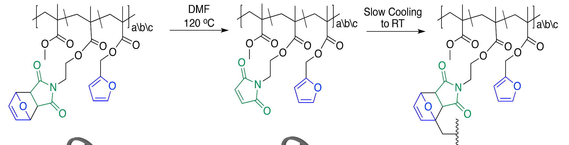
Exploring the Synthesis and Internal Cross-Linking Abilities of Single Polymer Chains via Diels-Alder Reactions
Jennifer Chouinard, Prof. Erik Berda
jmr386@wildcats.unh.edu; Parsons Hall, 23 Academic Way, Durham NH 03824
Introduction
Polymer synthesis is studied to gain an understanding of polymer units found in nature; proteins. Proteins are found in quaternary structures which can be broken down into tertiary structures and then into secondary structures, which include α-helices and β-sheets. These secondary structures are composed of primary structures which are perfectly sequenced polymers of approximately 20 possible monomers. The goal of my research was to synthesize linear random co-polymers using the monomers methyl methacrylate (MMA), furfuryl methacrylate (FMA), and a maleimide functionalized methacrylate (MIMA). I was able to explore the internal cross-linking abilities through thermal Diels-Alder (DA) chemistry between the pendant furan of FMA and the maleimide group of MIMA to form single-chain nanoparticles (SCNP).
Results
Discussion
MMA and FMA monomers were commercially available and the MIMA monomer was obtained through a simple two-step synthesis. The initial approach to polymer synthesis was through reversible-addition fragmentation chain transfer (RAFT) but was unsuccessful. Using a copper-mediated CRP technique, polymers were obtained as white powders. ¹H NMR was used to determine the percent monomer incorporations^{3,4}. Removal of the protecting group from the maleimide allowed for DA reactions to occur between the maleimide and furan pendant groups. SCNP formed easily by heating precursor polymers under dilute conditions
(1 mg/mL). MALS-SEC traces and ¹H NMR spectra each indicated the formation of SCNP.
Figure 2. ¹H NMR of MIMA in CDCl₃
δ 3.5ppm: 1.00
δ 6.5ppm: 0.18
δ 7.4ppm: 0.12
P1
MMA: 61.5%
FMA: 22.2%
MIMA: 16.3%
Future Work
The work done after my experiments was to determine the reversibility of the internal cross-links using retro-DA chemistry. A series of experiments were performed to evaluate the strength of these DA adducts as cross-linkers, as this reaction is known in many cases to be reversible. Although, it has been reported that some elastomers incorporated with DA linkages show the formation of nonreversible DA adducts. With this system, it was verified that the DA adduct cross-links were essentially nonreversible⁵.
Internal cross-linking
via thermal Diels-Alder chemistry
Figure 1. Linear polymer chains internally cross-link to form SCNP¹
Experimental
In a simple two-step synthesis using reagents 1-4, MIMA 5 was made. FMA 6, MMA 7, and MIMA 5 were polymerized using a copper-mediated controlled radical polymerization (CRP) technique. Monomer conversion was monitored using ¹H NMR. The solution was worked up, precipitated in MeOH and collected as a white powder 8². 8 was diluted in DMF and heated to 120 °C overnight then cooled to room temperature, precipitated in MeOH and SCNP 9 was collected.
Figure 3. ¹H NMR of P1 in CDCl₃
Figure 4. MALS-SEC trace overlays from parent polymer (P1) to nanoparticle (NP1)¹
Conclusions
We developed a way to form SCNPs using simple thermal DA chemistry. Our synthetic design was easy and tunable throughout multiple approaches, such as RAFT and copper-mediated CRP. SCNPs utilize chemistry in a way to intramolecularly cross-link polymer chains, however, many approaches are not as easily modified. A one-pot internal folding to form SCNP was achieved using the random terpolymer of MMA, FMA, and MIMA and heating under dilute conditions.
δ 3.5ppm: 1.00
δ 6.5ppm: 0.06
δ 7.4ppm: 0.05
P2
MMA: 81.7%
FMA: 11.4%
MIMA: 6.9%
Figure 6. MALS-SEC trace overlays from parent polymer (P2) to nanoparticle (NP2)¹
Acknowledgments
I would like to thank Prof. Erik Berda and Ashley Hanlon for their help and enormous amount of support. I would also like to thank the UNH Department of Chemistry for their funding.
1
2
3
4
5
Figure 5. ¹H NMR of P2 in CDCl₃
Scheme 1. Synthesis of MIMA monomer
₂
References
Hanlon, A.M.; Martin, I.; Bright, E. R.; Chouinard, J.; Rodriguez, K. J.; Pantenotte, G. E.; Berda, E. B. Polym. Chem., 2017, Advance Article.
Zhang, Z.; Wang, W.; Xia, H.; Zhu, J.; Zhang, W.; Zhu, X. Macromolecules 2009, 42 (19), 7360-7366.
(3) Nguyen, N. H.; Levere, M. E.; Percec, V. Journal of Polymer Science Part A: Polymer Chemistry 2012, 50, 860-873.
(4) Konkolewicz, D.; Wang, Y.; Krys, P.; Zhong, M.; Isse, A. A.; Gennaro, A.; Matyjaszewski, K. Polymer Chemistry 2014, 5, 4396-4417.
(5) Pramanik, N. B.; Nando, G. B.; Singha, N. K. Polymer 2015.
5
6
7
8
Scheme 2. Polymer synthesis via copper mediated-CRP
Figure 7. ¹H NMR of NP1 in CDCl₃
Sample | M_{n} [kDa] | M_{w} [kDa] | PDI | %FMA | %MIMA | Peak Retention Time (min)
P1 | 15.8 | 21.5 | 1.36 | 22.2 | 16.3 | 13.4
NP1 | 12.3 | 15.5 | 1.26 | - | - | 13.6
P2 | 9.4 | 12.5 | 1.33 | 11.4 | 6.9 | 13.5
NP2 | 8.7 | 10.3 | 1.18 | - | - | 13.5
8
9
diene
dienophile
Scheme 3. Formation of SCNP
Figure 8. Diels-Alder reaction mechanism between furan and maleimide pendant functional groups
Figure 9. M_{n}, M_{w}, PDA, monomer conversions, and peak retention times²

