Slide 1
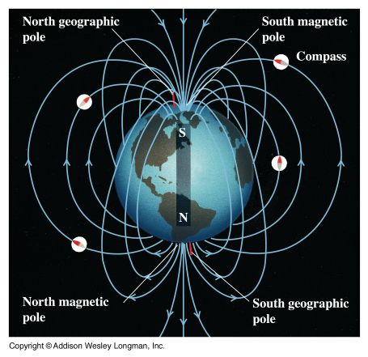
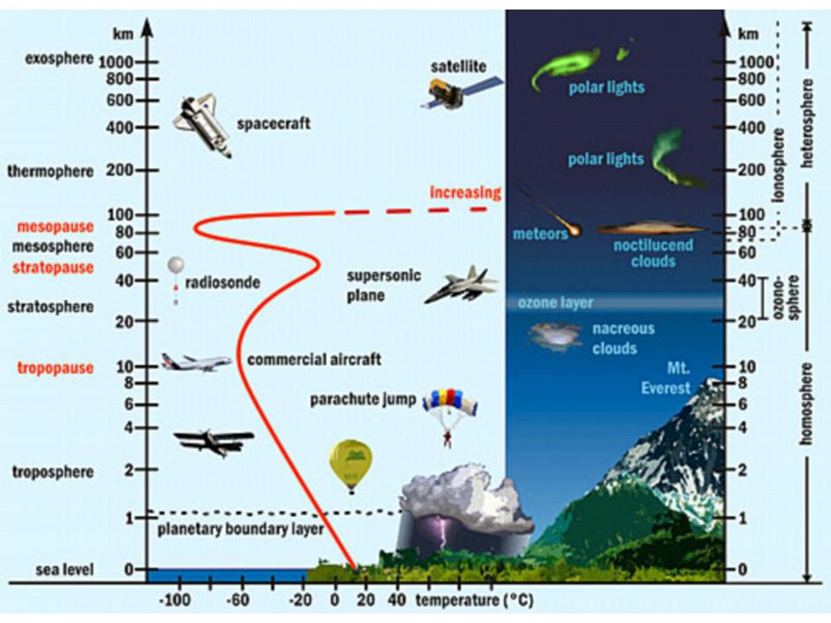
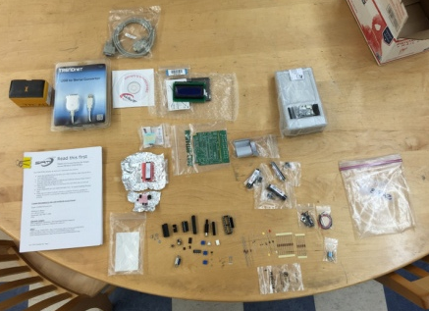
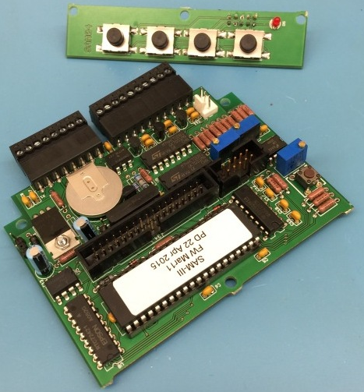
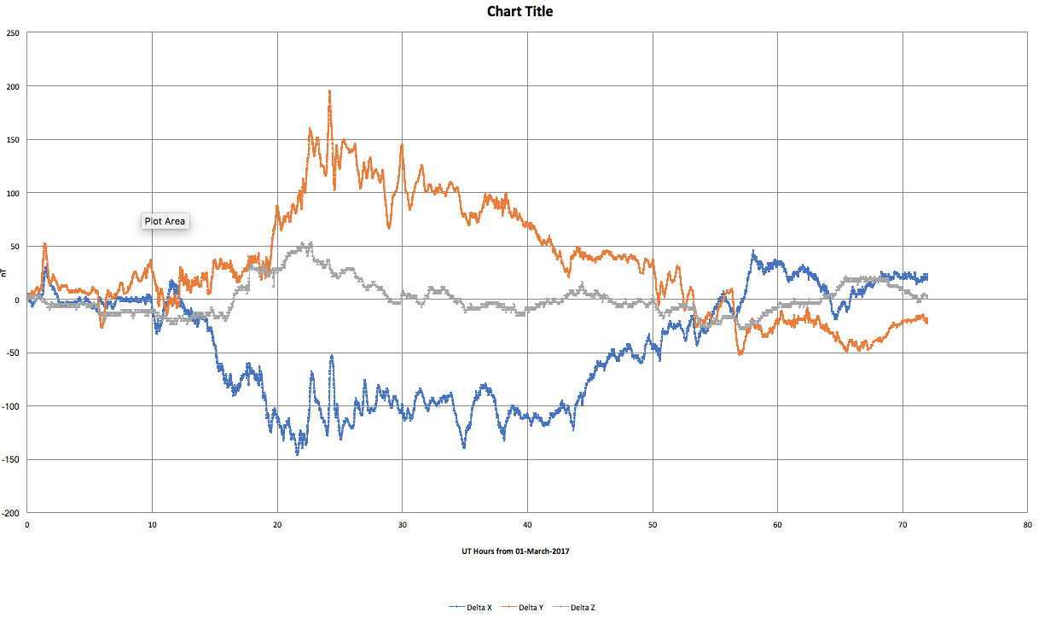

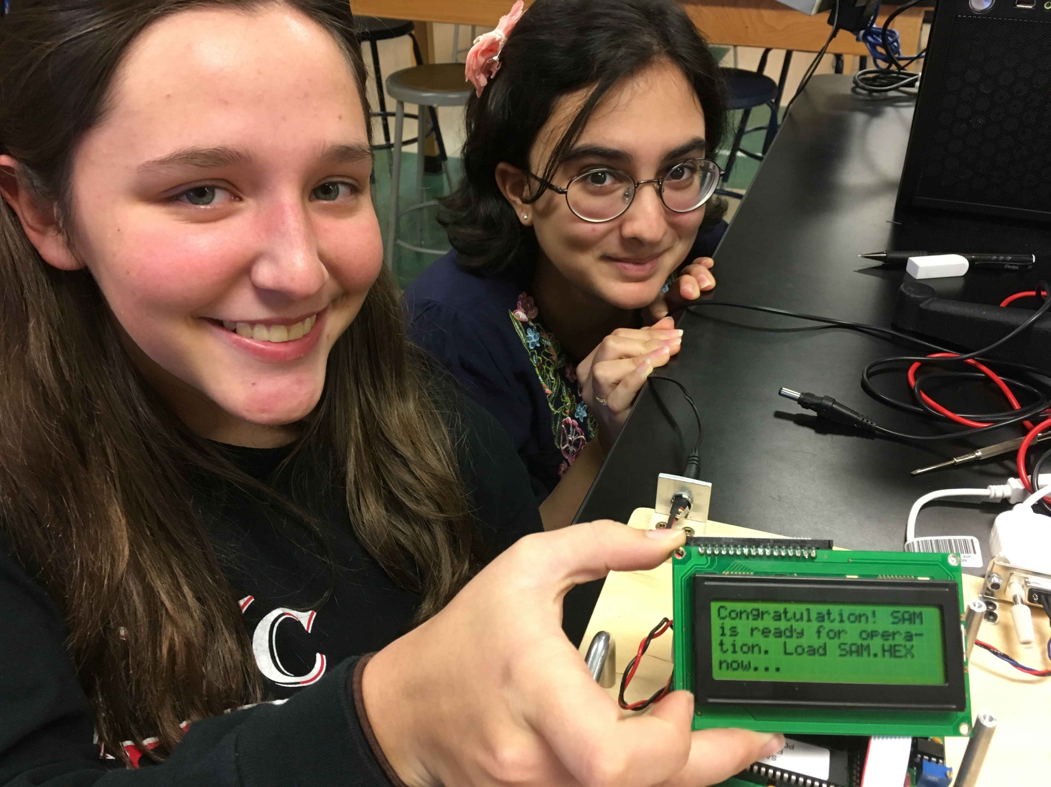
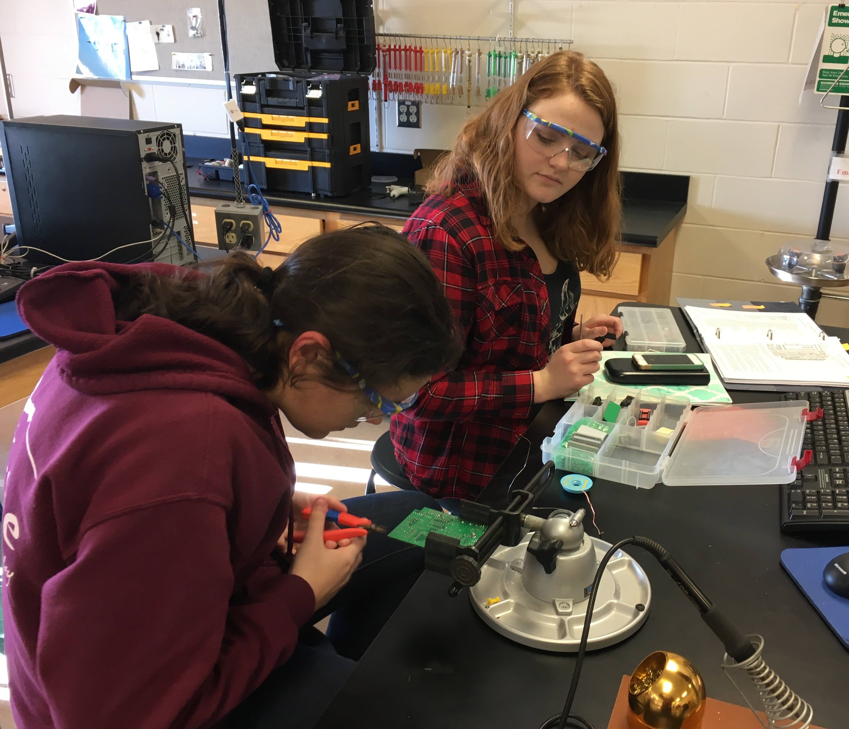
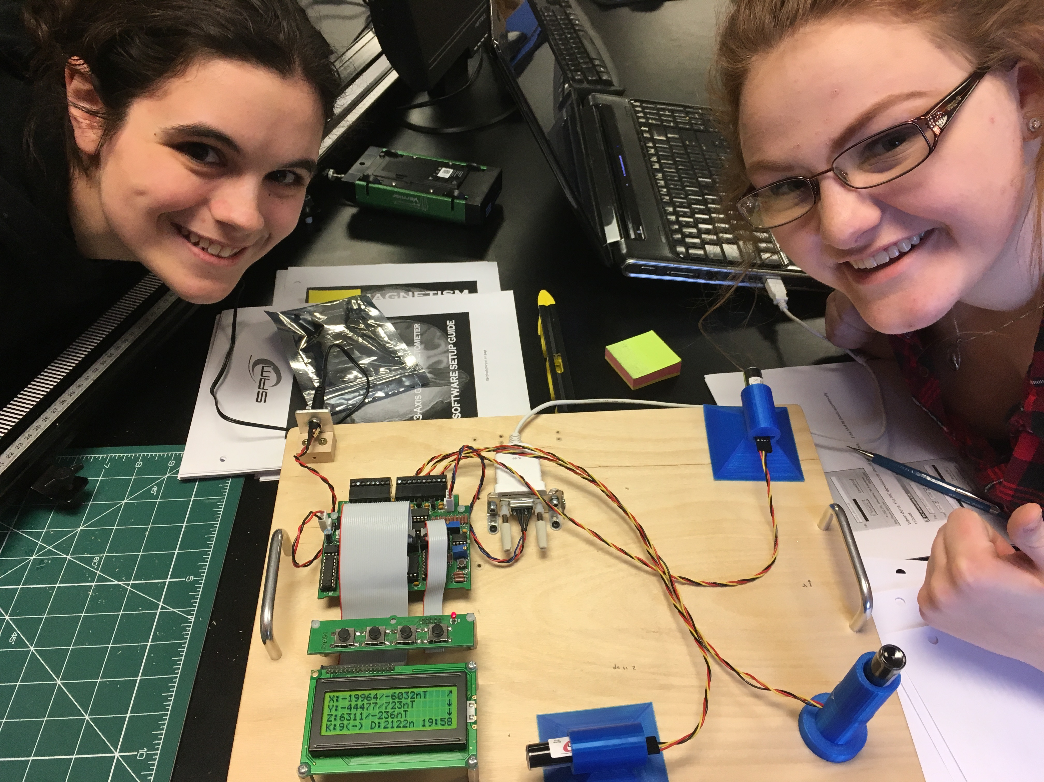
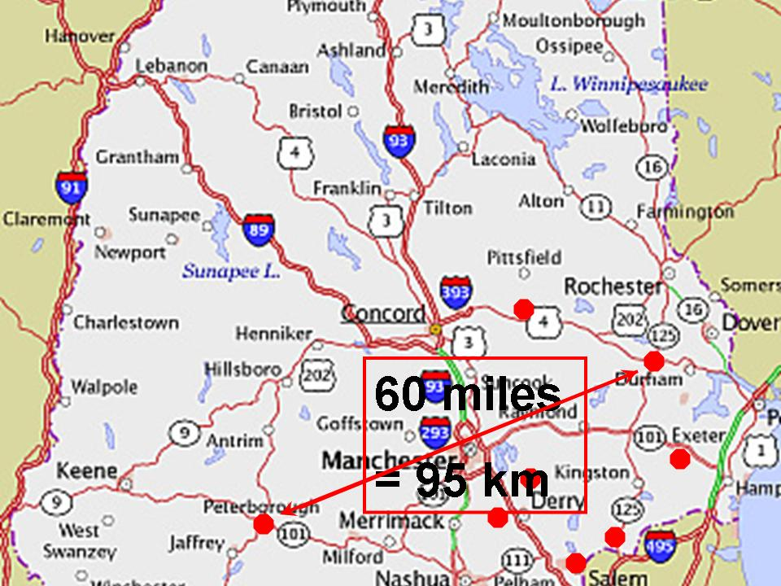
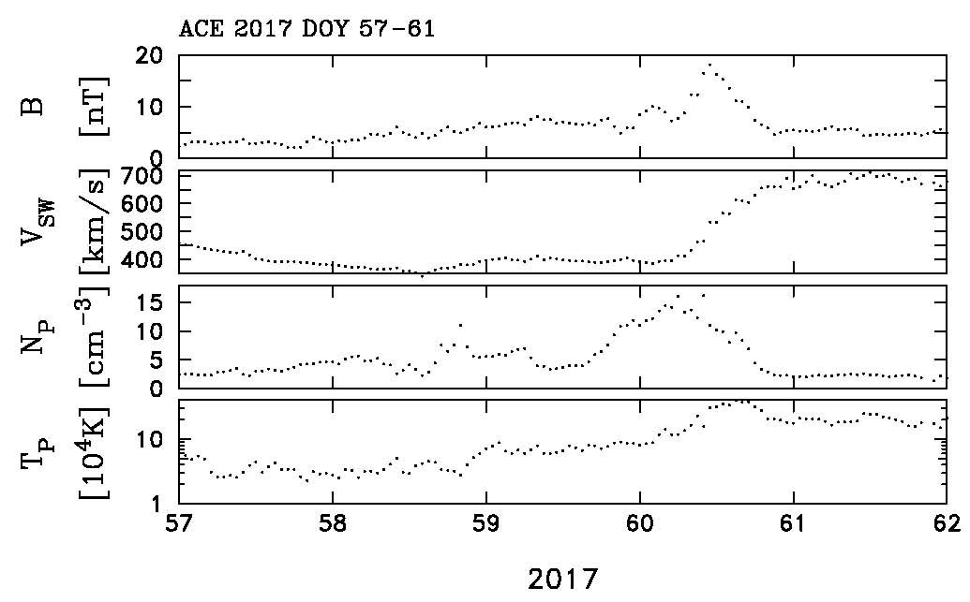
Space Weather Underground: A Collaboration Between UNH and Local High Schools
John Blackwell¹, Louis Broad², Cathy Duderstadt³, Gary Duranko⁴, Julia Fitzgibbons⁵, Eric Froburg³, Scott Goelzer⁶, Caroline Hayes⁵, Erin Janas⁵, Andria Johnson⁸, Harald Kucharek³, Marc Lessard³, Richard Levergood⁵, Cathleen Little⁷, Noe Lugaz³, Schuyler Michalak⁸, Andrew Pereira¹, Zackary Pine⁶, Alena Pursel⁵, Michelle Ramiz¹, Jason Rosenblum¹, Samantha Schofield⁵, Nathan Schwadron³, Meghan Silverman⁸, Charles Smith³, Sony Smith³, Harlan Spence³, Abigale Watson⁸, Carol Young⁸, and Katherine Young¹
¹Phillips-Exeter Academy; ²Timberlane Regional High School; ³University of New Hampshire; ⁴Salem High School; ⁵Londonderry High School; ⁶Coe-Brown Northwood Academy; ⁷Pinkerton Academy; ⁸Contoocook Valley High School
Abstract: UNH has formed a collaborative research and education venture with seven local high schools. Students are building SAM-III fluxgate magnetometers. In the process, students are learning both analog and digital electronics, circuit construction, and core physics from electromagnetism. The magnetometers will be used for demonstration purposes in the schools and as elements in a distributed array that will be coordinated for the purpose of performing space physics research in the New Hampshire area. Geomagnetic variations at ground level are caused by electric currents 100 km overhead. The measurement of spatial and temporal variability in the ground level fluctuations provides important clues to ionospheric dynamics that can be correlated with spacecraft data. While the construction of the magnetometers is documented, deployment of the instruments constitutes problems in power and data handling that are unsolved engineering problems that the teams must tackle. Several working magnetometers already exist and there are different approaches underway to solve the power and data handling problems. When completed, the array will permit advanced scientific research into ionospheric dynamics that will continue to involve the students and schools that built the array.
The Earth’s magnetic field is not a rigid object. It can be squeezed and distorted by the high-speed gas of the solar wind causing magnetic storms in the highest reaches of our atmosphere. This can result in the aurora seen in polar regions, but there are also potentially severe consequences to communication satellites, astronauts and the ground-based power grid. Ground based magnetometers measure the distortions in the Earth’s magnetic field and with an array of magnetometers we can gain a better understanding of the spatial and temporal variation of this complex magnetic system.
Soon after start up, one of the first student-built magnetometers detected a magnetospheric storm beginning at about hour 14:00 on March 1, 2017 (day of year 60). Note the large 150 nT swings in the Earth’s magnetic field near the surface. This ground event was matched with both magnetospheric satellite measurements, interplanetary solar wind measurements that tracked, and solar observations that tracked the eruption from the surface of the Sun, through interplanetary space, to the Earth’s magnetosphere. Measurements such as these validate the effectiveness of solar storms in inducing currents in the Earth’s magnetic field which lead to the likely disruption of our increasingly technological society. Once an array of these instruments has been established, we will gain a better understanding of how the disturbance propagates through the near-Earth environment and the dynamics that create these Space Weather storms.
Students at local high schools have been building sensitive magnetometers with the intent of deploying them in remote areas around their schools. By combining the measurements they and scientists at UNH can gain new insights into the dynamics of the magnetosphere and ionosphere in response to solar wind transients. A better understanding of the fundamental physics will lead to improved Space Weather models that will, in turn, help to protect our assets in space and here on Earth.
12 V DC power
y
The Simple Aurora Monitor magnetometer system (SAM III) consists of a three‑axis sensor array, a signal processor, and PC-based software. The system was designed by Dirk Langenbach (hardware) and Karsten Hanskey (software), and provided as a kit with documentation by Whitham D. Reeve of the Reeve Observatory in Anchorage, Alaska. The SAM III can measuring magnetic induction with a resolution of 1-2 nT within a range of ±50,000 nT. It is well suited for detecting fluctuations in Earth’s magnetic field.
The signal processor includes a PIC16F877 microcontroller, a real-time clock, and other through-hole components mounted on a printed circuit board. A push-button keyboard and liquid crystal display provide a simple user interface. All components are mounted on a printed circuit board. The software consists of a Windows™ compatible programs used for configuration of the signal processor, logging and viewing data, browsing archived data, and performing statistical analysis of data.
signal processor
digital alarm and analog outputs tied to K-index
x
z
three-axis sensor array
serial data,
EIA-232 & USB

