Slide 1


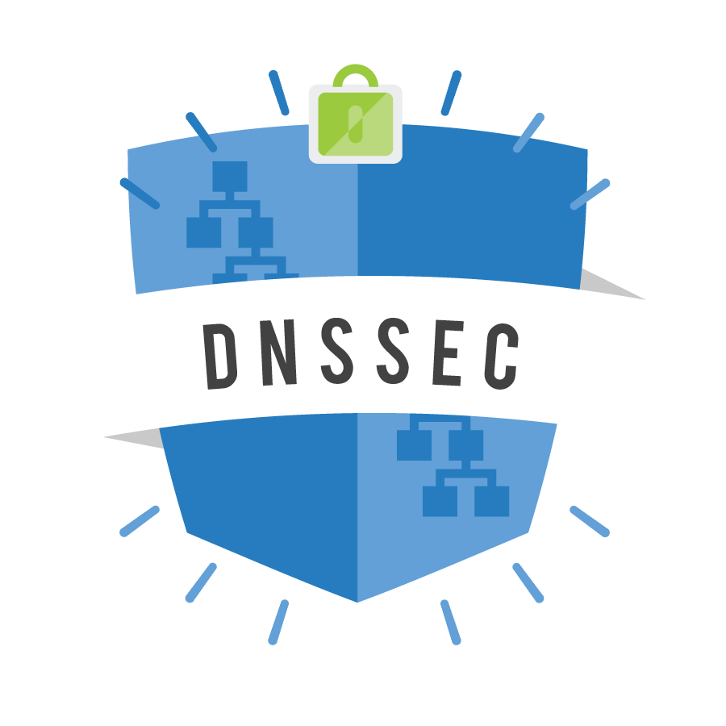
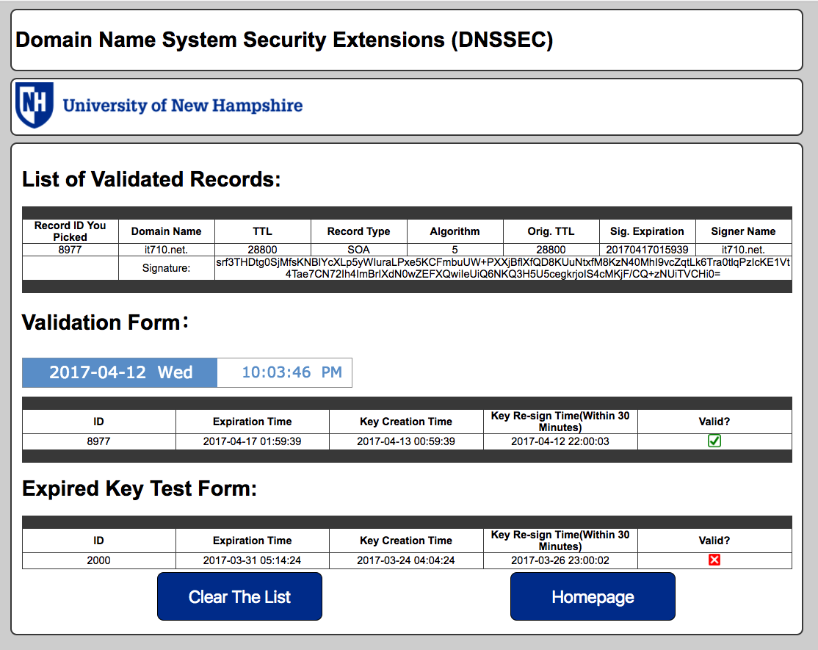
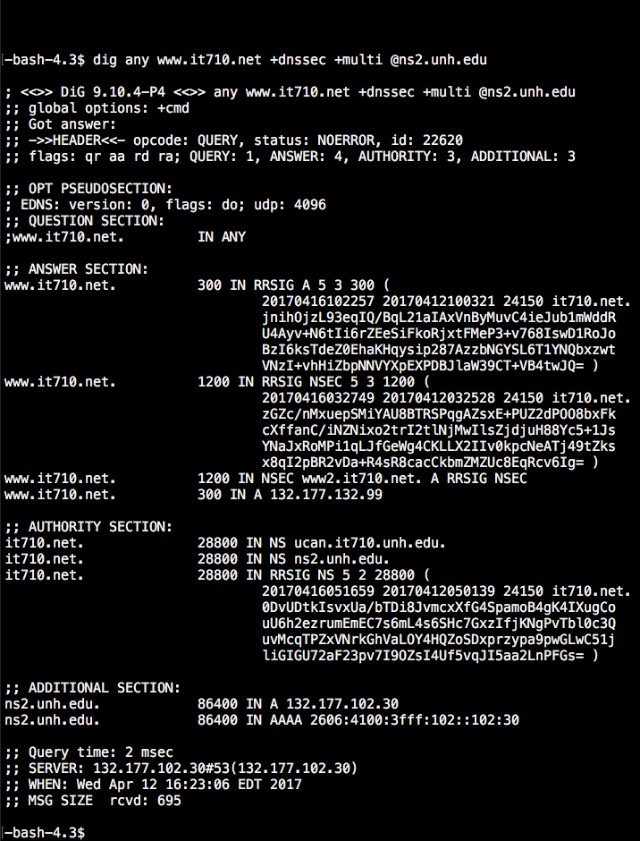
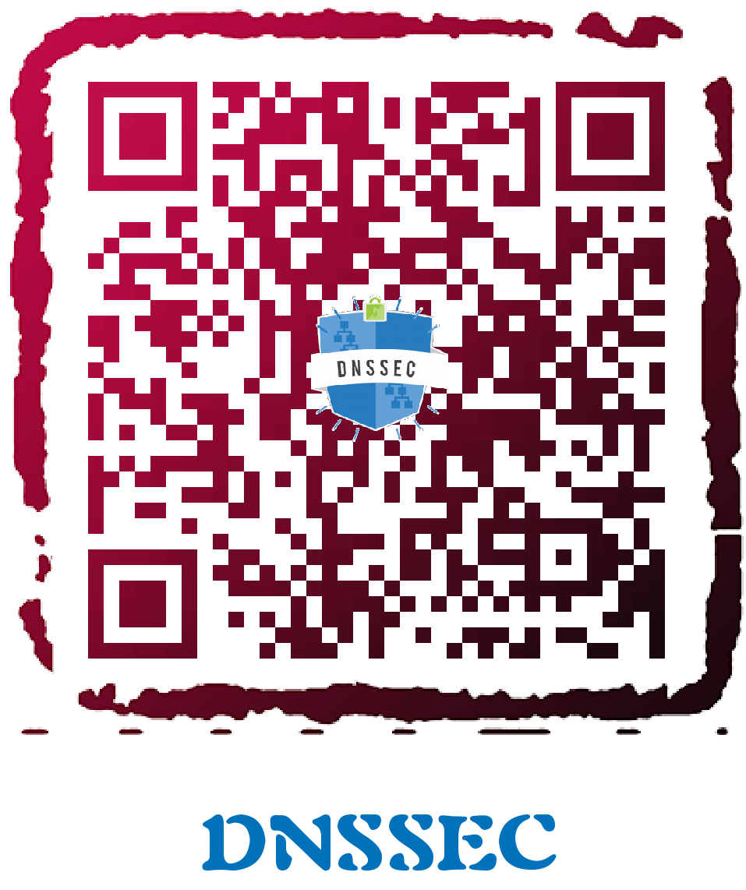












Domain Name System Security Extensions (DNSSEC)
Department of Computer Science
Project Team: Ryan Ducharme + LuYao Zhang
Project Advisor: Scott Kitterman
Abstract
Vulnerabilities in the Domain Name System have been discovered that allow attackers to hijack sessions and deceive users into visiting their web server. Domain Name System Security Extensions (DNSSEC) is a suite of extensions that are designed to make surfing the web safer by validating you are receiving the information you asked for.
Since only 8% of .EDU domains are DNSSEC-enabled, this project’s purpose is to propel the University of New Hampshire to lead the way and implement DNSSEC on the www.UNH.edu domain.
DNSSEC Chain of Trust
Project Goals
Long-Term
Sign the UNH.EDU zone at the University using appropriate keys
Configure all name servers to support DNSSEC
Short-Term
Create reporting tools on a remote server using MySQL database
Run queries against an isolated test domain that is signed with DNSSEC
    Scripts query the domain automatically from the remote server using Bash scripts
Maintain a web server to display reports and health checks of the signed zone
Snapshot of a Report on the Project Web Server
.GOV DNSSEC Implementation
What’s Next?
Install and test DNSViz alert tools on the remote server
    These tools will alert administrators if keys are nearing expiration or if the trust chain is broken
Monitor the website regularly to ensure the zone is being signed automatically
Analyze DNS log files for unusual activity or potential DDoS attempts
SCAN ME!
.EDU DNSSEC Implementation
A Simple DIG ANY of www.it710.net

