Slide 1
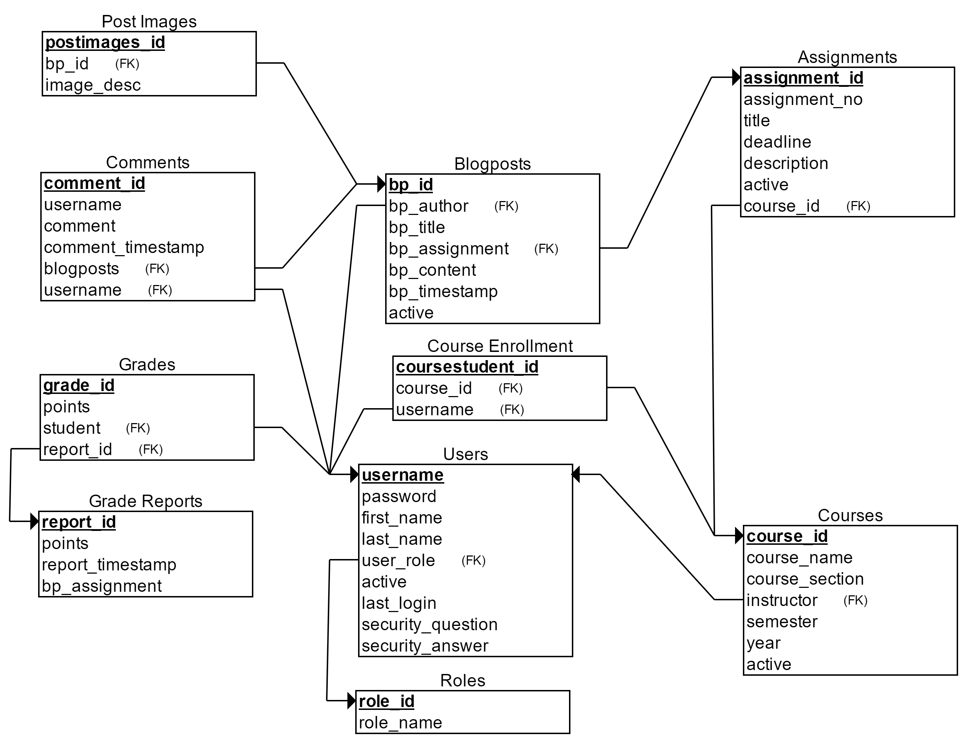
Anthro-Perspectives
A Blog Platform for Course Collaboration
Gina Bueno & Josh Andrews
Overview
Database Schema
Each semester, the introductory anthropology course assigns “Culture Snapshots”, blog posts that reflect course modules. Blog posts need a customized blog platform to support the collaboration of over 600 students.
Current System: anthrolens.wordpress.com
Hosted by WordPress
Only instructors have access to upload
Students upload assignments to Canvas and instructors select highlights for each module to upload
Limited number of posts
Our System: Anthro-Perspectives.com
Instructors have the ability to add assignments each semester as well as point values that can be used for grading
Instructors and students can upload blog posts and view other user’s posts
Instructors can create courses, assignments, and grade reports from their dashboards
Grade reports are exported in CSV format and can be uploaded to Canvas gradebooks
Custom domain name
Technologies Used
Benefits
Future Work:
Reduced instructor overhead
Aligned with the OER/ Open Pedagogy Movement
Grading functionality
Opportunity to collaborate across disciplines
Overcomes the limitations of WordPress
Beta: April 2017
Instructors will test the blog platform with current students
Release 1: Summer 2017
Release 2: Fall 2017

